Slide 1
ioPlacer
V. Bandeira, M. Fogaca,
E. Monteiro, I. Oliveira, R. Reis
UFRGS — Federal University of Rio Grande do Sul, Brazil

Slide 2
Motivation and Problem Statement
OpenROAD's RTL-GDSII needs to perform IO placement in block and chip-level
Our tool performs automatic IO placement
Modes: standalone or a library to integrate existing placers (e.g., RePlAce)
Given a placed design and IO pins (with their nets) we assign each pin to a position in the core boundary while trying to minimize the wirelength of the IO nets

Slide 3
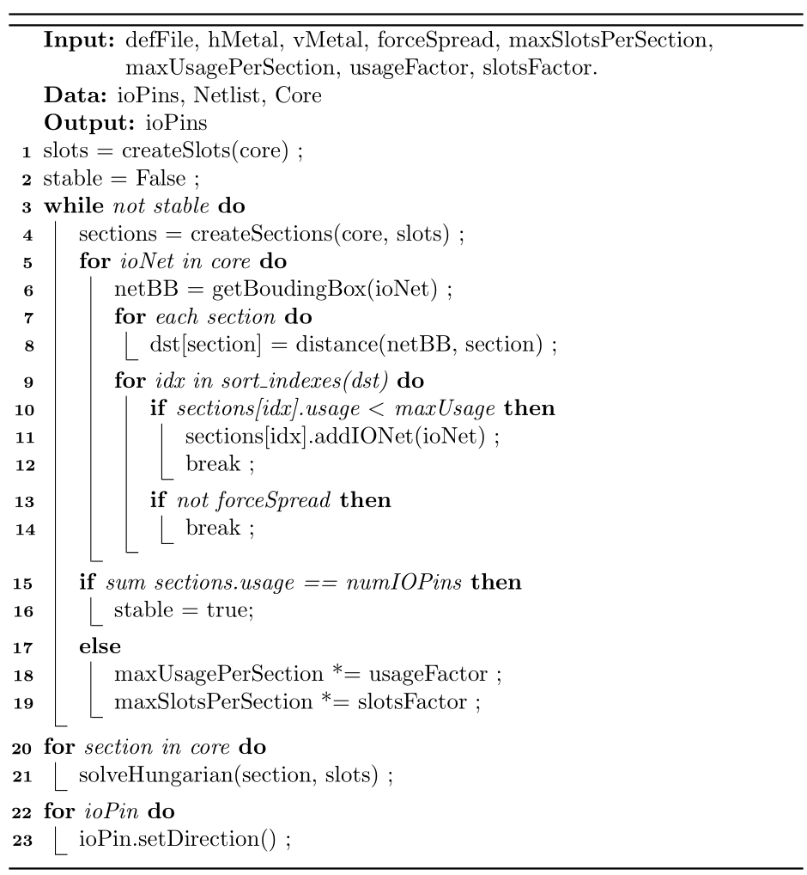
ioPlacer Algorithm
Large sections
Sparse sections
Blocked section

Slide 4
Current State
Standalone and Library modes available
Requirements C++11 and OpenMP
Fast and parallel execution
Tens of seconds to solution
ISPD18 benchmarks — 1211 IO pins
Standalone mode + def file parsing
Simple API
initCore([...]);
setMetalLayers([...]);
addIOPin([...]);
addInstPin([...]);
setSlotsPerSection([...]);
setSlotsUsagePerSection([...]);
forcePinSpread([...]);
run([...]);

