Slide 1
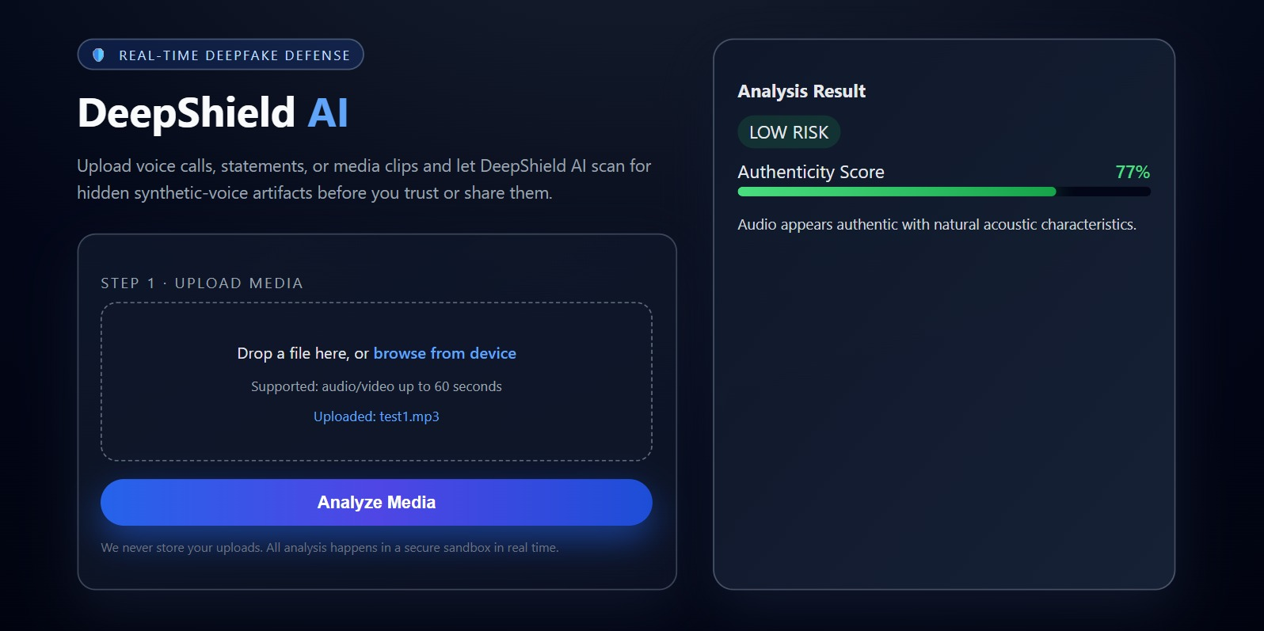
AUDIO DEEPFAKE DEFENSE
DeepShield AI
A local web app that screens uploaded voice notes for AI-generated audio patterns and explains the risk in plain language.
77%
8%
human voice note authenticity in demo
fake sample authenticity in test
Built for quick verification
Upload audio -> extract acoustic features -> classify with a trained Random Forest -> return score and risk.
KopCoders | DeepShield AI | PS2
01

Slide 2
PROBLEM
Voice cloning makes trust expensive.
A short audio clip can now impersonate a person, pressure a victim, or seed misinformation.
Scams
Misinformation
No easy check
Fake emergency calls and payment requests can sound like someone trusted.
Synthetic speeches or voice notes can spread before a human can verify them.
Most users do not have forensic tools or time to inspect audio signals.
DeepShield answers one question fast: should this audio be trusted?
KopCoders | DeepShield AI | PS2
02

Slide 3
SOLUTION
A simple upload flow turns audio into a risk signal.
The user sees an authenticity score, risk badge, and short explanation.
1
2
3
4
Upload
Extract
Classify
Explain
User selects a voice note or audio clip.
Backend computes acoustic features with librosa.
Random Forest estimates fake probability.
UI shows score, risk, and result text.
KopCoders | DeepShield AI | PS2
03

Slide 4
ARCHITECTURE
React and FastAPI keep the detection pipeline lightweight.
The model runs locally from a saved pickle file; uploads are temporary.
React UI
FastAPI
Audio Detector
Result JSON
File upload, progress, result display
Multipart upload route and cleanup
Feature extraction and model inference
score, risk, text returned to UI
Temporary upload storage is deleted in a finally block after analysis.
KopCoders | DeepShield AI | PS2
04

Slide 5
MACHINE LEARNING
The detector learns from acoustic fingerprints, not file names.
Training labels are real vs fake; prediction uses the same ordered feature vector.
13 MFCC mean coefficients capture speech spectral envelope.
RandomForestClassifier
Spectral centroid mean/std describes frequency brightness and variation.
Why this model?
Fast on CPU, robust for structured features, explainable enough for a hackathon prototype, and easy to serialize with joblib.
Zero-crossing rate measures waveform texture.
RMS energy captures loudness behavior.
fake_probability -> authenticity = (1 - p_fake) x 100
KopCoders | DeepShield AI | PS2
05

Slide 6
DEMO PROOF
The demo separates a human note from a fake sample.
The UI turns model probability into a visible risk badge and score bar.
Human voice note
Known fake sample
77%
LOW RISK
8%
HIGH RISK
authenticity score
authenticity score
The score is not a legal verdict; it is a fast screening signal that tells users when to be cautious.
KopCoders | DeepShield AI | PS2
06

Slide 7
TRUST DESIGN
Privacy and failure handling are built into the request cycle.
A detector should never make users choose between safety and data exposure.
Uploads are assigned UUID filenames to avoid collisions.
Core response schema
Files are removed after analysis using a finally block.
{ "score": "77%",
"risk": "LOW",
"text": "Audio appears authentic..." }
Backend errors return an ERROR state instead of fake scores.
CORS enables local React-to-FastAPI communication during development.
KopCoders | DeepShield AI | PS2
07

Slide 8
HONEST LIMITS
Deepfake detection is probabilistic, so the roadmap matters.
The current app is a strong prototype; production would need broader training and calibration.
Current limitations
Next improvements
Noise, compression, and short clips can affect features.
Train on more speakers, accents, devices, and spoofing methods.
Random Forest is lightweight but not state-of-the-art.
Add spectrogram CNN model for stronger audio detection.
Score should be treated as risk screening, not forensic proof.
Return evidence details and confidence calibration.
KopCoders | DeepShield AI | PS2
08

Slide 9
CLOSING
DeepShield makes suspicious audio easier to question before it spreads.
A practical local-first screening tool for voice authenticity.
Fast
Clear
Private
Runs locally with saved model inference.
Shows a score, risk badge, and explanation.
Deletes temporary uploads after processing.
KopCoders - DeepShield AI - PS2
KopCoders | DeepShield AI | PS2
09

