Slide 1
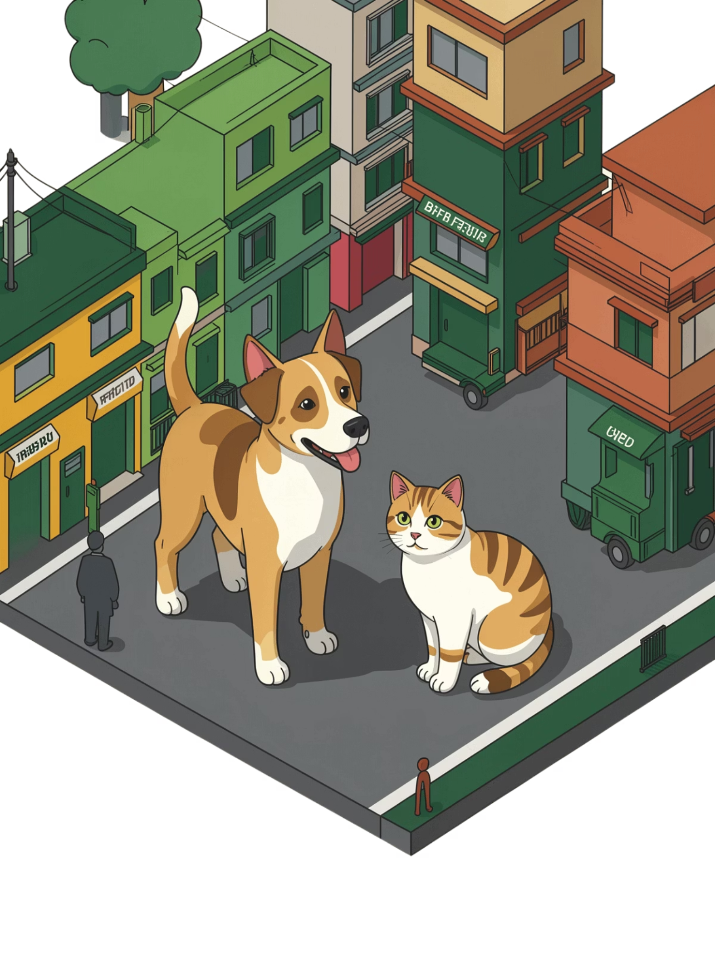
PawSense
A community-driven animal rescue and healthcare platform — bridging the gap between distress and response across India's 35 million pet-owning households and millions of stray animals.
PROTOTYPE OVERVIEW

Slide 2
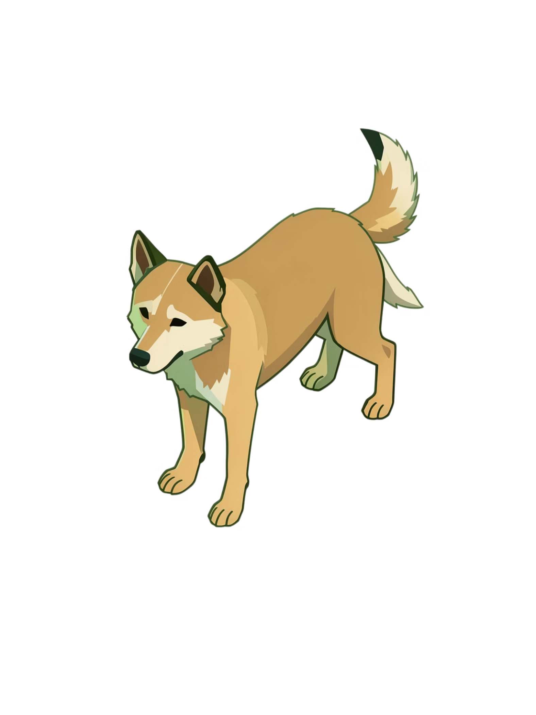
The Problem We're Solving
Fragmented Care
No Early Warning
Vets, groomers, shelters, and rescuers operate in silos — no shared data, no coordination layer.
Stray welfare depends on scattered NGO efforts with no real-time triage or distress signals.
Owner Guesswork
Pet owners make critical health decisions based on unreliable internet searches — not expert guidance.

Slide 3


How PawSense Works
Community Reports
Live Map Updates
NGO Triage
Resolution
Every report made by a community member instantly becomes an actionable data point for rescue organizations — closing the loop between public awareness and professional response.

Slide 4
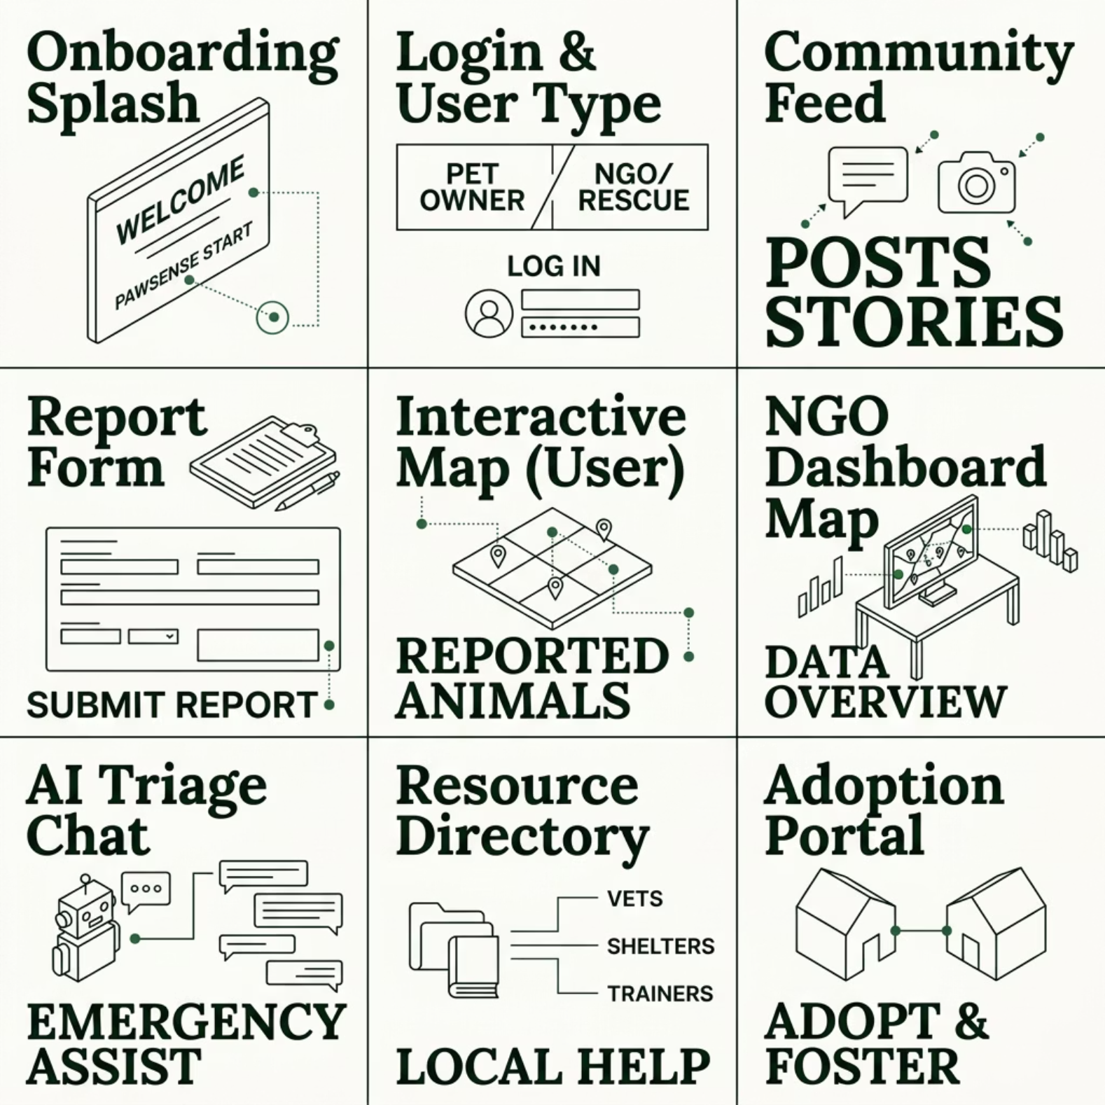


App Structure at a Glance
9 Core Views
PawSense is structured around two user types — General Users and Verified NGOs — each with tailored interfaces that share a live, unified data layer.
The Community Feed and NGO Dashboard Map are the two most critical surfaces — one for reporting, one for response.

Slide 5

Onboarding & Identity
Onboarding Splash
Login & Profile Type
A mission-first screen that communicates purpose immediately — empathy-driven copy, minimal UI, and a clear CTA to get started.
Users self-select their role during sign-up. Role selection unlocks different dashboard views and permissions.
General User — report, browse, adopt
Verified NGO — triage, assign, resolve
Animated logo reveal
Mission statement overlay
Single "Get Started" button
NGO accounts require verification to maintain trust and data integrity.

Slide 6
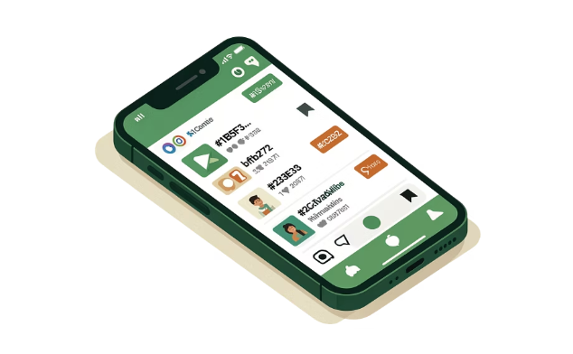
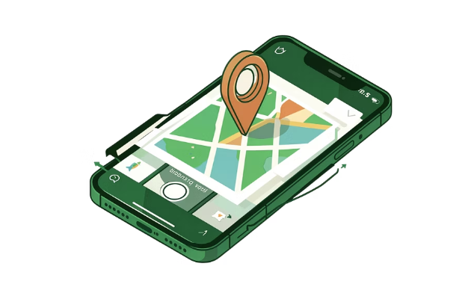
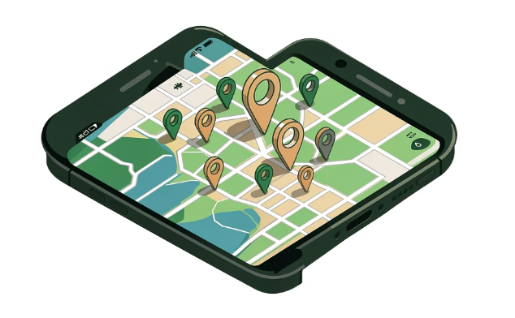
Community Feed & Reporting
Community Feed
Report Form
User Map View
A social-style scrollable feed of distress reports — each post carries an image, timestamp, location tag, and severity badge.
Image upload + mandatory GPS pin (Google Maps / Leaflet) + a 1–5 severity scale. Every field is required before submission.
A personal interactive map showing all nearby active reports — helping individuals see the scale of need around them.

Slide 7
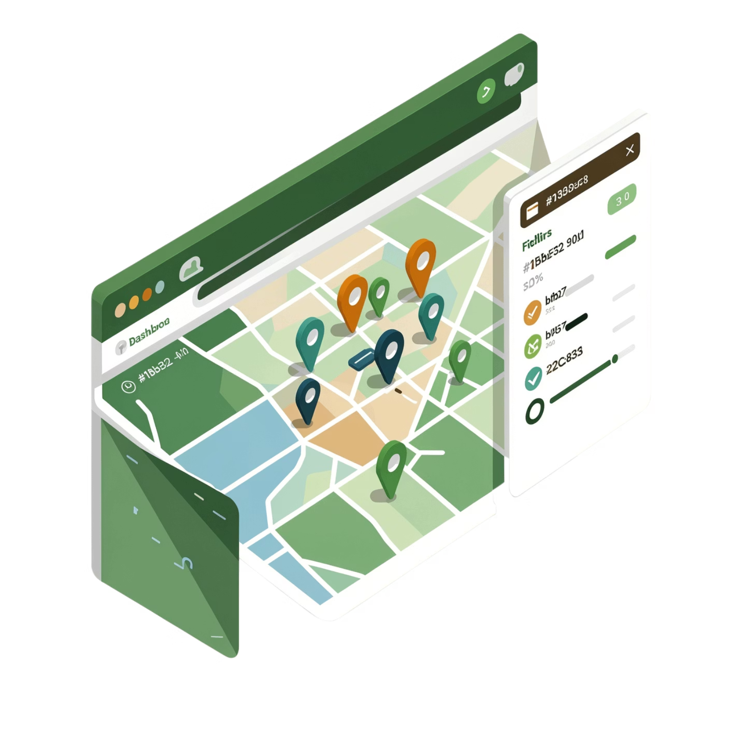

NGO Dashboard — The Command Center
Real-Time Coordination Map
When a community post is published, its geo-coordinates automatically populate the NGO dashboard. Rescue teams can:
View all active distress pins on a live map
Filter by urgency level (1–5 severity)
Mark cases as Rescue In-Progress or Resolved
Dynamic updates — no refresh needed. The map reflects the feed in real time.

Slide 8
AI Triage & Resource Discovery
🤖 AI Triage Chat (Simulation)
📍 Resource Directory
🏠 Adoption & Foster Portal
A searchable, location-aware list of nearby veterinary clinics and shelters. Filterable by distance, specialty, and availability — pulling from a curated, community-updated database.
A conversational interface where users can describe symptoms or upload an image and receive immediate first-aid guidance — simulated via a structured AI prompt layer. Reduces panic, improves outcomes before a vet arrives.
A secondary feed dedicated to animals ready for homes — each profile includes health status, rescue backstory, and a direct contact form for foster or adoption inquiries.

Slide 9
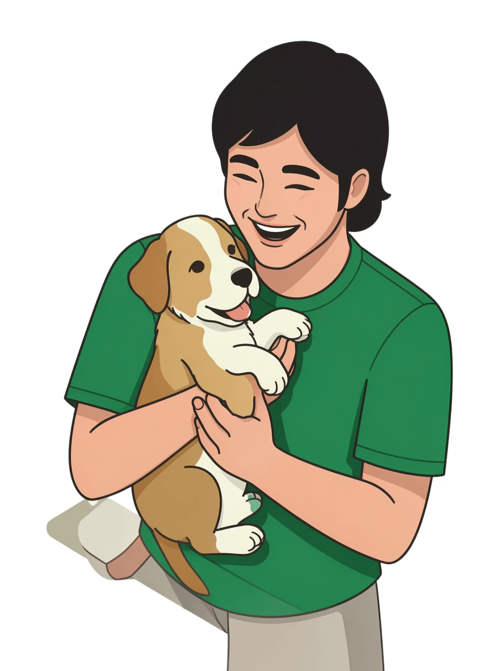
Prototype Screens
Insert your prototype screenshots below. Each placeholder represents one of the 9 core views of PawSense.
📱 Onboarding & Login
Paste your splash screen and role-selection screenshots here.
📰 Feed & Report Form
Paste your community feed and report submission UI here.
🗺️ Maps & NGO Dashboard
Paste your user map and NGO coordination dashboard here.
🤖 AI, Directory & Adoption
Paste your triage chat, resource list, and adoption portal here.

