Slide 1

Task 5 — Detailed Penetration Test Findings & Report

Slide 2

1. Executive Summary
A controlled penetration test was performed against the Metasploitable2 lab host (192.168.0.102) using Kali Linux. The engagement followed a standard pentest flow: reconnaissance (Nmap, whois, traceroute), vulnerability scanning (Nessus), and targeted exploitation (Metasploit). Multiple high- and critical-severity vulnerabilities were identified. A successful remote code execution exploit against Samba (CVE-2007- 2447) yielded a root shell, confirming full system compromise. Detailed findings and remediation guidance follow.

Slide 3

2. Scope & Objectives
Scope: Single host Metasploitable2 (192.168.0.102) in an isolated VirtualBox lab.
Objectives:
o Discover open ports and running services.
o Identify known vulnerabilities and misconfigurations.
o Exploit critical vulnerabilities to demonstrate impact (ethical, lab-only).
o Produce remediation guidance and validation steps.
(Sources: Task 1 reconnaissance and Task 2 Nessus scan summary).

Slide 4
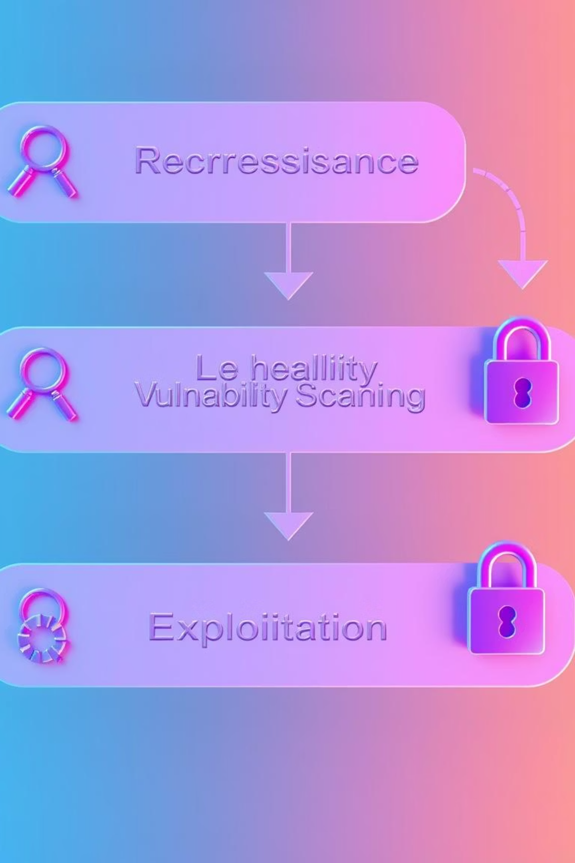
3. Methodology
01
02
Reconnaissance
Vulnerability Scanning
o whois, traceroute, and nmap -A -T4 to enumerate network and services. (See Task 1.)
o Nessus Essentials basic network scan used to identify CVEs and severity levels. (See Task 2.)
03
Exploitation
o Metasploit used to exploit high/critical findings (Samba usermap_script) and verify rootlevel access. (See Task 3.)

Slide 5
4. Summary of Key Findings (Consolidated)
The most important, high-impact findings discovered and validated during the engagement:
Samba — username map script RCE (CVE-2007-2447)
o Ports: 139/445 (SMB).
o Severity: Critical (RCE).
o Evidence: Successful Metasploit exploit / reverse shell; whoami returned root.
vsftpd 2.3.4 Backdoor (CVE-2011-2523)
o Port: 21 (FTP).
o Severity: Critical backdoor allows remote command execution (anonymous FTP present).
UnrealIRCd backdoor (CVE-2010-2075)
o Port: 6667 (IRC).
o Severity: Critical remote shell possible.
ProFTPD mod_copy (CVE-2015-3306)
o Port: 2121 (FTP alternative).
o Severity: Critical arbitrary file copy leading to code execution.
Apache Tomcat with Default Credentials (CVE-2009-3548)
o Port: 8180.
o Severity: Critical/High default admin credentials can allow WAR deployment and remote code execution.
Exposed Databases
o MySQL (3306) and PostgreSQL (5432) accessible; multiple version-specific issues found.
Other issues
o SSLv2 enabled on SMTP (deprecated and insecure), many legacy/unused services (telnet, rlogin, rexec), banner disclosure, and weak/old SSH version.
(Full list and counts of Critical/High/Medium/Low were documented in Task 2.)

Slide 6

5. Proof of Compromise (Evidence)
Metasploit session opened via exploit/multi/samba/usermap_script with reverse handler.
Shell output from the compromised host demonstrated root privileges (sample): whoami -> root; interactive bash shell on /bin/bash.
(Full command sequence and proof are recorded in the Task 3 report).

Slide 7
6. Risk Assessment (Prioritized)
High-level risk assessment with recommended priority:
Samba RCE (CVE-2007-2447)
High
Complete system compromise
Immediate
vsftpd backdoor
High
Remote code execution
Immediate
UnrealIRCd backdoor
High
Remote shell
Immediate
ProFTPD mod_copy
High
File/Code execution
Immediate
Default Tomcat creds
High
Application takeover
High
Exposed DBs (MySQL/Postgres)
Medium
Data exfiltration
High
SSLv2 on SMTP
Medium
MITM risk
Medium
Banner disclosure / deprecated services
Medium
Recon facilitation
Medium
(Assessment based on exploitability, impact, and lab verification).

Slide 8
7. Remediation & Hardening Recommendations (Actionable)
Prioritized, practical steps you can implement:
Immediate (within 24–72 hours)
Isolate the affected host from production networks (if this were a real host).
Patch/upgrade Samba to a secure, supported release; confirm fix for CVE-2007-2447. If immediate patching isn't possible, block SMB ports (139/445) at network perimeter/firewall.
Disable anonymous FTP and update/remove vsftpd 2.3.4; upgrade to a maintained FTP server or disable if unused.
Remove or disable backdoored/legacy services (UnrealIRCd, ProFTPD) or replace with patched versions.
Change default credentials and audit admin interfaces (Tomcat manager) — disable or restrict by IP.
Short-term (1–4 weeks)
Regenerate SSH host keys and move to modern OpenSSH with strong configuration (disable insecure ciphers/MACs).
Disable SSLv2 protocol support on all services; enforce TLS 1.2+.
Harden database access: restrict listening interfaces to localhost or internal subnets, enforce strong passwords, and enable encryption/auth plugins.
Remove unnecessary services (telnet, rlogin, rexecd) completely.
Medium-term (1–3 months)
Implement network segmentation to limit lateral movement.
Deploy IDS/IPS and central logging (SIEM) to detect anomalous activities.
Implement patch management and regular vulnerability scanning cadence (weekly/monthly).
Perform code/app review for web applications and enforce secure coding practices.
Long-term
Regular security training, change management, and periodic full-scope penetration tests.

Slide 9

8. Validation Plan (How to confirm fixes)
Re-run Nessus scan after each patch cycle and compare results to baseline (Task 2). Verify that the vulnerabilities are marked as "fixed."
Run targeted verification tests (e.g., re-run the Metasploit module against Samba in a safe manner) only after change approval.
Perform regression tests to ensure functionality remains intact.
Document changes in a remediation log (date, change, responsible person, verification evidence).

Slide 10

9. Conclusion
The Metasploitable2 host intentionally contained multiple critical vulnerabilities which were discovered and exploited during the assessment. In a production setting, these vulnerabilities would enable complete system takeover and data loss. Immediate remediation of the critical findings is strongly recommended, followed by the broader hardening steps outlined above.

