Slide 1
ZERO TO ONE · AI-NATIVE STORYTELLING (P1)
Team · The Reservoir Dogs
NEXUS
A living story multiverse.
Rewind any story, change one decision, and an AI rewrites the future —
keeping every character and every fact consistent. Narrated as audio drama.
POWERED BY
● Pocket FM
● Databricks
● OpenAI
● HackCulture

Slide 2
// 01 THE PROBLEM
One story. One ending.
→ A Pocket FM story is a single fixed path.
Written once, by one team — the listener just presses play.
→ Personalization stops at recommendations.
AI decides what you see next, but never touches the story itself.
→ “What if it went differently?” has no answer.
The most human question a listener asks is a dead end today.
02 / 15

Slide 3
// 02 THE INSIGHT
Don’t build an AI writer. Build a story only AI makes possible.
The prompt asks what storytelling becomes possible because AI exists.
Answer: a universe of infinite branching timelines that a single AI keeps perfectly consistent — something no human writers’ room could ever maintain by hand.
03 / 15

Slide 4
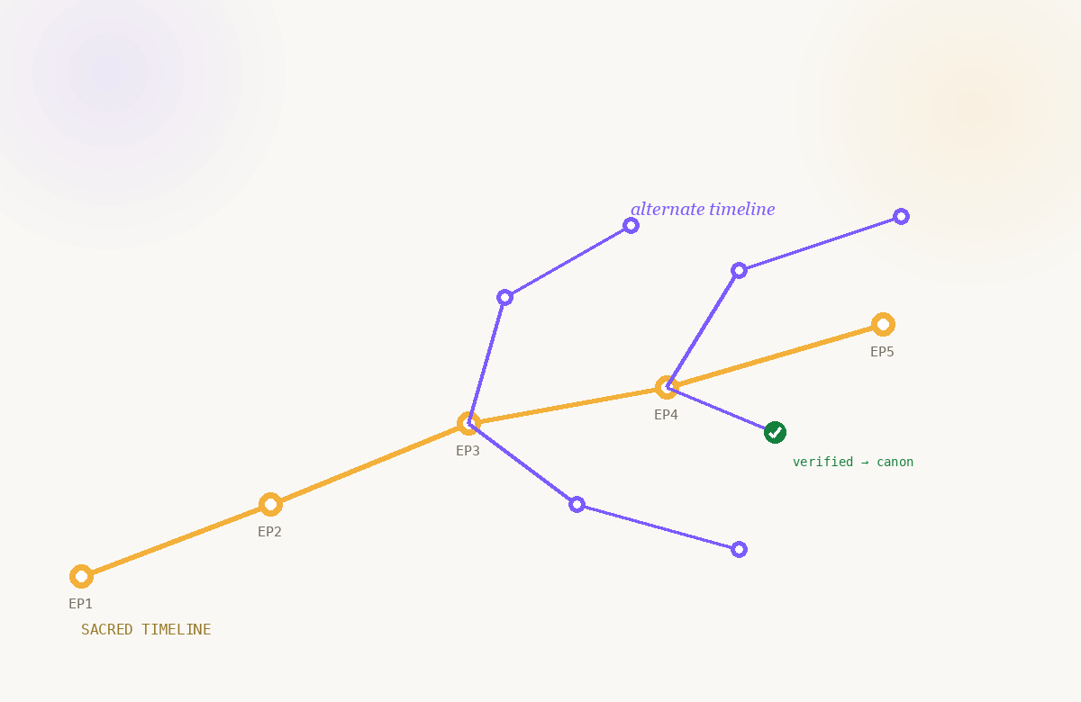
// 03 THE SOLUTION
NEXUS — the story time machine.
→ Rewind to any decision point in an episode.
“The hero spared the villain” → what if she didn’t?
→ AI regenerates the alternate future — consistently.
Remembers each character’s voice + what they can know.
→ Plays back as a cinematic multi-voice audio drama.
Pocket FM’s native format — not text on a screen.
→ Community rates; the author verifies canon.
One story becomes infinite, coherent timelines.
04 / 15

Slide 5
// 04 HOW IT WORKS
From one decision to a new consistent world.
1
Rewind
a decision
2
AI gathers
canon + memory
3
Regenerate
the timeline
4
Self-check
consistency
5
Narrate as
audio drama
6
Community
canonizes
→
→
→
→
→
05 / 15

Slide 6
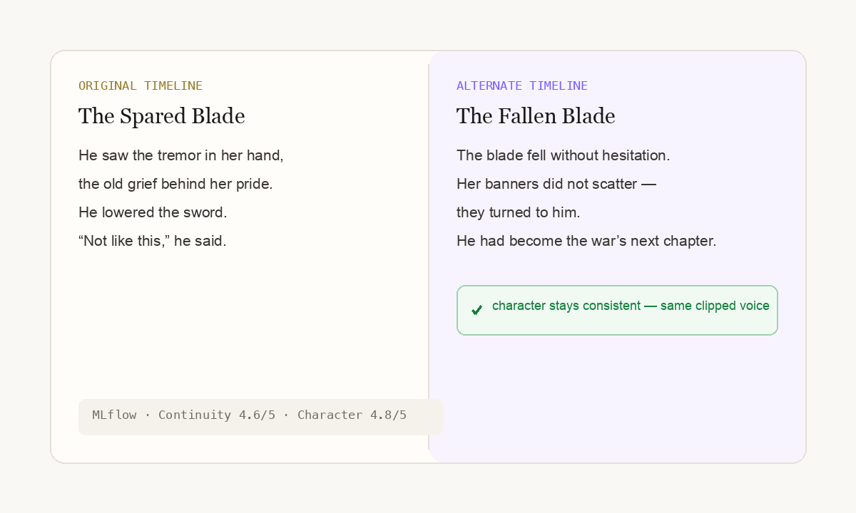
// 05 KEY FEATURE · 01
Story Time Machine + persistent memory.
→ Change one decision, regenerate every future.
The core P1 challenge — solved, not simulated.
→ Characters keep voice, goals + knowledge limits.
Never know what didn’t happen in this timeline.
→ Each side character carries its own memory.
The universe grows without breaking continuity.
06 / 15

Slide 7
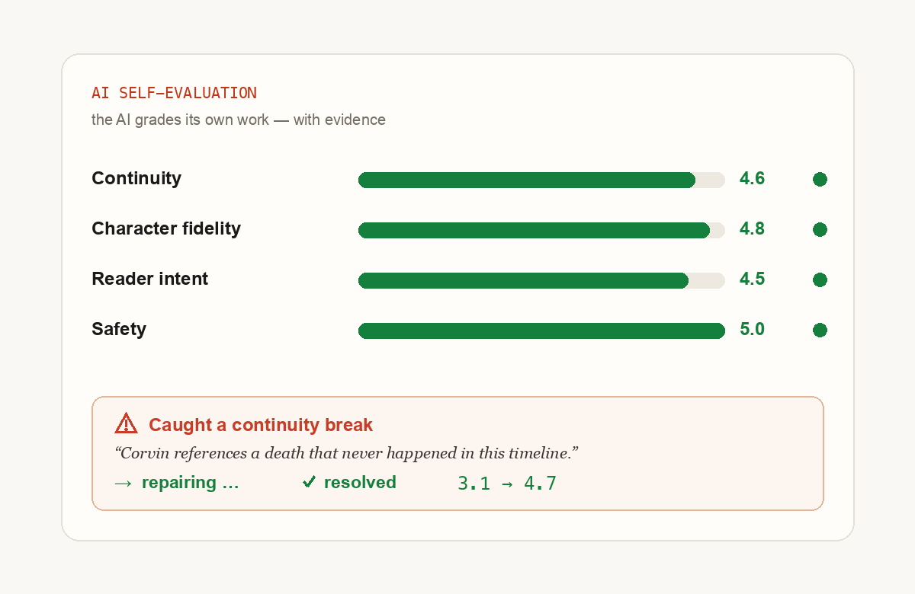
// 06 KEY FEATURE · 02 — OUR WOW
The AI grades and repairs itself — live.
→ Scored: continuity, character, reader-intent.
With exact quoted evidence — not ‘looks good’.
→ Catches a contradiction? It fixes itself, live.
Watch the score climb in front of the jury.
→ Nothing unsafe auto-publishes — a human decides.
Eval + human-in-the-loop, one story.
Every team claims “consistent.” We prove it — and self-correct when wrong.
07 / 15

Slide 8
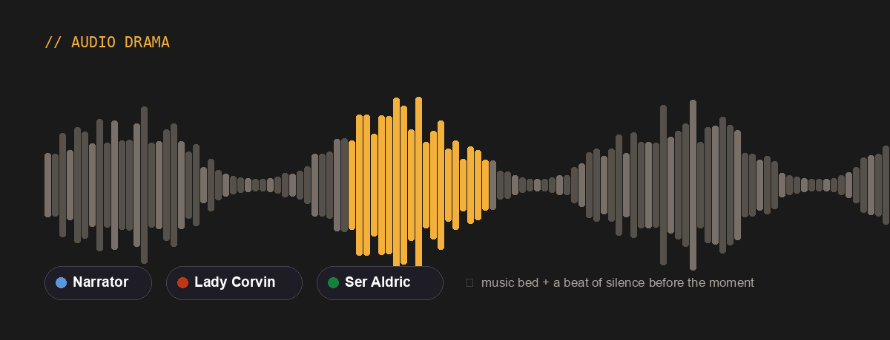
// 07 KEY FEATURE · 03
Cinematic audio drama, not text.
→ Distinct multi-voice narration per branch.
→ Music bed + a beat of silence before the moment.
→ Audio-first — a layer on Pocket FM’s strength.
08 / 15

Slide 9
// 08 KEY FEATURE · 04
AI Co-Author + community canon.
→ Readers steer the story with comments and ratings.
Their signals become the input that drives the next branch.
→ Co-authors write with an AI editor — human approves every line.
A VS-Code-style studio; nothing saves until the human signs off.
→ The original author verifies which branch becomes canon.
The universe grows, curated — AI keeps it coherent.
09 / 15

Slide 10
// LIVE DEMO
Let’s rewrite a fate.
Rewind → regenerate → watch it catch & fix itself → hear the branch.
10 / 15

Slide 11
// 09 UNDER THE HOOD
Built Databricks-native.
Databricks Apps
Serverless hosting + OAuth for the web app & agent
Lakebase (Postgres)
Single store: series, episodes, timelines, character memory
Foundation Model APIs
The tool-calling AI co-author that regenerates timelines
Mosaic AI Agent
Reads canon via tools, streams its reasoning live
MLflow 3 GenAI Eval
The consistency judges + the self-correction scores
Multi-voice TTS
Renders each branch into an audio drama
11 / 15

Slide 12
// 10 WHY WE’RE DIFFERENT
Not “AI writes a story.”
OTHER TEAMS
NEXUS
• One prompt → one story
• ‘Trust us it’s consistent’
• Generic single-voice TTS
• A one-shot demo
• A universe of consistent timelines
• Proves consistency — and self-corrects
• Multi-voice cinematic audio
• A platform Pocket FM could ship
12 / 15

Slide 13
// 11 WHY IT MATTERS FOR POCKET FM
Infinite content. Deeper engagement.
∞
+
◎
Timelines from one story
More catalogue, zero extra writers’ rooms
Listener retention
“My story” beats “a story” — people finish what feels theirs
A new format
Interactive, personal audio drama — AI-native, on-brand
13 / 15

Slide 14
// 12 WHAT’S NEXT
From hackathon to product.
→ Now — live demo
Rewind → consistent regeneration → self-correcting evals → audio drama.
→ Next — scale the universe
Vector memory for deep lineage; multi-level branching.
→ Then — Pocket FM integration
A personalization layer over the existing catalogue & voice pipeline.
→ Vision — every side character a protagonist
Infinite Story Universe: today’s villain is tomorrow’s hero.
14 / 15

Slide 15
NEXUS
Every story has infinite endings. We keep them true.
Other teams’ AI claims to be consistent.
Ours proves it — and fixes itself when it’s wrong.
● Pocket FM
● Databricks
● OpenAI
● HackCulture
Team · The Reservoir Dogs

