Slide 1
ARI: method, measurements, and what did not survive
Technical appendix. Every figure is generated from the results JSON.
Reports are Ed25519-signed. Verification is independent of our SDK.

Slide 2
INSTRUMENT
What SEMQ is, and what it is for
SEMQ maps a float vector to a symbolic code by comparing against a calibrated scale.
Codes are exact, so agreement is a hash comparison rather than a threshold.
Invariance follows from the operator's form, not from a trained codebook. CI asserts it on three architectures per commit.
Retracted: we previously claimed SEMQ is necessary for the index. It is not. A frozen product quantizer also works.
What survives is verification cost: our guarantee is checkable in advance, theirs must be re-measured for every codebook shipped.

Slide 3
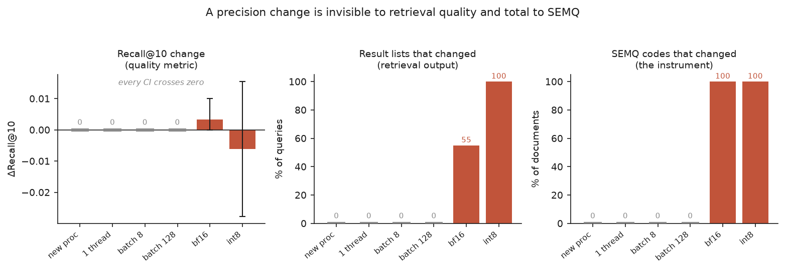
MEASUREMENT
ARI-R: retrieval quality is blind to a serving change
BEIR SciFact, 5,183 documents, 300 queries with real relevance judgements. Grey bars are controls: new process, single thread, 4x and 16x batch. All read exactly zero, which is what makes the red bars interpretable.

Slide 4
MEASUREMENT
ARI-R: the TF32 audit gap, both halves measured
Condition vs fp32/CPU | R@10 | delta R@10 | 95% CI | top-10 lists same | SEMQ HER
GPU fp32, TF32 off | 0.7833 | +0.0000 | [+0.0000, +0.0000] | 100.00% | 0.9992
GPU fp32, TF32 on | 0.7833 | +0.0000 | [+0.0000, +0.0000] | 96.33% | 0.5267
The CI on the quality metric is exactly [0.0000, 0.0000]. Not small. Zero.
The TF32-off row is the control. It rules out 'the GPU did it'.
Narrowed claim: retrieval *quality* is blind. Retrieval *result lists* are not. int8 changes 100% of them.

Slide 5
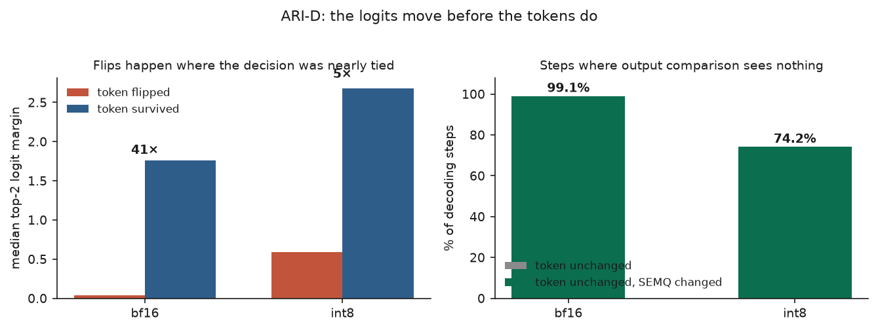
MEASUREMENT
ARI-D: the logits move before the tokens
Teacher-forced: every condition is scored on the reference token sequence, so position i sees an identical context. That isolates the per-step computation from compounding divergence.

Slide 6
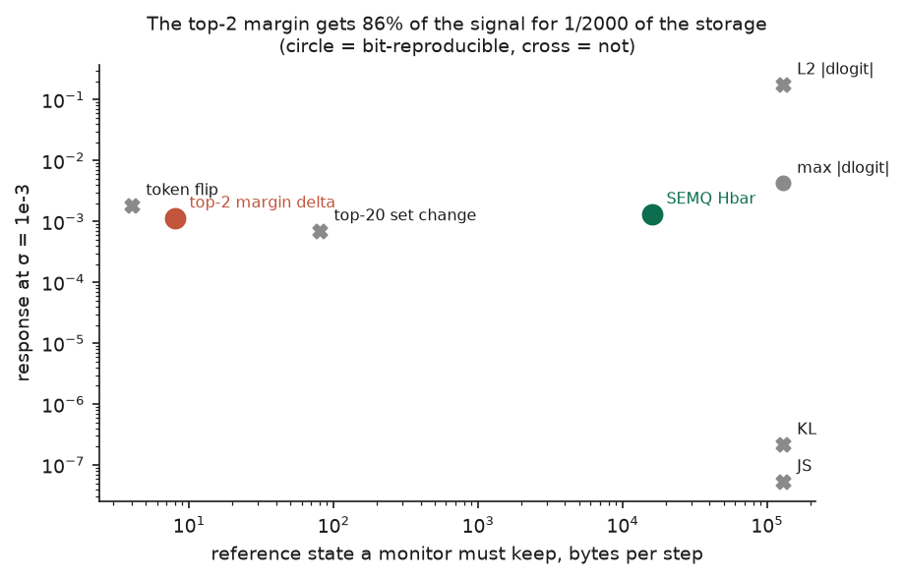
ADVERSARIAL
ARI-D: the result that goes against us
The top-2 margin sits at the same height and 2,000x to the left.
86% of the signal for 8 bytes per step against SEMQ's 16,000.
Both are equally bit-reproducible.
For detecting a precision change, ship the margin.
KL divergence is out for a different reason: it is second order, so it reads zero when it matters, and regrouping the arithmetic moves it 4.6%.

Slide 7
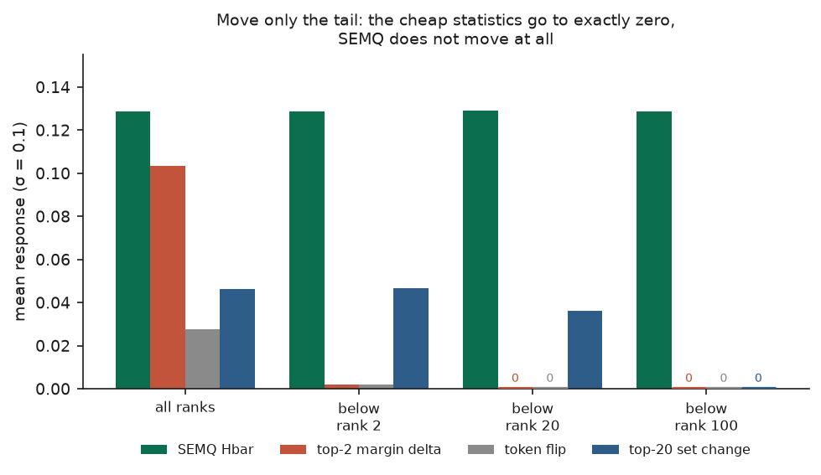
ADVERSARIAL
ARI-D: what survives is coverage, not sensitivity
Move only the tail of the distribution and leave the top ranks untouched.
SEMQ does not move: 0.1289 against 0.1288.
The margin and the token statistic read exactly zero.
They are structurally blind, not merely less sensitive.
Open question: does any real serving change produce tail-confined drift? A precision change does not. A token-suppression filter or an adapter might.

Slide 8
METHOD
ARI-E: the estimator and its control
Cross-harness disagreement means nothing until you know how often one harness disagrees with itself.
E(h1, h2) = mean self-consistency - cross-harness agreement
Zero means the harnesses are interchangeable on those cases.
If a harness has one run per case, self-consistency is unmeasurable. The code refuses to report an effect rather than assuming 1.0.
Intervals resample cases, not runs, because runs of one case are not independent.

Slide 9
MEASUREMENT
ARI-E: measured on 22,000 real agent runs
Contrast | Cases | Self | Cross | Effect | 95% CI
scaffold model=qwen35_122b | 10,788 | 0.874 | 0.785 | +0.089 | [+0.083, +0.094]
scaffold model=minimax_m25 | 12,195 | 0.899 | 0.849 | +0.050 | [+0.044, +0.052]
model, scaffold=sweagent | 10,674 | 0.880 | 0.839 | +0.041 | [+0.039, +0.046]
model, scaffold=openhands | 11,933 | 0.892 | 0.833 | +0.059 | [+0.054, +0.062]
Source: nvidia/Open-SWE-Traces. SWE-agent and OpenHands, crossed with two models. Neither scaffold was built by us.
Outcome is the repository's own test suite, which the agent never saw.
Largest threat: 22% of rows were ungraded and dropped. If grading failure tracks difficulty, the surviving set is easier.

Slide 10
POWER
ARI-E: why the earlier plan would have failed
Pass-rate gap | Repeats | 25 cases | 100 cases | 200 cases
0.00 (null) | 2 | 8% | 6% | 6%
0.20 | 2 | 8% | 11% | 37%
0.20 | 5 | 23% | 74% | 96%
0.40 | 5 | 99% | 100% | 100%
We planned to run 25 cases at 2 repeats. That design detects a 20-point gap 8% of the time.
The published result that motivated the work, 24/25 against 19/25, is a 20-point gap. We would have missed it nine times in ten.
Simulated before spending the compute, not after.

Slide 11
ATTESTATION
Verification architecture
Signing uses SEMQ. Repo content-addresses the artifacts, notary produces an Ed25519 sidecar.
What is signed is a manifest, not the report. It names every input by digest, so swapping the data underneath an unchanged report fails.
Verification does not require SEMQ. The standalone verifier is stdlib plus cryptography, and a test walks its import graph to prove it.
Stated limits: a pass shows what was signed, not who signed it unless you pass a key you already trust. Without a timestamp authority the recorded time is the signer's own clock.

Slide 12
CREDIBILITY
What we retracted, and why that matters
Claim | Status
'SEMQ is ~300x more sensitive than retrieval' | Retracted
'SEMQ is necessary for the index' (v1, seed stability) | Retracted
'A frozen VQ is not verifiable' (v2) | Retracted
'Serving changes are invisible to retrieval' | Narrowed to quality metrics
'SEMQ is the most sensitive decoding probe' | Withdrawn; margin is cheaper
Each was retracted because we tested it adversarially and it failed, not because someone else caught it.
The claims that remain have survived that process.

