Slide 1
Intro to Julia Language
Control, Optimization, and Networks Lab
The University of Texas at Dallas
Sleiman Safaoui
December 16, 2019
Notes:
12/13/19
1
1

Slide 2
Topics
What is Julia
Why Julia?
Speed Test
How to Use Julia
Useful Libraries
Resources
Notes:
12/13/19
2
2

Slide 3
What is JuliaLang
Fast
General
Dynamic
Easy-to-use
Optionally typed
Open source
Notes:
12/13/19
3
3

Slide 4
Why Julia?
Dynamic Environment Problem
People love them
Usually compromise speed
Programming Language Compromise:
High-level dynamic
Low-level fast
Notes:
12/13/19
4
4

Slide 5
Why Julia?
Easy to learn and use, Fast, and Dynamic
Can define equally fast and compact data types as native ones
Can use unicode character (\gamma, \delta, \Eta, …) with tab completion
Designed for numerical and scientific computing
FREE
Bonus I: Good documentation
Bonus II: Growing community
Bonus III: Many tutorials
Notes:
12/13/19
5
5

Slide 6
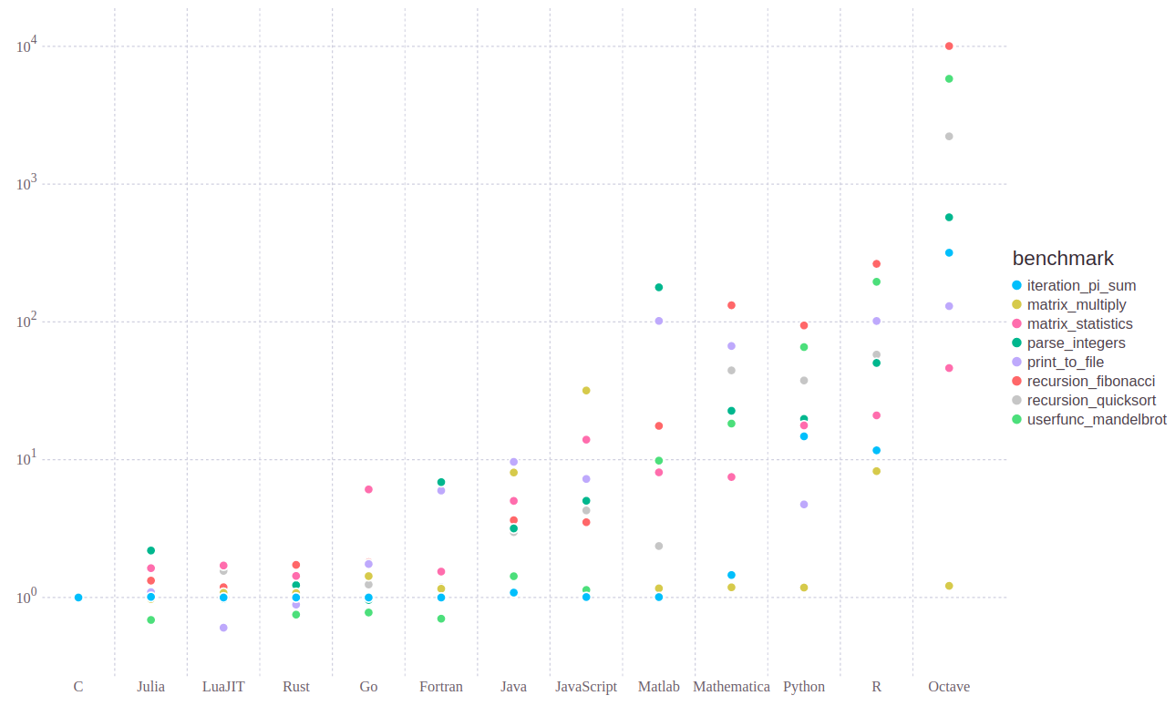
Speed Test
Julia benchmark tests: https://julialang.org/benchmarks/
Notes:
12/13/19
6
6

Slide 7
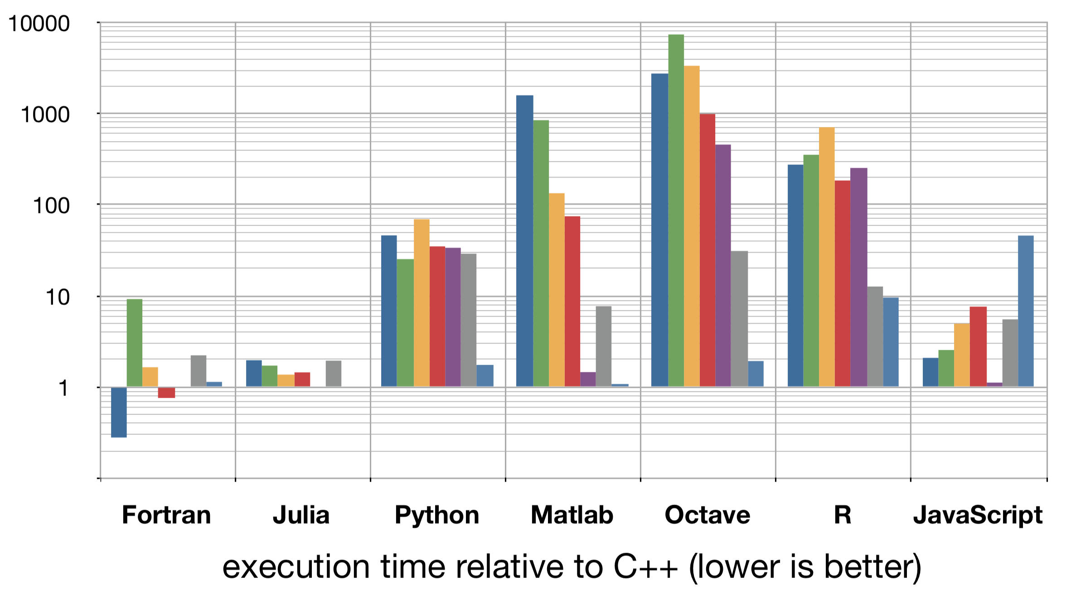
Speed Test
MIT: https://archive.is/o/ja8BQ/https://github.com/JuliaLang/julia-tutorial/raw/master/Vision/vision.pdf
Notes:
12/13/19
7
7

Slide 8
Speed Test
Hackernoon merge sort: https://hackernoon.com/performance-analysis-julia-python-c-dd09f03282a3
Notes:
12/13/19
8
8

Slide 9
Speed Test
Our speed test ..
Not comprehensive
Very specific
But interesting results
Two main test:
Matrix Inverse
Load a native “optimized” function (except in c++)
Nested For Loops
For loops are basic
Simple problem
Single threaded
Notes:
12/13/19
9
9

Slide 10
Speed Test
Matrix Inverse:
Random 5000x5000
C++: using eigen
Python (numpy), Julia, Matlab: native inv function
Time only the inverse function
Nested For Loops
Each loop counts up to 10000
Add index to a variable at every iteration
For loop and addition “+” are native, data types defined when needed
Notes:
12/13/19
10
10

Slide 11
Speed Test
Results
Matrix Inverse
Program | Threads | Avrg Time (sec) | Time for 10 experiments (sec) | Avrg*threads
C++ w/ -O3 | 1 | 24.27 | 242.7 | 24.27
C++ w/ Ofast | 1 | 25.14 | 251.4 | 25.14
Julia (script) | 8 | 2.52 | 25.2 | 20.16
Julia (function) | 8 | 2.48 | 24.8 | 19.84
Matlab (script) | 4 | 1.8 | 17.99 | 7.2
Matlab (function) | 4 | 1.79 | 17.95 | 7.16
Python (script) | 4 | 2.09 | 20.99 | 8.36
Python (function in script) | 4 | 2.15 | 21.5 | 8.6
Python (fuction out of script | 4 | 2.09 | 20.99 | 8.36
Notes:
12/13/19
11
11

Slide 12
Speed Test
Results
Nested For Loops
Program | Threads | Avrg Time (sec) | Time for 10 experiments (sec)
C++ | 1 | 0.22 | 2.2
C++ w/ -O3 | 1 | 2e-6 | 2e-5
C++ w/ Ofast | 1 | 2e-6 | 2e-5
Julia (script) | 1 | 5.66 | 56.6
Julia (function) | 1 | 3.38e-8 | 3.38e-7
Matlab (script) | 1 | 0.11 | 1.1
Matlab (function) | 1 | 0.11 | 1.1
Python (script) | 1 | 6.16 | 61.6
Python (function in script) | 1 | 3.25 | 32.5
Python (function out of script) | 1 | 3.47 | 34.7
Notes:
12/13/19
12
12

Slide 13
Speed Test
Results Takeaway:
Julia demonstrates higher level of native parallelization (8 threads vs 4) in native functions
Julia demonstrates speed in native functions (for, +)
Julia and Python are faster when function are used (as opposed to scripts)
Notes:
12/13/19
13
13

Slide 14
How to Use
Install Julia
Write/Run code:
Julia REPL
Atom Julia Client + Juno, Install
Jupyter Notebook
Notes:
12/13/19
14
14

Slide 15
How to Use
JuliaBox
Run Julia in browser
Uses Jupyter
Notes:
12/13/19
15
15

Slide 16
Useful Libraries/Packages
Visualization:
Plots.jl (plotting API)
PyPlot.jl (MatPlotLib.PyPlot based plotter)
Machine Learning:
JuliaML
Automatic Differentiation
CUDA GPU Acceleration cuArrays
JuliaDB (to work with persistent data set – terabytes of data)
Notes:
12/13/19
16
16

Slide 17
Useful Libraries/Packages
Fourier transforms: AbstractFFTs.jl
Image processing: JuliaImages
NonLinear Dynamics: JuliaDynamics
Biology, quantum physics, quantitative economics, ….
Control: ControlSytems.jl:
LQR
PID
Advanced pole-zero placement
Stability boundary for PID controllers
PID plots
Transfer functions, state space system, analysis, time and frequency response
Notes:
12/13/19
17
17

Slide 18
Useful Libraries/Packages
Parallel Computing
Coroutines (Tasks which can start, be interrupted, and resumed without using space)
Multi-threading
Multi-core/Distributed Processing
Divided over different CPU cores or different machines
Notes:
12/13/19
18
18

Slide 19
Installing Packages
In the Julia REPL run:
using Pkg
Pkg.add("Package Name")
Replace "Package Name” with the desired package’s name
E.g. for Plots package: Pkg.add(”Plots")
Notes:
12/13/19
19
19

Slide 20
Resources
https://julialang.org/learning/
https://archive.is/ja8BQ
Notes:
12/13/19
20
20

