Slide 1
Intro to Julia Language
Control, Optimization, and Networks Lab
The University of Texas at Dallas
Sleiman Safaoui
December 16, 2019

Slide 2
Topics
What is JuliaLang
Why Julia?
  Speed test
How to use Julia
Useful libraries

Slide 3
What is JuliaLang
Fast
General
Dynamic
Easy-to-use
Optionally typed
Open source

Slide 4
Why Julia?
Dynamic Environment Problem
  People love them
  Usually compromise speed
Programming Language Compromise:
  High-level dynamic
  Low-level fast

Slide 5
Why Julia?
Dynamic Environment Problem
  People love them
  Usually compromise speed
Programming Language Compromise:
  High-level dynamic
  Low-level fast

Slide 6
Why Julia?
Easy to learn and use, Fast, and Dynamic
Can define equally fast and compact data types as native ones
Can use unicode character (\gamma, \delta, \Eta, …) with tab completion
Bonus I: Good documentation
Bonus II: Growing community
Bonus III: Many tutorials

Slide 7
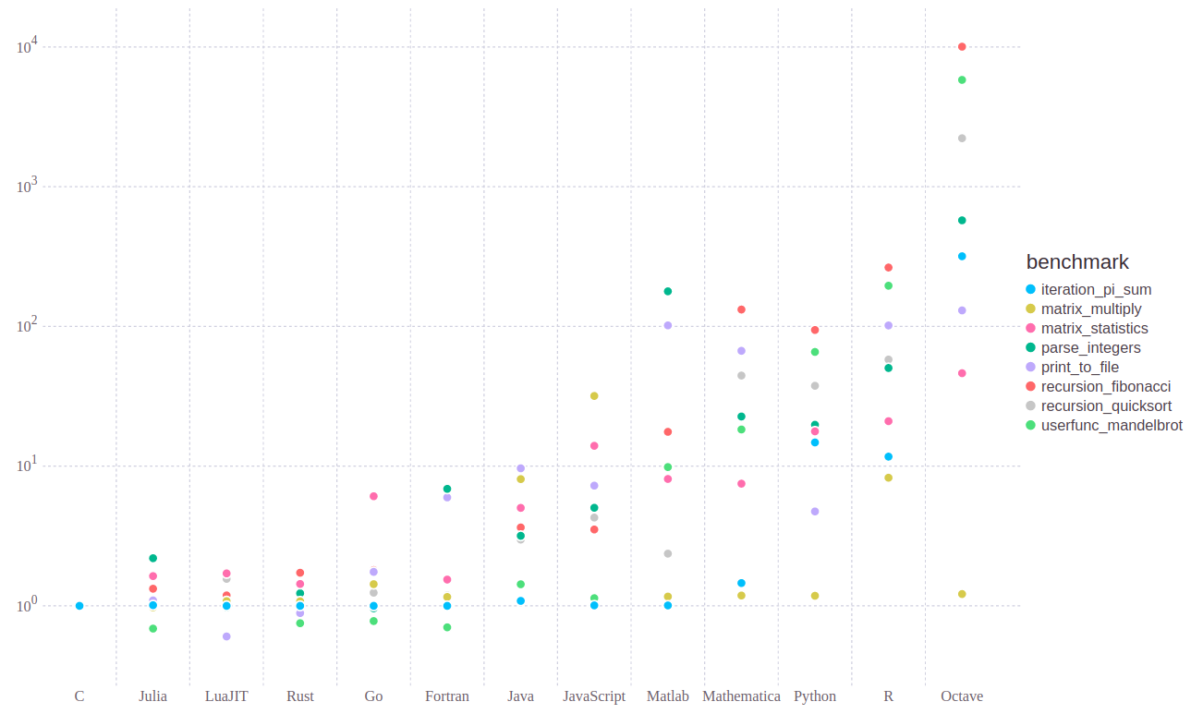
Speed Test
Julia benchmark tests: https://julialang.org/benchmarks/

Slide 8
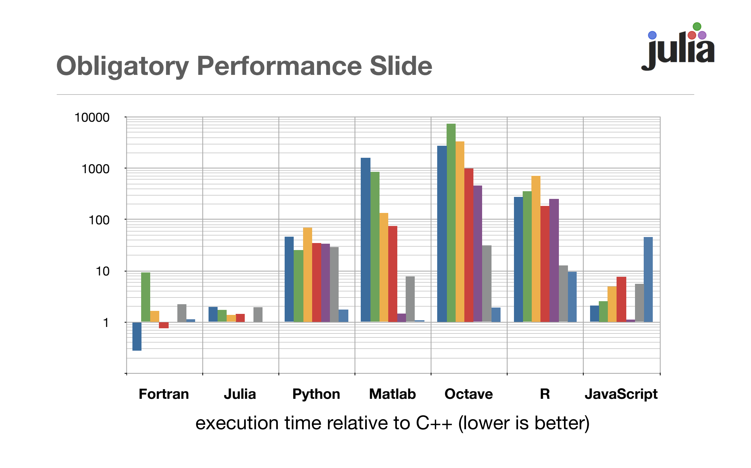
Speed Test
MIT: https://archive.is/o/ja8BQ/https://github.com/JuliaLang/julia-tutorial/raw/master/Vision/vision.pdf

Slide 9
Speed Test
Hackernoon merge sort: https://hackernoon.com/performance-analysis-julia-python-c-dd09f03282a3

Slide 10
Speed Test
Our speed test ..
  Not comprehensive
  Very specific
  But interesting results
Two main test:
  Matrix Inverse
    Load a native “optimized” function (except in c++)
  Nested For Loops
    For loops are basic
    Simple problem
    Single threaded

Slide 11
Speed Test
Matrix Inverse:
  Random 5000x5000
  C++: using eigen
  Python (numpy), Julia, Matlab: native inv function
  Time only the inverse function
Nested For Loops
  Each loop counts up to 10000
  Add index to a variable at every iteration
  For loop and addition “+” are native, data types defined when needed

Slide 12
Speed Test
Results
  Matrix Inverse
Program | Threads | Avrg Time (sec) | Time for 10 experiments (sec) | Avrg*threads
C++ w/ -O3 | 1 | 24.27 | 242.7 | 24.27
C++ w/ Ofast | 1 | 25.14 | 251.4 | 25.14
Julia (script) | 8 | 2.52 | 25.2 | 20.16
Julia (function) | 8 | 2.48 | 24.8 | 19.84
Matlab (script) | 4 | 1.8 | 17.99 | 7.2
Matlab (function) | 4 | 1.79 | 17.95 | 7.16
Python (script) | 4 | 2.09 | 20.99 | 8.36
Python (function in script) | 4 | 2.15 | 21.5 | 8.6
Python (fuction out of script | 4 | 2.09 | 20.99 | 8.36

Slide 13
Speed Test
Results
  Nested For Loops
Program | Threads | Avrg Time (sec) | Time for 10 experiments (sec)
C++ | 1 | 0.22 | 2.2
C++ w/ -O3 | 1 | 2e-6 | 2e-5
C++ w/ Ofast | 1 | 2e-6 | 2e-5
Julia (script) | 1 | 5.66 | 56.6
Julia (function) | 1 | 3.38e-8 | 3.38e-7
Matlab (script) | 1 | 0.11 | 1.1
Matlab (function) | 1 | 0.11 | 1.1
Python (script) | 1 | 6.16 | 61.6
Python (function in script) | 1 | 3.25 | 32.5
Python (function out of script) | 1 | 3.47 | 34.7

Slide 14
Speed Test
Results Takeaway:
  Julia demonstrates higher level of parallelization (8 threads vs 4) in native functions
  Julia demonstrates speed in native functions (for, +)
  Julia and Python are faster when function are used (as opposed to scripts)

