Slide 1
Digital Transformation of Campus Services
A roadmap for the 2026–2029 planning cycle
Department of Computer Science
Dr. A. Presenter
Faculty Development Seminar · 21 September 2026

Slide 2
Outline
Context
Programme of work
The campus

Slide 3
Context
Section 1

Slide 4
The university at a glance
Established to revive the educational glory of Shikarpur
7
2
815
Degree programmes
Faculties
Students enrolled
A public sector general university serving Shikarpur and upper Sindh.
Teaching, research and community engagement across the humanities, sciences and professional disciplines.
  Second-level items use the crest’s royal blue.
    Third-level items pick up the gold accent.

Slide 5


One university, three scripts
English
The Shaikh Ayaz University, Shikarpur
Sindhi
Urdu
The Sindhi and Urdu names are pictures (powerpoint/source/art), set in Lateef and Noto Nastaliq Urdu, so they display correctly on every computer.

Slide 6
Blocks and semantic colours
Standard block
Example block
Maroon header on the crest’s mist tint. Use for definitions, summaries and key takeaways.
Royal blue header, sampled from the ring of the university crest.
Key terms sit in maroon bold; highlights use a light gold wash. Alerted text is red.

Slide 7
Programme of work
Section 2

Slide 8
Every service a student touches should work on a phone, in Sindhi or English, on the first attempt.

Slide 9
Numbered workstreams
Student records and admissions portal
Learning management system and lecture capture
Campus network, Wi-Fi and data centre refresh
Library discovery and digital repository
Phase 1 Assessment and procurement.
Phase 2 Pilot with two faculties.
Phase 3 University-wide rollout.

Slide 10
Tabular data
Workstream | Owner | Year
Admissions portal | Registrar’s Office | 2026
Learning management | Faculty of Education | 2027
Network refresh | IT Directorate | 2027
Digital repository | Central Library | 2028
Table 1 | Indicative delivery schedule.

Slide 11
The campus
Section 3

Slide 12
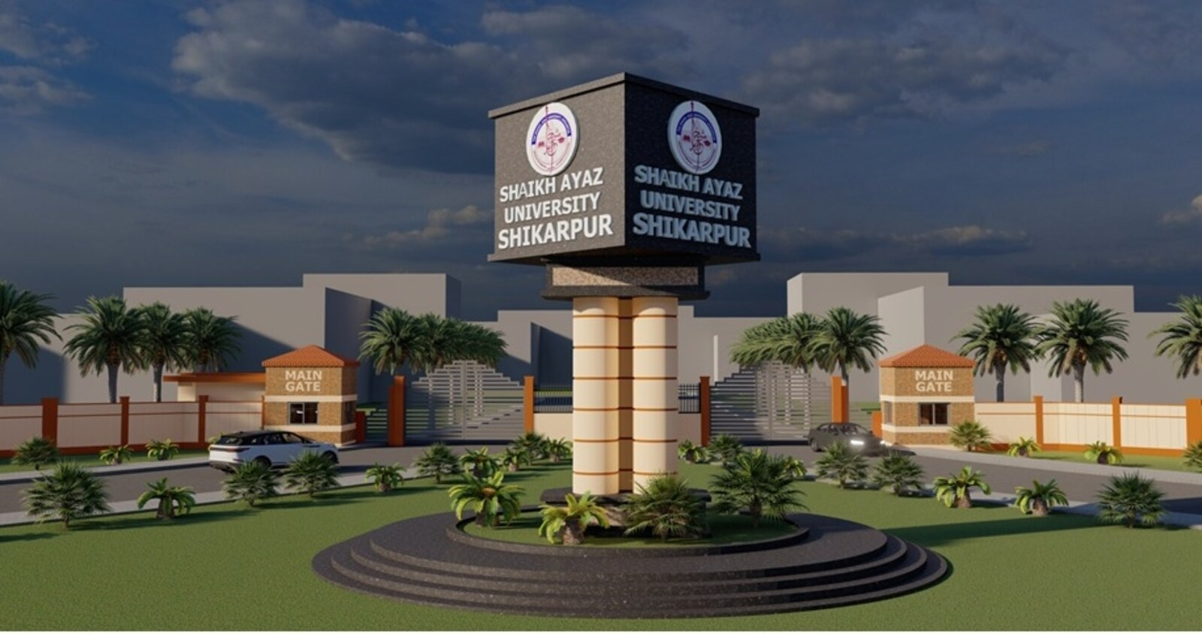
The campus on Main Road, Shikarpur — the setting for every service described in this plan.

Slide 13
Revival of Educational Glory of Shikarpur.
Motto of The Shaikh Ayaz University, Shikarpur

Slide 14
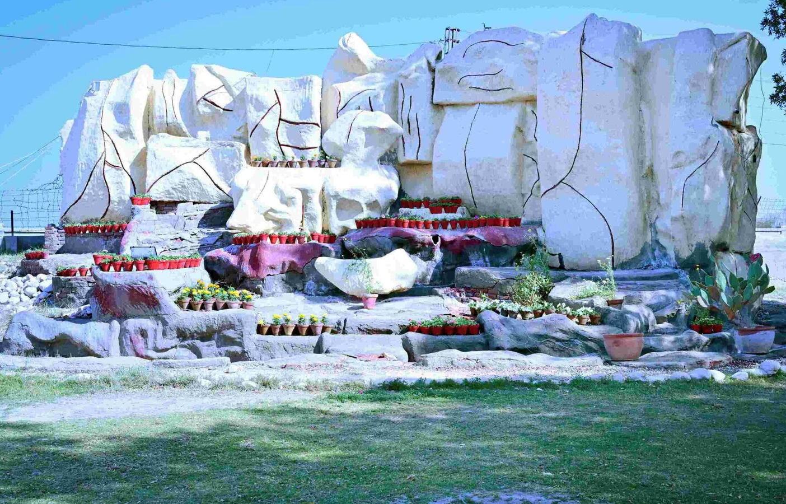
Figures
Captions are numbered and the label is set in maroon.
Photographs sit flush to the text column; full-bleed images get their own slide with the Photo layout.
Figure 1 | The campus monument.

Slide 15
Thank you

Slide 16
Digital Transformation of Campus Services
A roadmap for the 2026–2029 planning cycle
Department of Computer Science
Dr. A. Presenter
Faculty Development Seminar · 21 September 2026

Slide 17
Digital Transformation of Campus Services
A roadmap for the 2026–2029 planning cycle
Department of Computer Science
Dr. A. Presenter
Faculty Development Seminar · 21 September 2026

