Slide 1

PRODUCT ANALYST INTERN
Assignment
-Shruti Shrivastav

Slide 2


Project analysis slide 2
Problem Statement
Two Datasets :-
GOAL :-
We have to identify patterns & insights from the dataset.Also,look out for insights/triggers that activated the users and subsequently engaged them.
Event Description Mapping.csv
User – Event Raw Dataset.csv

Slide 3
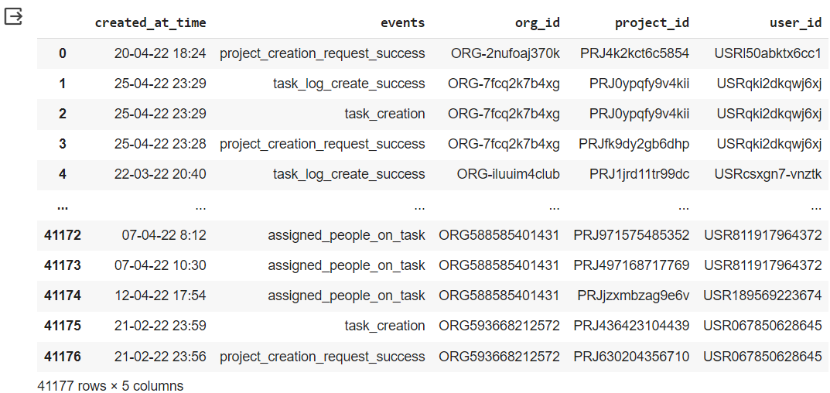
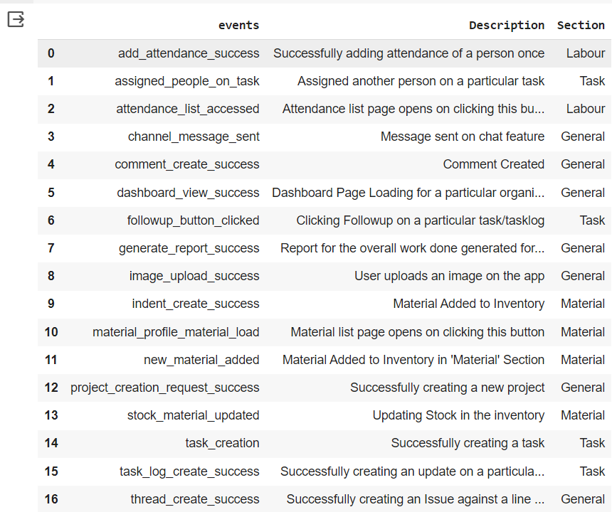
Project analysis slide 2
Datasets Given
User – Event Raw Dataset.csv
Event Description Mapping.csv

Slide 4


Project analysis slide 2
Tech-Stacks Components
NUMPY
MATPLOTLIB
Python
JUPYTER-NOTEBOOK
PANDAS
GOOGLE-COLAB

Slide 5
Project analysis slide 3
STRATEGY
DATASETS LOADED
DATA INTEGRATION
EXPLORATORYDATA ANALYSIS
DATASET INSIGHTS
CONCLUSION
OR RESULTS
Read data from CSV datasets files and loaded into a pandas library Data-Frame.
By merging data from both data frames, we have created a cohesive dataset that facilitates a holistic analysis and the generation of insights spanning both datasets.
Gaining insights from data by using statistical summaries and visual representations.
Plotted Bar chart
Time-Data analysis
Analyze User Behavior
10 Active top users
Extracted valuable findings, which encompassed user behavior patterns and preferences related to app sections.

Slide 6
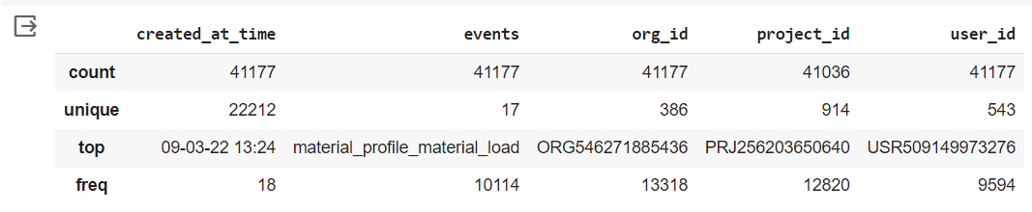
Project analysis slide 4
Data Analysis-A
df_user.describe()
Total distinct Events: 17
Total distinct Users : 543
Total distinct Projects : 914
Total distinct Organizations : 386
Most active user : USR509149973276 (which appears 9594 times)
The most frequently opened page(Material List) which has been opened 10114 times by clicking on material_profile_material_load button.

Slide 7
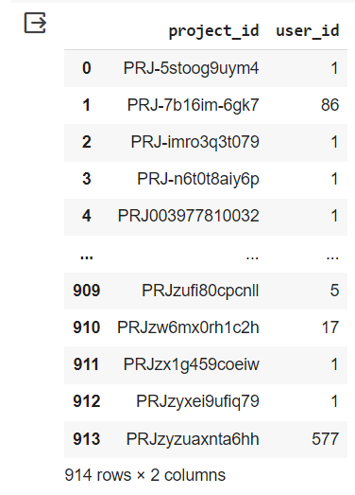
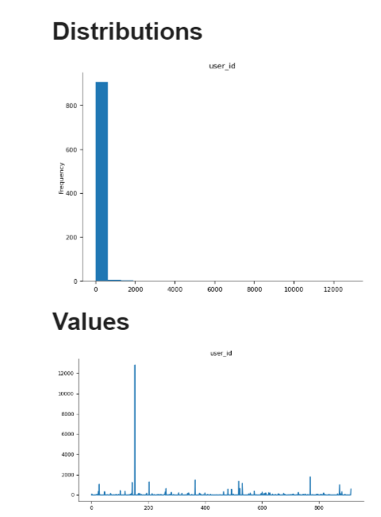
Project analysis slide 4
Data Analysis-B
df_user.groupby(["project_id"], as_index = False).user_id.count()
It counting all users entries associated with each project, so if a user appears multiple times for the same project, each appearance is counted.
Project ID with the maximum users: PRJ256203650640
No of users associated with this project : 12820

Slide 8
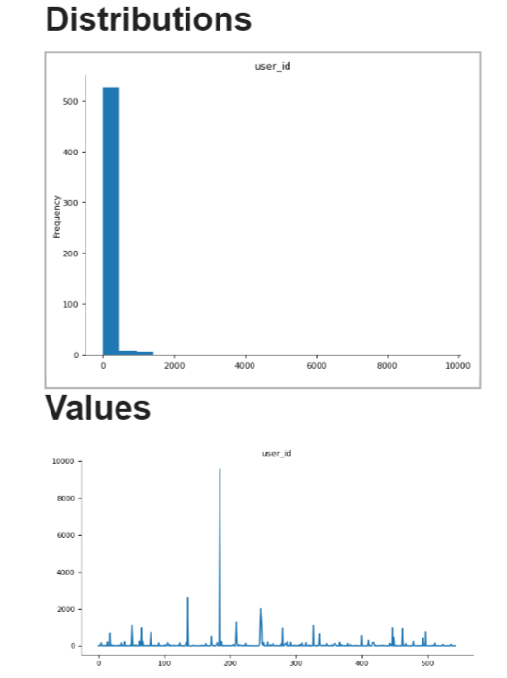
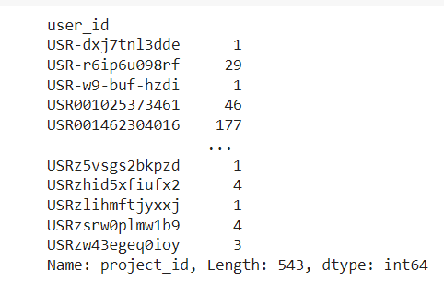
Project analysis slide 4
Data Analysis-C
df_user.groupby(["user_id"]).project_id.count()
result = df_user.groupby(["user_id"]).project_id.nunique()
max_projects_user = result[result == result.max()]
The total occurrences of each project were counted for every user in the dataset.
Among all the users, USR289696600578 stands out as they are associated with the highest number of unique projects, totaling 29 in their portfolio.
This information is essential as it allows us to tailor our results to meet the specific requirements of the organization, aligning our findings with their project-related needs and objectives.

Slide 9
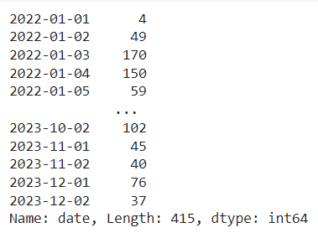
Project analysis slide 4
Time-Data Analysis
merged_df['created_at_time'] = pd.to_datetime(merged_df['created_at_time’])
merged_df['date'] = merged_df['created_at_time'].dt.date
date_event_counts = merged_df['date'].value_counts().sort_index()
The dataset spans a total of 415 unique days.
Notably, 2022-06-07 stands out as the day with the highest event count in the dataset, totaling 396 events on that specific date.
This information is valuable for grasping the temporal patterns of events and activities within the dataset, shedding light on how events are distributed across various dates and enhancing our understanding of the temporal dynamics of the data.

Slide 10
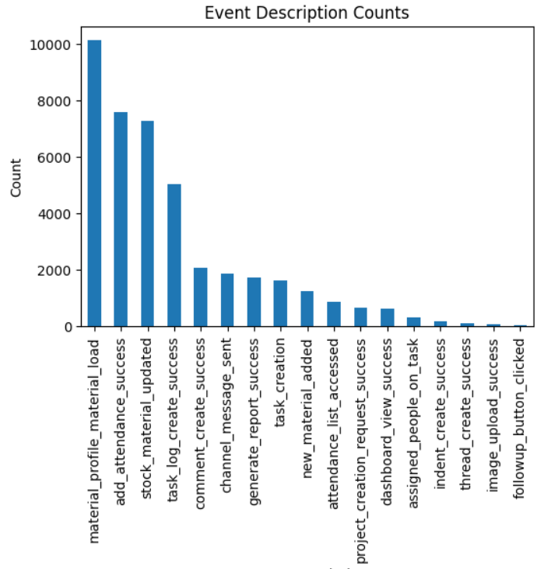
Project analysis slide 4
Project & Organization Insights levels
org_project_summary = merged_df.groupby(['org_id', 'project_id'])['event'].count()
plotted bar chart using Matplotlib
Overview of how many events occurred for each
organization-project pair.
It helps you understand event activity related
to different projects within each organization.
Highest event activity material_profile_material_load
No.of occurrences : 10114

Slide 11
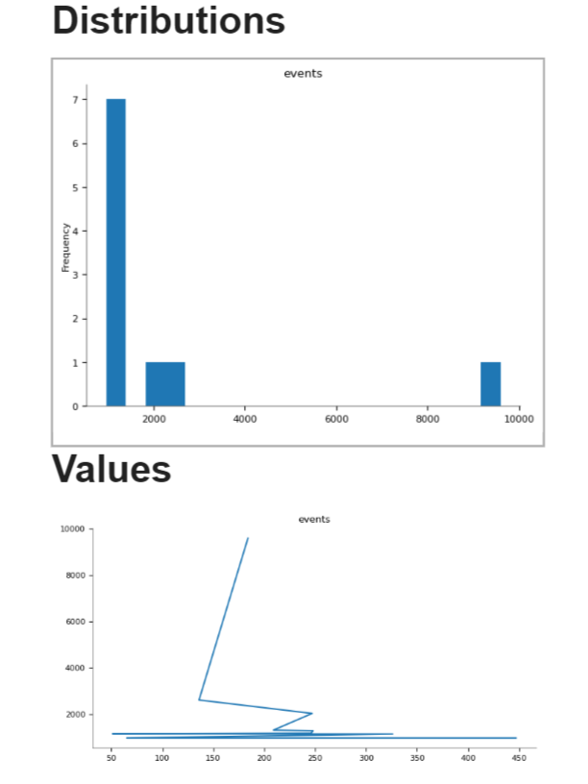
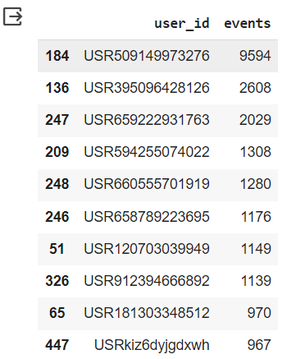
Project analysis slide 4
10 Most Active Users
user_event_counts = df_user.groupby("user_id")["event"].count().reset_index()
user_event_counts = user_event_counts.sort_values(by="event", ascending=False)
top_10_users = user_event_counts.head(10)

Slide 12
Project analysis slide 6
CONCLUSION
Given Dataset contain 415 day’s data.
No of unique Events : 17
No of unique Users : 543
No of unique Projects : 914
No of unique Companies : 386
The most frequent loaded page(event): material_profile_material_load
Most active User ID : USR509149973276
Project ID (PRJ256203650640) has maximum no of active users.
User ID (USR289696600578) associated with maximum no of projects in given datasets.
2022-06-07 had the most events in given dataset.
Date-wise event counts have been calculated to track the distribution of events over each day
I have examined user behavior by focusing on specific event descriptions such as "Successfully creating a new project" and "Successfully creating a task“.
Extracted top 10 users list.
“ We can get more insights from given datasets according to company’s requirements ”

Slide 13
Project analysis slide 8
About Given Data
MERITS
The dataset offers transparent linkages between events, their respective descriptions, and the relevant sections, ensuring a straightforward comprehension of each event's context.
Event descriptions are rich in information, greatly aiding the comprehension of the significance of each event within the organization's operations.
The data has been methodically structured and organized, rendering it well-suited for in-depth analysis and effective visualization.
LIMITATIONS
The dataset lacks information regarding data completeness. The absence of comprehensive data can distort the analysis and result in inaccurate conclusions.
Although user IDs are included, there is a lack of in-depth data concerning user behavior patterns, preferences, and demographics. Grasping user behavior is crucial for both enhancing user experiences and optimizing system performance.

Slide 14
Project analysis slide 8
Source Code
GITHUB REPOSITORY
https://github.com/The-Shruti/Shruti_Shrivastav_Assignment_Powerplay/blob/main/Shruti_Shrivastav_Powerplay.ipynb

Slide 15
Thank You !

