Slide 1

PRODUCT ANALYST INTERN
Assignment
-Shruti Shrivastav

Slide 2


Project analysis slide 2
Problem Statement
Two datasets given:-
Goal :-
We have to identify patterns & insights from the dataset.Also,look out for insights/triggers that activated the users and subsequently engaged them.
Event Description Mapping.csv
User – Event Raw Dataset.csv

Slide 3
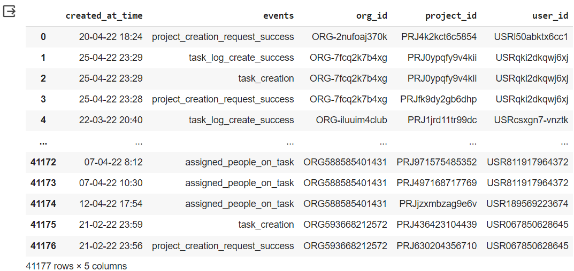
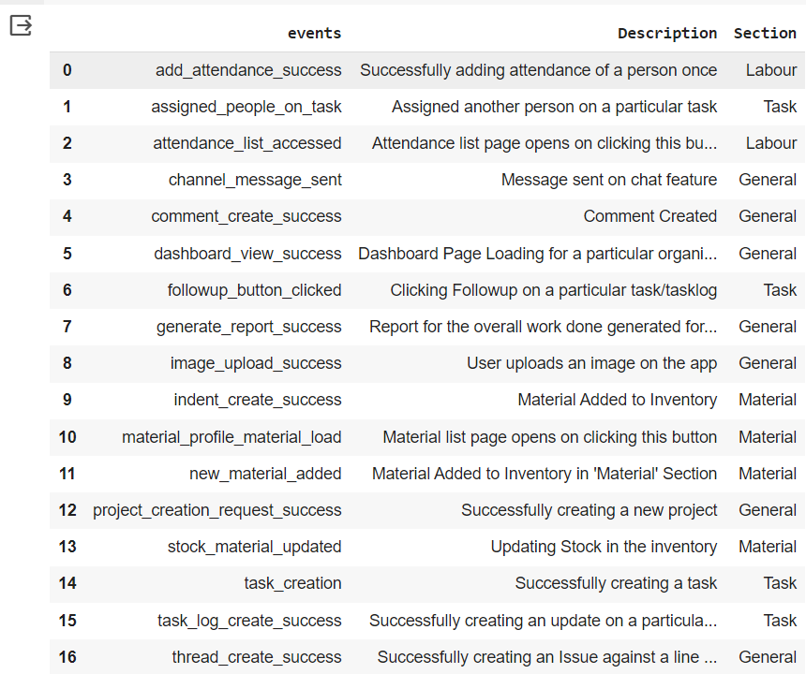
Project analysis slide 2
Datasets Preview
User – Event Raw Dataset.csv
Event Description Mapping.csv

Slide 4


Project analysis slide 2
Tools & Tech-Stacks
NUMPY
MATPLOTLIB
Python
JUPYTER-NOTEBOOK
PANDAS
GOOGLE-COLAB

Slide 5
Project analysis slide 3
Approach
DATASETS LOADED
DATA INTEGRATION
EXPLORATORYDATA ANALYSIS
DATASET INSIGHTS
CONCLUSION
OR RESULTS
Read data from CSV files(Datasets) and loaded into a pandas Data-Frame.
Combined data from both data-frames to provide a unified view, which enabling comprehensive analysis and insights across both datasets.
Understanding data through statistical summaries and visualizations.
Plotted Bar chart
Time-series analysis
Analyze User Behavior
Top active users
Obtained valuable insights, including user behavior patterns, and app section preferences

Slide 6
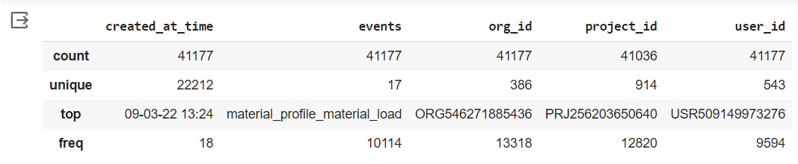
Project analysis slide 4
Statistics-1
df_user.describe()
Total distinct Events: 17
Total distinct Users : 543
Total distinct Projects : 914
Total distinct Organizations : 386
Most active user : USR509149973276 (which appears 9594 times)
The most frequently opened page(Material List) which has been opened 10114 times by clicking on material_profile_material_load button.

Slide 7
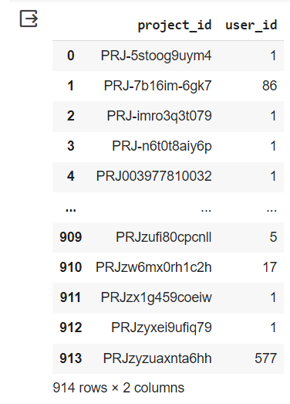
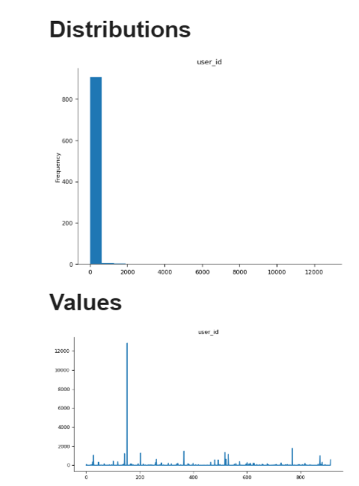
Project analysis slide 4
Statistics-2
df_user.groupby(["project_id"], as_index = False).user_id.count()
It counting all users entries associated with each project, so if a user appears multiple times for the same project, each appearance is counted.
Project ID with the maximum users: PRJ256203650640
No of users associated with this project : 12820

Slide 8
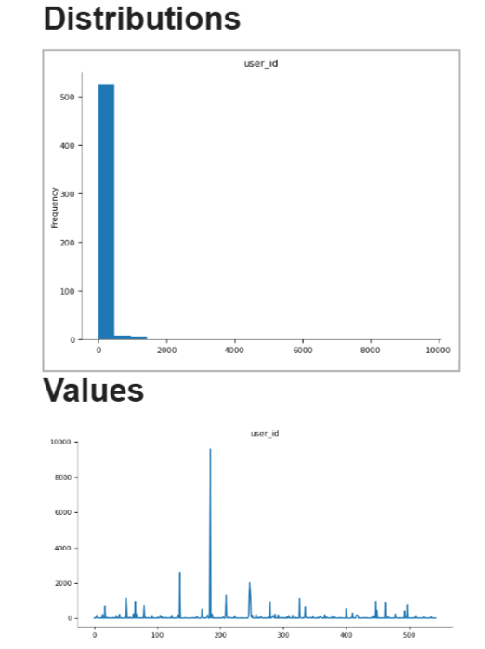
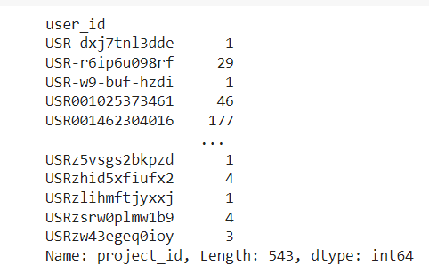
Project analysis slide 4
Statistics-3
df_user.groupby(["user_id"]).project_id.count()
result = df_user.groupby(["user_id"]).project_id.nunique()
max_projects_user = result[result == result.max()]
Counted total occurrences of project for each user.
User which is associated with the maximum unique projects: USR289696600578
Total no of unique projects : 29
We can find any results according to organization’s requirements.

Slide 9
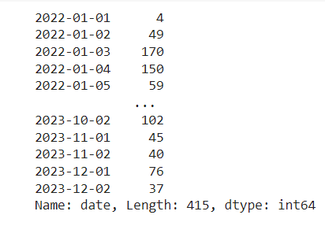
Project analysis slide 4
Time-Series Analysis
merged_df['created_at_time'] = pd.to_datetime(merged_df['created_at_time’])
merged_df['date'] = merged_df['created_at_time'].dt.date
date_event_counts = merged_df['date'].value_counts().sort_index()
Total no of unique days in given dataset : 415
2022-06-07 had the most events in given dataset.
Total no of events on 2022-06-07 : 396
It helps to understand the temporal behavior of events or activities.
It will helps us to gain insights into how events are distributed across different dates, providing valuable information about the temporal aspects of data.

Slide 10
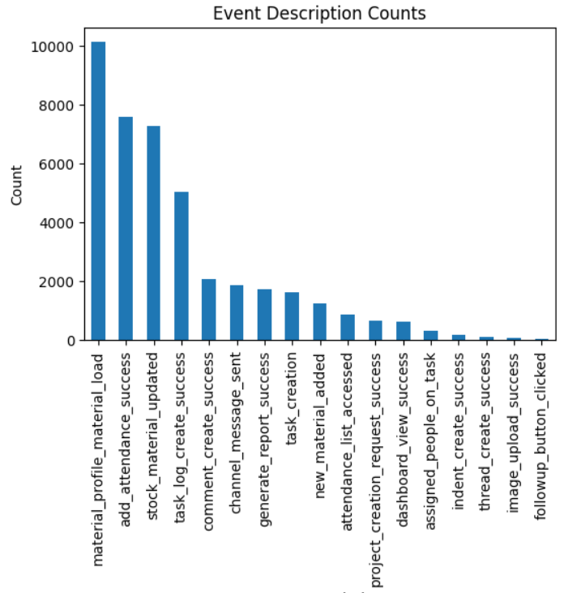
Project analysis slide 4
Org and Project level Insights
org_project_summary = merged_df.groupby(['org_id', 'project_id'])['event'].count()
plotted bar chart using Matplotlib
Overview of how many events occurred for each
organization-project pair.
It helps you understand event activity related
to different projects within each organization.
Highest event activity material_profile_material_load
No.of occurrences : 10114

Slide 11
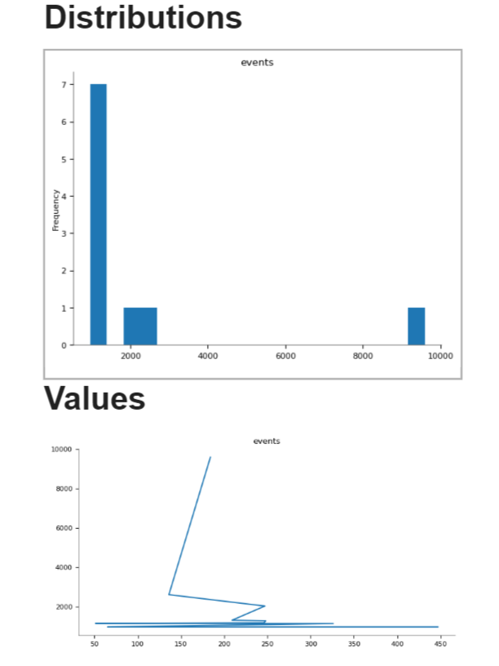
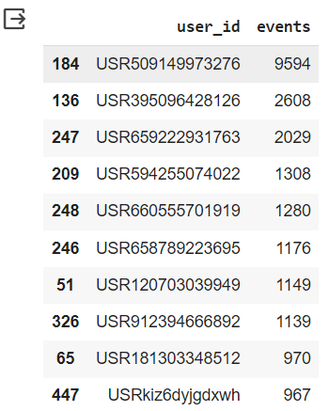
Project analysis slide 4
Top-10 most active users
user_event_counts = df_user.groupby("user_id")["event"].count().reset_index()
user_event_counts = user_event_counts.sort_values(by="event", ascending=False)
top_10_users = user_event_counts.head(10)

Slide 12
Project analysis slide 6
Conclusions
Given Dataset contain 415 day’s data.
No of unique Events : 17
No of unique Users : 543
No of unique Projects : 914
No of unique Companies : 386
The most frequent loaded page(event): material_profile_material_load
Most active User ID : USR509149973276
Project ID (PRJ256203650640) has maximum no of active users.
User ID (USR289696600578) associated with maximum no of projects in given datasets.
2022-06-07 had the most events in given dataset.
Date-wise event counts have been calculated to track the distribution of events over each day
I have examined user behavior by focusing on specific event descriptions such as "Successfully creating a new project" and "Successfully creating a task“.
Extracted top 10 users list.
“ We can get more insights from given datasets according to company’s requirements ”

Slide 13
Project analysis slide 8
About Given Data
POSITIVE ASPECTS
NEGATIVE ASPECTS
The dataset provides clear mappings between events, their descriptions, and sections, making it easy to understand the context of each event
The descriptions of events are informative, helping to understand what each event signifies in the context of the organization's activities.
The data is structured and organized, making it suitable for analysis and visualization.
There is no information about the completeness of the data. Missing or incomplete data can skew the analysis and lead to incorrect conclusion.
While user_ids are provided, there is no detailed information about user behavior patterns, preferences, or demographics. Understanding user behavior is essential for user experience analysis and system optimization.

Slide 14
Project analysis slide 8
Source Code
Git-hub :- https://github.com/The-Shruti/Shruti_Shrivastav_Assignment_Powerplay/blob/main/Shruti_Shrivastav_Powerplay.ipynb

Slide 15
Thank You !

