Slide 1

E.D.N.U.S: Emotion Detection for Individuals with Neurological Disorders Using Speech
Batch Members :
Surendaranath .K (180801201)
Vishal. B (180801223)
Vishal Balaji Sivaraman (180801224)
GUIDE:
Dr. Sheena Christabel Pravin,
Assistant Professor,
Department of Electronics and Communication Engineering

Slide 2
Outline
Abstract
Objectives
Literature Survey
Existing System
Block Diagram
Proposed Methodology
Model Architecture
Results
Project Outcome
Conclusion & Future Scope
References

Slide 3
Abstract
Emotion is a psychological condition that is linked to the neurological system. It is what a person feels on the inside as a result of the environment in his immediate surroundings.
A person's emotions can be sensed in a variety of ways. Tonal characteristics, face expression, and body gesture are some of the predominant ways in which one can conclude the person’ emotions.
Human information processing includes the computation or categorization of emotion based on speech or facial expression, out of which computation / categorization of emotion based on speech signal shows more accurate results due to the fact that the facial expression would be the same for certain emotions like guilt, fear, lie, etc. Hence as a result during categorization of the emotion, the model would result in erroneous decisions.

Slide 4
Abstract (CONTD)
So based on the above validated conclusion we the team have devised an ideal, cost effective, applicable solution which we term as
E.D.N.U.S: Emotion Detection for Individuals with Neurological Disorders Using Speech
From the above acronym one can conclude that the proposed system would be categorizing the emotion of any individual based on his speech sample (these include talking, short sentences, etc.), Based on the results appropriate actions could be taken for maintaining the wellbeing of the person.

Slide 5
Objectives
Short term Objective (Project)
We envision to construct a fully functional system using software ,which would be compatible with any host system.
Long term Objective (Product)
We envision to construct a unique, interactive Health Bot which would be embedded into a cloud service, followed by which the users could access the same using a dedicated Interactive website.

Slide 6
Literature Survey
S.no | Title | Summary | Year
1) | Automated accurate speech emotion recognition system using twine shuffle pattern and iterative neighborhood component analysis techniques | The team behind this project used a cryptographic structure called a shuffle box to generate features and iterative neighbourhood component analysis to pick them. The suggested technique is divided into three stages: I Tunable Q wavelet transform (TQWT) for multi-level feature creation, (ii) twine shuffle pattern (twine-shuf-pat) for feature production, and (iii) discriminative features are chosen and categorised using iterative neighbourhood component analysis (INCA). | 2021
2) | Att-Net: Enhanced emotion recognition system using lightweight self-attention module | The researchers have proposed a simple and lightweight deep learning-based self-attention module (SAM) for the SER system in this work. SAM is provided the transitional features map, which efficiently creates the channel and spatial axes attention map with minimal overheads. the team had made the use of a multi-layer perceptron (MLP) in channel attention to extracting global cues and a special dilated convolutional neural network (CNN) in spatial attention to extract spatial info from input tensor. | 2021

Slide 7
Literature Survey(CONTD)
S.no | Title | Summary | Year
3) | Multimodal Emotion Recognition using Deep Learning | This study examines the use of deep learning to recognize emotional signs in multimodal data and compares their applicability based on current research. Multimodal affective computing systems are compared to unimodal solutions since they have a better classification accuracy. The amount of emotions seen, characteristics collected, categorization method, and database consistency all affect accuracy. | 2021
4) | Emotion recognition in low-resource | This study focuses on emotion identification from speech data in situations when memory and computing resources are limited. One way to achieve this aim is to reduce the number of characteristics used in inductive inference. In this paper, we compare three state-of-the-art feature selection methods: Infinite Latent Feature Selection (ILFS), ReliefF, and Fisher (generalised Fisher score), to our newly suggested feature selection technique called ‘Active Feature Selection' (AFS). The evaluation is carried out using two standard acoustic paralinguistic feature sets on three emotion recognition data sets (EmoDB, SAVEE, and EMOVO) (i.e. eGeMAPs and emobase). | 2021

Slide 8
Literature Survey (CONTD)
S.no | Title | Summary | Year
5) | DNN-HMM-Based Speaker-Adaptive Emotion Recognition Using MFCC and Epoch-Based Features | The team's suggested system incorporates MFCC and epoch-based characteristics. We used our previous work on robust epoch recognition from emotional speech to extract emotion-specific epoch-based characteristics, such as immediate pitch, phase, and excitation strength. The combined feature set outperforms the MFCC characteristics, which have been used as a baseline for SER systems in the literature, by 5.07 percent, and state-of-the-art methods by 7.13 percent. The suggested model outperforms state-of-the-art methods by 2.06% when just MFCC characteristics are used. | 2020

Slide 9

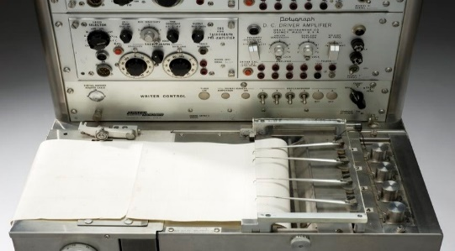
Existing System
Topic | Picture | Drawbacks
Manual Interrogation/Chatting Process |  | 1) Time Consuming 2) Often leads to wrong Conclusion 3) Violates privacy
Polygraph machine |  | 1) Subjects can bypass the system 2) Tampering of Data is possible

Slide 10
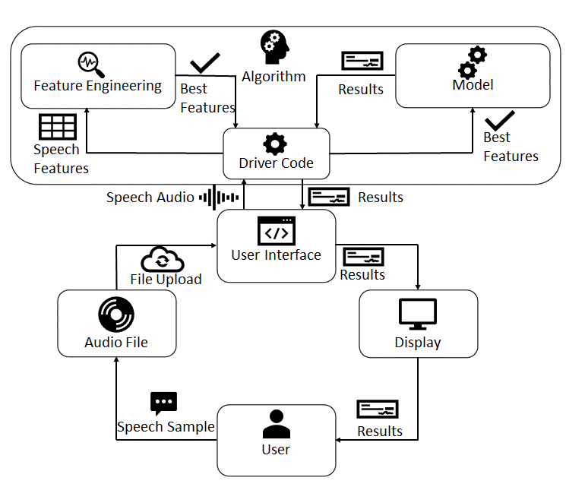
Block diagram

Slide 11
Proposed Methodology
Procedure
Model Working Principle
Algorithm Workflow Chart

Slide 12
Procedure
The solution is simple and works in only 3 steps
Initially the subject would upload the audio file recording of his/ her speech.
The speech signal present in the file would be processed into an audio signal that would be sent to the model which is embedded in the User Interface for validation.
Upon completion of input validation, the proposed autoencoder model would extract the best speech features from the input speech features such as Mel, Chroma & Mel Frequency Cepstral Coefficients (MFCC), followed by which the best features are supplied as input to the proposed Super Learner Model, which would classify the emotion corresponding to the audio signal. Appropriate action may be taken by user for their wellbeing, based on the emotion classification report.

Slide 13
Model Working Principle
As discussed earlier , two pivotal components namely Autoencoder and Model contribute as a backbone in the proposed project.
Autoencoder: An Autoencoder is a customizable feed forward neural network which comprises of an encoder and decoder model. Now the primary function of the autoencoder model is to reduce complexity by performing dimensionality reduction (selecting the best features), which in turn would contribute to a boost in accuracy during training of the parent model. In our project we propose a Deep Autoencoder.
Model: The parent model chosen for training would be a super learner model which is more or less a cascaded structure of a number of machine learning models , so since this project focuses on Emotion classification based on speech signal hence we propose a Super Learner Classification Algorithm.

Slide 14
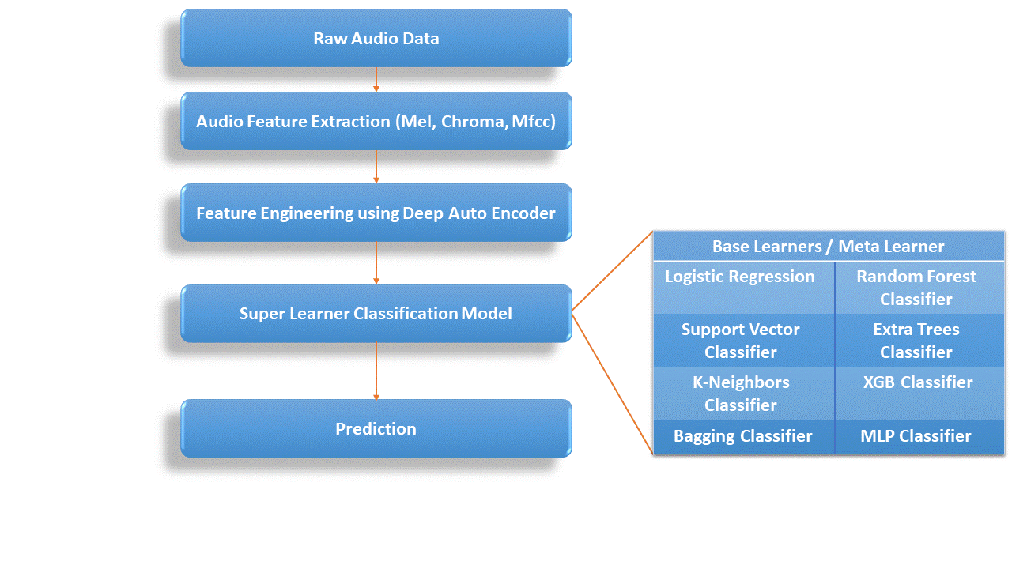
Algorithm Workflow chart

Slide 15
Model Architecture
Autoencoder Architecture
Proposed Super Learner Model Architecture

Slide 16
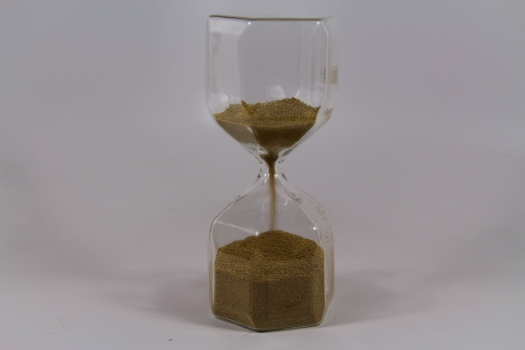
Autoencoder Architecture
Encoder
Bottle Neck Layer
Hour Glass
Decoder
Autoencoder Model Layout

Slide 17
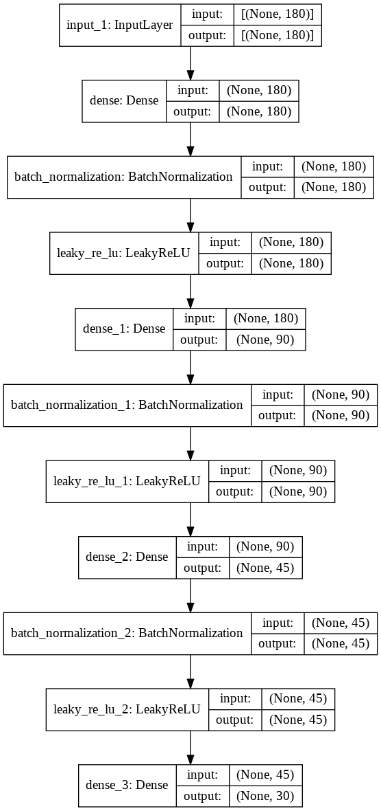
Autoencoder Architecture (CONTD)
Proposed Deep Autoencoder: Encoder Section

Slide 18
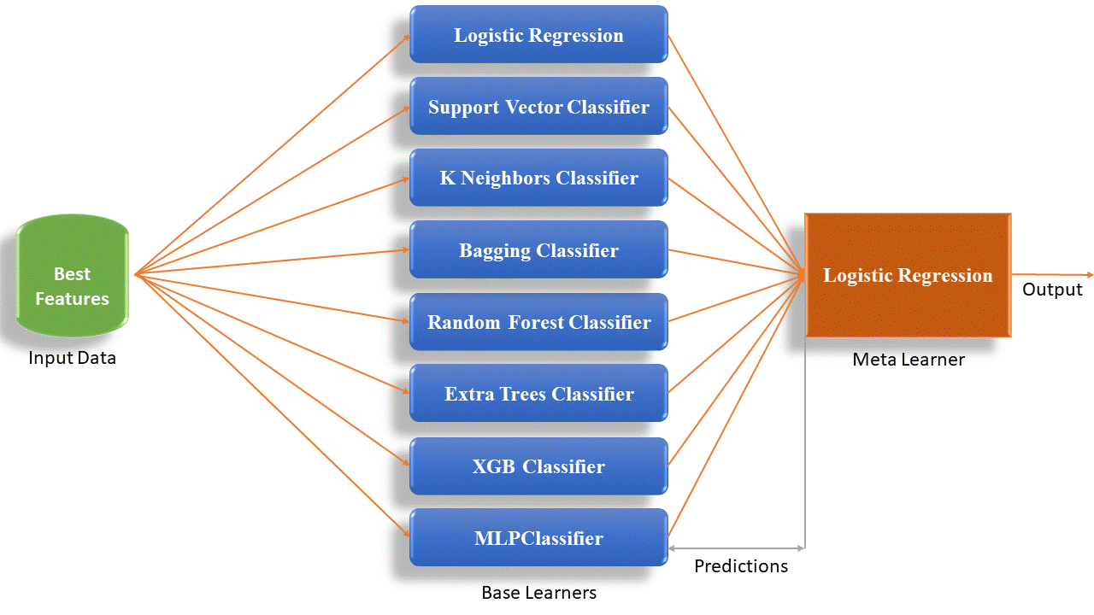
Proposed Super learner Model Architecture

Slide 19
Results
Autoencoder Results
Super Learner Results
Super Learner Graphical Analysis
Confusion Matrix

Slide 20
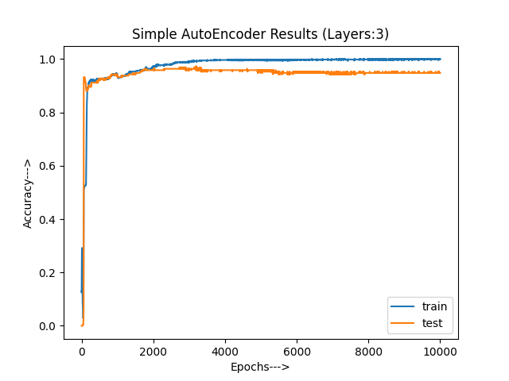
Autoencoder Results

Slide 21
Super learner Results
Metric | SLM with Autoencoder | SLM without Autoencoder
Accuracy Score (%) | 84 | 76
Balanced Accuracy Score (%) | 83 | 76
Cohen Kappa Score (%) | 78 | 68
F1 Score(Macro) (%) | 83 | 76
F1 Score(Micro) (%) | 84 | 76
F1 Score(Weighted) (%) | 84 | 76

Slide 22
Super learner Results (CONTD)
Metric | SLM with Autoencoder | SLM without Autoencoder
Jaccard Score( Macro) (%) | 72 | 61
Jaccard Score( Micro) (%) | 72 | 61
Jaccard Score(Weighted) (%) | 72 | 62
Hamming Loss | 0.1614 | 0.2395

Slide 23
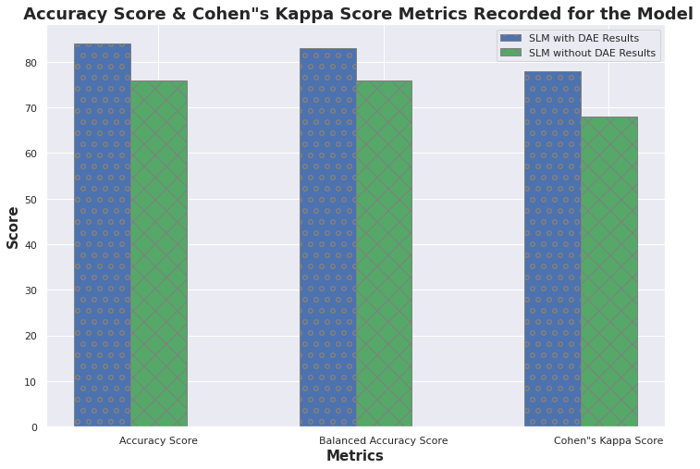
Super Learner Graphical Analysis

Slide 24
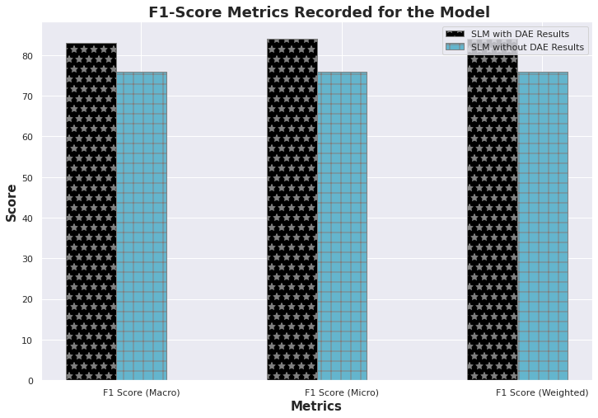

Slide 25
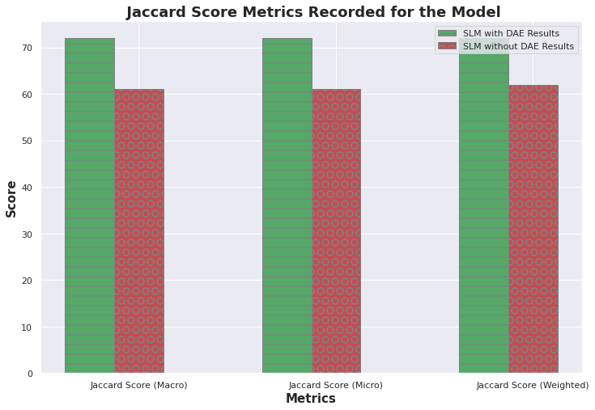

Slide 26
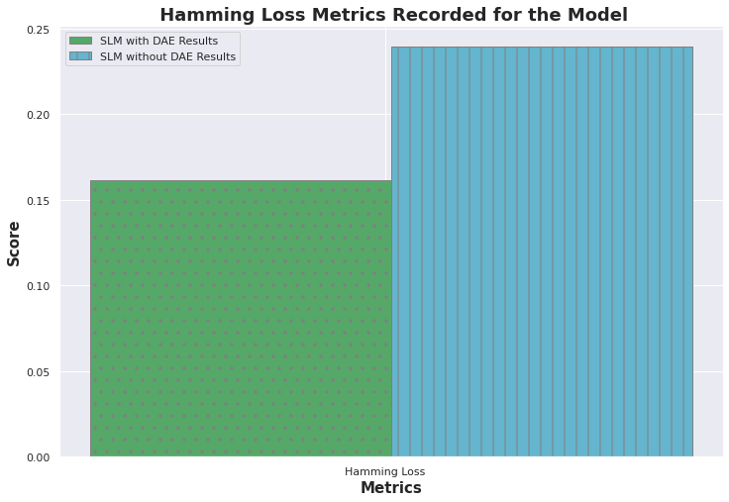

Slide 27
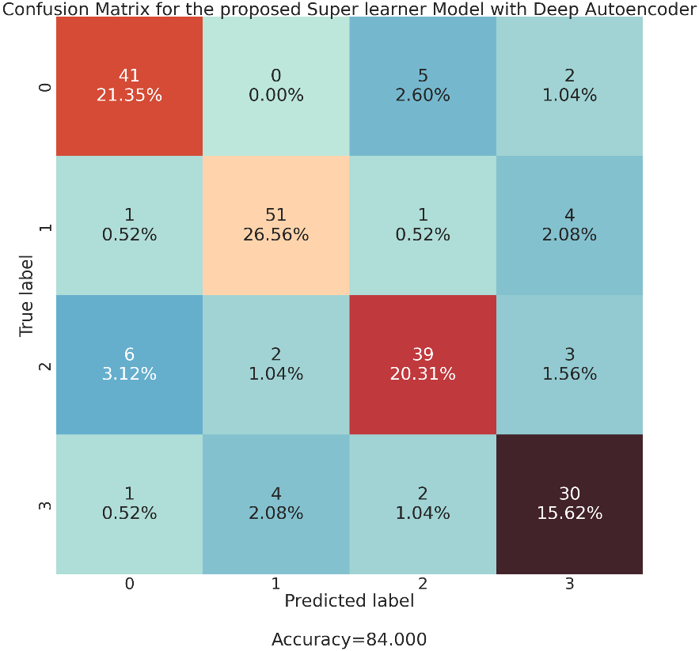
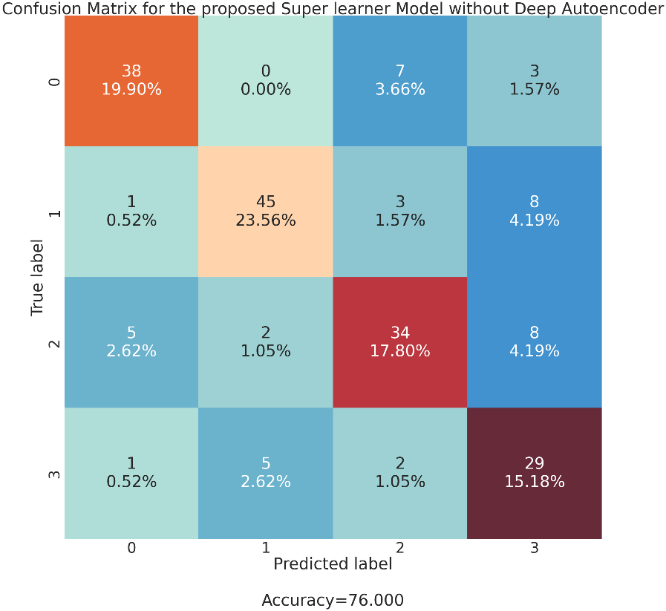
Confusion Matrix
The Emotion Classes are [‘calm', 'happy’, 'sad’, 'angry']

Slide 28
Project Outcome

Slide 29
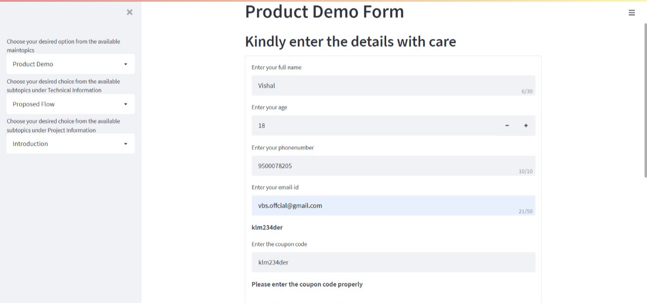
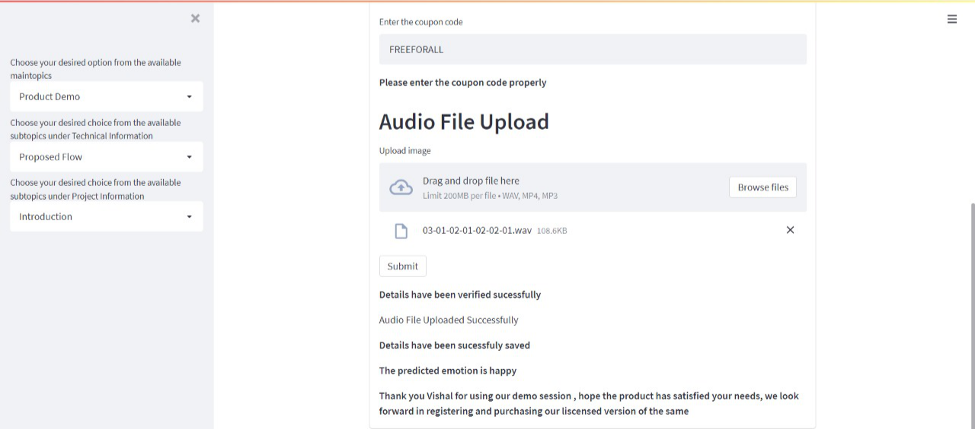

Slide 30
Conclusion & Future Scope
It can be concluded that the proposed Super learner model incorporated with a Deep Autoencoder model outperforms other models with its ground breaking results on a dense dataset like speech. Furthermore, It is proposed to take this project forward as a product by incorporating certain features elaborated under the future scope section.
We envision to construct a fully functional system using Raspberry pi which would be compatible with any host system.

Slide 31
References
1)Stuti Juyal, Chirag Killa, Gurvinder Pal Singh, Nishant Gupta, Vedika Gupta ‘Emotion Recognition from Speech Using Deep Neural Network’ https://link.springer.com/chapter/10.1007/978-3-030-76167-7_1
2)Huang, F., Zhang, J., Zhou, C. et al. A deep learning algorithm using a fully connected sparse autoencoder neural network for landslide susceptibility prediction. Landslides 17, 217–229 (2020). DOI: 10.1007/s10346-019-01274-9 https://link.springer.com/article/10.1007%2Fs10346-019-01274-9
3)R. A. Khalil, E. Jones, M. I. Babar, T. Jan, M. H. Zafar, and T. Alhussain, "Speech Emotion Recognition Using Deep Learning Techniques: A Review," in IEEE Access, vol. 7, pp. 117327-117345, 2019, DOI: 10.1109/ACCESS.2019.2936124 https://ieeexplore.ieee.org/document/8805181
4)Mehebub Sahana, Binh Thai Pham, Manas Shukla, Romulus Costache, Do Xuan Thu, Rabin Chakrabortty, Neelima Satyam, Huu Duy Nguyen, Tran Van Phong, Hiep Van Le, Subodh Chandra Pal, G. Areendran, Kashif Imdad & Indra Prakash (2020) Rainfall induced landslide susceptibility mapping using novel hybrid soft computing methods based on multi-layer perceptron neural network classifier, Geocarto International, DOI: 10.1080/10106049.2020.1837262
5)Sheena Christabel Pravin, Palanivelan, M, ‘A Hybrid Deep Ensemble for Speech Disfluency Classification’, Circuits, Systems, and Signal Processing, Springer, vol. 40, no.8, pp. 3968-3995, July 2021.
https://www.researchgate.net/publication/349228170_A_Hybrid_Deep_Ensemble_for_Speech_Disfluency_Classification
.

Slide 32
References (CONTD)
6)Krishnan, P.T., Joseph Raj, A.N. & Rajangam, V. Emotion classification from speech signal based on empirical mode decomposition and non-linear features. Complex Intell. Syst. 7, 1919–1934 (2021). DOI:10.1007/s40747-021-00295-z https://link.springer.com/article/10.1007%2Fs40747-021-00295-z
7)Mohamad Nezami, O., Jamshid Lou, P. & Karami, M. ShEMO: a large-scale validated database for Persian speech emotion detection. Lang Resources & Evaluation 53, 1–16 (2019).DOI: 10.1007/s10579-018-9427-x https://link.springer.com/article/10.1007%2Fs10579-018-9427-x
8)M. Deshpande and V. Rao, "Depression detection using emotion artificial intelligence," 2017 International Conference on Intelligent Sustainable Systems (ICISS), 2017, pp. 858-862, DOI: 10.1109/ISS1.2017.8389299 https://ieeexplore.ieee.org/document/8389299
9)M. N. Stolar, M. Lech, R. S. Bolia and M. Skinner, "Real-time speech emotion recognition using RGB image classification and transfer learning," 2017 11th International Conference on Signal Processing and Communication Systems (ICSPCS), 2017, pp. 1-8, DOI: 10.1109/ICSPCS.2017.8270472 . https://ieeexplore.IEEE.org/document/8270472
10) J. D. Arias-Londono, J. I. Godino-Llorente, M. Markaki, and Y. Stylianou, On combining information from modulation spectra and Mel-frequency cepstral coefficients for automatic detection of pathological voices, Logoped. Phoniatr. Vocol. 36(2) (2011) 60–69. https://pubmed.ncbi.nlm.nih.gov/21073260/

