Slide 1


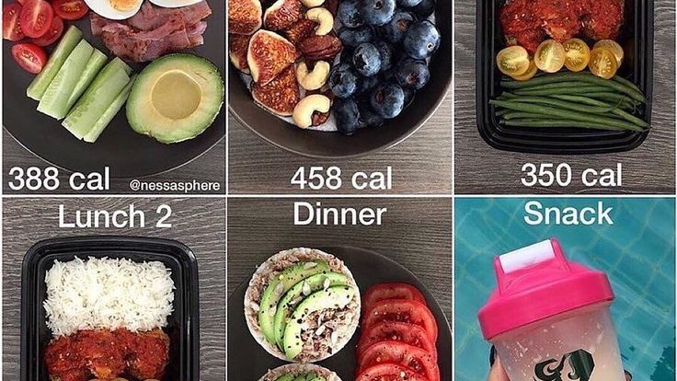
Meal Planner Application
- FINAL PROJECT
PRESENTED BY
Aishwarya v

Slide 2

Overview of Project
.
The purpose of the Meal Planner application is to create and maintain a database of Users Meal plan.
If the user wants to edit or update his calorie requirement for that day or choose another calorie intake recipes can click on start planning. The browser will display a collection of recipes and healthscore from the spoonacular api on the web.
Once the user finds recipes they want as per their calorie requirement in their meal planner, the user can print those recipes and save it.

Slide 3


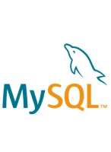


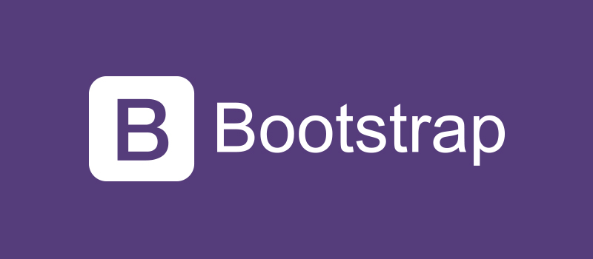

Technologies used

Slide 4
FINAL DemO
http://localhost:8080/

Slide 5


