Slide 1
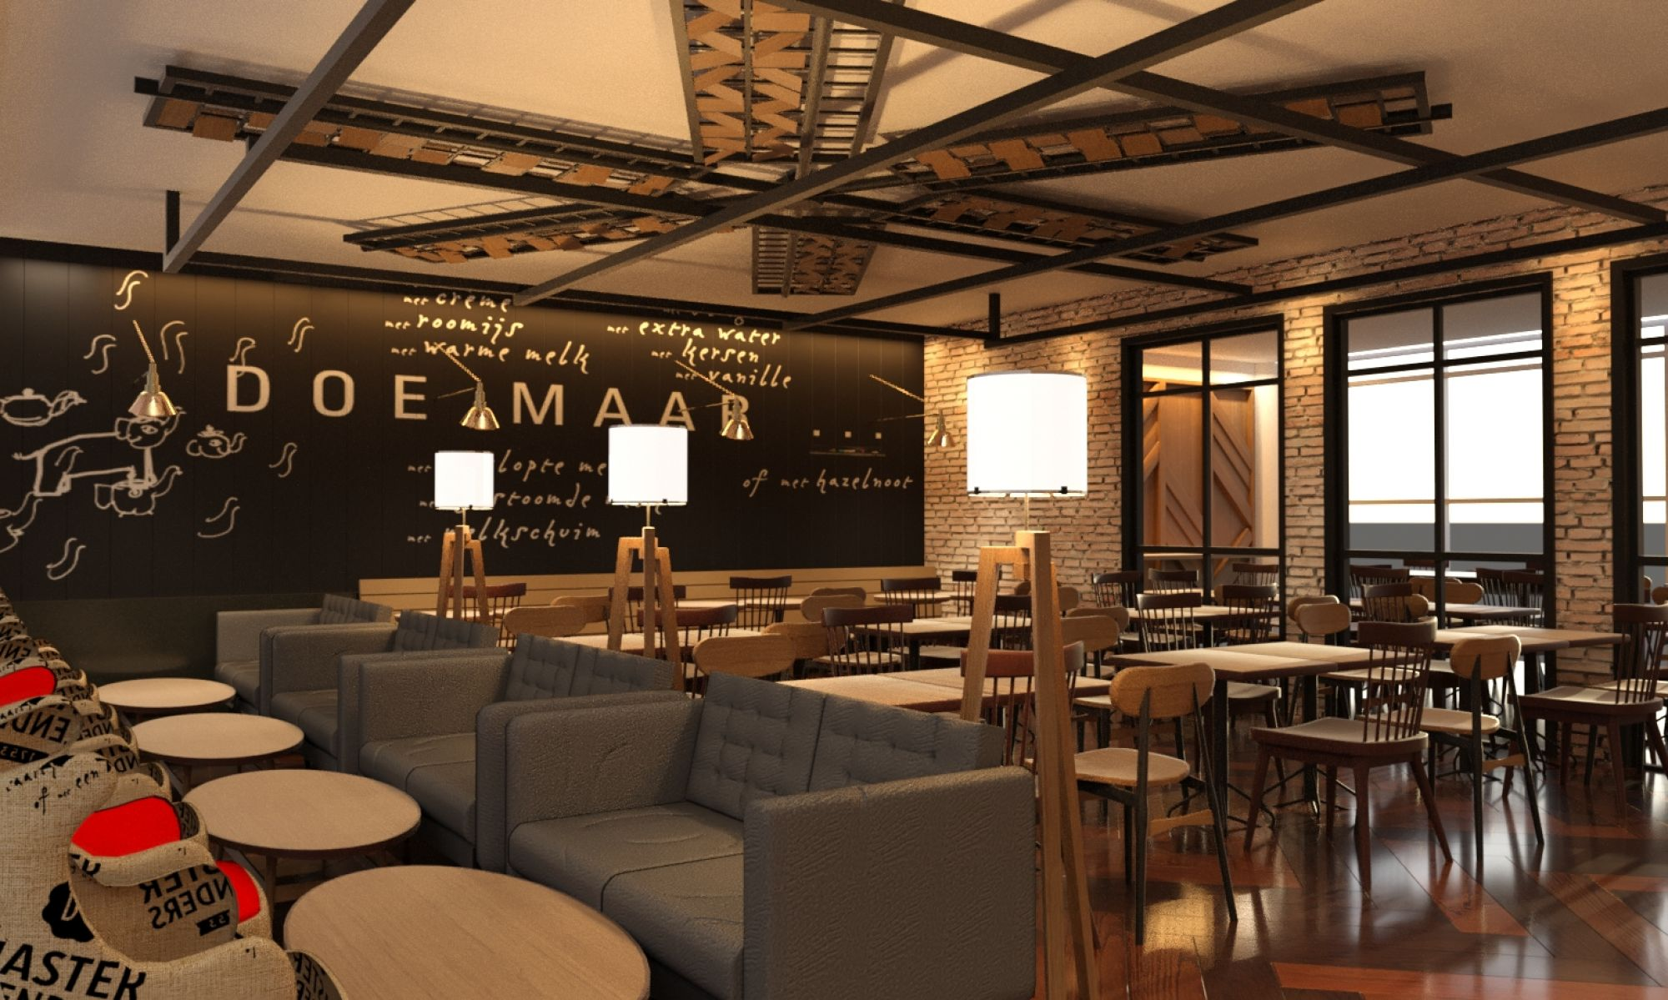
Final Project - Venue Explorer
Jay Kye

Slide 2








Technologies Used

Slide 3
Demo
http://localhost:8080/

Slide 4
Features for Version 2.0
Implement Google Map
Implement “Premium” API endpoints
Improve on Front end

Slide 5
Q & A

