Slide 1
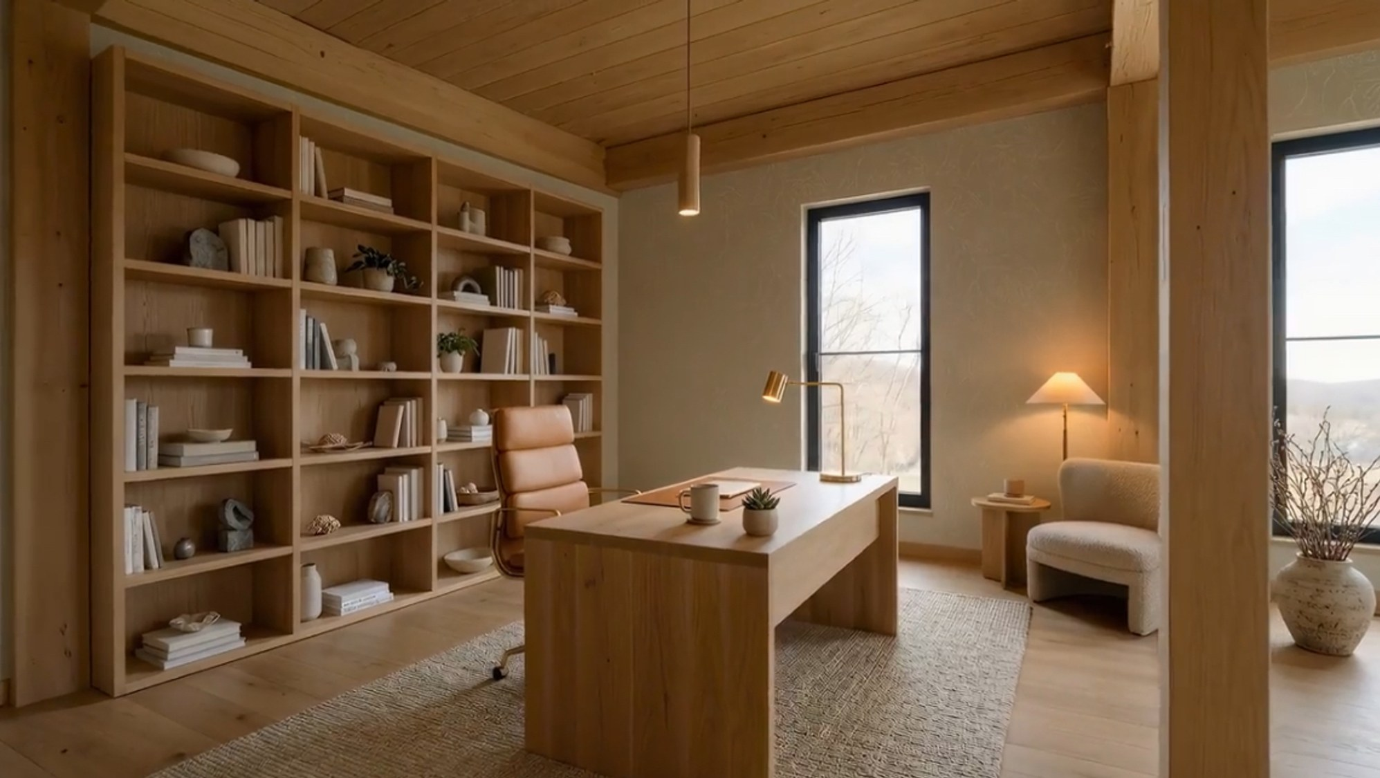
A RARE ESTATE OPPORTUNITY · ARRINGTON, TENNESSEE
2495 Deer Meadow Lane
8.79 private acres · a modern Scandinavian retreat · room to build your estate
$2,700,000 Offered by The Stonehouse Company · Compass

Slide 2
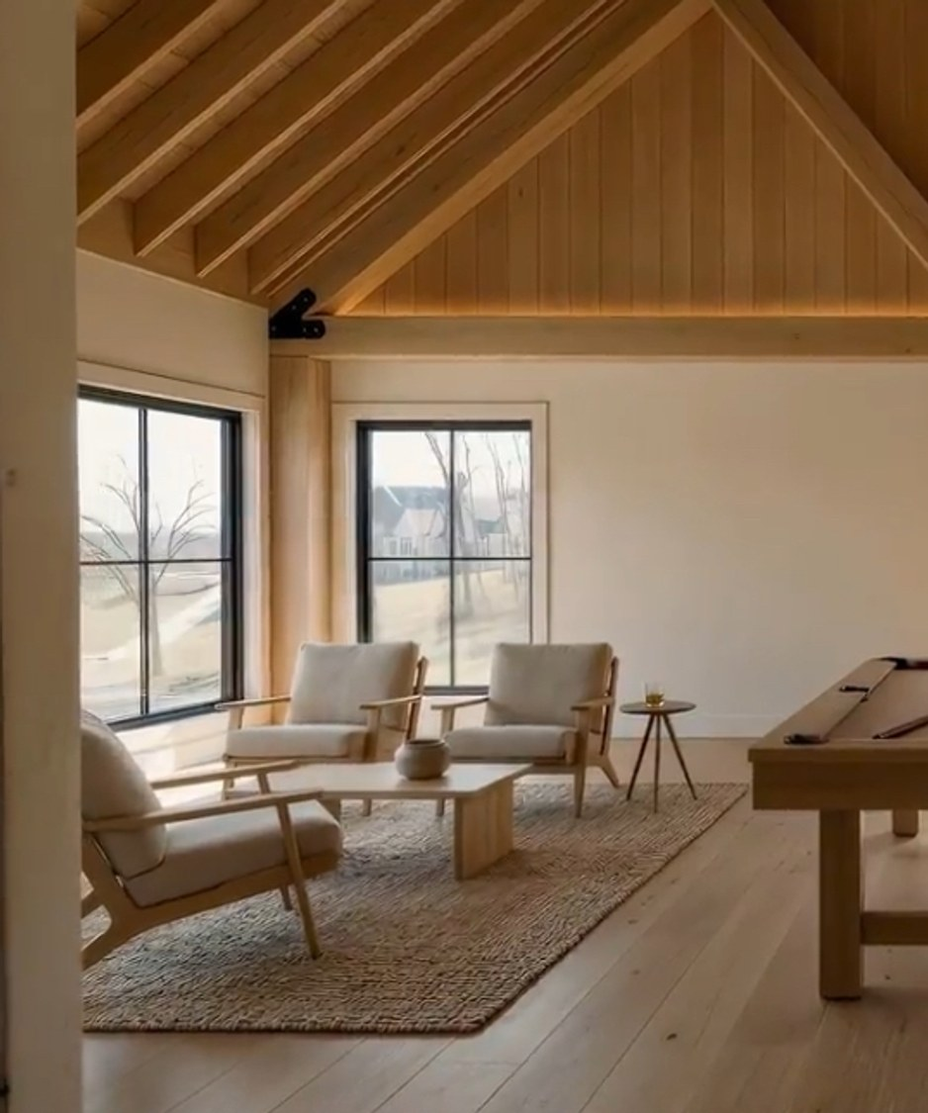
THE OPPORTUNITY
The final homesite in an
enclave of $8M+ estates
Set in the wooded hills of Arrington, this 8.79-acre tract is the last remaining canvas within a private community of custom estates valued at $8 million and above — a level of scarcity that rarely reaches the open market.
8.79
ACRES OF PRIVATE LAND
$8M+
SURROUNDING ESTATE VALUES
2026
NEW SCANDINAVIAN BUILD ON SITE
THE STONEHOUSE COMPANY
2495 DEER MEADOW LANE · ARRINGTON, TN

Slide 3
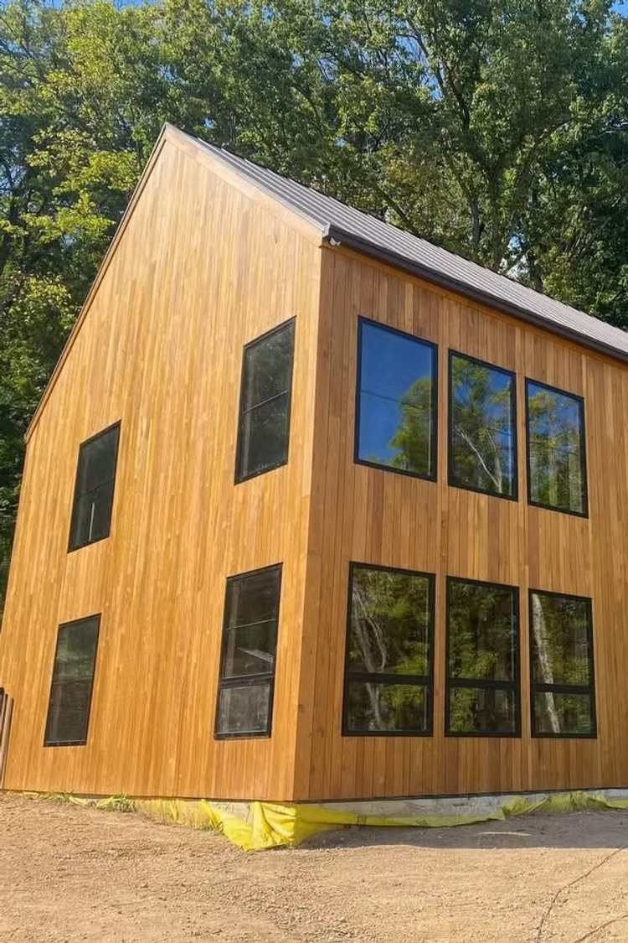
AT A GLANCE
Property overview
8.79 AC
3,000 SF
Lot size (382,892 SF)
Barndominium residence
3 BD / 1.5 BA
Built 2026
Plus 2nd-floor bonus room
New construction
Williamson Co.
Septic
Top-rated school district
Serviced & build-ready
THE STONEHOUSE COMPANY
2495 DEER MEADOW LANE · ARRINGTON, TN

Slide 4
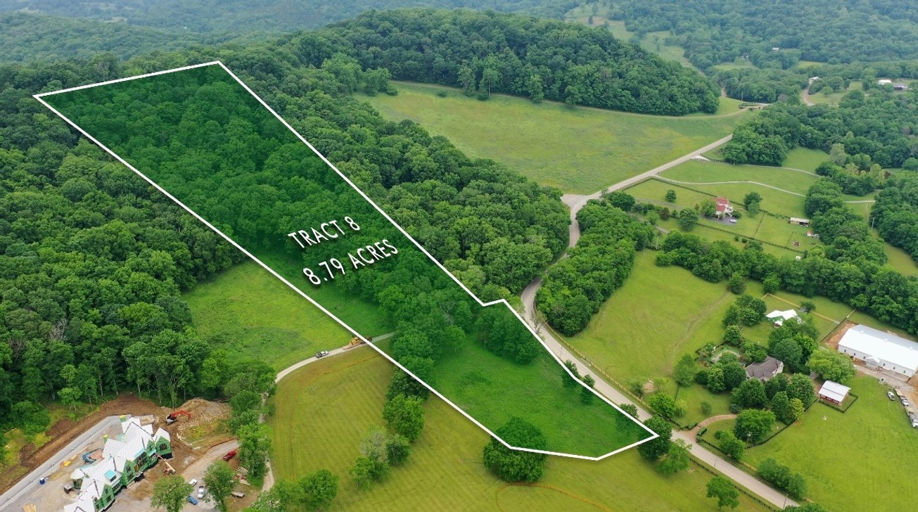
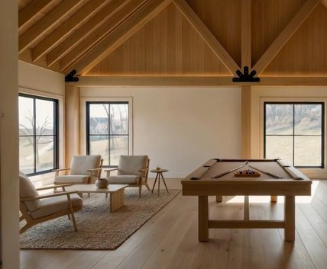
THE LAND
8.79 acres in the hills of Arrington
A quiet, wooded canvas. Rolling topography and mature tree cover on a private street — space to build, entertain, and retreat, all inside prestigious Williamson County.
THE STONEHOUSE COMPANY
2495 DEER MEADOW LANE · ARRINGTON, TN

Slide 5
THE RESIDENCE
A Scandinavian-style barndominium
3,000 sq. ft. of clean, modern design — three bedrooms, a full kitchen, and a soaring second-floor bonus room. Live on-site in comfort while your main estate takes shape, or keep it as a private high-end retreat.

Slide 6
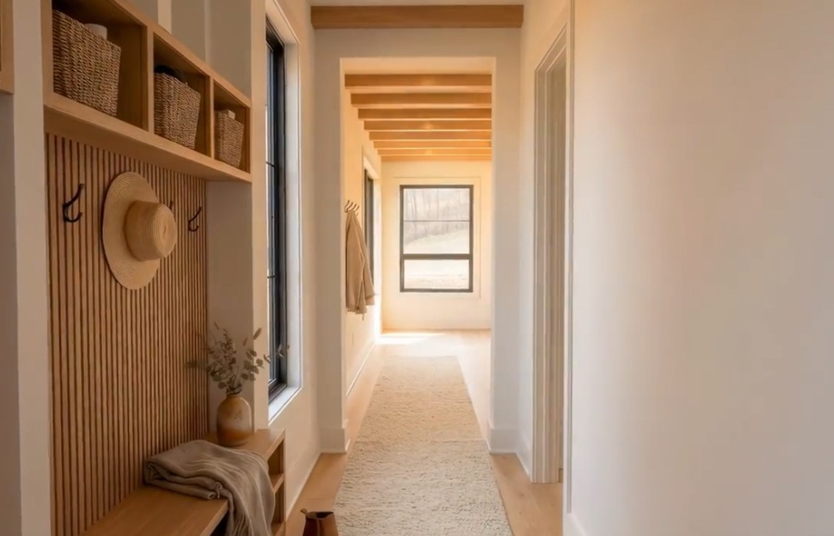
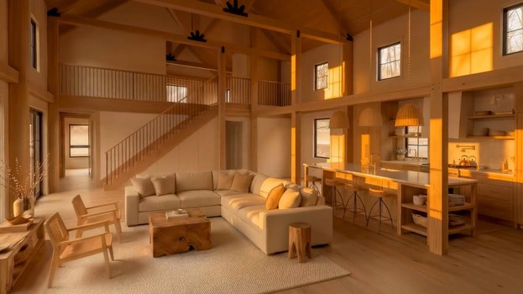
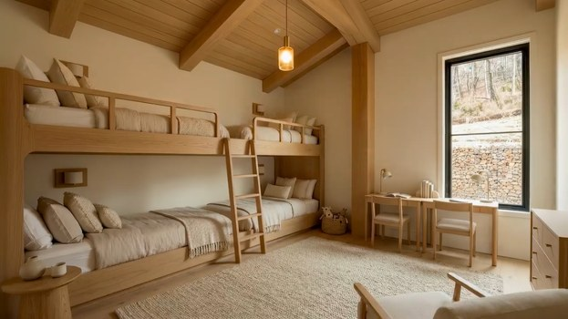
INTERIORS
Warm, minimal, light-filled
THE STONEHOUSE COMPANY
Interior images are artist's renderings for illustrative purposes only.

Slide 7
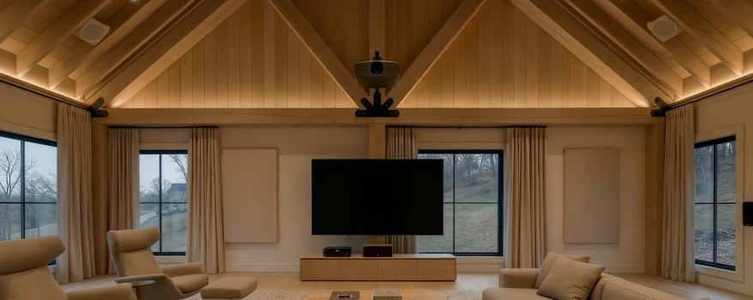
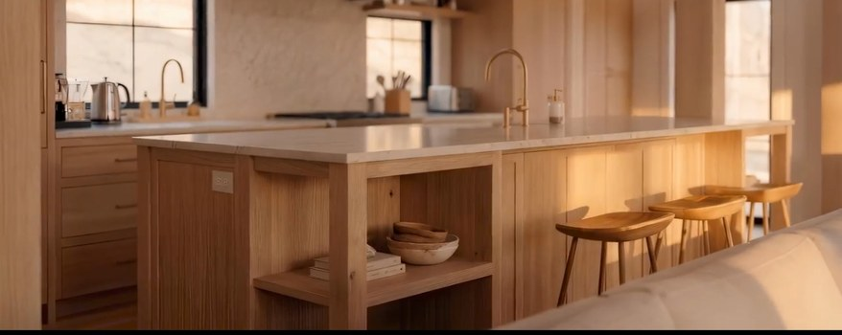
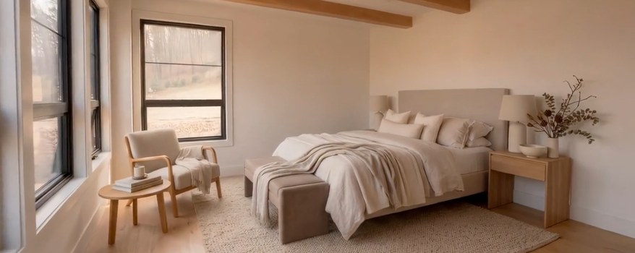
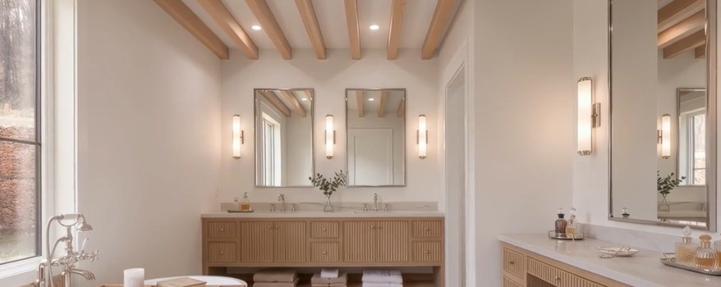
INTERIORS
Every room considered
THE STONEHOUSE COMPANY
Interior images are artist's renderings for illustrative purposes only.

Slide 8
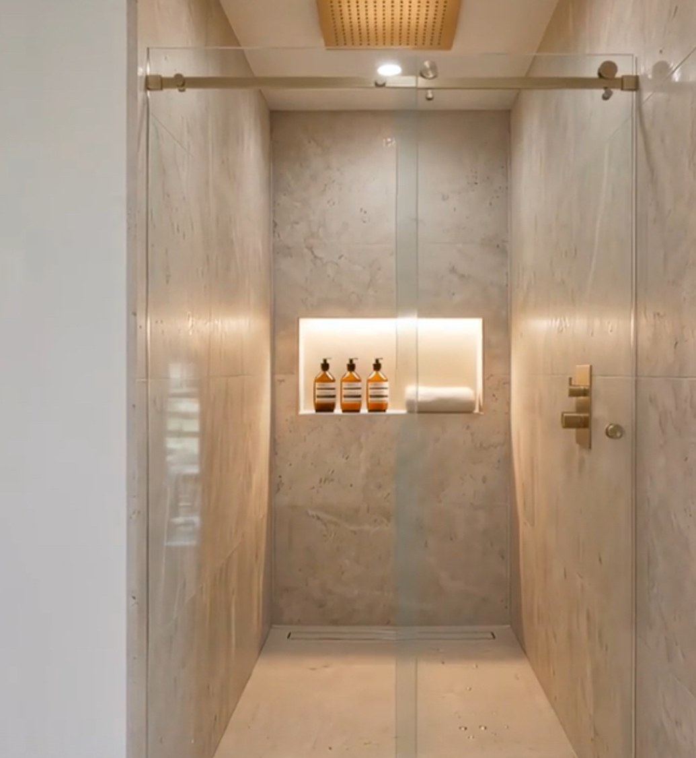
FLEXIBLE BY DESIGN
A bonus level built for how
you actually live
Recording studio
Acoustically ideal, private second-floor volume
Golf simulator
Height and footprint for a full swing bay
3-car garage
Convert the structure for luxury vehicle storage
In-law suite
A self-contained private residence for guests
THE STONEHOUSE COMPANY
2495 DEER MEADOW LANE · ARRINGTON, TN

Slide 9
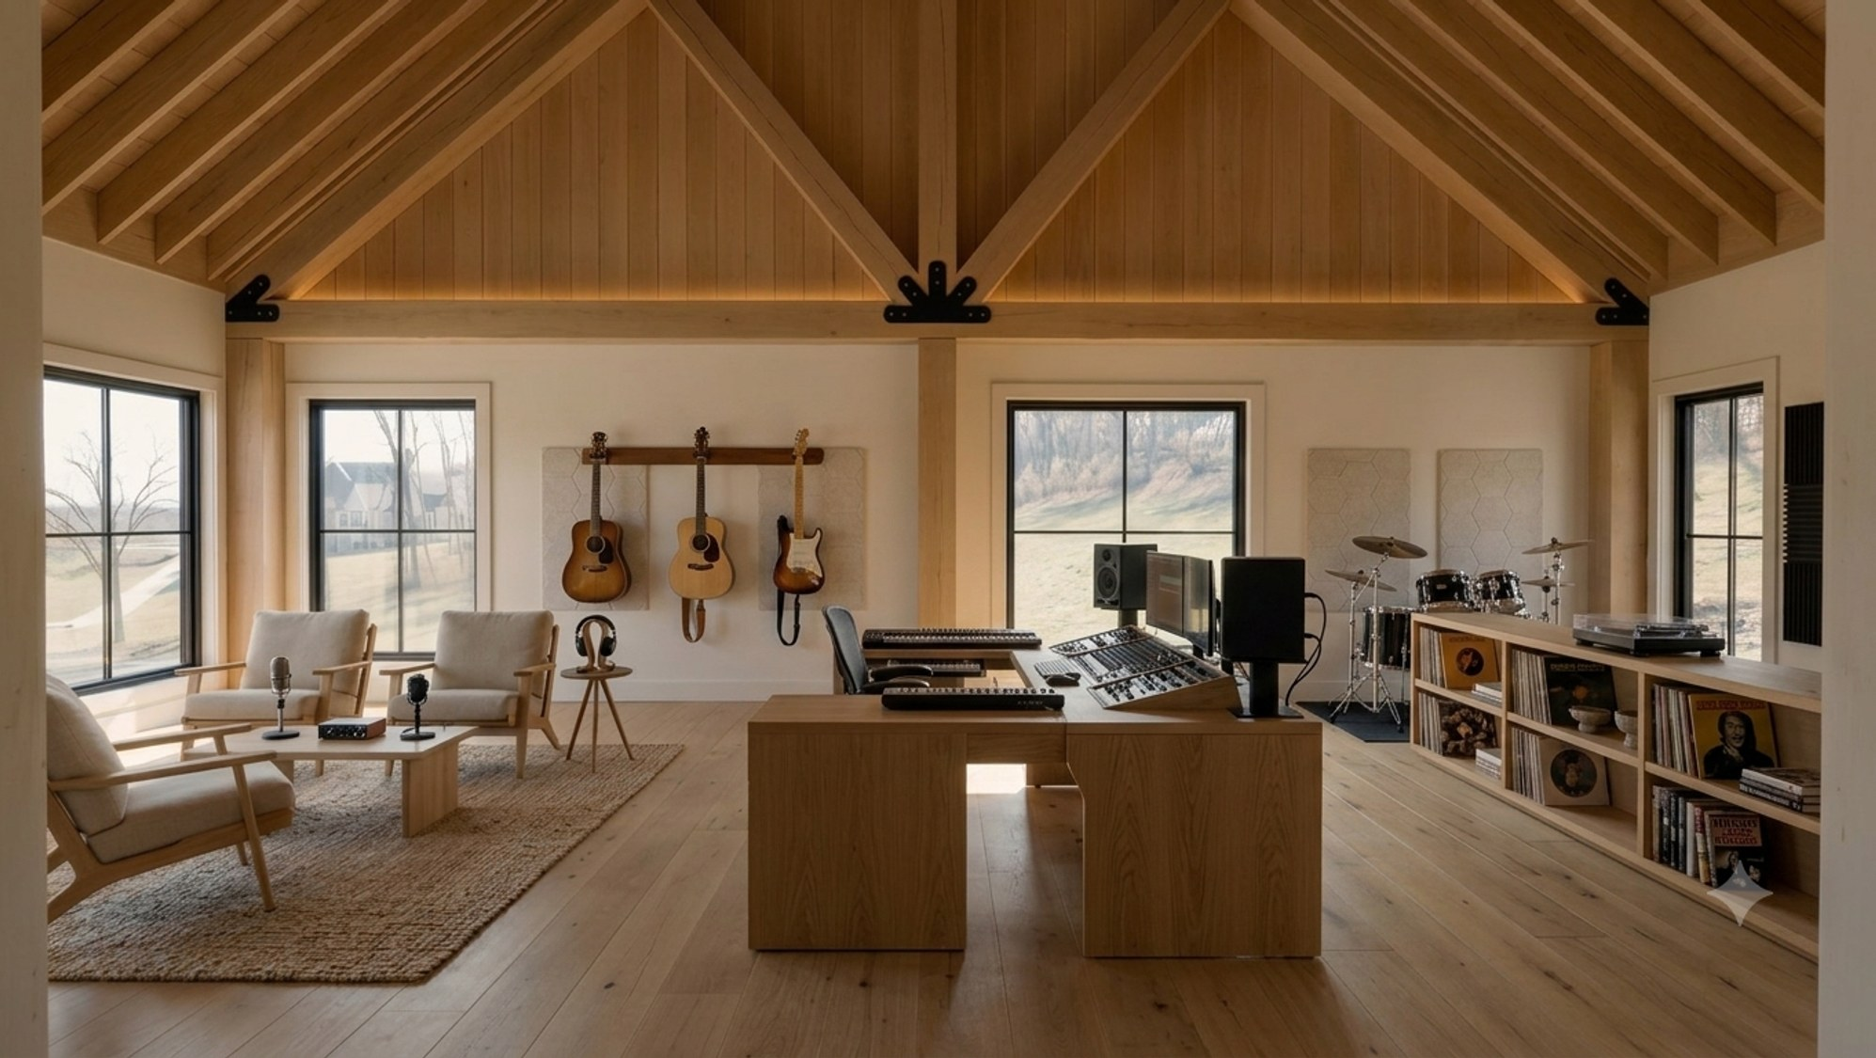
THE BONUS LEVEL
A recording studio,
built in
The soaring second-floor volume is tailor-made for music — wood-lined for warmth, filled with natural light, and sized to track, mix, and unwind.
Vaulted timber acoustics
Warm, wood-lined room with height to spare
Track, mix & produce
Room for a full console, monitors, and live takes
Listening lounge
Instruments, seating, and a vinyl corner
Interior images are artist's renderings for illustrative purposes only.

Slide 10
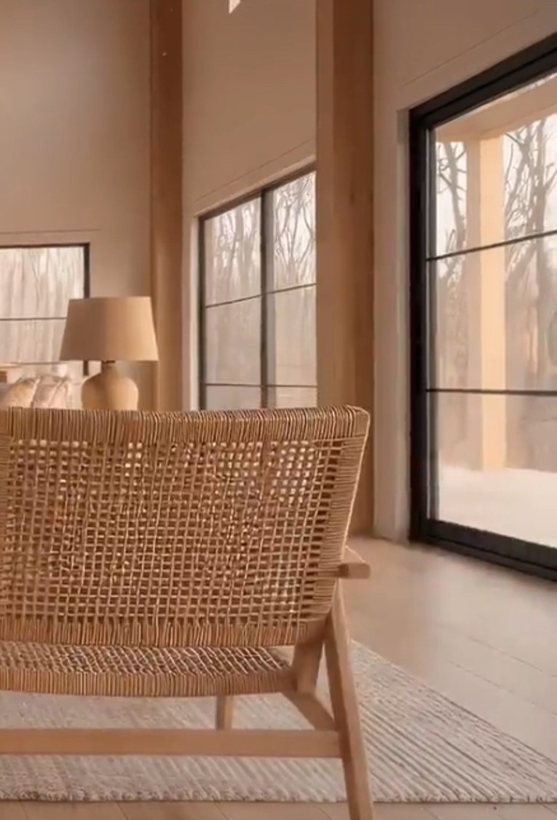
FUTURE POTENTIAL
Build the estate you
have in mind
The site is prepared and build-ready for a custom 4-bedroom, 3-bath residence — equally suited to a modern-minimal or an organic European estate aesthetic.
Live while you build
Occupy the barndominium and oversee construction on-site
A blank canvas
8.79 acres to site your home, pool, and outbuildings
Instant pedigree
Enter a proven $8M+ enclave from day one
THE STONEHOUSE COMPANY
2495 DEER MEADOW LANE · ARRINGTON, TN

Slide 11
THE DESIGN NARRATIVE
The Design Vision
A curated narrative for the estate — exterior elevations, interiors, landscape,
and the material and fixture selections that define it.
THE STONEHOUSE COMPANY
2495 DEER MEADOW LANE · ARRINGTON, TN

Slide 12
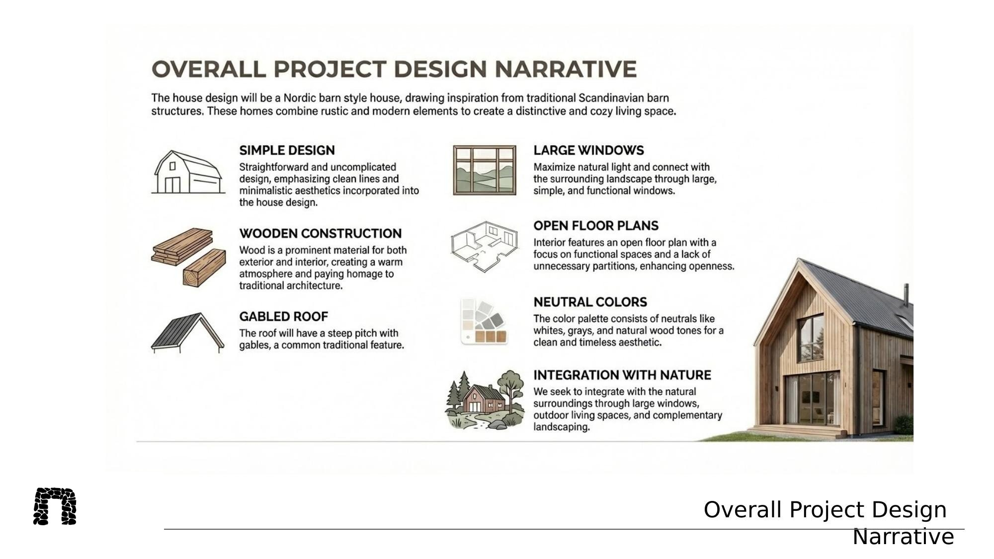

Slide 13
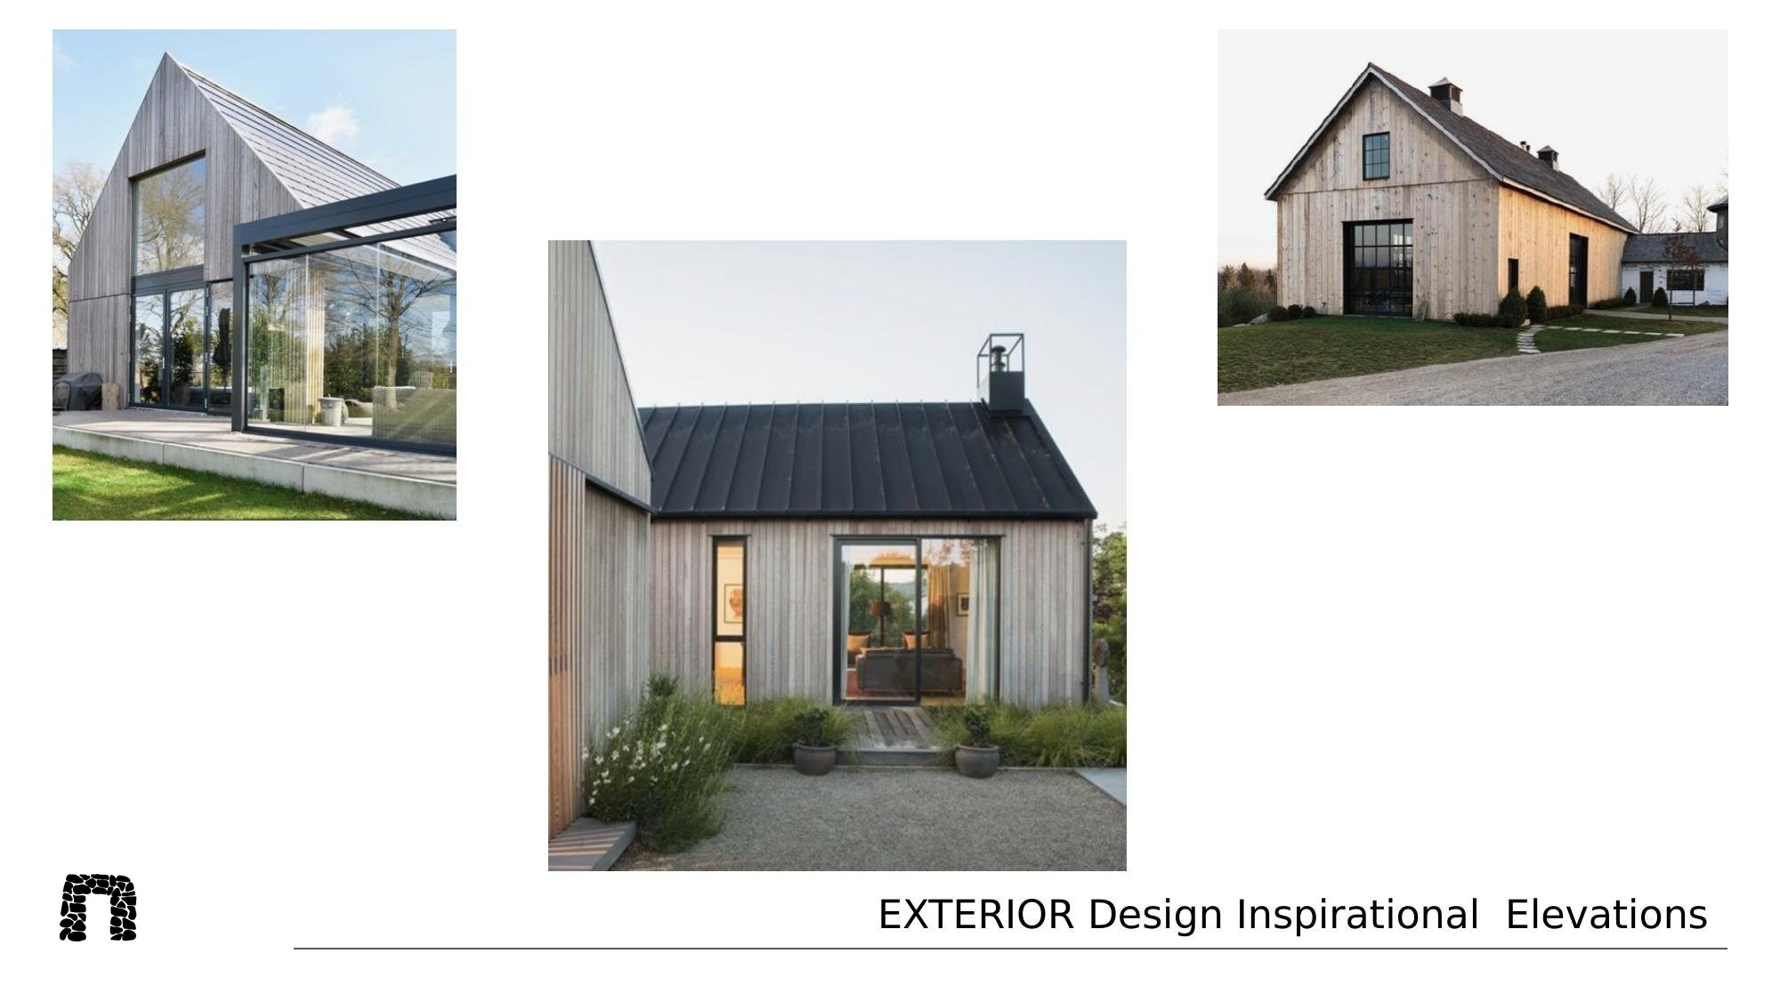

Slide 14
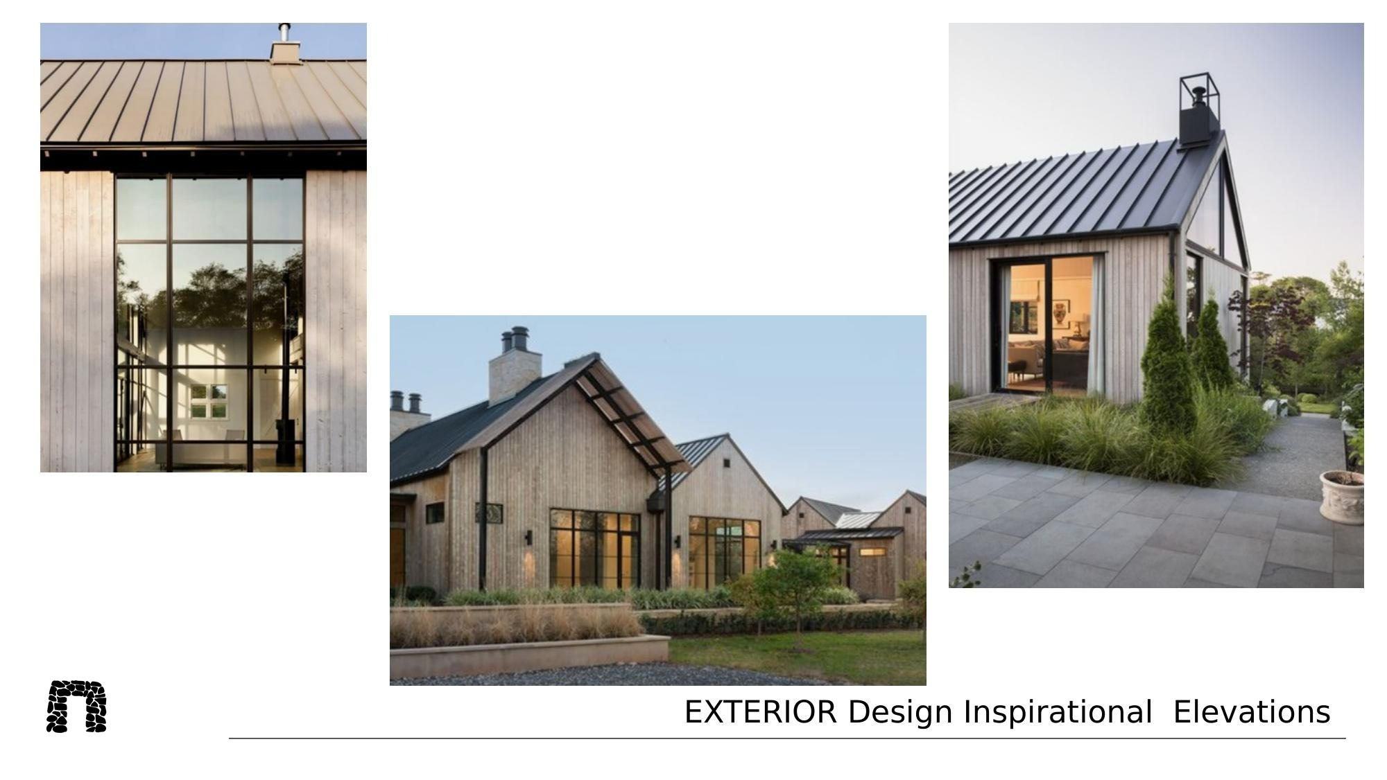

Slide 15
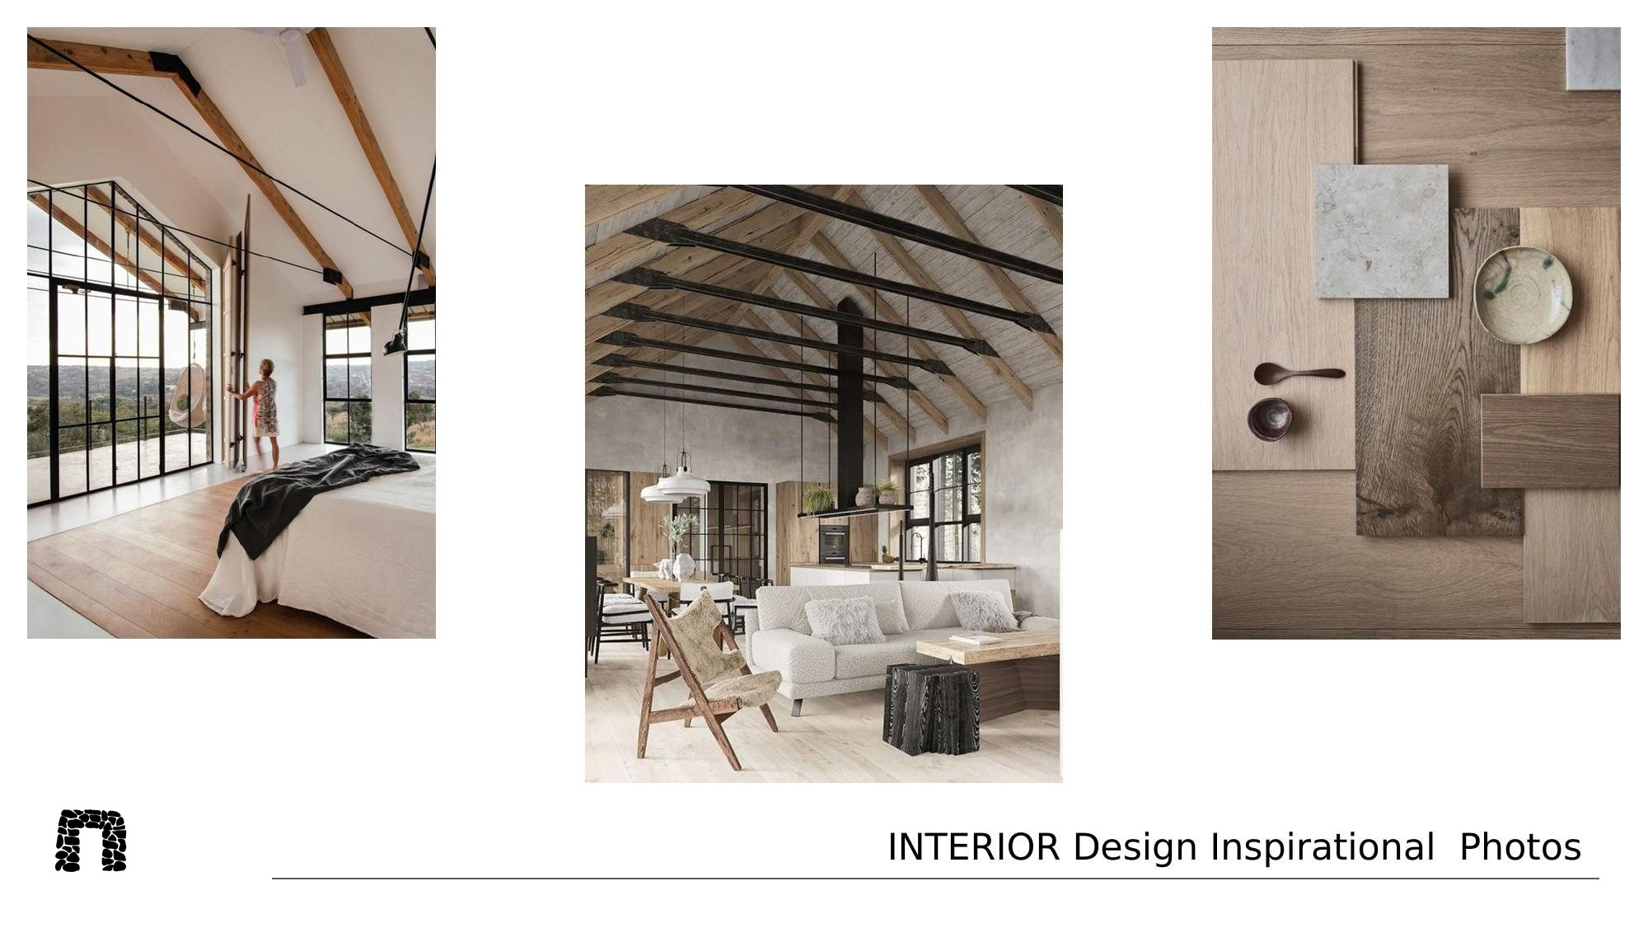

Slide 16
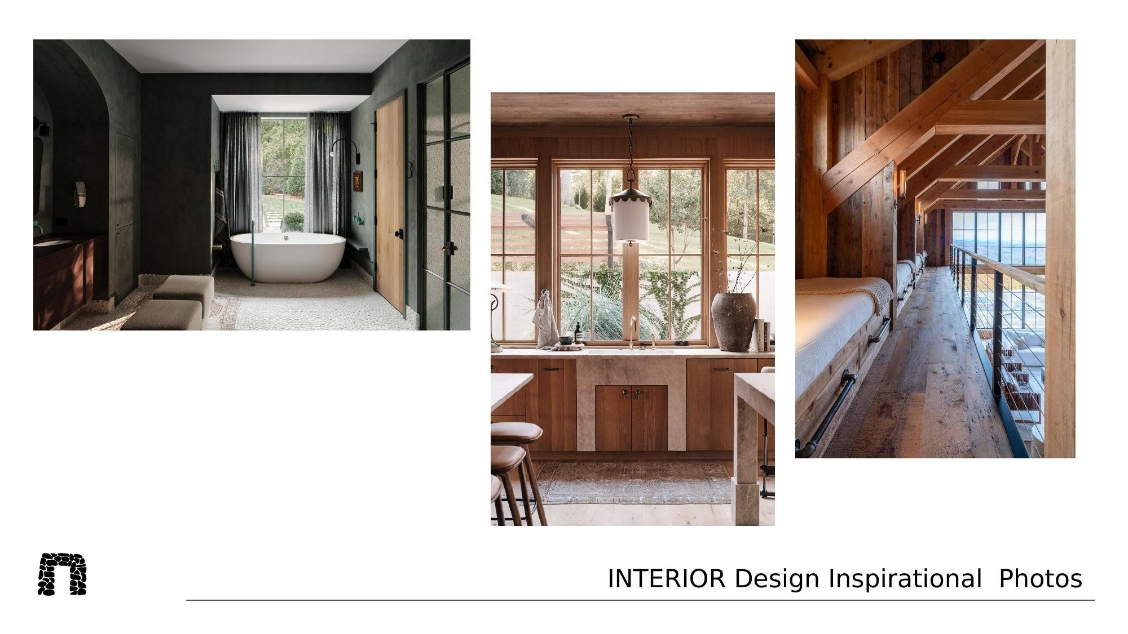

Slide 17
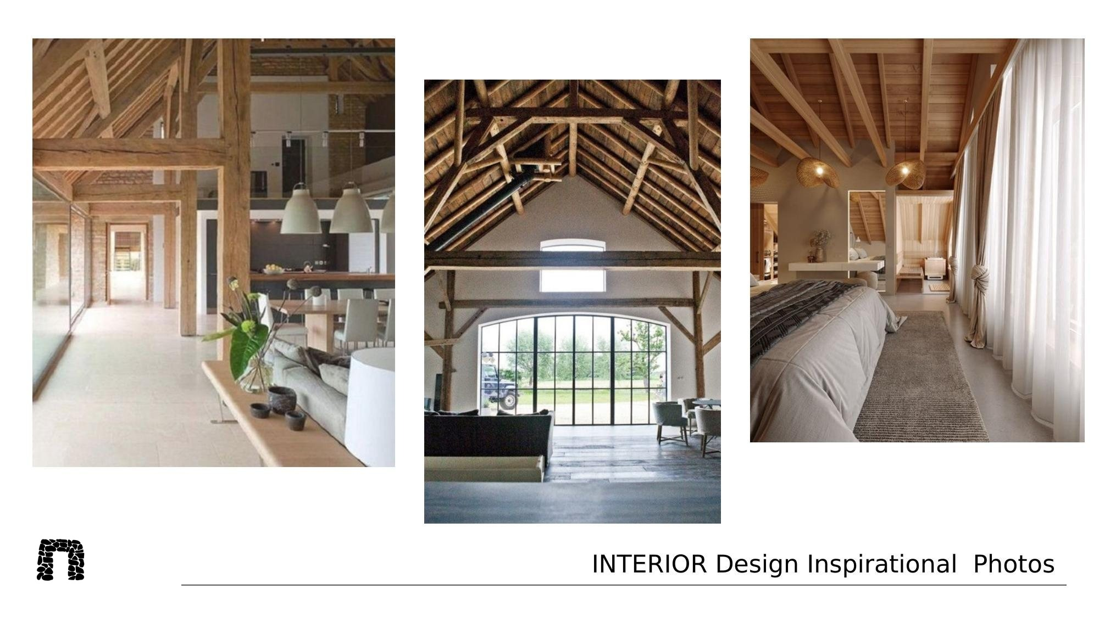

Slide 18
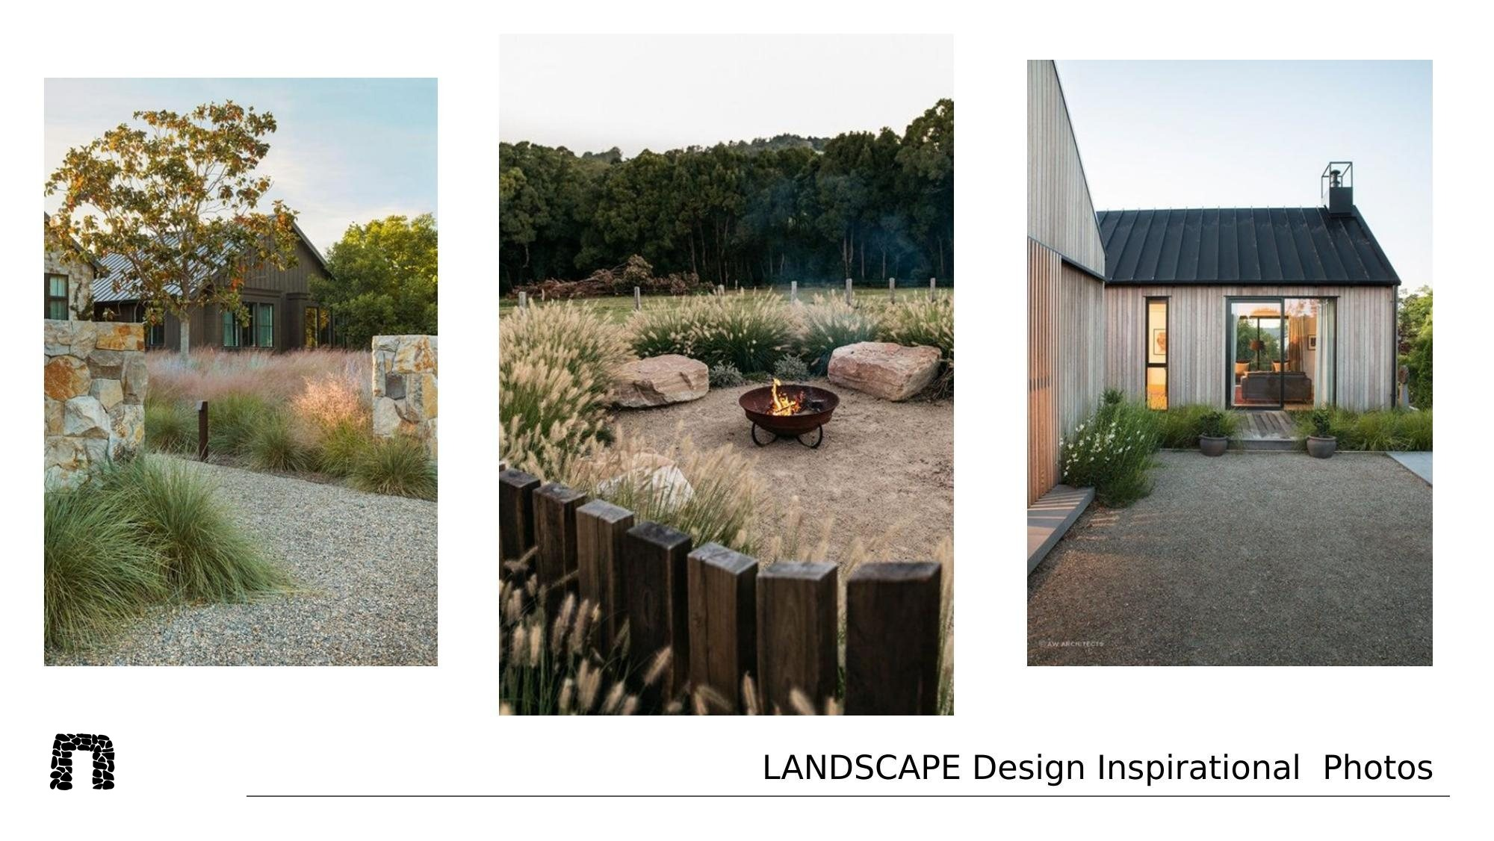

Slide 19
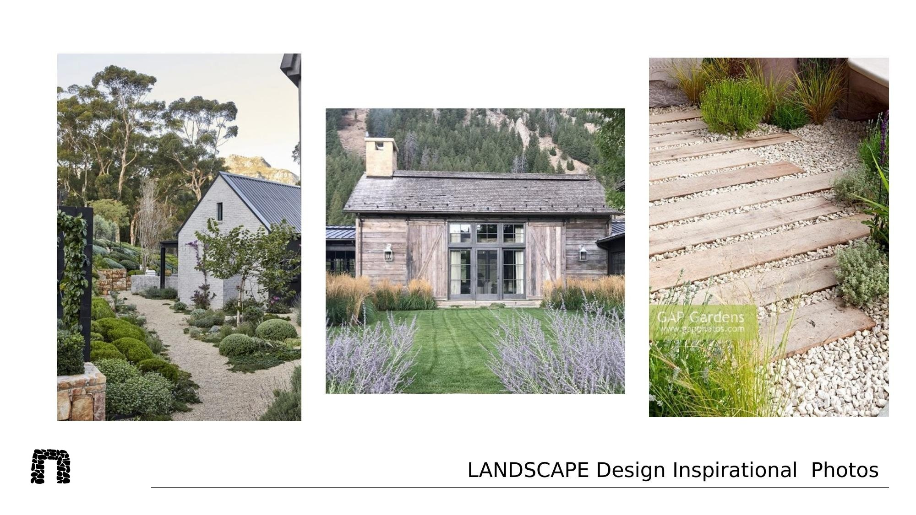

Slide 20
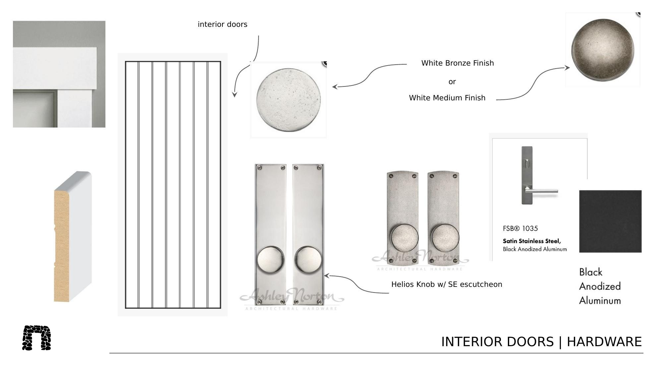

Slide 21
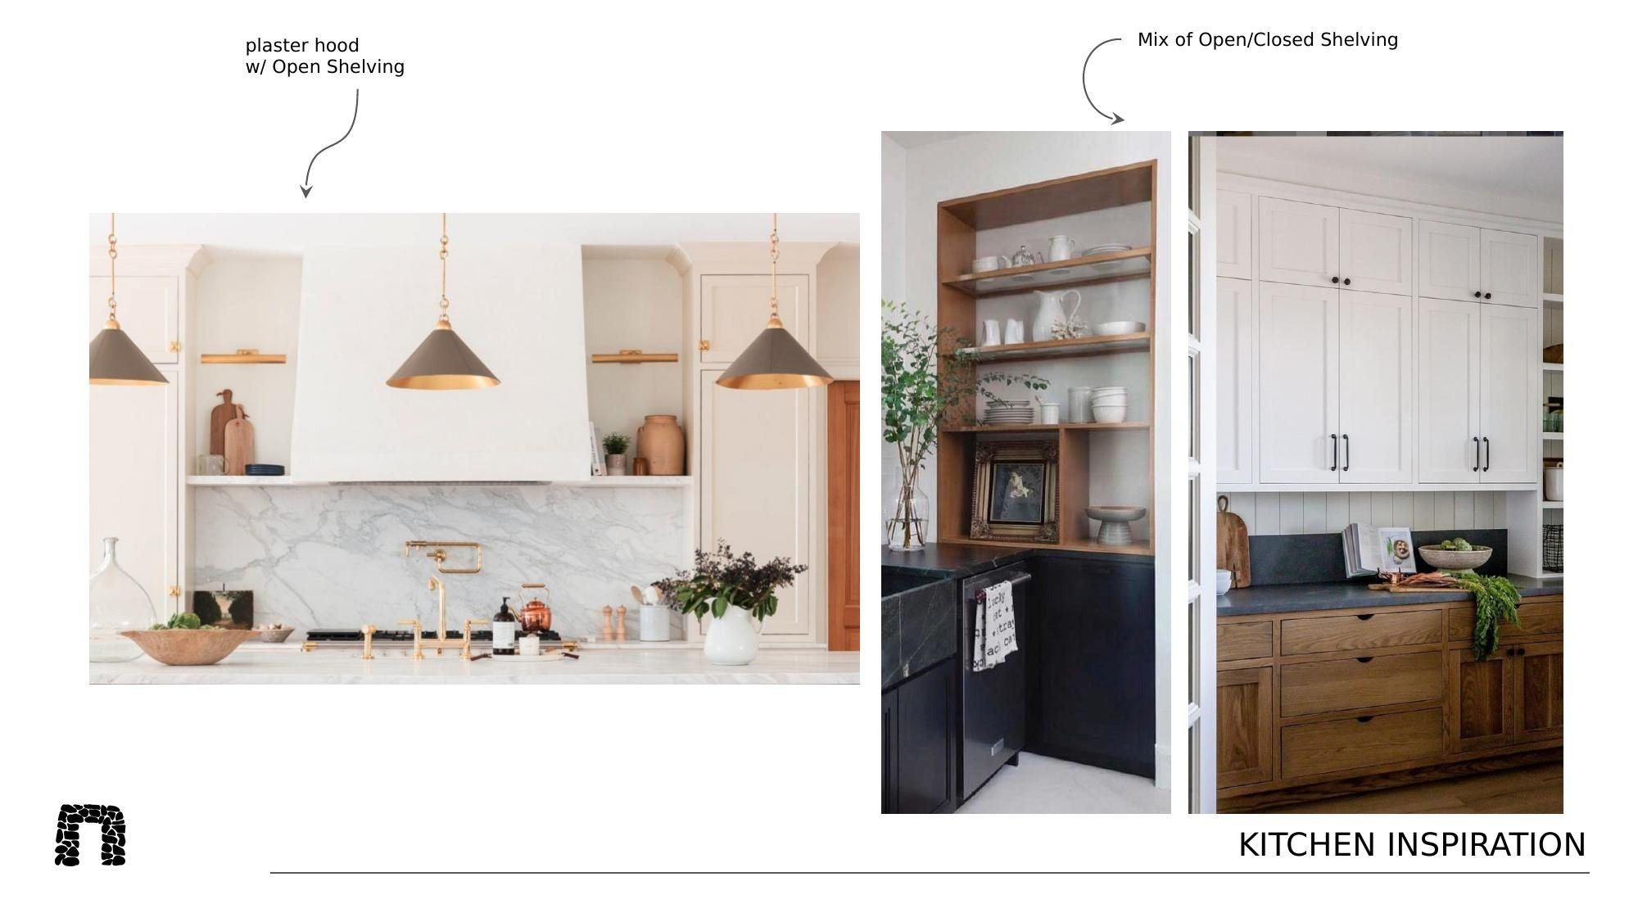

Slide 22
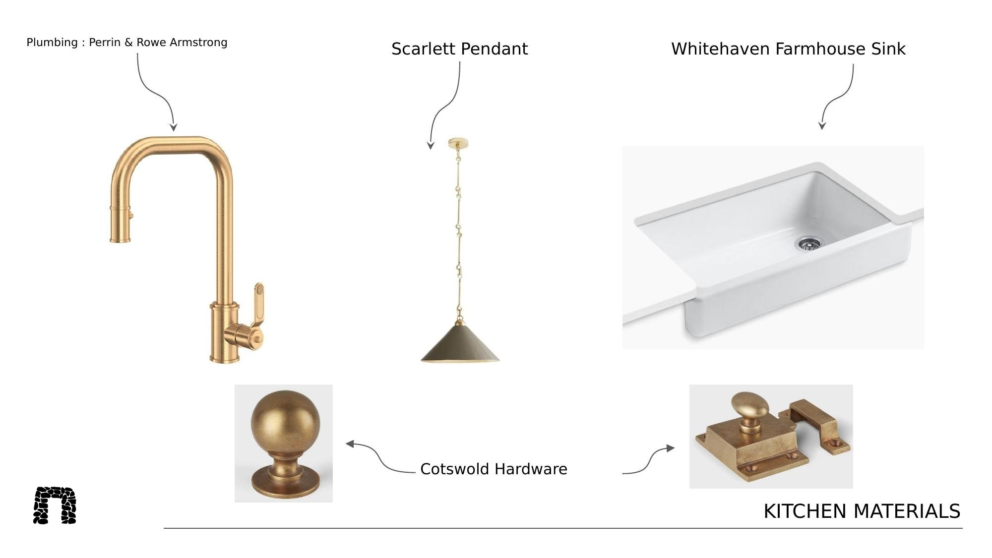

Slide 23
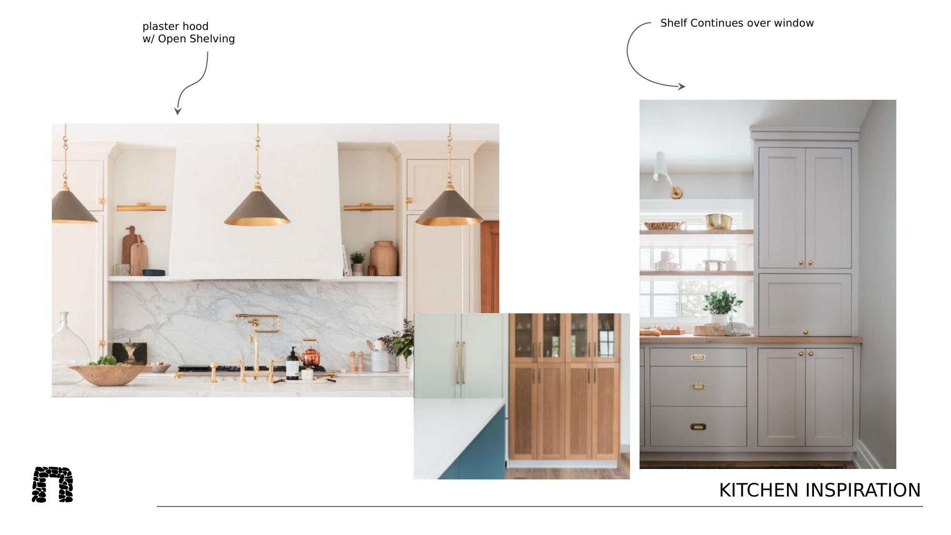

Slide 24
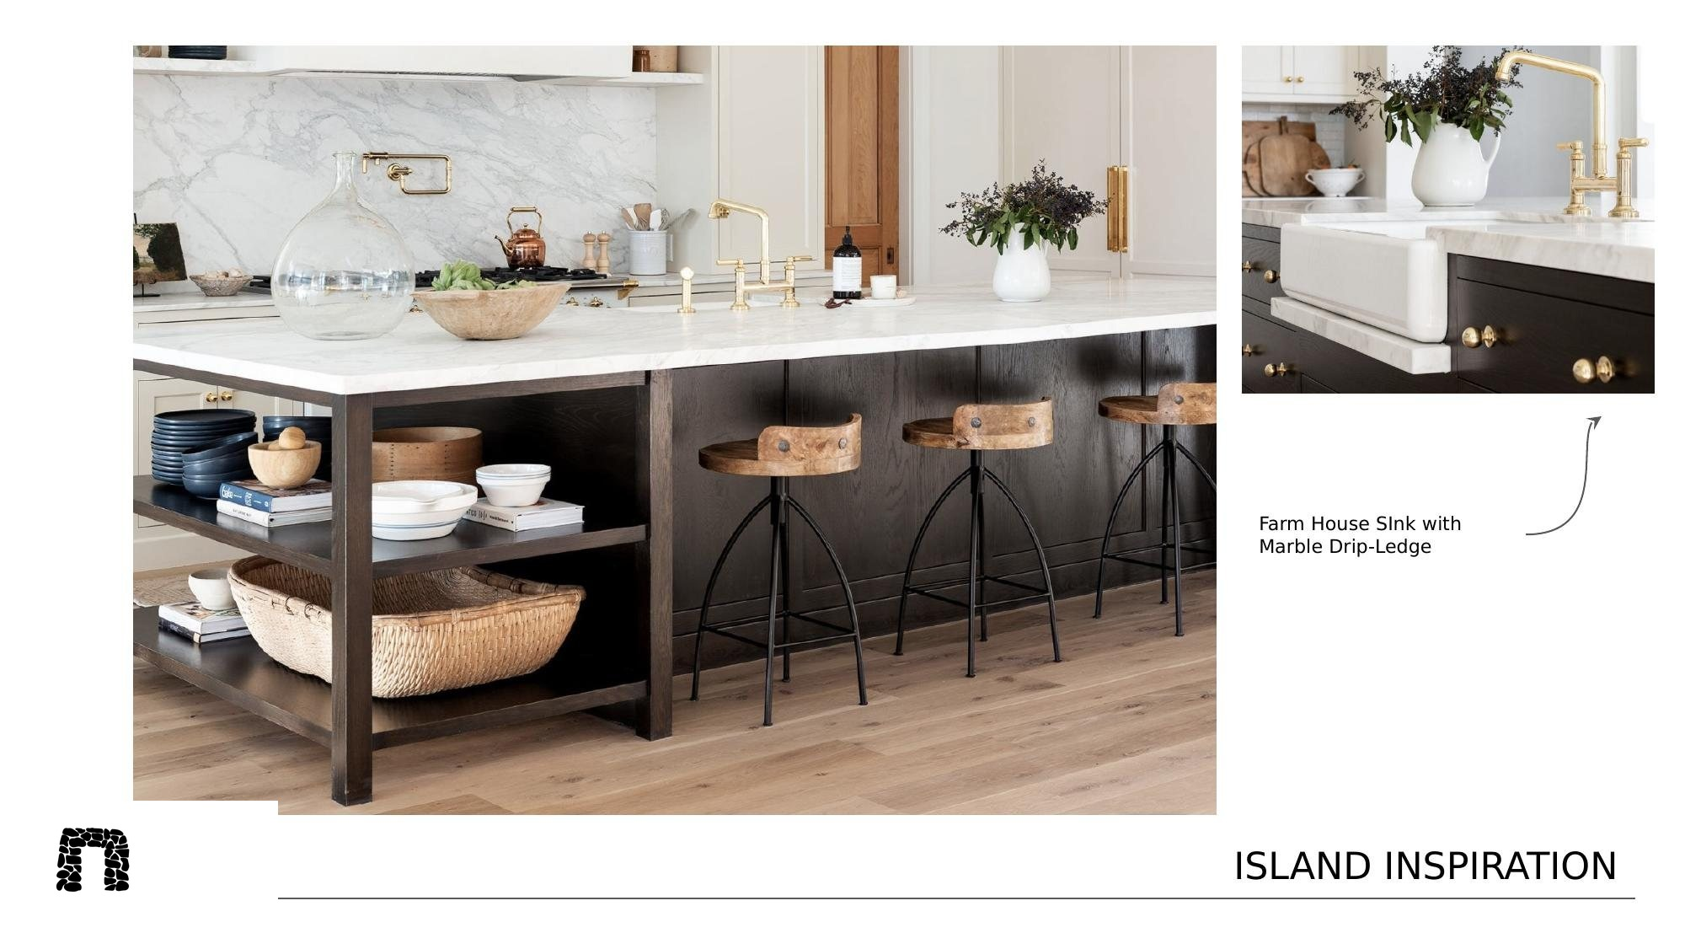

Slide 25
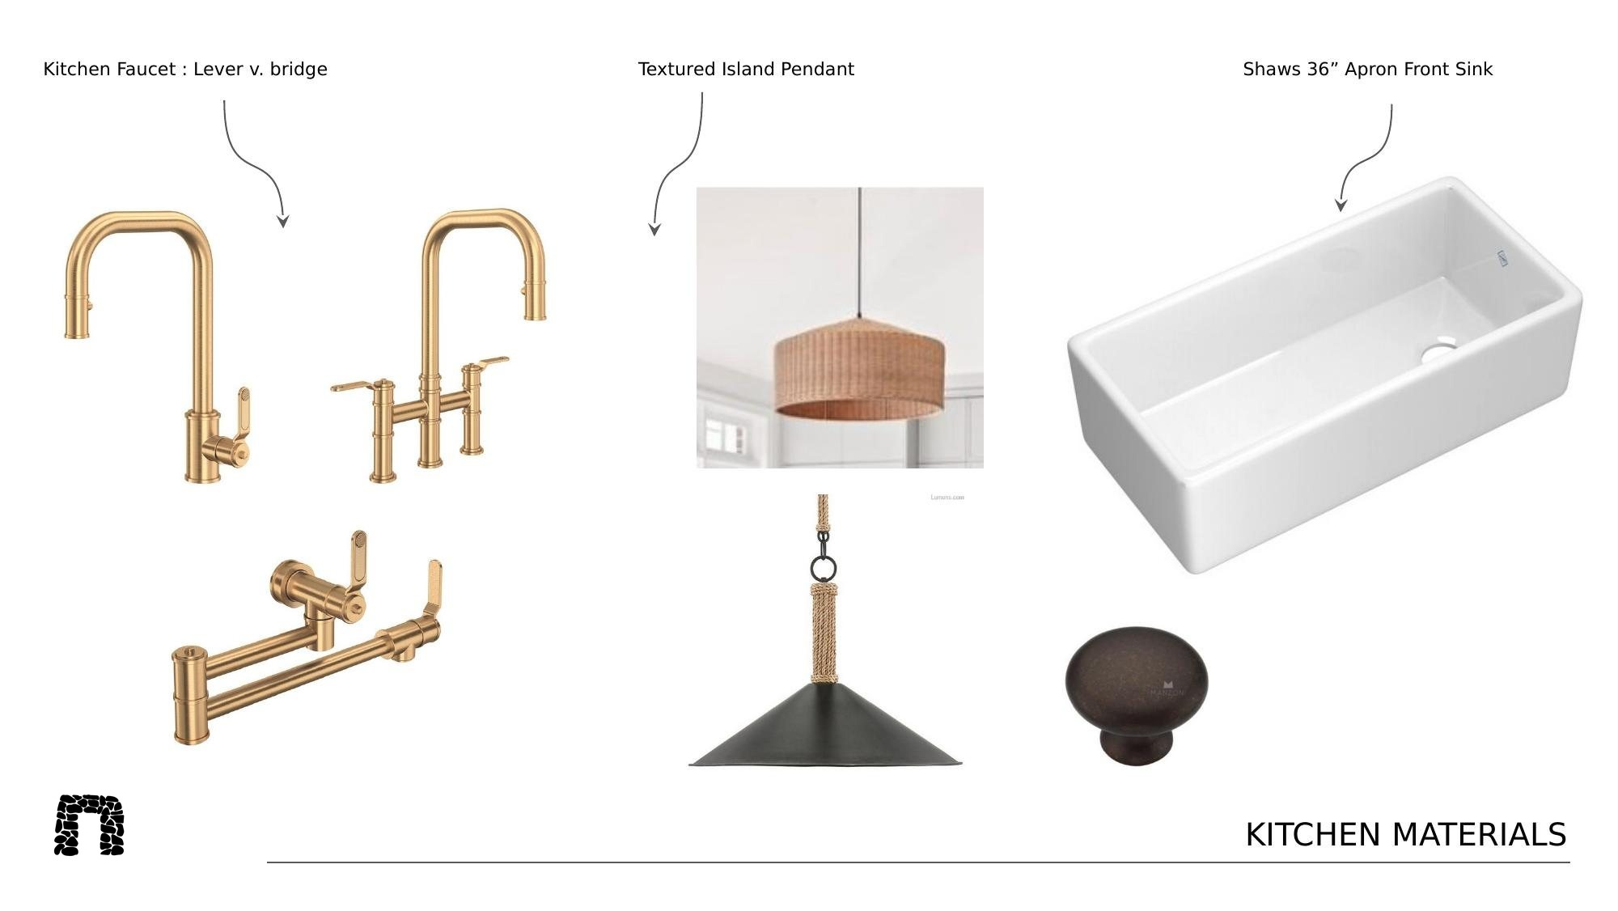

Slide 26
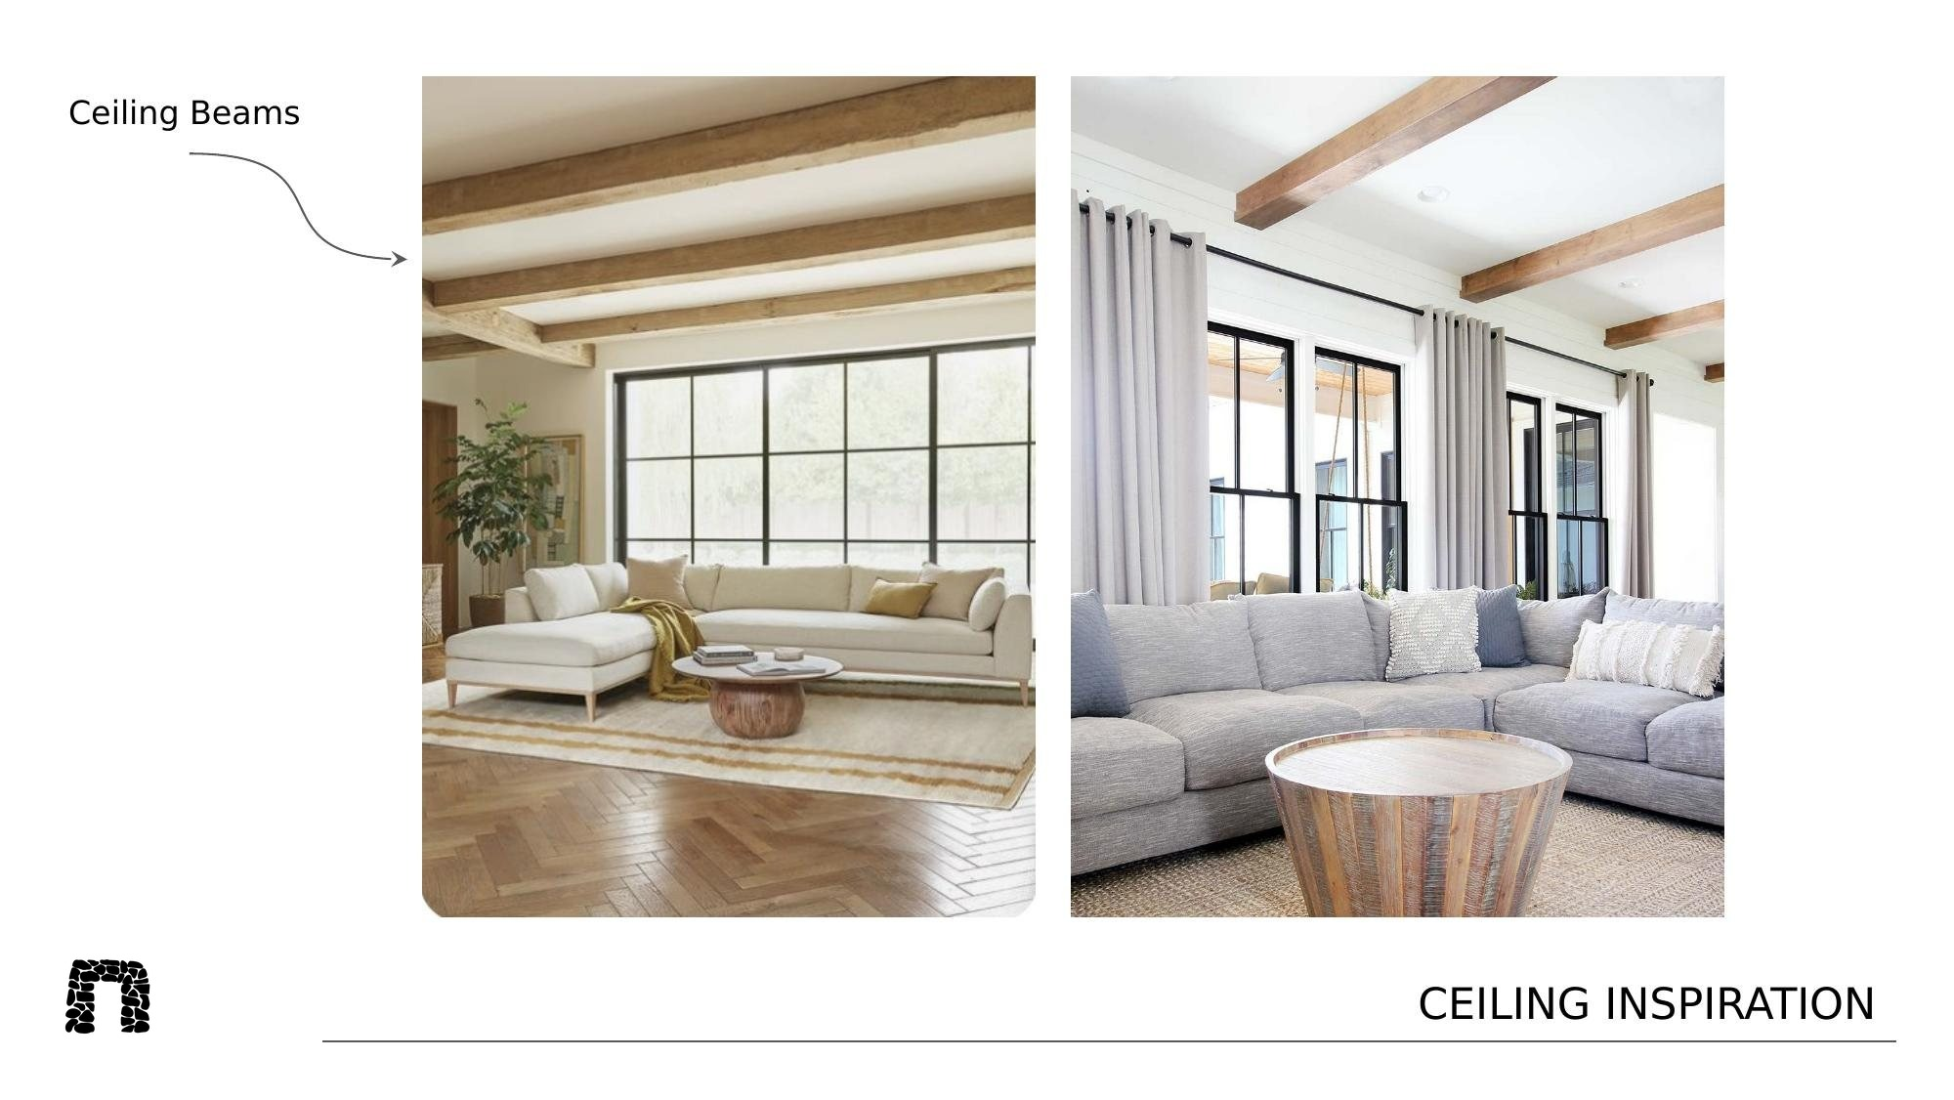

Slide 27
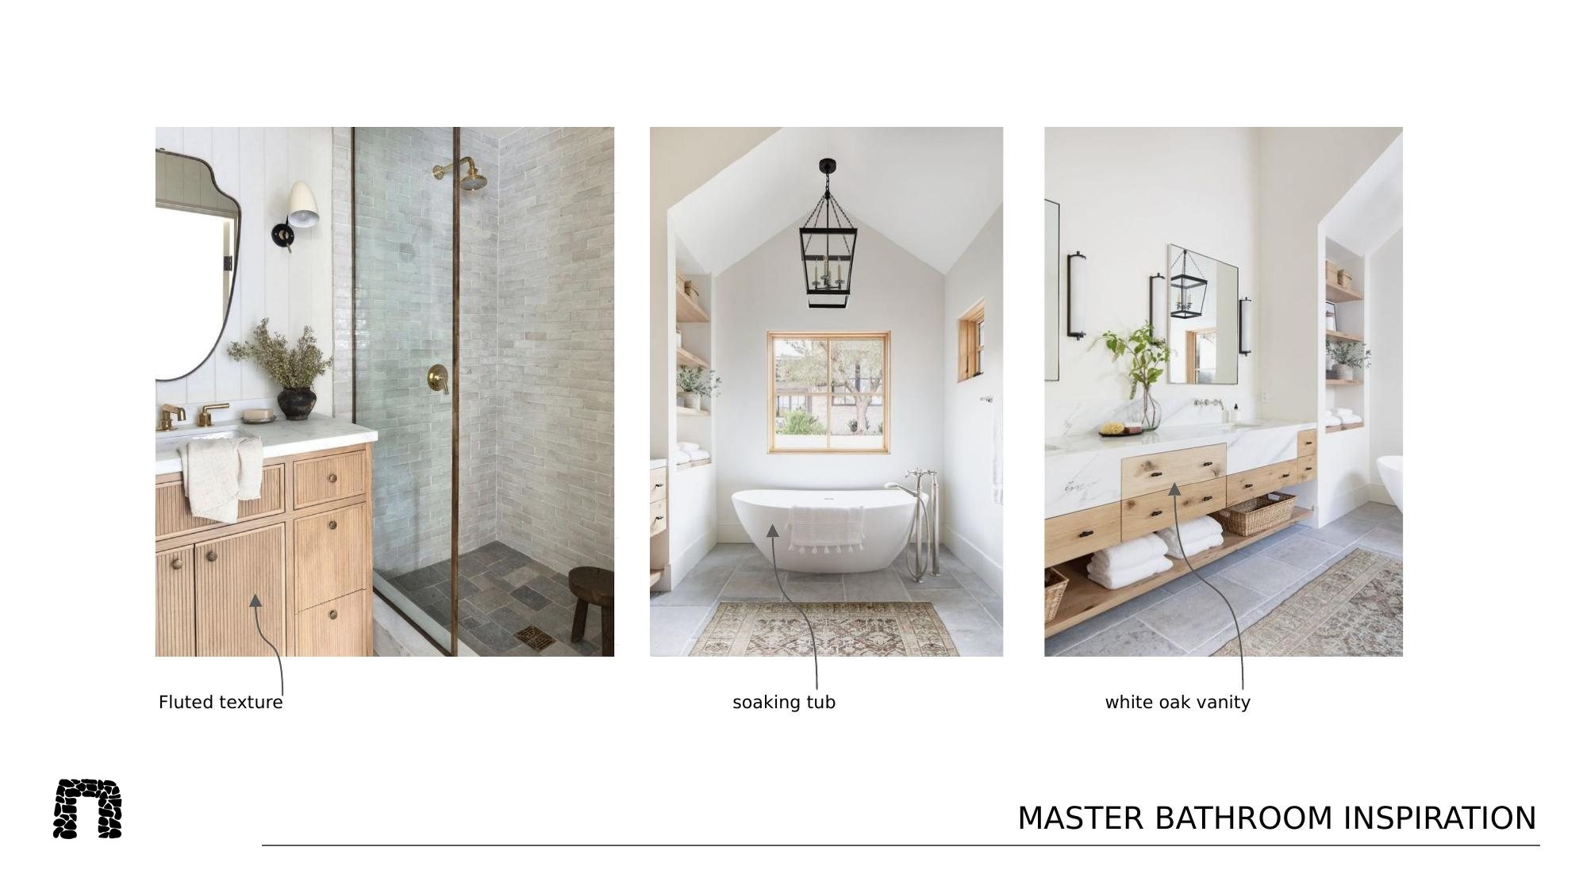

Slide 28
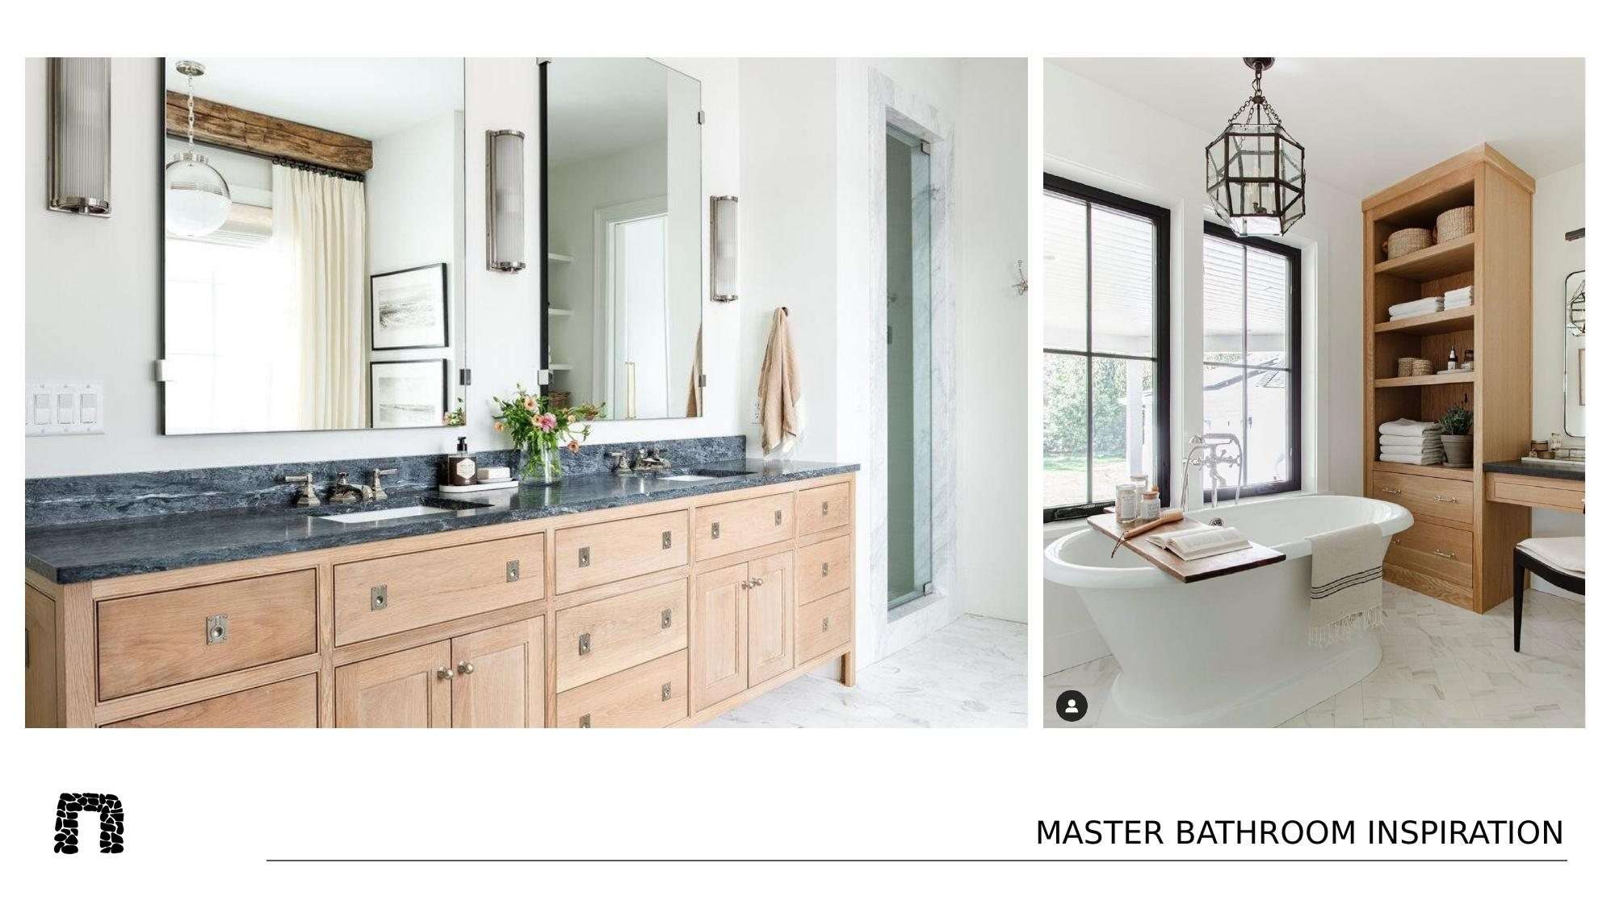

Slide 29
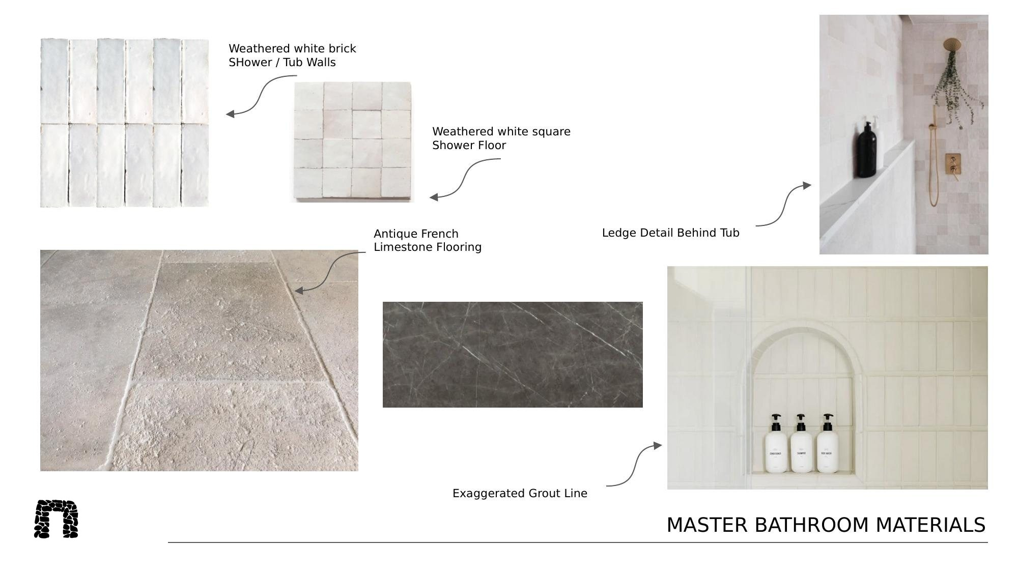

Slide 30
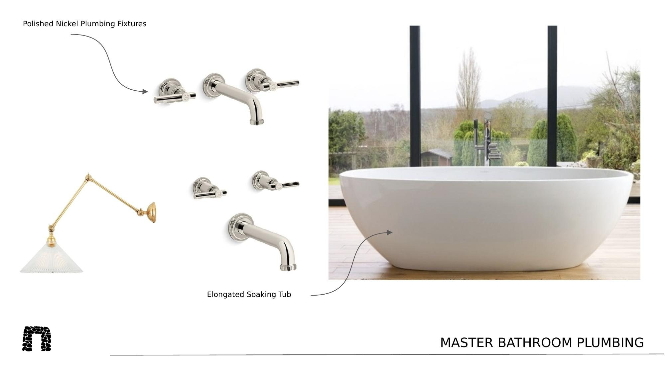

Slide 31
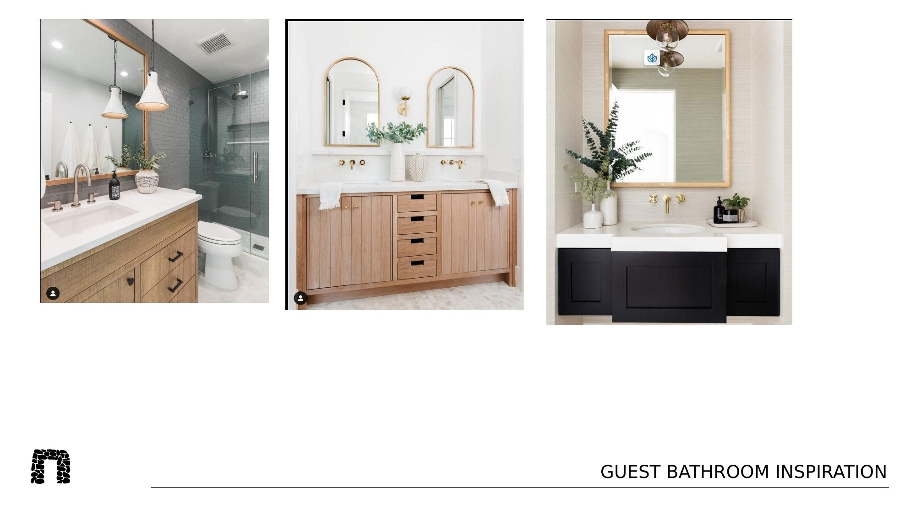

Slide 32
LOCATION & SCHOOLS
Arrington — Williamson County, Tennessee
One of the Nashville region's most sought-after addresses: acreage, privacy, and quiet roads — minutes from Franklin, wineries, and top-tier amenities, within an award-winning public school district.
9/10
7/10
7/10
GREATSCHOOLS RATING
GREATSCHOOLS RATING
GREATSCHOOLS RATING
Fred J Page High School
Fred J Page Middle School
Arrington Elementary
Grades 9–12
Grades 6–8
Grades PK–5
School ratings via GreatSchools.org. Proximity and boundaries are not a guarantee of enrollment; verify directly with the district.
THE STONEHOUSE COMPANY
2495 DEER MEADOW LANE · ARRINGTON, TN

Slide 33
INVESTMENT SNAPSHOT
The value case
$2,700,000
$900 / SF
$8M+
$1,873
Offering price
On the existing residence
Comparable estate values in the enclave
Annual property taxes (2025)
Why it holds value
Land in a capped, high-value enclave is inherently scarce. With a finished residence already in place and 8.79 acres to build on, a buyer secures both immediate use and long-horizon upside as the final estate in the community is completed.
THE STONEHOUSE COMPANY
2495 DEER MEADOW LANE · ARRINGTON, TN

Slide 34
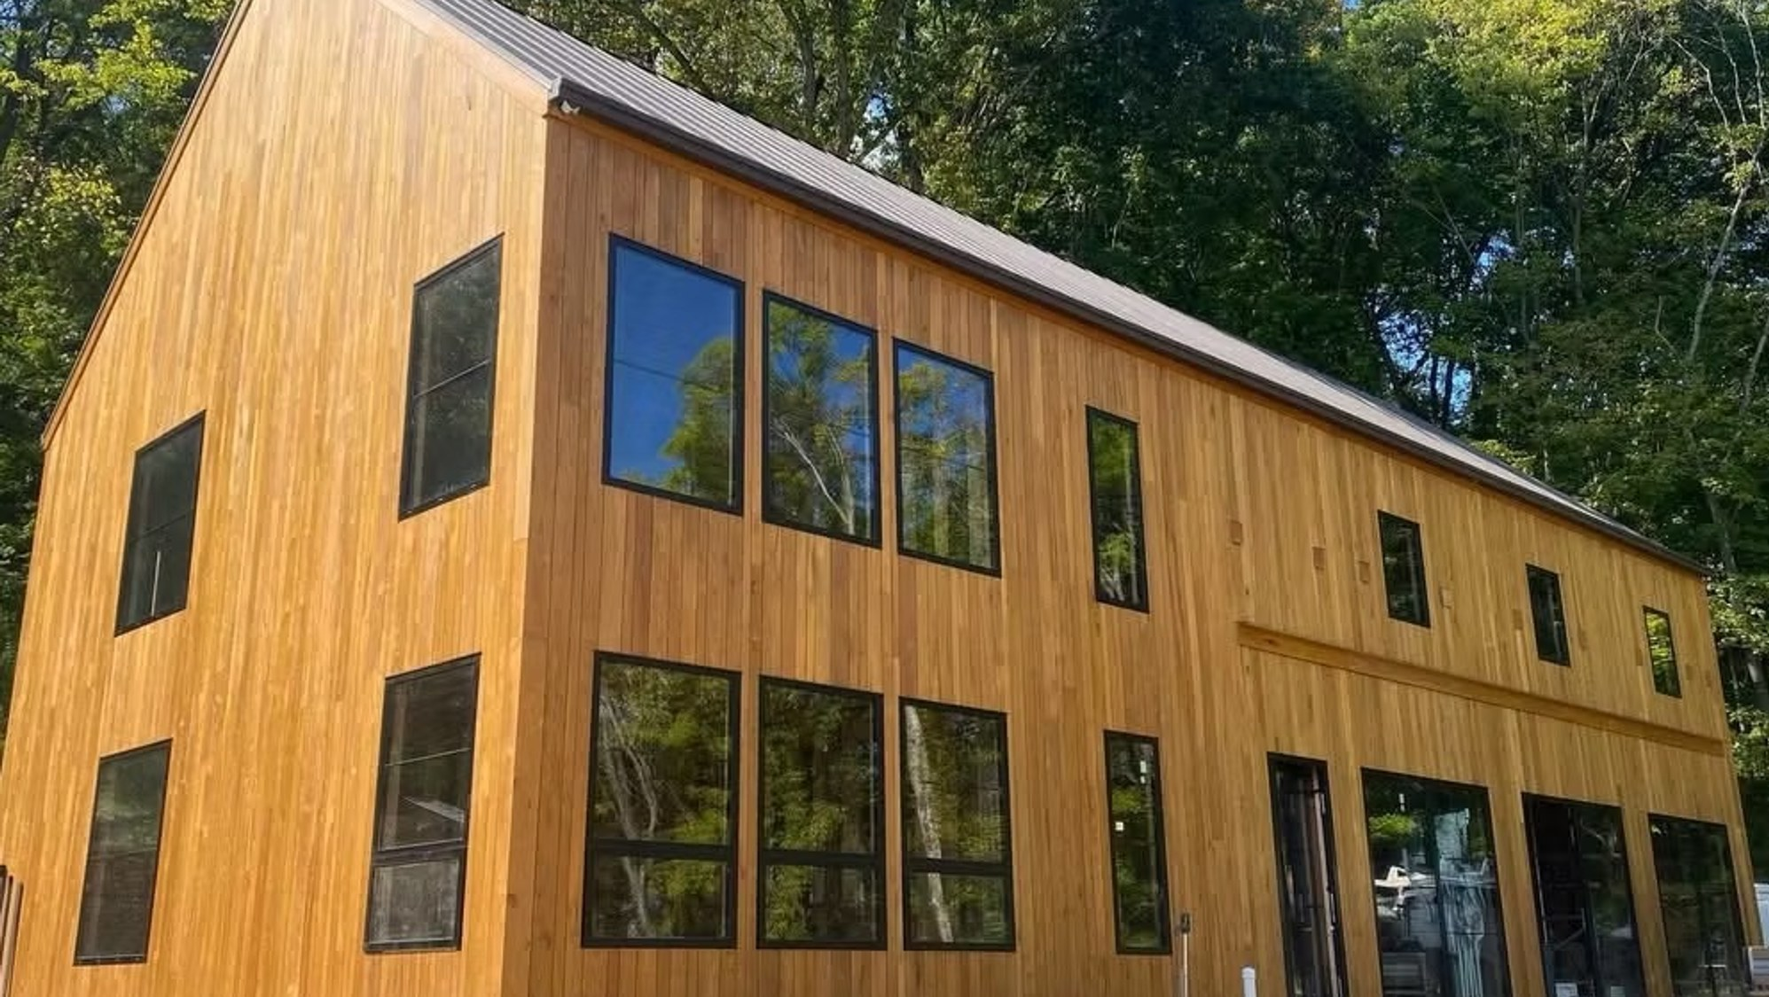
ARRANGE A PRIVATE TOUR
Come see what the final
homesite feels like
Private showings by appointment. I'd be glad to walk the land with you and talk through build options and timeline.
Ryan · The Stonehouse Company
(615) 812-0066 ryan@stonehouserealtyco.com thestonehouseco.com
Interior images are artist's renderings for illustrative purposes only; final finishes and specifications may vary.
Offered at $2,700,000 · Compass · Equal Housing Opportunity
Notes:
Interior images are illustrative renderings only; actual colors, materials, and final specifications may vary. Information deemed reliable but not guaranteed — buyer to verify all details independently.

