Slide 1
Evidence Mapping in Shiny
Ozayr Mohammed
Junior Data Scientist

Slide 2
Background
Approached by our Evidence & Knowledge Team (Alison Turner, Shiona Aldridge, Freddie Finlay, Richard Ward)
Evidence team often required to produce evidence maps
Looking for data science solution to evidence maps production
Internal solution rather than outsourcing
Evidence Map process
Data collection
Data Processing
Visualisation

Slide 3
What is an evidence map?
A visualisation of body of evidence for a specific topic
Usually for identifying gaps in evidence
Evidence typically categorised into a table with parameters as column and row headers
Typically Interactive:
Change table parameters
Filter the evidence

Slide 4
Example evidence maps

Slide 5
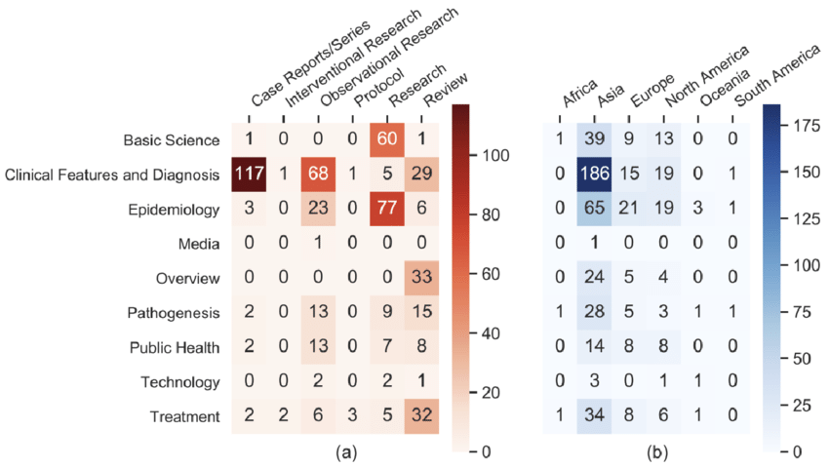
Coronavirus Disease 2019 (COVID-19): An Evidence Map of Medical Literature Evidence maps of the distribution of article topics by (a) article type and (b) continent of origin https://pubmed.ncbi.nlm.nih.gov/32615936/

Slide 6
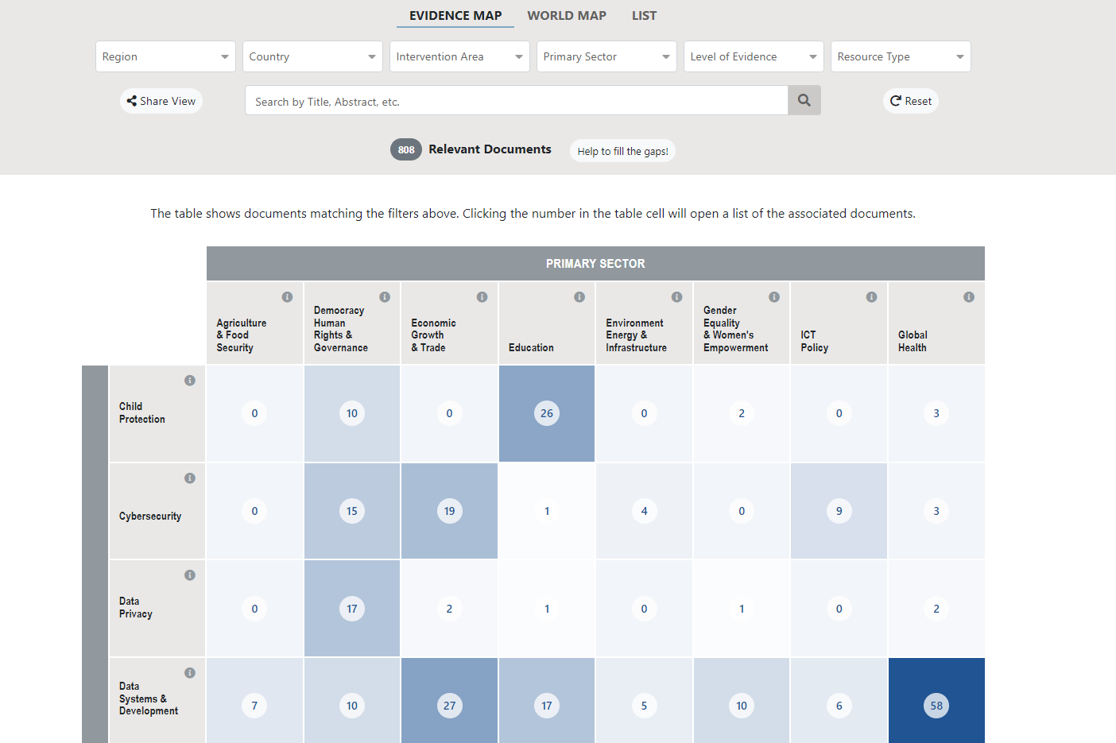
Digital Ecosystem Evidence Map https://deem.digitaldevelopment.org/#/em_grid?filters=

Slide 7
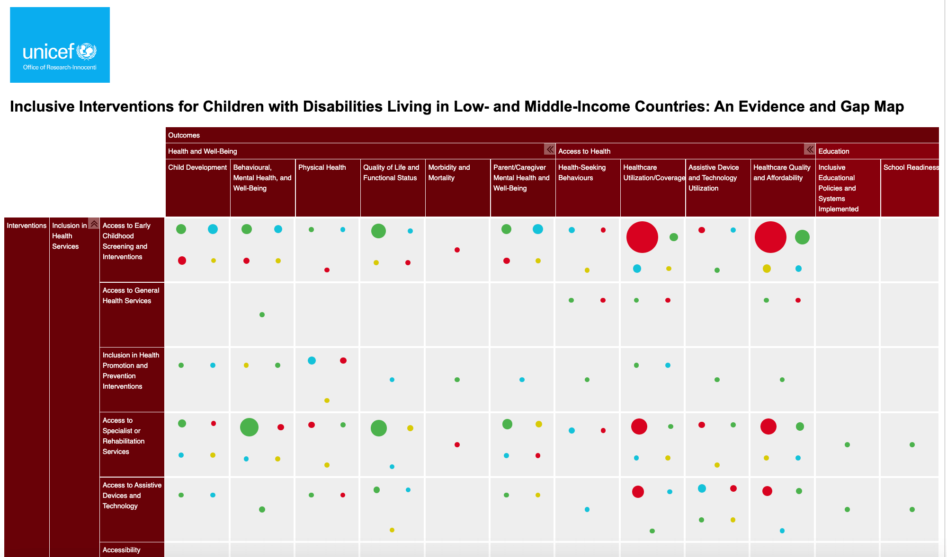
https://www.unicef-irc.org/evidence-gap-maps

Slide 8
Why use data science in an evidence map?
The process
Data collection (Evidence Team)
Data processing (Evidence Team + Data Science Team)
Data visualisation (Data Science Team)
Reduces repetition of work
Frees up resources to work on a single data science solution
Greater control over features and final outputs

Slide 9
Our Aims
Produce a similar output with Shiny package
Have a single generic solution
Repurpose for specific project needs

Slide 10
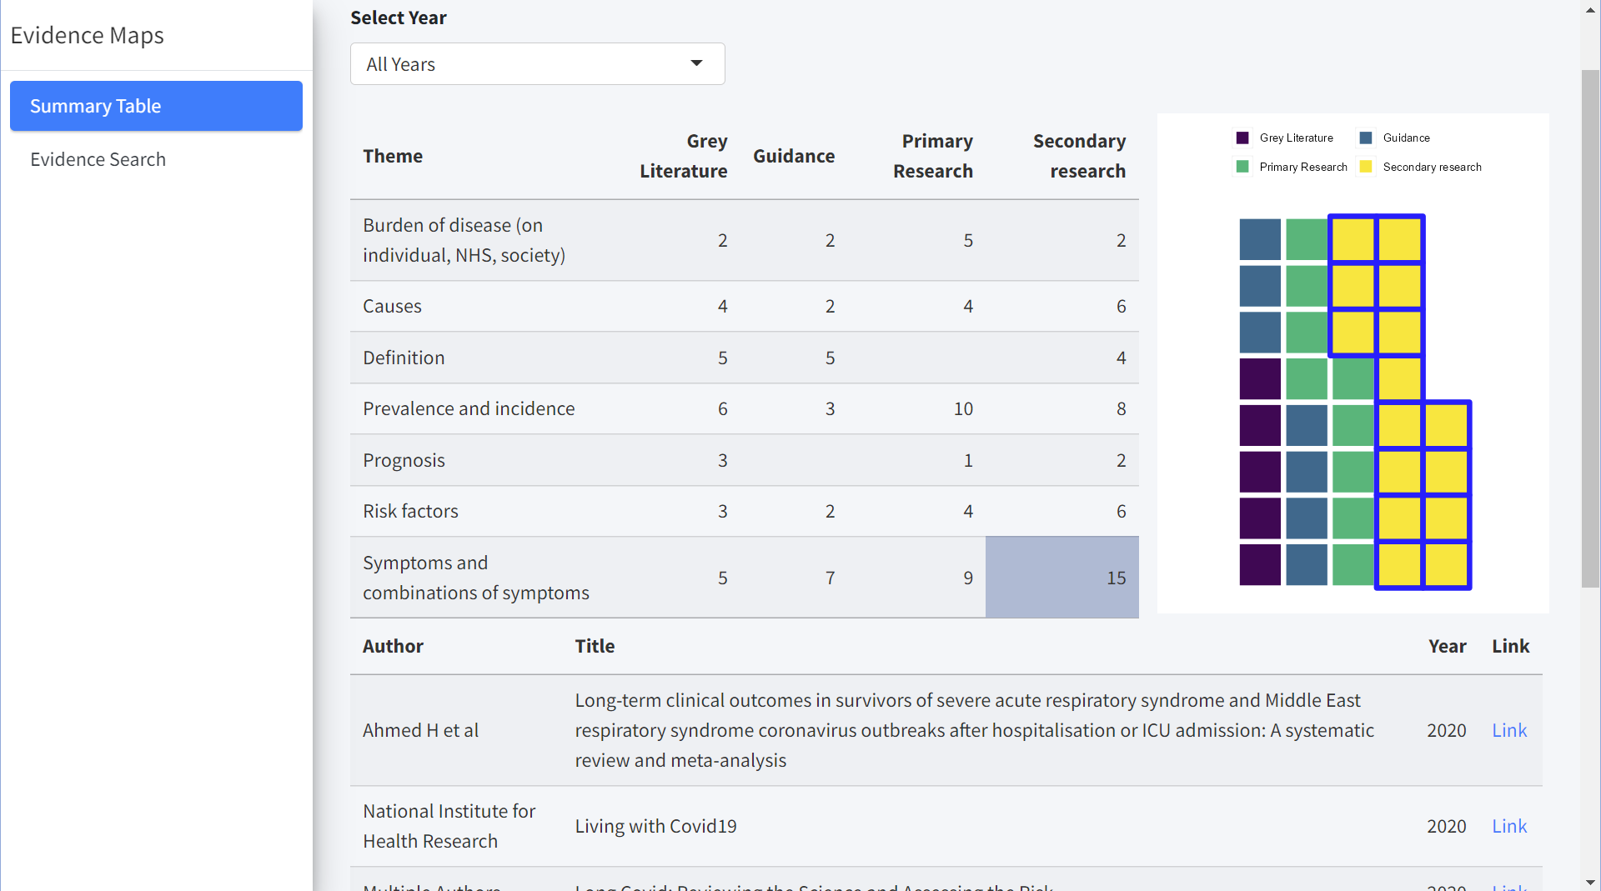
Generic Solution v0.1.0

Slide 11
NHP – Generic solution repurposed
Department for Health and Social Care’s “New Hospitals Programme”
40 hospitals will be built by 2030
The Strategy Unit is involved with demand modelling and forecasting
Evidence map to support forecasting
Builds upon generic v0.1.0

Slide 12
Programming approach
Evidence map application developed using Shiny package
Shiny is an R package for producing dashboards
Golem package used to modularise Shiny dashboard
A ‘…framework for building production-grade shiny applications’*
Code is written in separate modules
Modules are called upon dashboard start up
Modules can be reused/repurposed within other projects
Turns code into a package
*https://github.com/ThinkR-open/golem

Slide 13
Programming approach
Project was managed using GitHub
Public repository - https://github.com/The-Strategy-Unit/evidence_maps
v0.1.0 release (Generic application)
NHP Evidence Map being built using v0.1.0

Slide 14
Future Plans
Generic solution for all our evidence maps
Pre-built modules that can be ‘toggled’
To continue developing generic solution whilst repurposing it for specific projects along the way

Slide 15



Stay connected with us!
Questions…
strategyunitwm.nhs.uk
@Strategy_Unit
strategy.unit@nhs.net

