Slide 1
All decks should start with this slide

Slide 2





Divider slide
Subtitle

Slide 3

Content slide with picture
Insert subtitle or intro sentence here
Add text here – a useful space to include text that isn’t bullet points. Have a look at the end of this slide deck for an example of how this slide can be used but try not to over do it with words!
Add text here – a useful space to include text that isn’t bullet points. Have a look at the end of this slide deck for an example of how this slide can be used but try not to over do it with words!
Notes:
We need to bring the right individuals and businesses together to foster innovation and to deliver hospitals of the future.

Slide 4
Content slide with picture
Insert bullet points here
Insert bullet points here
Insert bullet points here
Insert bullet points here
Notes:
We need to bring the right individuals and businesses together to foster innovation and to deliver hospitals of the future.

Slide 5
Alternative divider slide

Slide 9
Useful slides / graphics
Please contact the Comms Team if you need any
additional, approved slides or templates: nhp.comms@nhs.net

Slide 10
Health and Social Care Planning: Update
[EXAMPLE]
Natalie Forrest, SRO

Slide 11

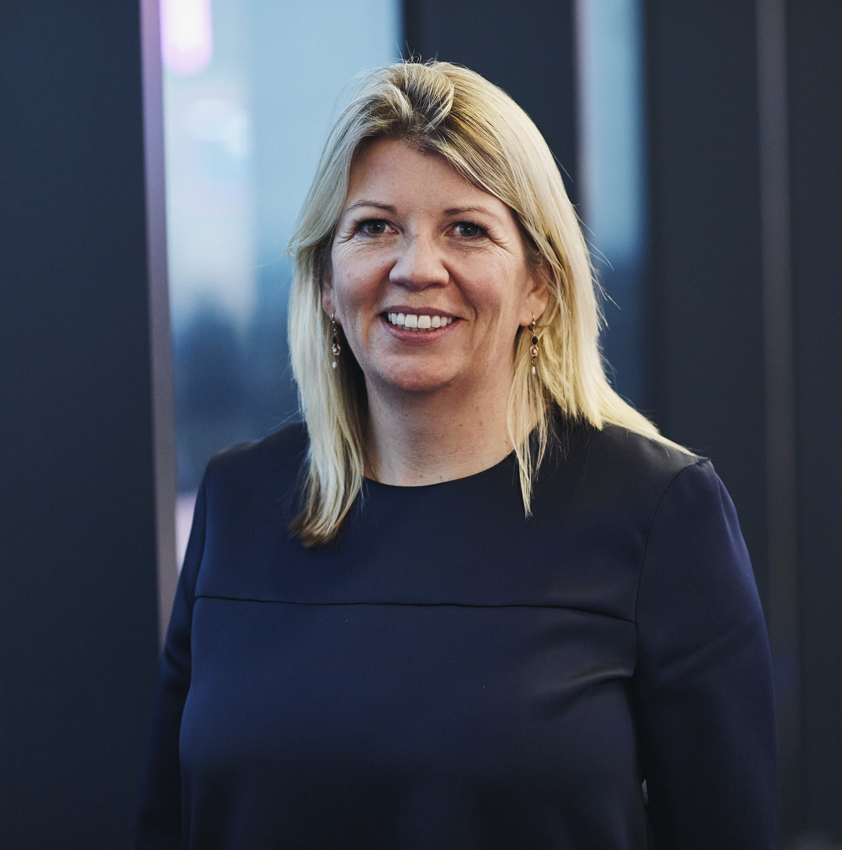

[Example]
Thank you for joining the New Hospital Programme Autumn Market Update, both in-person and online. We are excited to share with you the latest Programme developments and our approach to delivery; with further details to be shared around key strategic areas of the Hospital 2.0 standardised design approach, the Programme Clinical and Digital Strategy, and the overarching Commercial approach. The scale of the Programme will call upon the skills and expertise of companies of all sizes, across a broad range of sectors. No matter your business we believe there’s a part for you to play in delivering hospitals of the future. That’s why we’re calling upon the knowledge and experience of the widest breadth of suppliers from construction components to medical equipment and beyond.
Natalie Forrest
Senior Responsible Owner
Morag Stuart
Chief Programme Officer

Slide 12
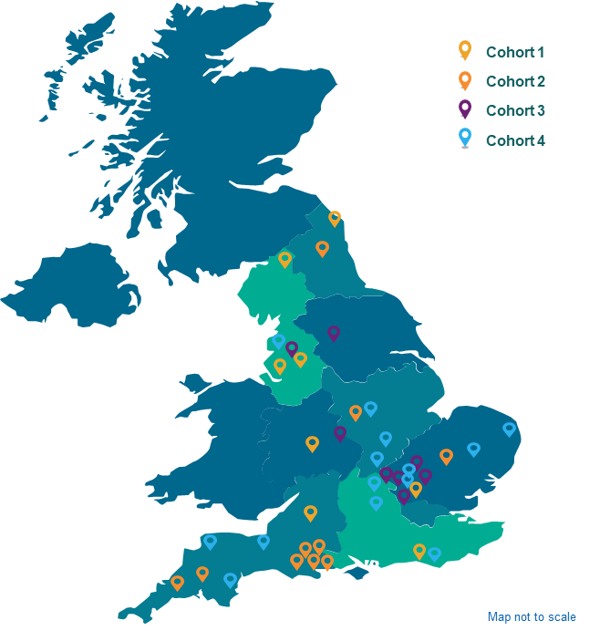




The New Hospital Programme
Building 40 hospitals and now including RAAC hospitals (Reinforced Autoclaved Aerated Concrete)
A centralised programme to deploy a systematic approach including developing a common set of design principles incorporating modern methods of construction
Development and application of a common commercial and procurement strategy to achieve economies of scale and mitigate supply constraints​
​
On-going Programme Business Case

Slide 13


Useful icons / graphics
(copy & paste)

