Slide 1
Arduino Libraries
Presentation to T-Exchange
August 2026
Norman Dunbar
Notes:
Open PDF document in viewer.
Open Nemo in T_Exchange.
Open IDE & load Barebones.ino.
Have Barebones.ino loaded into Uno.

Slide 2
Introduction – What’s Coming
What are libraries?
How to develop a library for LM75 sensors
Brief details of the LM75 temperature sensors
Writing the Library
Installing the library
Using the library in sketches

Slide 3
What Are Libraries?
A library is something you write to prevent you having to write the same code again and again in multiple sketches
Write it once in a library
Use it multiple times in different sketches
Sell it or give it away – if it’s really useful

Slide 4
Developing Libraries
File system structure
Boilerplate files – three of
Header files
Source files
Beware of the C++ header files!

Slide 5
File System Structure
Top level - LM75_AB
Subdirectories
  examples – contains example sketches
  src – contains library source files
Boilerplate files
  keywords.txt
  library.properties
  LICENSE
Notes:
Show actual LM75_AB structure at this point.

Slide 6
Boilerplate Files
The Licence file – LICENSE
The Properties file – library.properties
The Keywords file – keywords.txt
Notes:
LICENSE – See Section 2.1, page 5.
Properties – See Section 2.2, page 6.
Keywords – See Section 2.3, page 8.

Slide 7
Header Files
Usually named something.h
May be more than one
Defines constants used by the library
Forward declares any functions exported by the library
Used by the library and by sketches

Slide 8
Source Files
The C, C++ or Assembly Language code for the library
May be more than one source file
Used to create the library
Recompiled and linked for every sketch using the library
Should really be written in Assembly or C, not C++

Slide 9
Beware of C++
Wire.h, for example, is written in C++
Your library file is named something.c – it’s a C file
Compilation errors abound and they are pretty meaningless – usually relating to the Printable.h header
Problem – C compiler doesn’t know C++
Solution – rename your source files to something.cpp
C++ can use C files. C cannot use C++ files

Slide 10
LM75A/LM75B Temperature Sensors
Reasonably accurate temperature sensor
Communicates over I2C/TWI/Wire protocol
Temperature range from -55 to +125 Celcius
Accurate +/-2C (-25 to +100) or +/-3C (-55 to +125)
Clock speeds from 20 to 400 Hz
Up to eight devices allowed on the bus
Alarm enabled to handle over temperature situations
Notes:
See also Chapter 3, page 11.

Slide 11
Writing the LM75_AB Library
Switching to Arduino IDE for this bit!
Notes:
See Chapter 4, Barebones.ino, page 15.
See Chapter 5, LM75_AB Library, page 23.
Once written, install it – Section 5.2, page 26.
See then Chapter 6, WithLibrary.ino, page 29.

Slide 12
Installing the LM75_AB Library as Source Files
Close the Arduino IDE
Copy the LM75_AB directory
Paste into Arduino/libraries
Open the IDE again

Slide 13
Installing the LM75_AB Library as a Zip File
Compress the LM75_AB directory to a Zip file
Open the Arduino IDE if not already open
Click Sketch→Include Library→Add .Zip Library
Navigate to the LM75_AB.zip file location
Double-click the LM75_AB.zip file
On completion the library can be used straight away

Slide 14
Using the Library in Sketches
Testing the library with any examples provided
  File→Examples→LM75_AB→Temperature
Writing a sketch that uses the library
  Sketch→Include Library→LM75_AB

Slide 15
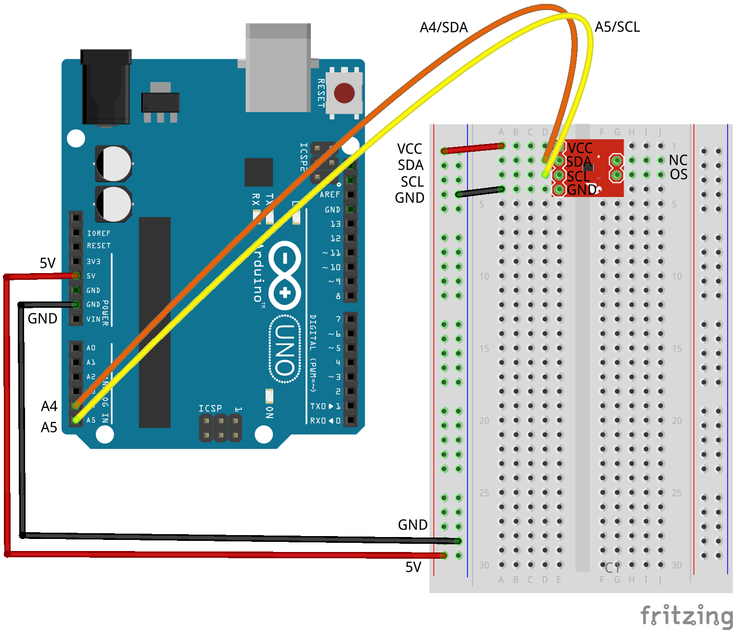
The Demonstration Circuit

Slide 16
Questions and Maybe Answers!
Any questions?
Notes:
Maybe demonstrate the Assembly version?
* Connect D2 to the LM75A’s OS pin.
* Add a 560R and LED to D13 before:
Serial Monitor should be open.
LM75A_Comparator. – LED on when hot, off when cool. Simple.
LM75A_Interrupt – Show it working as is, identical to the Comparator version.
Then comment line 219 and show it again, the LED never goes out!

Slide 17
Thank you for Listening
You can wake up at the back now, I’m done!
Everything from tonight is available on GitHub
https://github.com/NormanDunbar/T-Exchange

