Slide 1
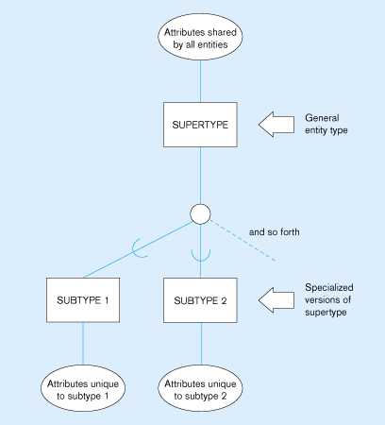
Basic notation for supertype/subtype relationships

Slide 2
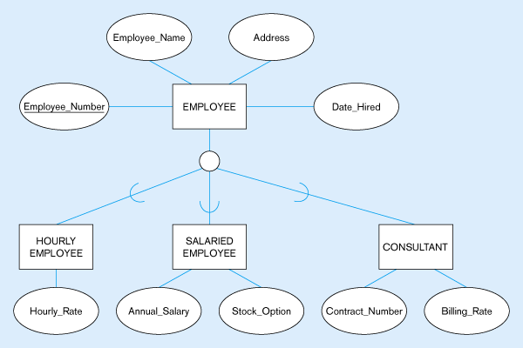
Employee supertype with three subtypes
All employee subtypes will have emp_no., name, address, and date-hired
Each employee subtype will also have its own attributes

Slide 3
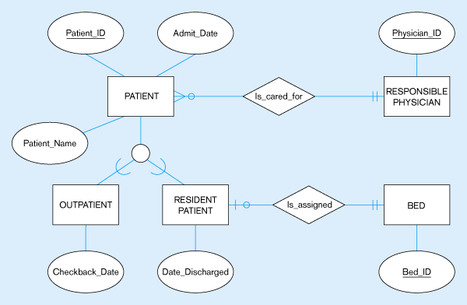
Supertype/subtype relationships of patients
Both outpatients and resident patients are cared for by a responsible physician
Only resident patients are assigned to a bed

Slide 4
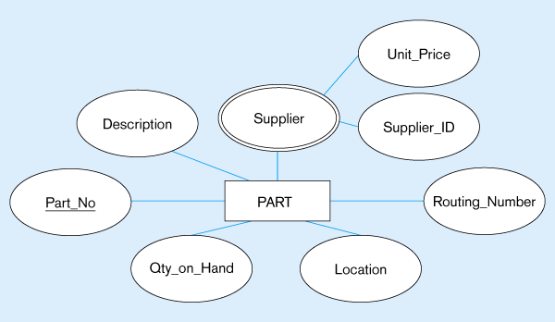
Example of specialization
Entity type PART
Applies only to purchased parts
Only applies to manufactured parts

Slide 5
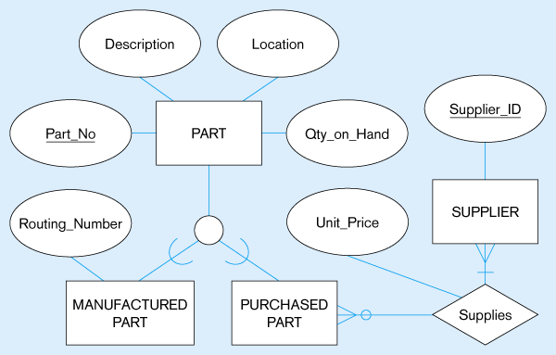
Specialization to MANUFACTURED PART and PURCHASED PART
Created 2 subtypes
Note: multivalued attribute was replaced by a relationship to another entity

Slide 6
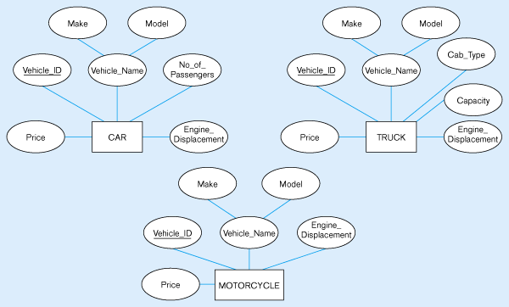
Example of generalization
Three entity types: CAR, TRUCK, and MOTORCYCLE
All these types of vehicles have common attributes

Slide 7
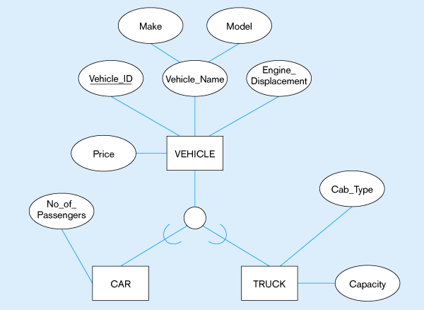
Generalization to VEHICLE supertype
So we put the shared attributes in a supertype
Note: no subtype for motorcycle, since it has no unique attributes

Slide 8
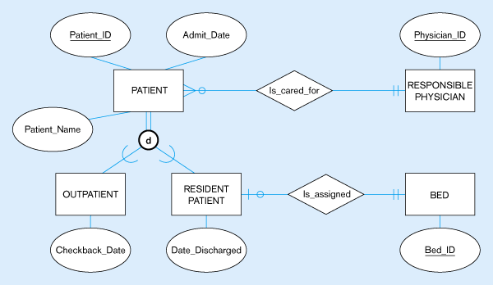
Examples of disjointness constraints
Disjoint rule
A patient can either be outpatient or resident, but not both

Slide 9
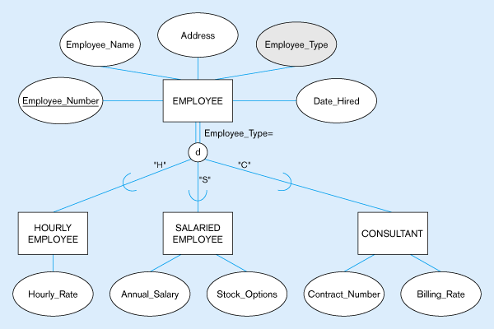
Subtype discriminator (disjoint rule)
A simple attribute with different possible values indicating the subtype

Slide 10
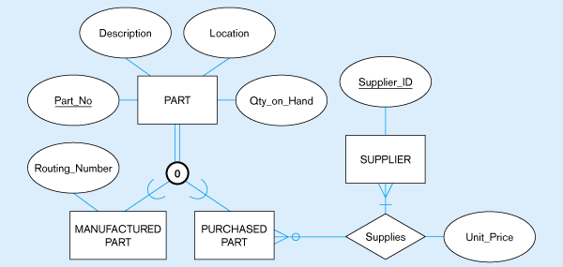
Overlap rule
A part may be both purchased and manufactured

Slide 11
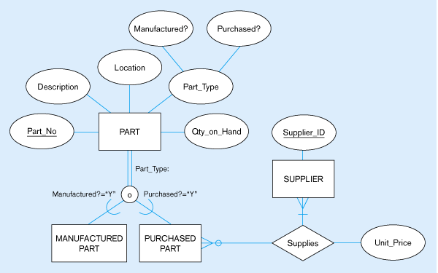
Subtype discriminator (overlap rule)
A composite attribute with sub-attributes indicating “yes” or “no” to determine whether it is of each subtype

Slide 12
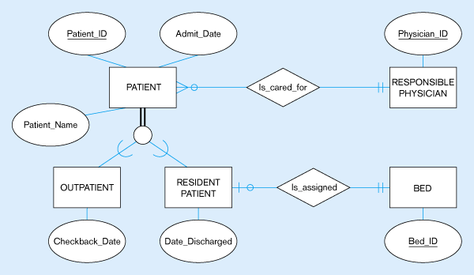
Examples of completeness constraints
Total specialization rule
A patient must be either an outpatient or a resident patient

Slide 13
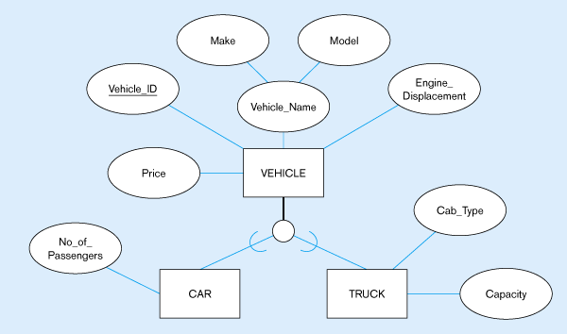
Partial specialization rule
A vehicle could be a car, a truck, or neither

Slide 14
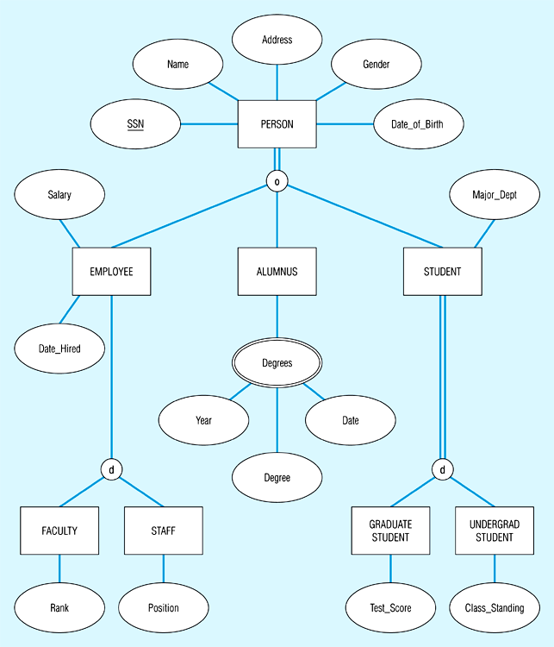
Example of supertype/subtype hierarchy

