Slide 1
Normalization Practice

Slide 2
1NF
PK
Customer_ID | Name | Address | Company Name
104 | Mr. Ray Suchecki | 123 Pond Hill Road, Detroit, MI, 48161 | CSUB
624 | Mr. Toby Stein | 431 North Phillips Road, South Bend, IN, 46611 | Bakersfield
627 | Mr. Gilbert Scholten | 3915 Hawthorne Avenue, Toledo, OH, 43603 | BPA
PK
Student_ID | Advisor | Advisor_Office | Class_1 | Class_2 | Class_3
1022 | Jones | 412 | 101-07 | 143-01 | 159-02
4123 | Smith | 216 | 201-01 | 211-02 | 214-01

Slide 3
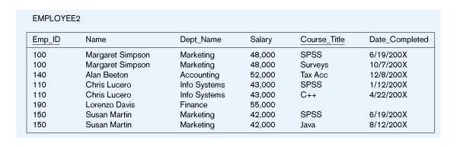
2NF
PK
PK

Slide 4
Functional Dependencies in EMPLOYEE2
Dependency on entire primary key
PK
PK
EmpID
CourseTitle
Name
DeptName
Salary
DateCompleted
Dependency on only part of the key
Define functional dependencies of above table
using a functional dependency notation, then normalize to 2NF

Slide 5
2NF
Below table name is “Rental Info”. Arrowed direction shows functional dependency information.
Define functional dependencies of table using functional dependency notation then normalize to 2NF
Depends on both TransID and VideoID
PK
PK
Rental Info TransID VideoID Copy# Title Rent
Depends only on VideoID

Slide 6
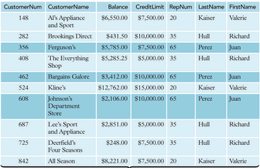
3NF: Define functional dependencies of below table using a functional dependency notation, then normalize to 3NF
PK

Slide 7
BCNF
Project
PK
PK
Project_ ID | Manager_ ID | Manager_ Dept | Manager_ Lname | Project_ Budget | Project_ Location
Define functional dependencies of below table using a functional dependency notation, then normalize to BCNF

