Slide 1


Slide 2



Slide 3


Slide 4


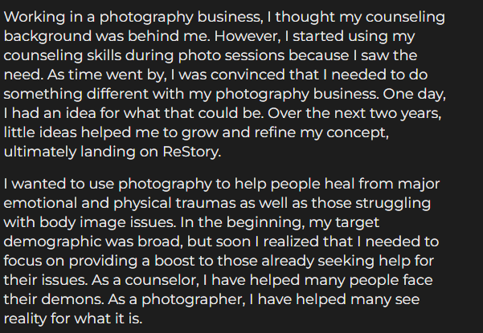

Slide 5



Slide 6
Survey

Slide 7
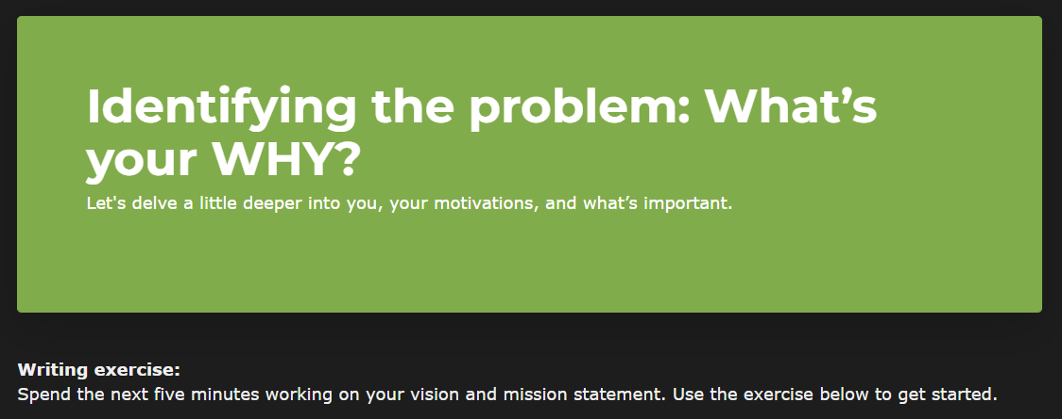
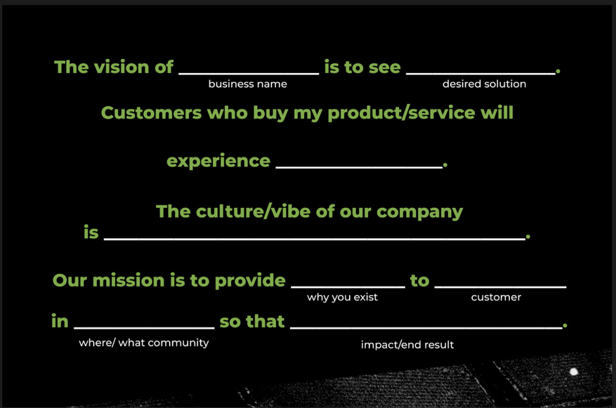

Slide 8
Survey

Slide 9

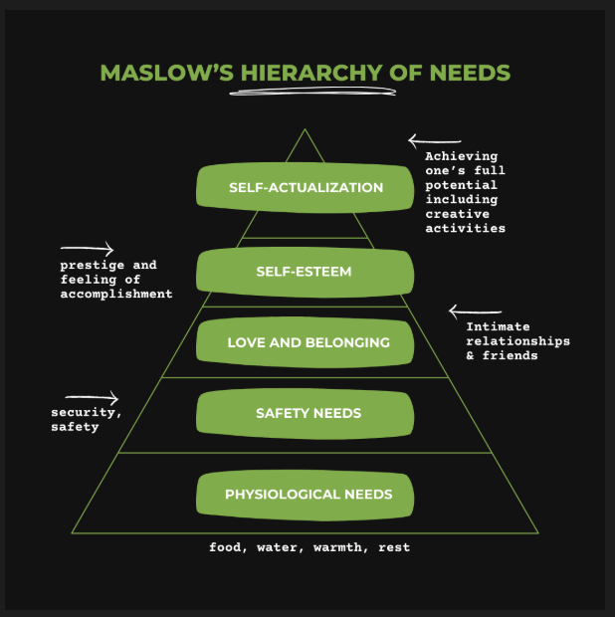

Slide 10
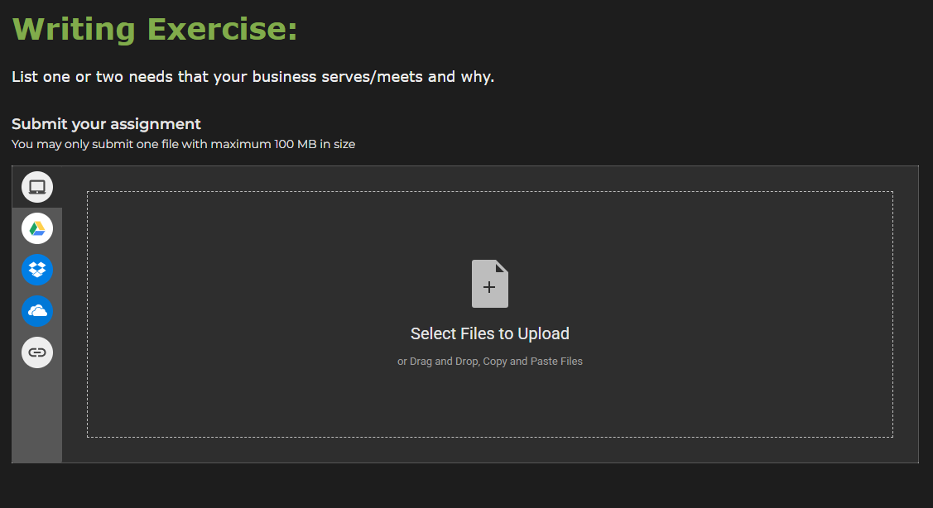
Survey

Slide 11
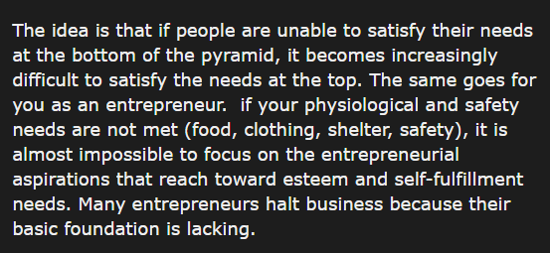


Slide 12

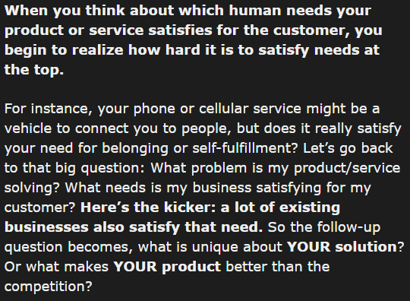

Slide 13
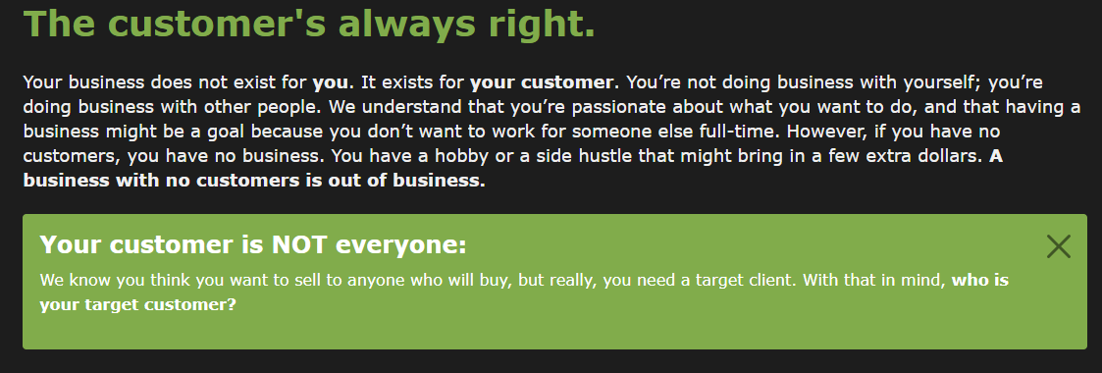


Slide 14
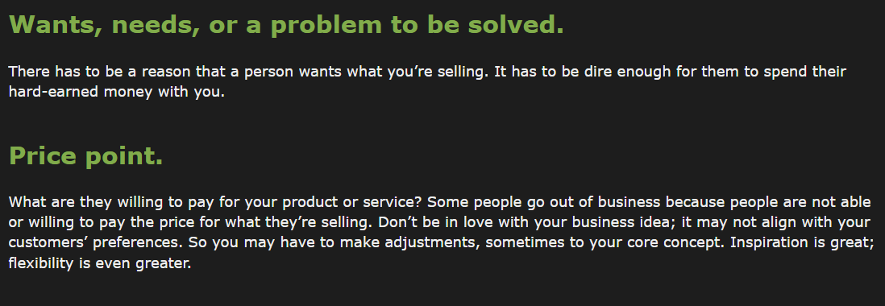

Slide 15
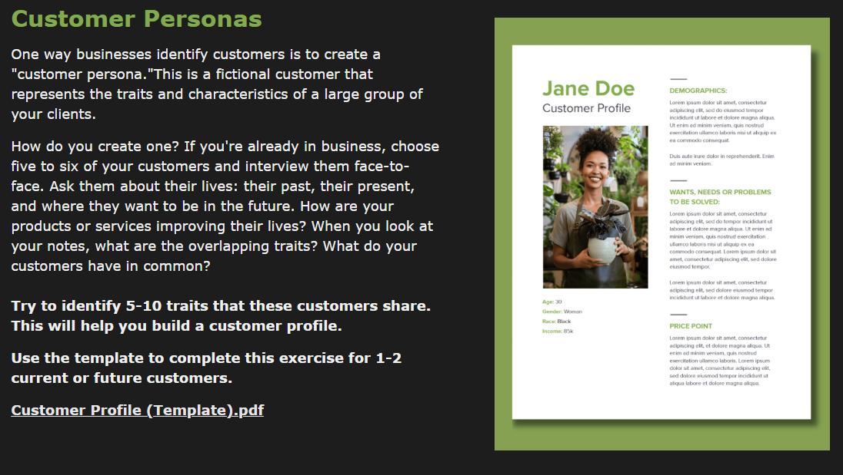

Slide 16
Survey

Slide 17


Slide 18
Survey

Slide 19


Slide 20
In lesson four’s panel discussion, entrepreneurs and first-time business owners share their start up stories, focusing on the support networks they relied upon to get going.
You’ll discover what challenges they’ve faced and what keeps them motivated. Watch the video and write down key points that jump out to you.

Slide 21
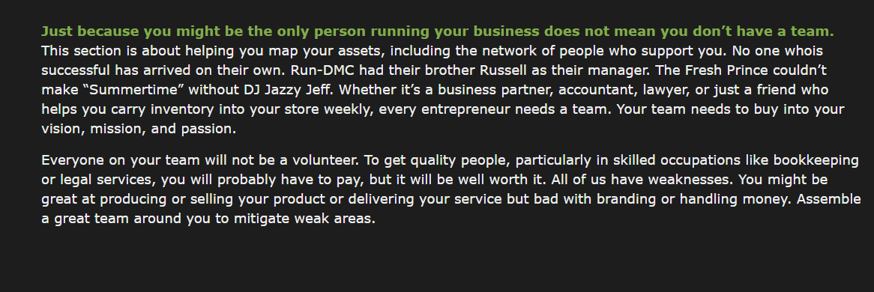

Slide 22
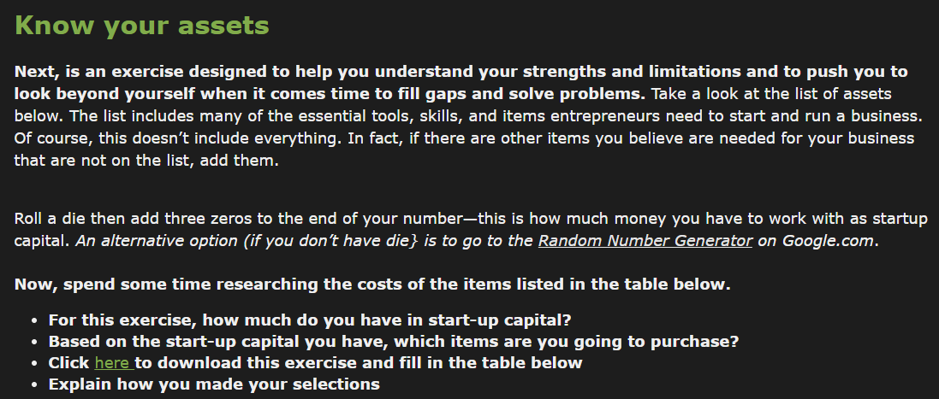

Slide 23
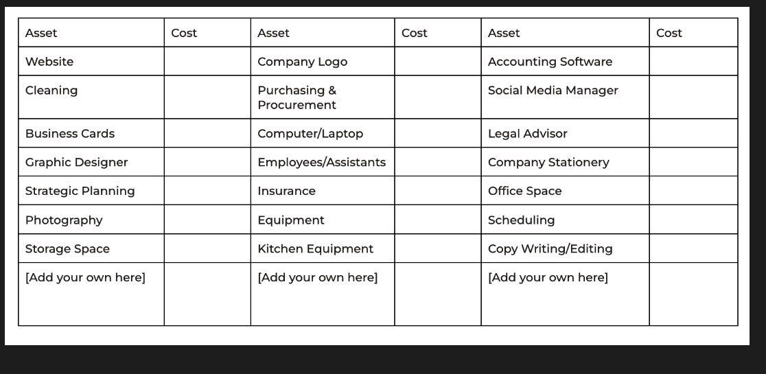
Survey

Slide 24
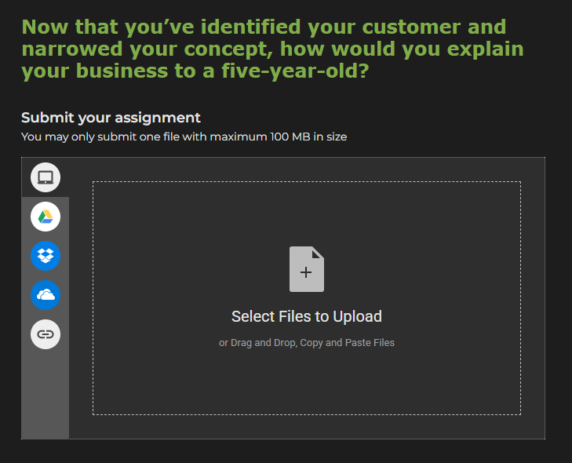
Survey

Slide 25
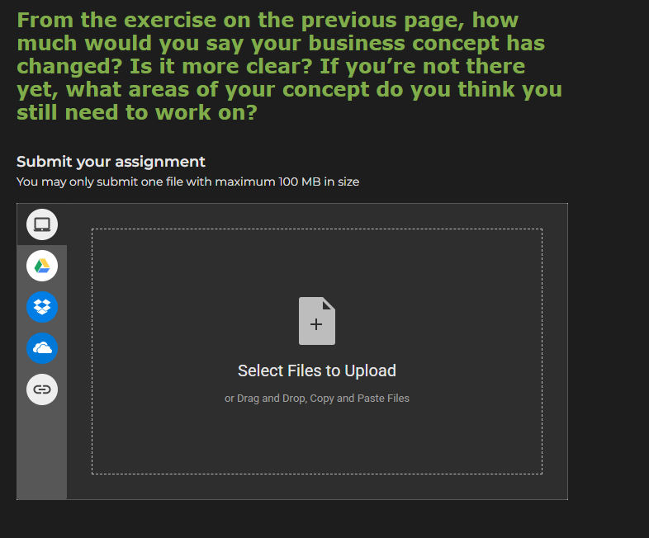
Survey

Slide 26
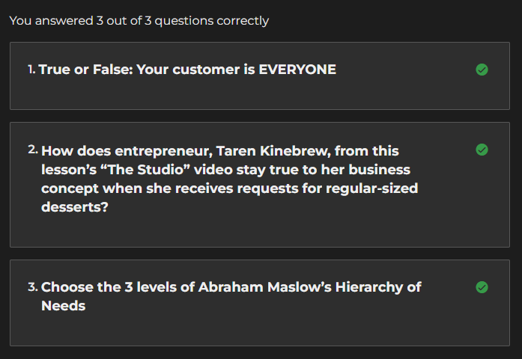
Quiz

Slide 27
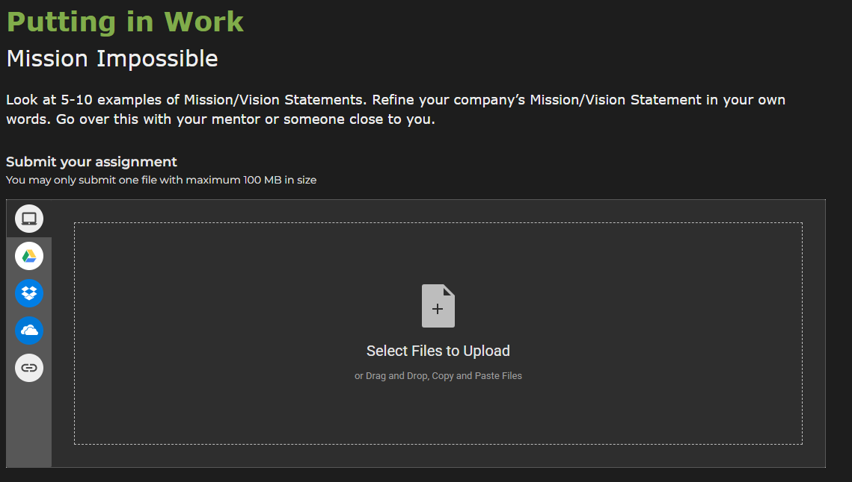
Survey

Slide 28
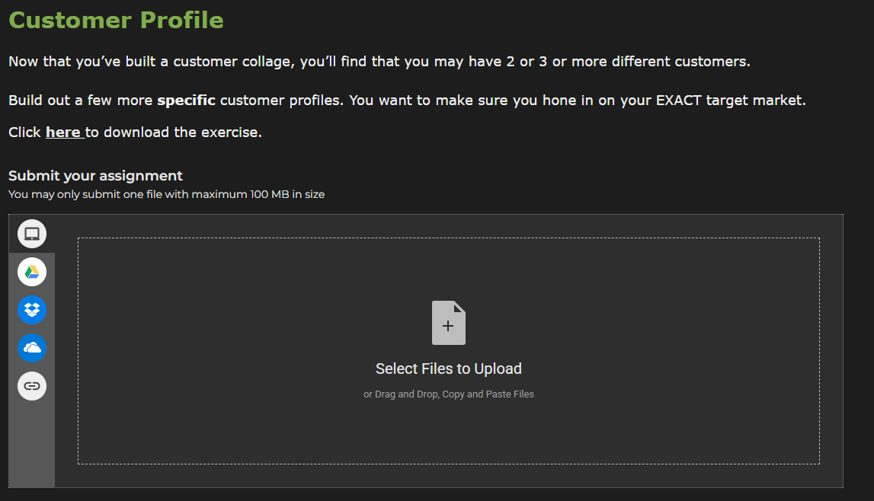
Survey

Slide 29
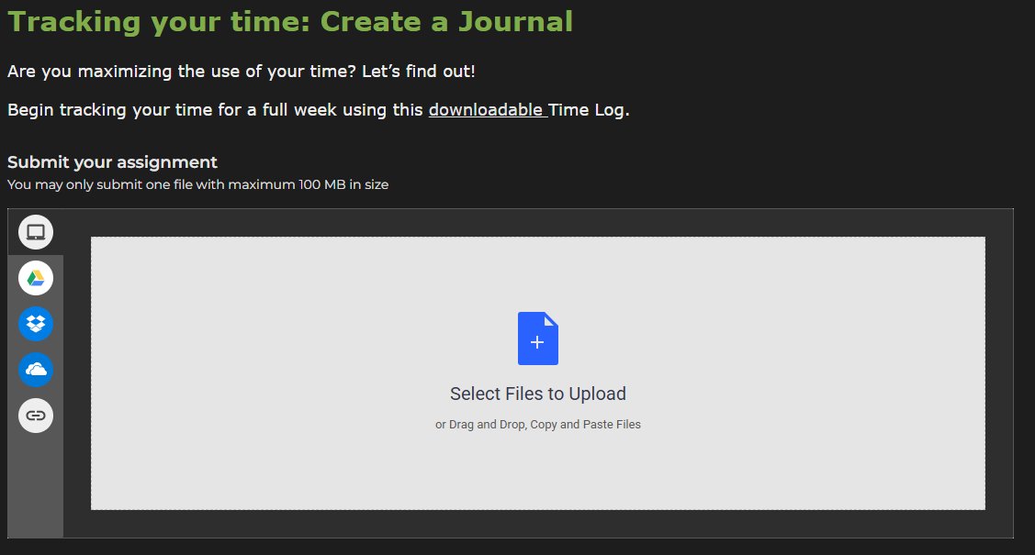
Survey

Slide 30

Survey

Slide 31


Slide 32


