Slide 1


Slide 2
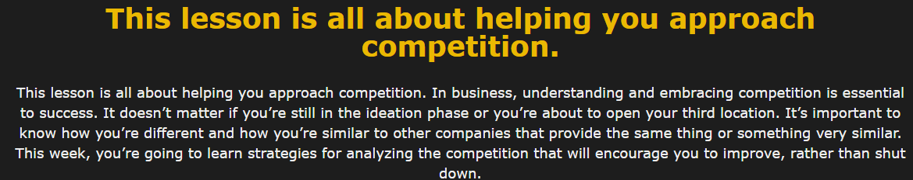

Slide 3


Slide 4
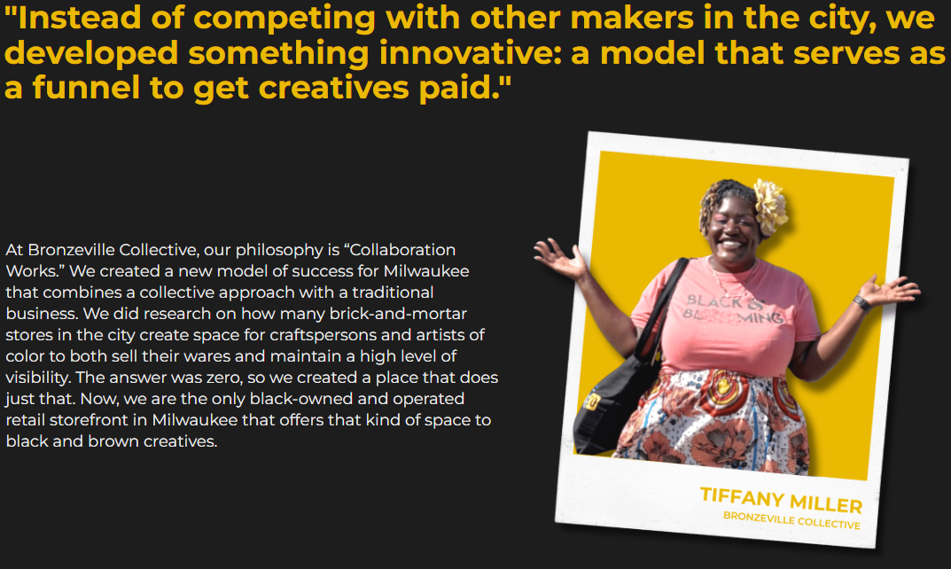
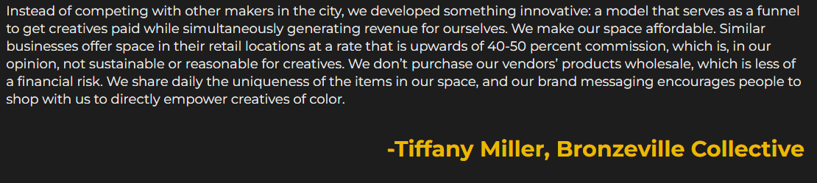

Slide 5
Survey: Before we go any further:
You’re in the ring if you’re in business. If you aren’t a competitor, your competitors are. Don’t get punched out because you aren’t competing. In the broadest sense, Webster’s Dictionary defines the word ‘compete’ as “to strive to gain or win something by defeating or establishing superiority over others who are trying to do the same; to take part in a contest; to contend.” Write down your thoughts and feelings about competition. Are you a competitive person? How do you deal with competition? How do you feel when you win or when you lose?
Submit your assignment
You may only submit one file with maximum 100 MB in size

Slide 6
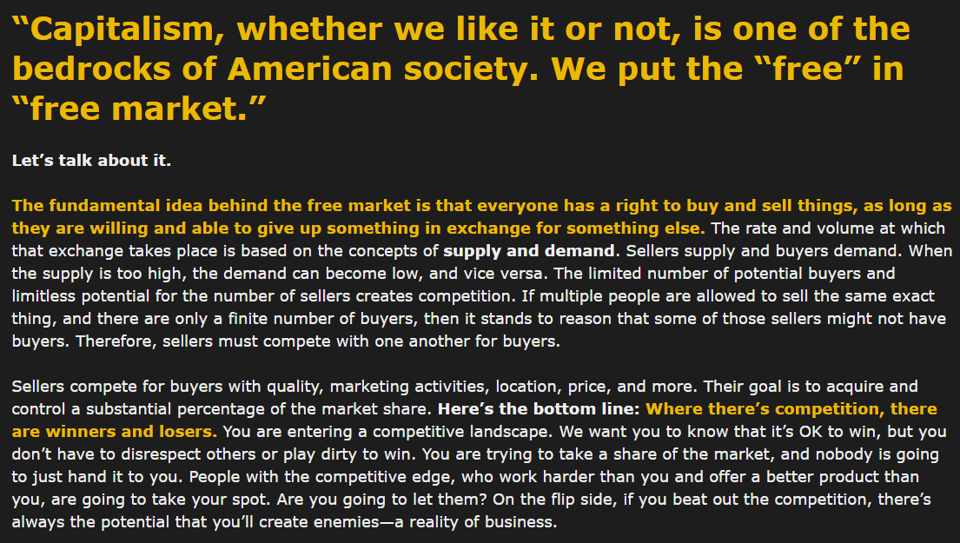

Slide 7
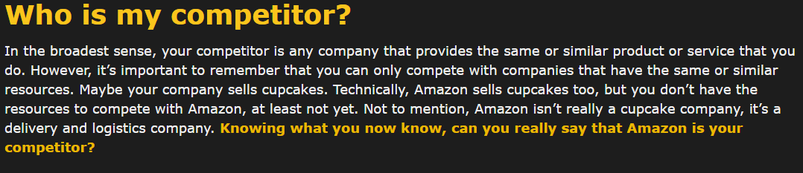

Slide 8
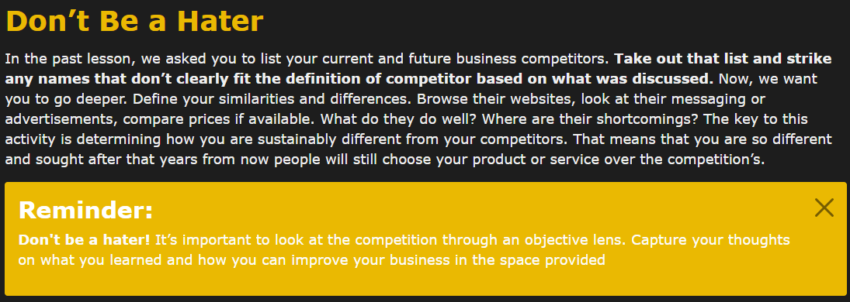

Slide 9
Survey: Don’t Be a Hater
In the past lesson, we asked you to list your current and future business competitors. Take out that list and strike any names that don’t clearly fit the definition of competitor based on what was discussed. Now, we want you to go deeper. Define your similarities and differences. Browse their websites, look at their messaging or advertisements, compare prices if available. What do they do well? Where are their shortcomings? The key to this activity is determining how you are sustainably different from your competitors. That means that you are so different and sought after that years from now people will still choose your product or service over the competition’s.
Reminder:
Don't be a hater! It’s important to look at the competition through an objective lens. Capture your thoughts on what you learned and how you can improve your business in the space provided
Submit your assignment
You may only submit one file with maximum 100 MB in size

Slide 10
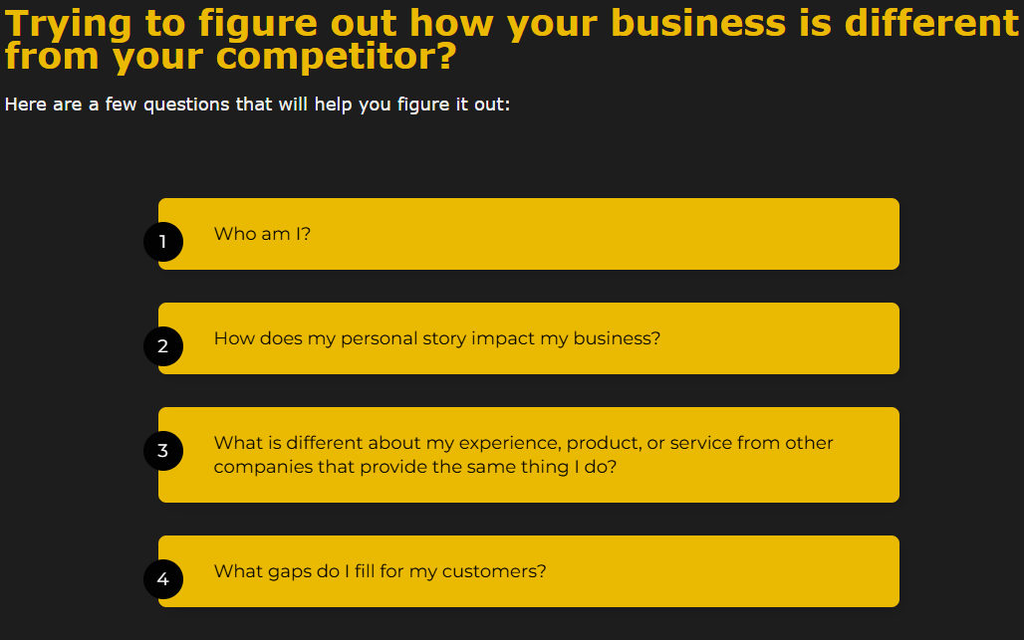

Slide 11
Survey: Trying to figure out how your business is different from your competitor?
Here are a few questions that will help you figure it out:
1Who am I?
2How does my personal story impact my business?
3What is different about my experience, product, or service from other companies that provide the same thing I do?
4What gaps do I fill for my customers?

Slide 12
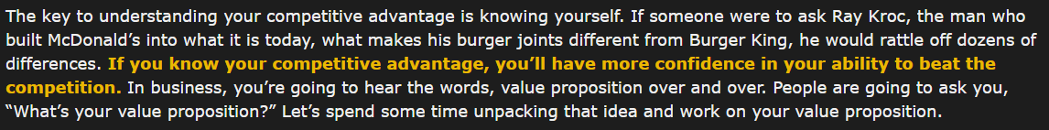


Slide 13
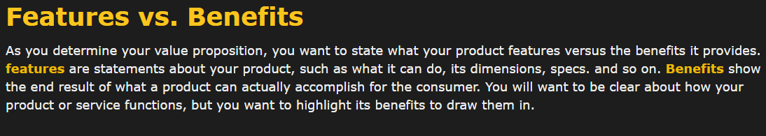

Slide 14
Survey: What is value when it comes to products and services? What about our personal values? How are these similar? How are they different? Jot down your answers.
Value —the monetary worth of something; a fair return or equivalent in goods, services, or money for something exchanged; something (such as a principle or quality) intrinsically desirable.
Submit your assignment
You may only submit one file with maximum 100 MB in size

Slide 15
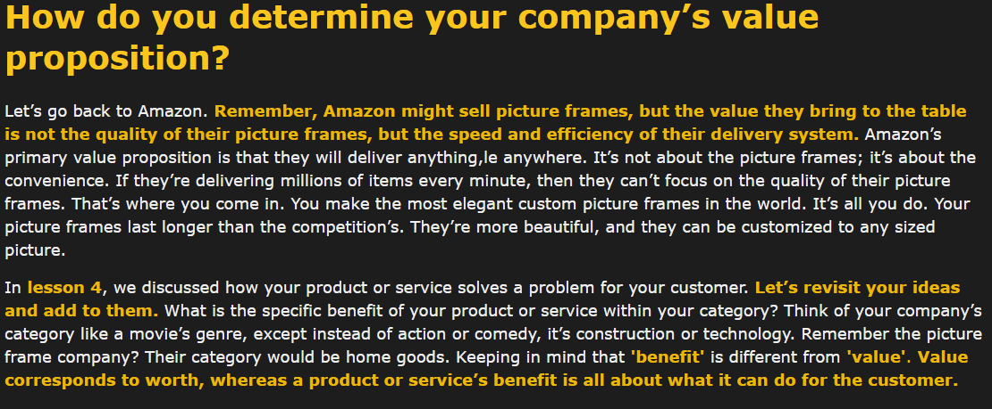

Slide 16
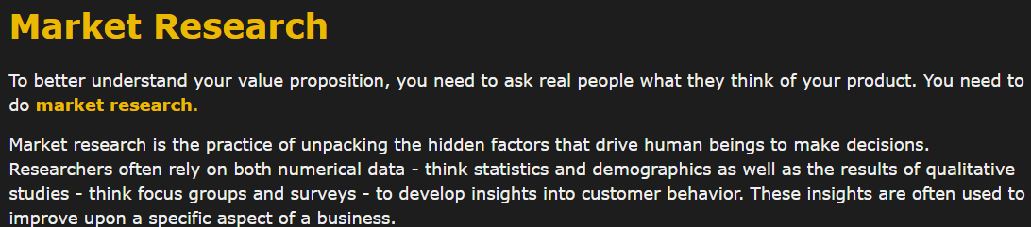
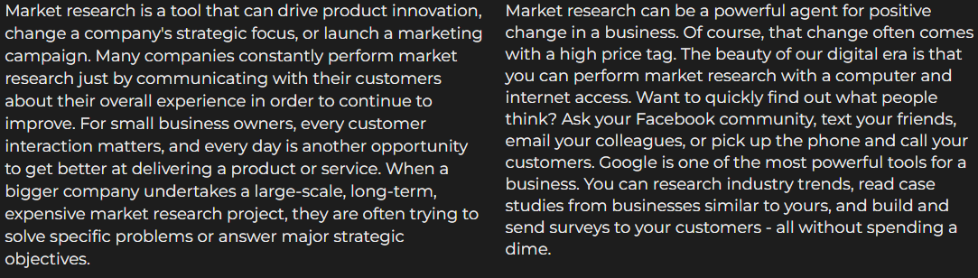

Slide 17


Slide 18
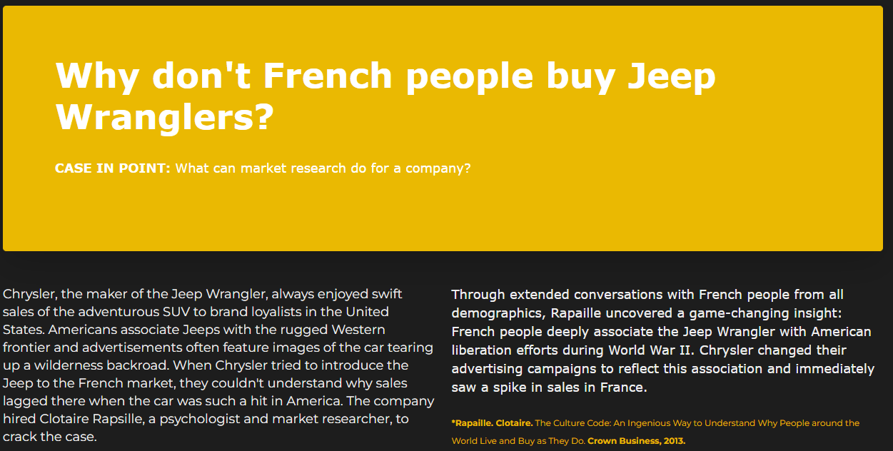

Slide 19
Survey: Are you a competitive person? How do you deal with competition? How do you feel when you win or when you lose? Have your answers changed from the beginning of class? Why or why not?
Submit your assignment
You may only submit one file with maximum 100 MB in size
My Device
Google Drive
Dropbox
OneDrive
Link (URL)
Select

Slide 20
Survey: Find five to ten current or future customers and interview them about how your products or services fit into their lives. Don’t be afraid to get deep; it will help you figure out how to better meet their needs with your product or service. Ask questions like:
What drew you to my product?
What problem does my product or service solve, or what need does this product or service meet?
If you did not know me, would you buy this product or service?
Would you buy at this price point?
How much do you think this product or service is worth?
How much would YOU pay for it?
Submit your assignment
You may only submit one file with maximum 100 MB in size

Slide 21
Survey: Go to your business canvas and answer the corresponding questions on sticky notes in the Competition and Value Proposition sections. Once you’ve done that, type out paragraphs of those responses in your Business Synopsis. If you need to go back to the previous sections to make a few changes, feel free to do so. We will cover Cost Structures next week. Make sure you read ahead to be prepared.
Submit your assignment
You may only submit one file with maximum 100 MB in size

Slide 22
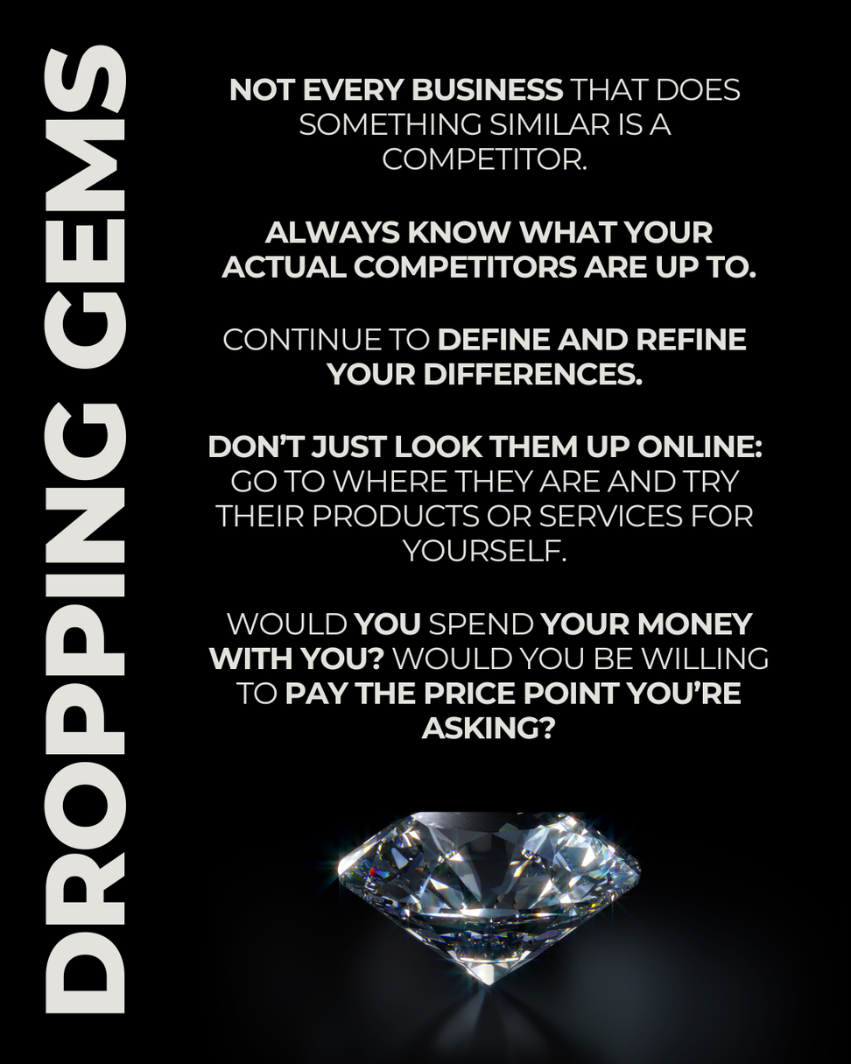

Slide 23


Slide 24
Question 1 of 5
Who are your competitors?
Choose only ONE best answer.
A - This answer is correct.
A company that provides the same or similar services that you do that has similar resources to you.
B
A company that provides the same or similar services that you do that has way more or way less resources than you.
Quiz
Question 4 of 5
Which of the following are types of market research?
Choose only ONE best answer.
A
Numerical/quantitative, for example, analyzing statistics like demographics
B
Qualitative, for example, conducting focus groups and surveys
C - This answer is correct.
Both
Question 5 of 5
You need a lot of money and resources to conduct market research.
Choose only ONE best answer.
A
TRUE, it can be really expensive to conduct market research.
B - This answer is correct.
FALSE, there are more affordable ways to conduct market research such as reaching out to customers on social media and asking them what they think of your product.
Question 2 of 5
Which of the following are features of a product?
Choose only ONE best answer.
A - This answer is correct.
Statements about your product such as what it can do, its dimensions, specs, etc.
B
The end result of what a product can actually accomplish for the customer
Question 3 of 5
What is the difference between benefit and value?
Choose only ONE best answer.
A - This answer is correct.
Value corresponds to worth, whereas a product or service’s benefit is all about what it can do for the customer
B
Benefit corresponds to worth, whereas a product or service’s value is all about what it can do for the customer

