Slide 1

Tokenization Station

Slide 2

Opening Remarks
Save millions of dollars
Reduced risk of lawsuits and large fines
Reduced risk of bad public image
Reduced risk of an attacker gaining access to personal data – Protecting our Customers!
Happy Customers – Happy Us!

Slide 3
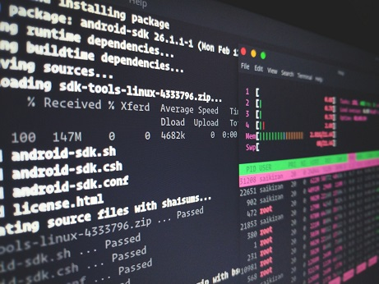
How?
Tokenization of PAN data through the use of zero-knowledge proofs.
Preserve BIN information to allow unchanged routing for BAU.
One-way hash of account number
Automated update between systems through GIT
Diff control and complete history (GIT)

Slide 4
Zero-Knowledge Proof
Idea is to prove a piece of data between two endpoints is equal without sending the sensitive data
Some data is converted to a new piece of data that is irreversible and by no means related to the original
This irreversible data is then sent to a receiving location (another internal system)
That internal system will then run a check against this irreversible data to confirm it is the intended piece of information
If the data has been tampered with in any way, the receiving system will be unable to look up the corresponding value and it is then marked as invalid

Slide 5
Demo Time!
Read in .db file
Dump the tokenized lookup database
Detokenize a PAN for use
Tokenize a single PAN and add to .db
Export to distribute to other internal apps
Automated updated to other internal systems of new changes to .db

Slide 6

Where to go from here?
Addition of encryption algorithms to encrypt database
Cryptographic hash function for tokenization rather than in-house solution
Feedback from internal apps on more use-cases
Possibly migrated to cloud for greater scalability

Slide 7

Questions ?

