Slide 1
Presentation: Development of an E-commerce Sales Chatbot Presenter: Shubh Kumar

Slide 2
Project Overview
Objective: Build a chatbot that enhances customer shopping experience on an e-commerce platform
Features: Login, product search, product display, session management
Scope: Focused on one product category with 100 mock items

Slide 3
Technology Stack
Frontend: React.js for responsive and modular UI
Backend: Python Flask for REST API and session management
Database: MySQL (MySQL Workbench) storing product and user data
Tools: VS Code, PowerShell, npm, pip

Slide 4
System Architecture
React frontend communicates with Flask backend via REST APIs
Flask backend connects to MySQL database
Session management using Flask sessions and cookies
Flow: User login → Chat input → Backend processes query → Results returned and displayed

Slide 5
Implementation Details
User authentication with hashed passwords using bcrypt
Chatbot interface accepts user queries and sends to backend
Backend searches products using SQL LIKE queries
Products displayed in cards with image, name, price, category
Session continuity maintained during interaction
Conversation reset button available

Slide 6
Challenges and Solutions
Session continuity: Managed Flask sessions with proper CORS and cookies
Mock data population: Created SQL script with 100 randomized product entries
UI design: Built an intuitive chatbot interface for easy product exploration

Slide 7
Demo & Sample Queries
Search queries like: "Product 10", "Electronics", "Books"
Display of matching product cards
Login and session maintained during chat

Slide 8
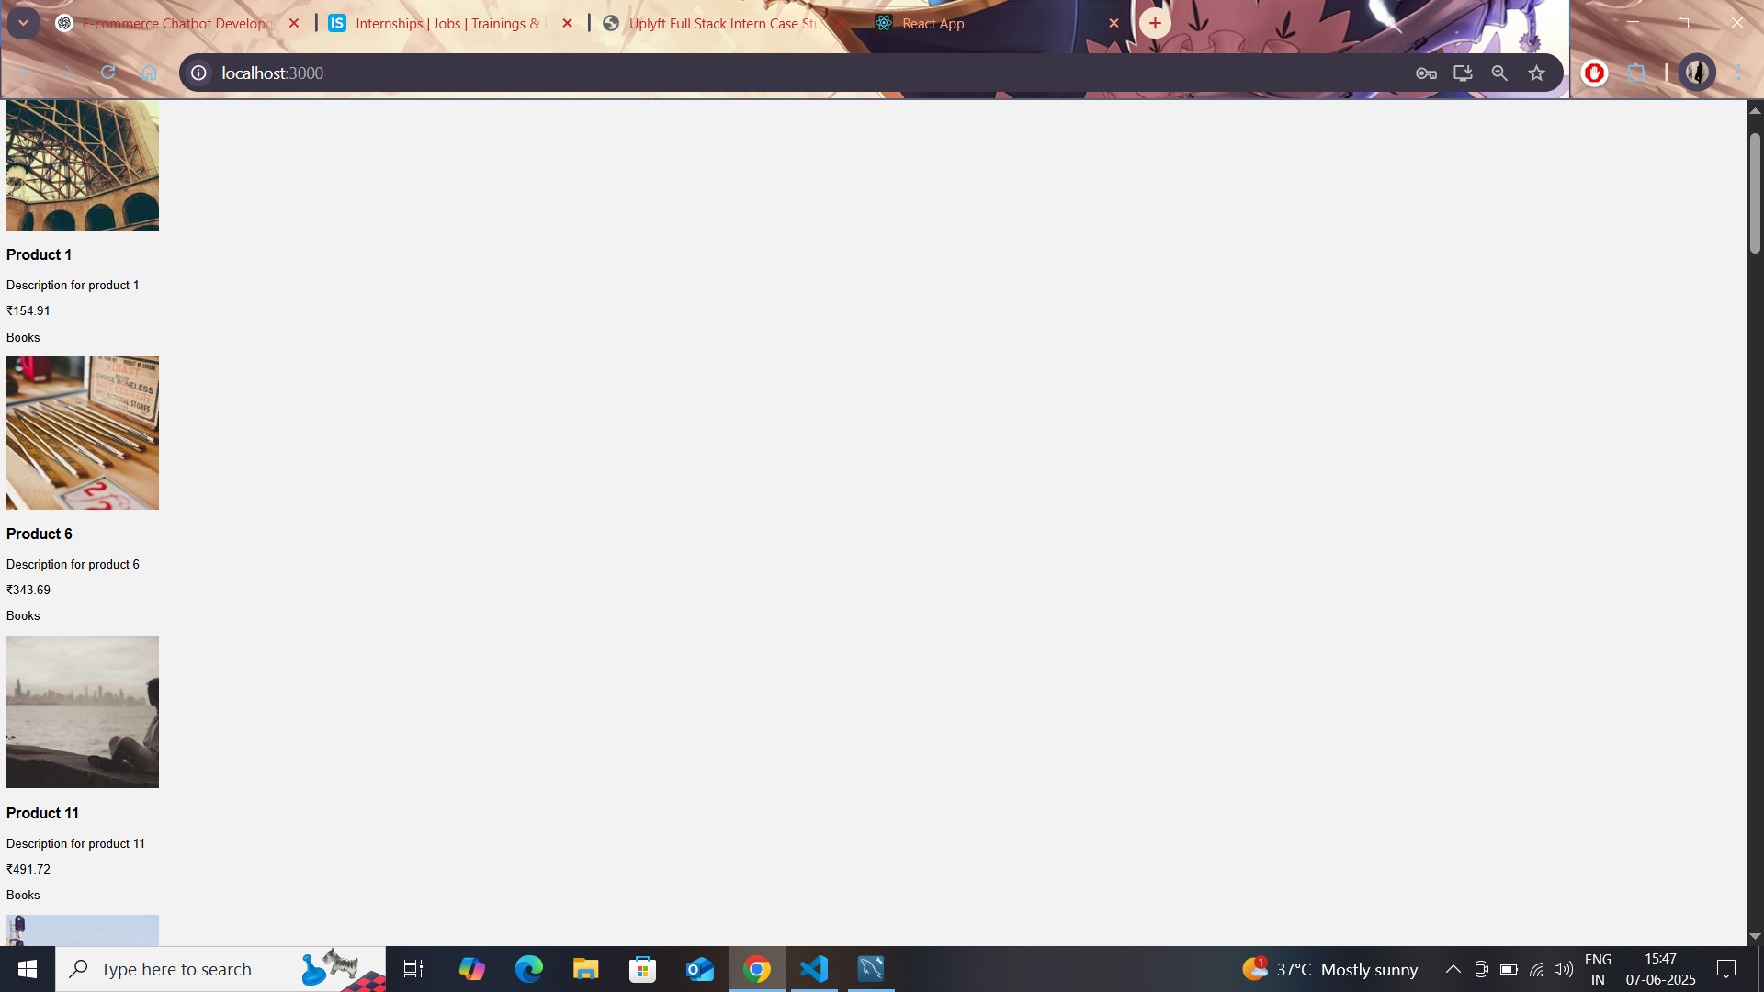

Slide 9
Learnings and Future Enhancements
Full-stack integration experience with React, Flask, and MySQL
Importance of secure session management in web apps
Clean, modular, and maintainable code practices
Future: Add NLP for natural language queries, shopping cart, checkout, improved security with JWT

Slide 10
THANK YOU

