Slide 1

APEX INSTITUTE OF TECHNOLOGY
DEPARTMENT OF COMPUTER SCIENCE & ENGINEERING
Design and Analysis of Algorithm
24CSH-282
Master Subject Coordinator- Er. Kriti Taneja (E13537)
Topic- Introduction to Algorithms, Ordered Notations
DISCOVER . LEARN . EMPOWER

Slide 2
Course Objectives
The Course aims to:
The Student will acquire knowledge on Proving Algorithm Correctness.
To analyze and design different algorithms based on different designing approaches.
To choose appropriate algorithm design techniques for solving real-time problems.
To apply and synthesize efficient algorithms.
.

Slide 3
Course Outcomes
On completion of this course, the students shall be able to:-
CO1 | Understand the fundamental concepts of algorithm analysis, ordered notations, recurrence relations, greedy methods, and backtracking techniques.
CO2 | Apply various sorting algorithms, searching algorithms, graph algorithms and algorithmic techniques to solve computational problems effectively.
CO3 | Analyze the performance and efficiency of different algorithms in various scenarios, various classes for complex problems like P, NP and NP Complete, NP Hard.
CO4 | Evaluate and compare algorithmic strategies including dynamic programming, divide-and-conquer, greedy methods and Branch & Bound.
CO5 | Design and implement optimized solutions for complex problems using advanced algorithmic techniques.

Slide 4
Unit-1 Syllabus
UNIT-1 | Introduction, Algorithm Design Techniques, Back Tracking | Contact Hours:15
Introduction | Ordered Notations, Inductions, Pigeon hole principles, Recurrence Relations
Algorithm Design Techniques | Greedy Algorithms for Knapsack Fractional Problem, Job Sequencing Problem with the deadline, Huffman Coding, Amortization, Optimal Algorithms.
Back Tracking | Understanding of Back Tracking, Recursive Back Tracking, Iterative Back Tracking, N-Queen’s Problem, Hamiltonian Cycle, Knight’s Tour Problem, Lower –Bound Theory.

Slide 5
Topics to be covered
Introduction to Algorithms
Ordered Notations

Slide 6
Design and Analysis of Algorithm
Design and Analysis of Algorithm is very important for designing algorithm to solve different types of problems in the branch of computer science and information technology.

Slide 7
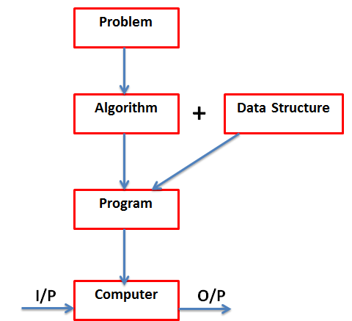
Basic Concept

Slide 8
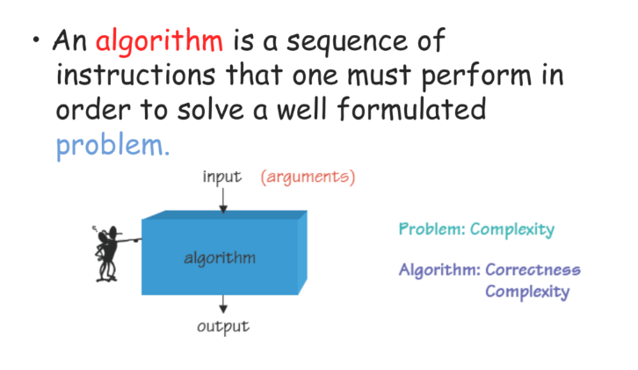
Introduction to Algorithm

Slide 9
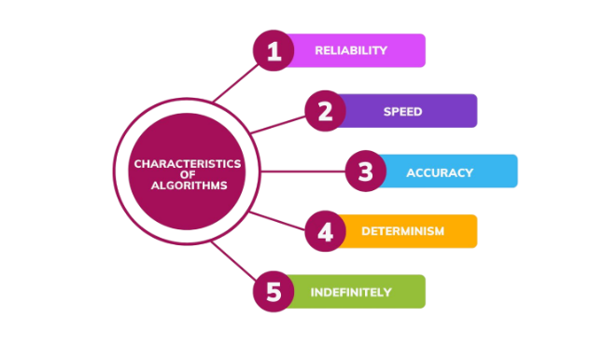
Characteristics of a Good Algorithm

Slide 10
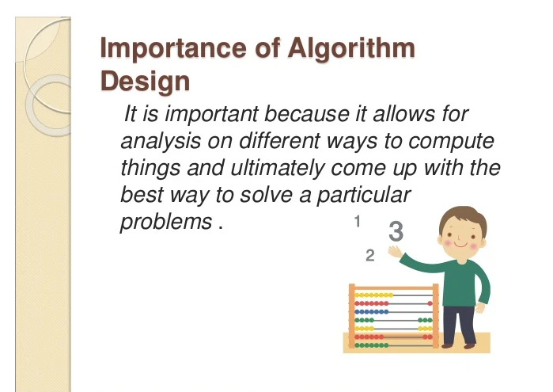
Importance of Studying Algorithms

Slide 11
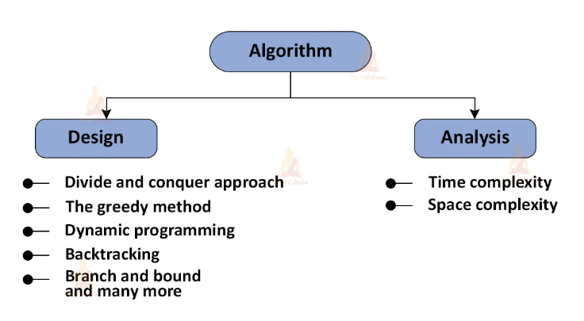
Analysis of Algorithms
.

Slide 12
Ordered Notations
In Design and Analysis of Algorithms, ordered notations are mathematical tools used to describe the running time or space requirement of an algorithm as the input size n → ∞.

Slide 13
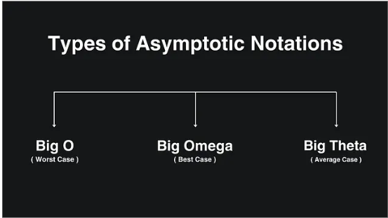
Types of Ordered Notations

Slide 14
Big-oh notation (O)
(Asymptotic Upper Bound)
‘O’ (Big Oh) is the most commonly used notation. A function f(n) can be represented is the order of g(n) that is O(g(n)), if there exists a value of positive integer n as n₀ and a positive constant c
Hence, function g(n) is an upper bound for function f(n), as g(n) grows ffaster than (n).

Slide 15
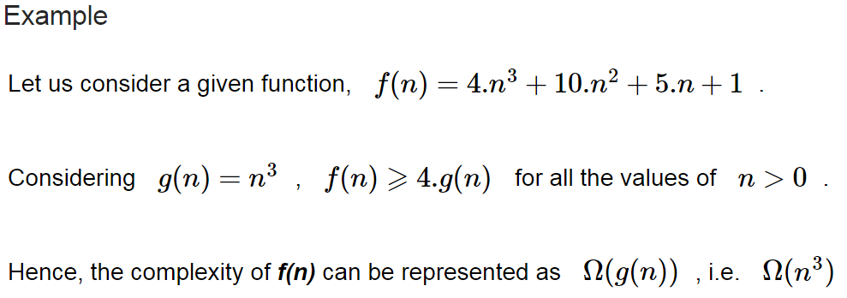
Omega Notation(Ω)
(Asymptotic Lower Bound)
We say that f(n)=Ω(g(n)) when there exists constant c that f(n)⩾c.g(n) for all sufficiently large value of n. Here n is a positive integer. It means function g is a lower bound for function f; after a certain value of n, f will never go below g.

Slide 16
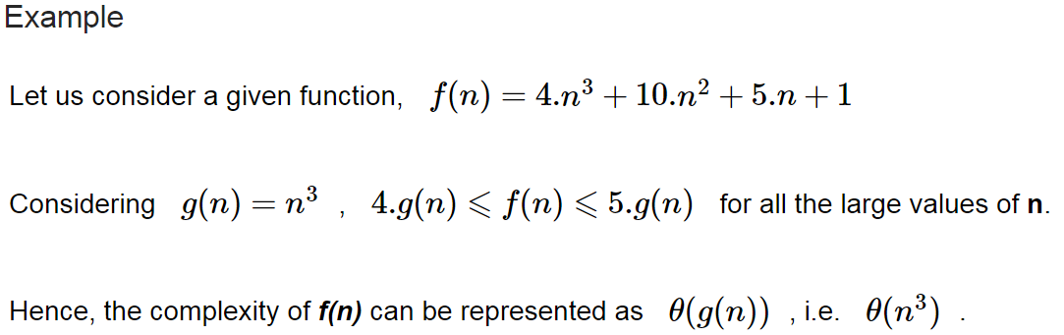
Theta (θ)
(Asymptotic Tight Bound)
We say that f(n)=θ(g(n)) when there exist constants c₁ and c₂ that c1.g(n)⩽f(n)⩽c2.g(n) for all sufficiently large value of n. Here n is a positive integer.
This means function g is a tight bound for function f.

Slide 17
Little ο asymptotic notation
Big-Ο is used as a tight upper-bound on the growth of an algorithm’s effort (this effort is described by the function f(n)), even though, as written, it can also be a loose upper-bound. “Little-ο” (ο()) notation is used to describe an upper-bound that cannot be tight.

Slide 18
Little ω asymptotic notation
Let f(n) and g(n) be functions that map positive integers to positive real numbers. We say that f(n) = ω(g(n)) if for any real constant c > 0, there exists an integer constant n0 ≥ 1 such that f(n) > c * g(n) ≥ 0 for every integer n ≥ n0.
f(n) has a higher growth rate than g(n),so main difference between Big Omega (Ω) and little omega (ω) lies in their definitions:
In the case of Big Omega f(n)=Ω(g(n)) and the bound is 0<=c*g(n)<=f(n),
but in case of little omega, it is true for 0<=c*g(n)<f(n).

Slide 19
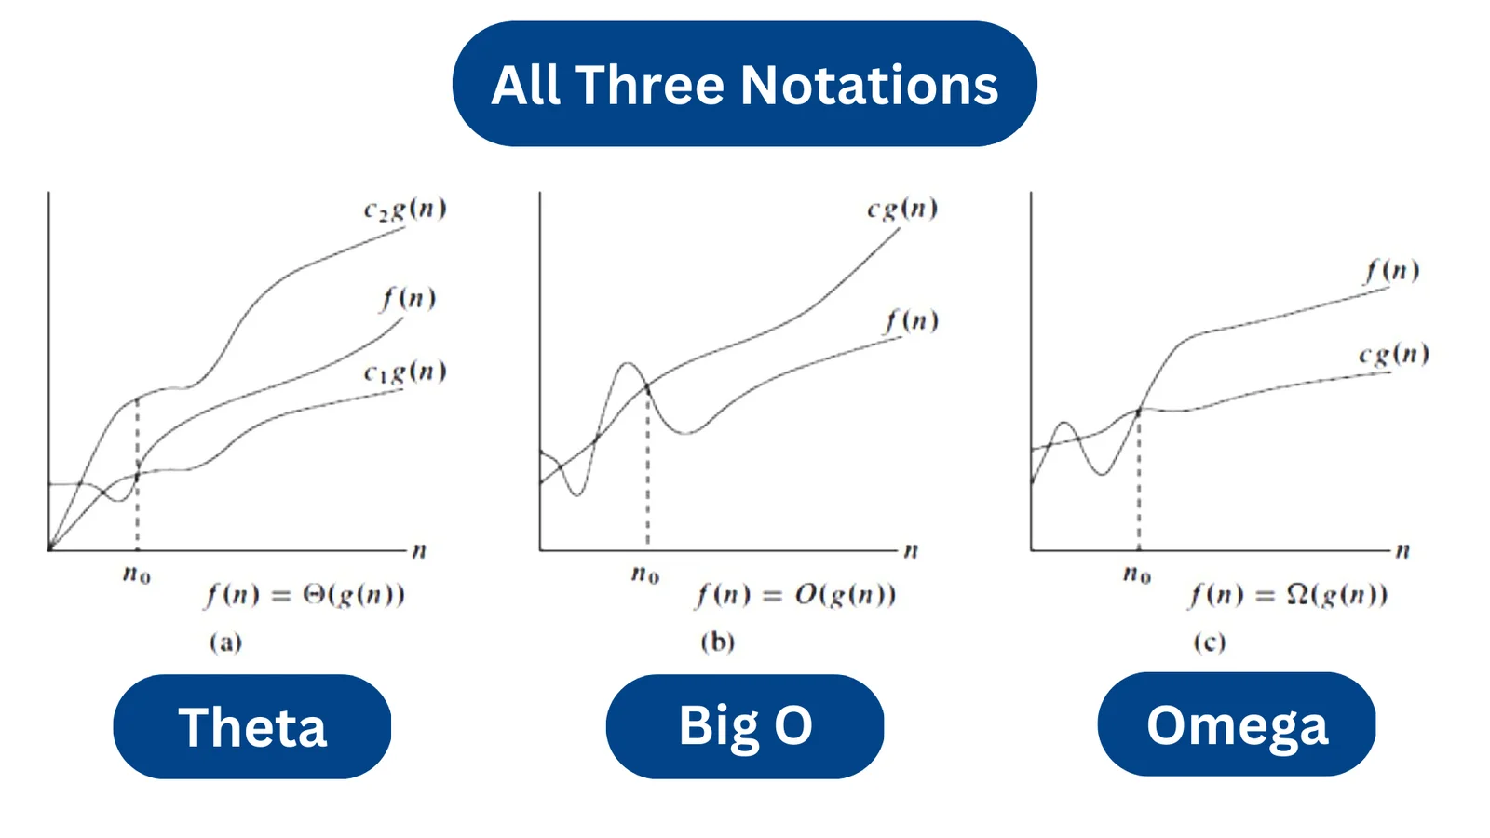

Slide 20
Next Lecture
Inductions…..

Slide 21
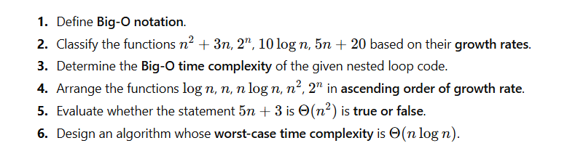
Practice Questions

Slide 22
References/ Articles/ Videos
Text books:
Cormen, Leiserson, Rivest, Stein, “Introduction to Algorithms”, Prentice Hall of India, 3rd edition 2012. problem, Graph coloring.
Horowitz, Sahni and Rajasekaran, “Fundamentals of ComputerAlgorithms”, University Press (India), 2nd edition
Websites:
https://www.geeksforgeeks.org/introduction-to-algorithms/
https://www.tutorialspoint.com/design_and_analysis_of_algorithms/index.htm
Video Links:
https://youtu.be/UglQN5S9-lc?si=0g26HAB8i7TO1hFc
https://youtu.be/EolP-WNP-Zc?si=7OBaaU35ebbBzd4Y
https://youtu.be/9mjGoOBy8vs?si=aWk8KncPVCHIUD9m

Slide 23
Faculty-curated videos, NPTEL, Coursera, LinkedIn, or other relevant learning resources
https://onlinecourses.nptel.ac.in/noc23_cs96/preview
https://nptel.ac.in/courses/106106131
https://nptel.ac.in/courses/106106208
https://www.linkedin.com/learning/learning-algorithms

Slide 24

Class-Wise Feedback
https://forms.gle/hDw6VtS7k2r4amVF7
Kindly scan the QR code to fill out the feedbackform. Your input is valuable for enhancingteaching quality and course delivery.​

Slide 25
THANK YOU
For queries
Email: kriti.e13537@cumail.in

