Slide 1

APEX INSTITUTE OF TECHNOLOGY
DEPARTMENT OF COMPUTER SCIENCE & ENGINEERING
Design and Analysis of Algorithm
24CSH-282
Master Subject Coordinator- Er. Kriti Taneja (E13537)
Topic- Pigeonhole Principle
DISCOVER . LEARN . EMPOWER

Slide 2
Course Objectives
The Course aims to:
The Student will acquire knowledge on Proving Algorithm Correctness
To analyze and design different algorithms based on different designing approaches.
To choose appropriate algorithm design techniques for solving real-time problems.
To apply and synthesize efficient algorithms.
.

Slide 3
Course Outcomes
On completion of this course, the students shall be able to:-
CO1 | Understand the fundamental concepts of algorithm analysis, ordered notations, recurrence relations, greedy methods, and backtracking techniques.
CO2 | Apply various sorting algorithms, searching algorithms, graph algorithms and algorithmic techniques to solve computational problems effectively.
CO3 | Analyze the performance and efficiency of different algorithms in various scenarios, various classes for complex problems like P, NP and NP Complete, NP Hard.
CO4 | Evaluate and compare algorithmic strategies including dynamic programming, divide-and-conquer, greedy methods and Branch & Bound.
CO5 | Design and implement optimized solutions for complex problems using advanced algorithmic techniques.

Slide 4
Unit-1 Syllabus
UNIT-1 | Introduction, Algorithm Design Techniques, Back Tracking | Contact Hours:15
Introduction | Ordered Notations, Inductions, Pigeon hole principles, Recurrence Relations
Algorithm Design Techniques | Greedy Algorithms for Knapsack Fractional Problem, Job Sequencing Problem with the deadline, Huffman Coding, Amortization, Optimal Algorithms.
Back Tracking | Understanding of Back Tracking, Recursive Back Tracking, Iterative Back Tracking, N-Queen’s Problem, Hamiltonian Cycle, Knight’s Tour Problem, Lower –Bound Theory.

Slide 5
Topic to be Covered
Pigeonhole Principle

Slide 6
Pigeonhole Principle
The Pigeonhole Principle (PHP) is a simple but very
powerful mathematical principle used in algorithm
analysis, combinatorics, and proof techniques.

Slide 7
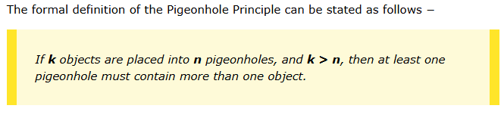

Slide 8
Pigeonhole Principle
In algorithms, PHP helps in:
Proving existence of solutions
Designing and analyzing hashing
Showing collisions must happen
Proving lower bounds in algorithms
Showing that certain patterns must repeat

Slide 9
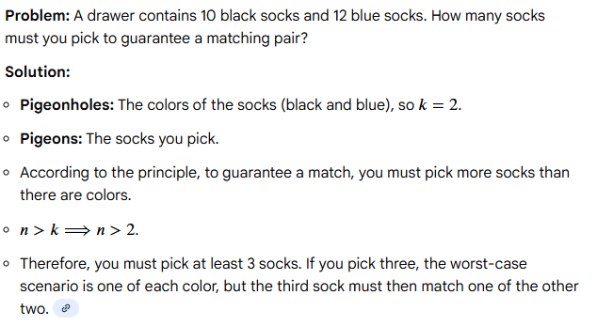
Example 1: Matching socks

Slide 10
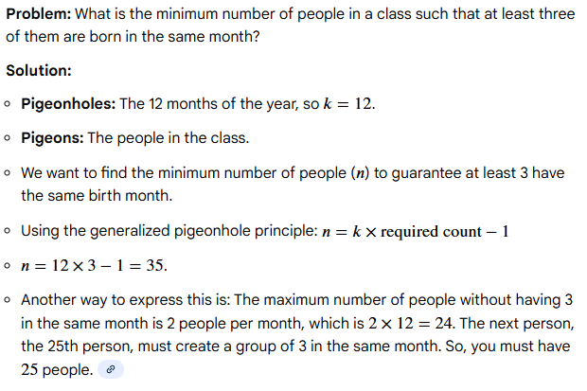
Example 2: Birthdays

Slide 11
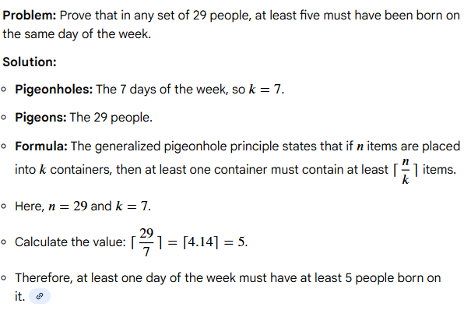
Example 3: Days of the week

Slide 12
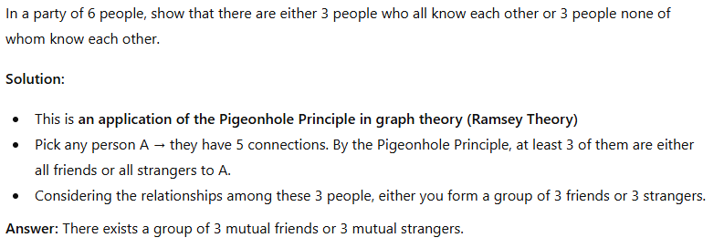
Example 4: Handshake Problem

Slide 13
Next Lecture
Recurrence Relations……….

Slide 14
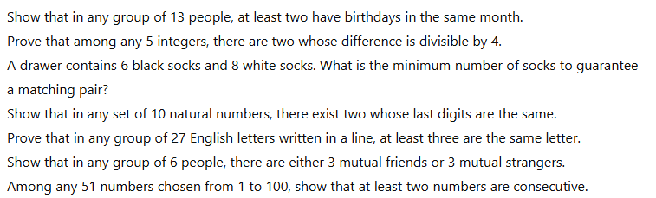
Practice Questions

Slide 15
References
Text Books:
Cormen, T. H., Leiserson, C. E., Rivest, R. L., & Stein, C. (2022). Introduction to Algorithms (4th ed.). The MIT Press.
Horowitz, E., Sahni, S., & Rajasekaran, S. (2008). Fundamentals of Computer Algorithms (2nd ed.). Universities Press (India).
Sedgewick, R., & Wayne, K. (2011). Algorithms (4th ed.). Addison-Wesley.
Reference Books:
Tenenbaum, A. M., Augenstein, M. J., & Langsam, Y. (2009). Data Structures using C and C++ (2nd ed.). Prentice Hall of India.
Brassard, G., & Bratley, P. (1996). Fundamentals of Algorithmics. Prentice Hall of India.
Video Links:
https://youtu.be/UglQN5S9-lc?si=0g26HAB8i7TO1hFc
https://youtu.be/EolP-WNP-Zc?si=7OBaaU35ebbBzd4Y
https://youtu.be/9mjGoOBy8vs?si=aWk8KncPVCHIUD9m

Slide 16

Class-Wise Feedback
https://forms.gle/hDw6VtS7k2r4amVF7
Kindly scan the QR code to fill out the feedbackform. Your input is valuable for enhancingteaching quality and course delivery.​

Slide 17
THANK YOU
For queries
Email: kriti.e13537@cumail.in

