Slide 1

APEX INSTITUTE OF TECHNOLOGY
DEPARTMENT OF COMPUTER SCIENCE & ENGINEERING
Design and Analysis of Algorithm
24CSH-282
Master Subject Coordinator- Er. Kriti Taneja (E13537)
Topic- Recurrence Relations
DISCOVER . LEARN . EMPOWER

Slide 2
Course Objectives
The Course aims to:
The Student will acquire knowledge on Proving Algorithm Correctness.
To analyze and design different algorithms based on different designing approaches.
To choose appropriate algorithm design techniques for solving real-time problems.
To apply and synthesize efficient algorithms.
.

Slide 3
Course Outcomes
On completion of this course, the students shall be able to:-
CO1 | Understand the fundamental concepts of algorithm analysis, ordered notations, recurrence relations, greedy methods, and backtracking techniques.
CO2 | Apply various sorting algorithms, searching algorithms, graph algorithms and algorithmic techniques to solve computational problems effectively.
CO3 | Analyze the performance and efficiency of different algorithms in various scenarios, various classes for complex problems like P, NP and NP Complete, NP Hard.
CO4 | Evaluate and compare algorithmic strategies including dynamic programming, divide-and-conquer, greedy methods and Branch & Bound.
CO5 | Design and implement optimized solutions for complex problems using advanced algorithmic techniques.

Slide 4
Unit-1 Syllabus
UNIT-1 | Introduction, Algorithm Design Techniques, Back Tracking | Contact Hours:15
Introduction | Ordered Notations, Inductions, Pigeon hole principles, Recurrence Relations
Algorithm Design Techniques | Greedy Algorithms for Knapsack Fractional Problem, Job Sequencing Problem with the deadline, Huffman Coding, Amortization, Optimal Algorithms.
Back Tracking | Understanding of Back Tracking, Recursive Back Tracking, Iterative Back Tracking, N-Queen’s Problem, Hamiltonian Cycle, Knight’s Tour Problem, Lower –Bound Theory.

Slide 5
Topic to be Covered
Recurrence Relations
Substitution method
Recursion-tree method
Master method

Slide 6
Recurrence Relations
A recurrence relation is an equation that defines a sequence of values using previous terms of the sequence. In simpler words, it expresses the solution of a problem in terms of smaller instances of the same problem.

Slide 7
Definition
A recurrence relation, T(n), is a recursive function of integer variable n.
Like all recursive functions, it has both recursive case and base case.
Example:

Slide 8
Components of a Recurrence Relation
It has 2 main components:
Recurrence Equation (Relation)
This part defines how the current term of the sequence depends on previous terms.
Initial Condition(s)
These are the starting values needed to compute the rest of the sequence.

Slide 9
Types of Recurrence Relations
Linear Recurrence Relation
A linear recurrence relation is a recurrence relation in which each term is a linear combination of previous terms.
Example: aₙ = 3aₙ₋₁ + 2aₙ₋₂
Non-Linear Recurrence Relation
A non-linear recurrence relation is a recurrence relation in which the terms are combined in a non-linear way (multiplication, powers, division, etc.).
Example: aₙ = aₙ₋₁ · aₙ₋₂ + 1

Slide 10
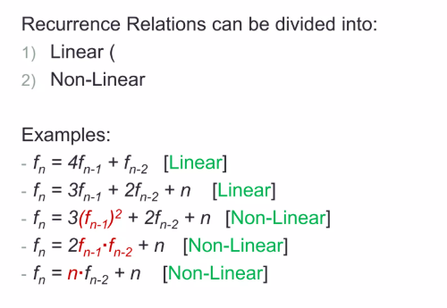
Examples Recurrence Relations

Slide 11
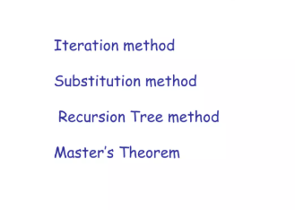
Methods to solve

Slide 12
Iteration method
Steps:
Expand the recurrence
Express the expansion as a summation by plugging the recurrence back into itself until you see a pattern.
Evaluate the summation

Slide 13
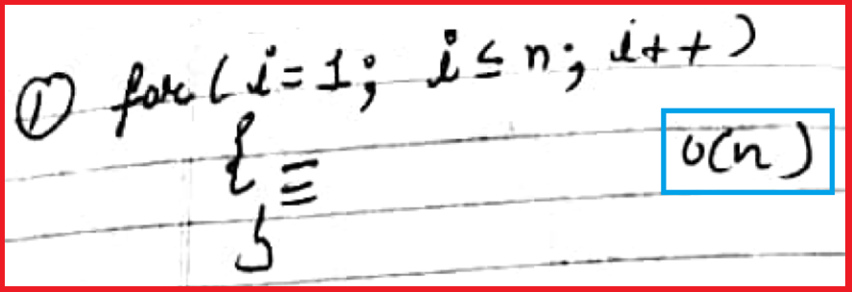
Example 1

Slide 14
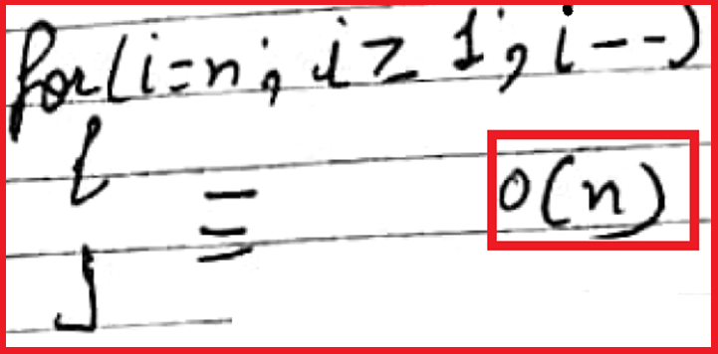
Example 2

Slide 15
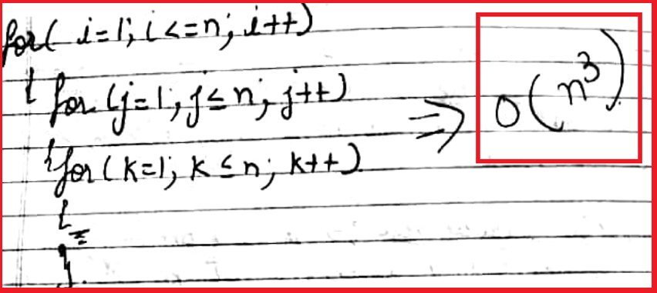
Example 3

Slide 16
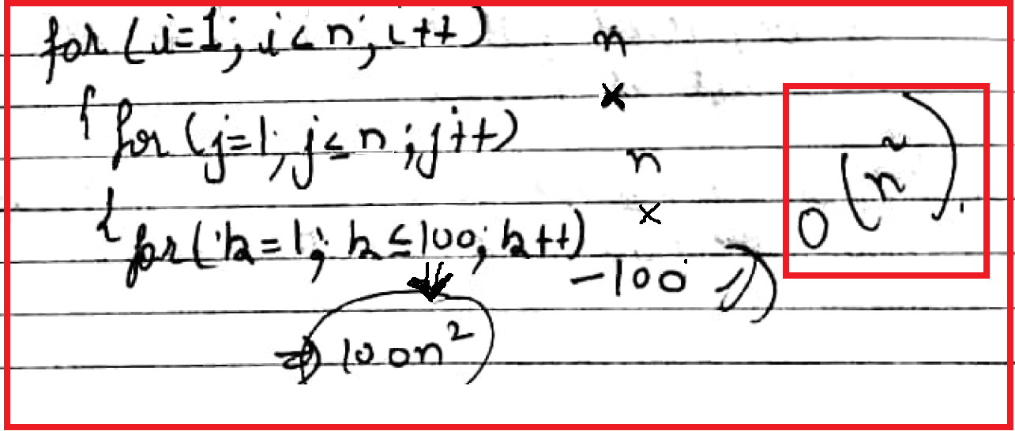
Example 4

Slide 17
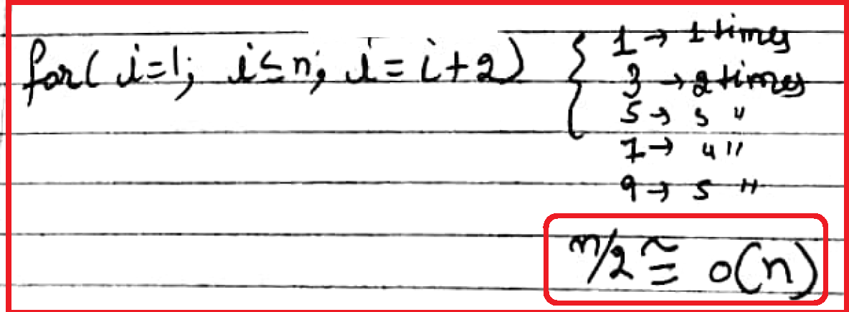
Example 5

Slide 18
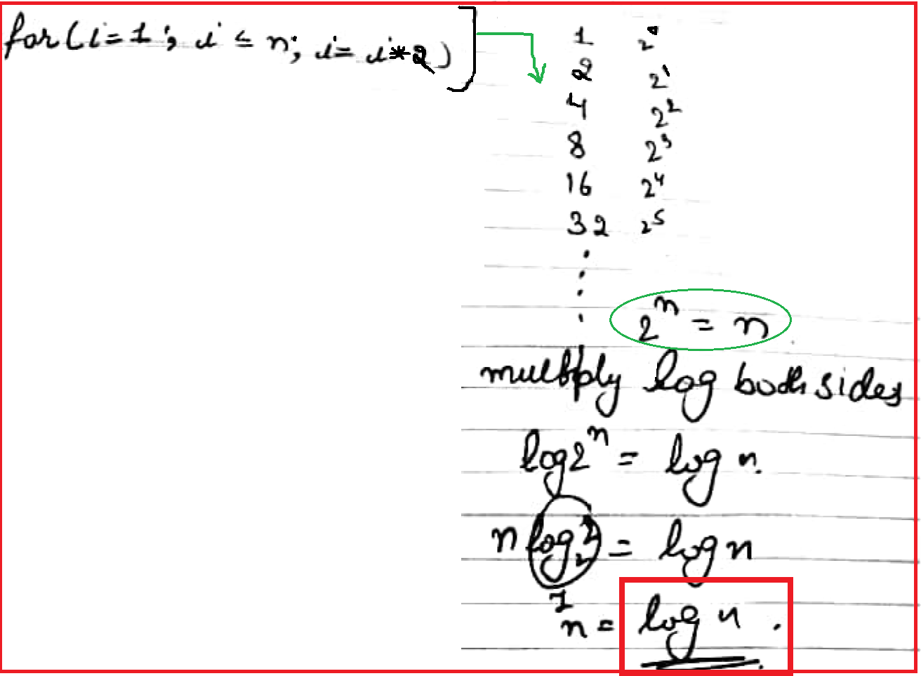
Example 6

Slide 19
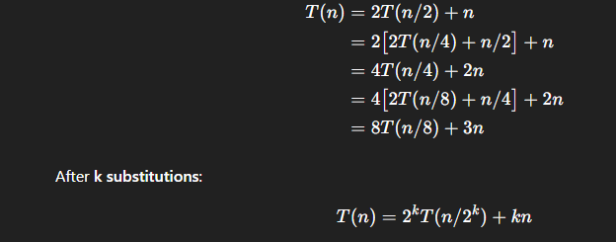
Example of Substitution Method
Given Recurrence
T(n)=2T(n/2)+n
Step 1: Substitute repeatedly
Start expanding the recurrence:

Slide 20
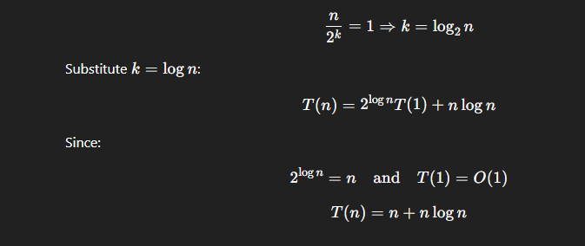
Step 2: Reach the base case
The recursion stops when:

Slide 21

Step 3: Final Result

Slide 22
Substitution Method
The substitution method
The “making a good guess method”
Guess the form of the answer, then use induction to find the constants and show that solution works
Run an example: merge sort
T(n) = 2T(n/2) + cn
We guess that the answer is O(n lg n)
Prove it by induction
Can similarly show T(n) = Ω(n lg n), thus Θ(n lg n)

Slide 23
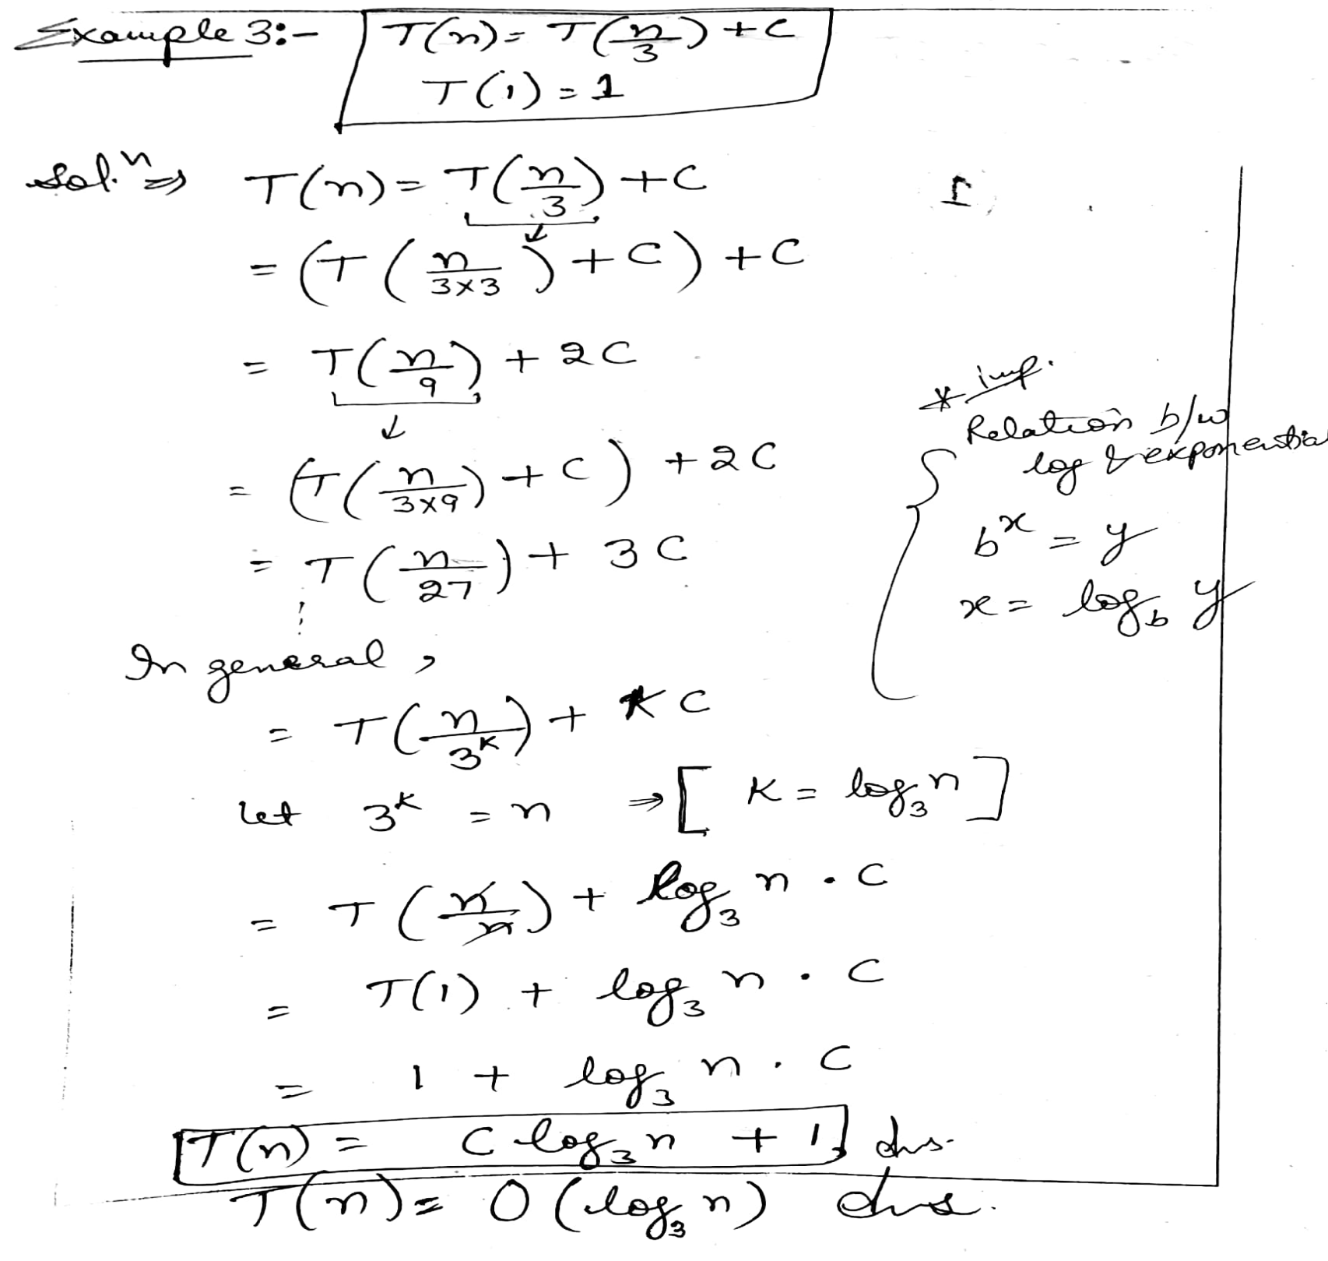

Slide 24
Recursive Tree Methods
A recursion tree models the costs (time) of a recursive execution of an algorithm.
Recursion Tree Method which is in the form of a tree where at each level nodes are expanded.

Slide 25
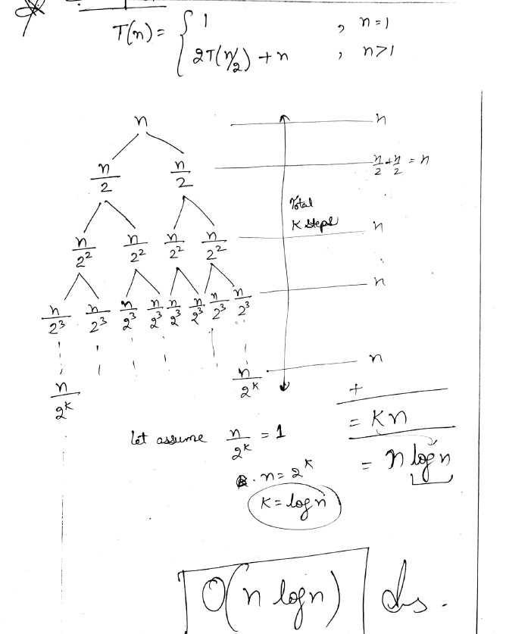

Slide 26
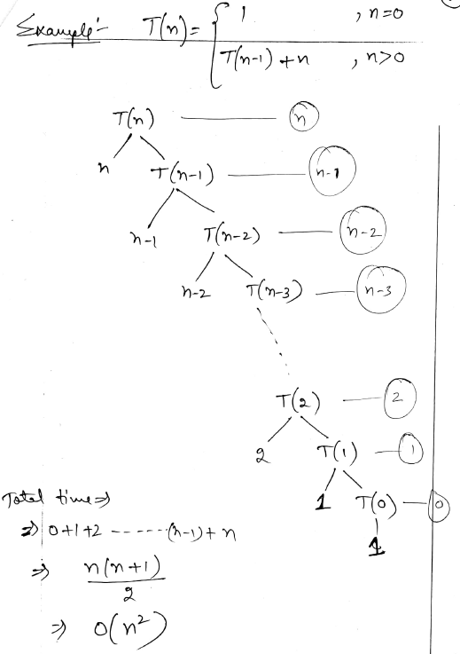

Slide 27
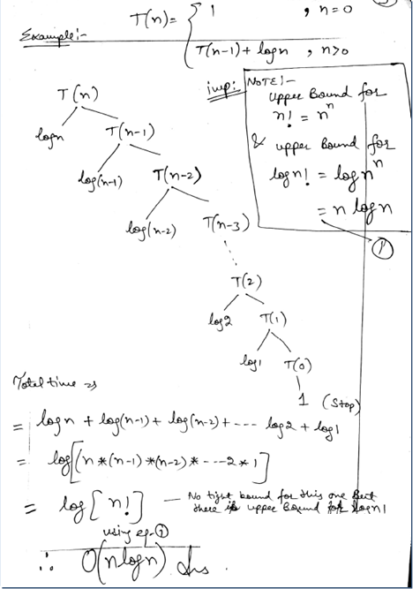

Slide 28
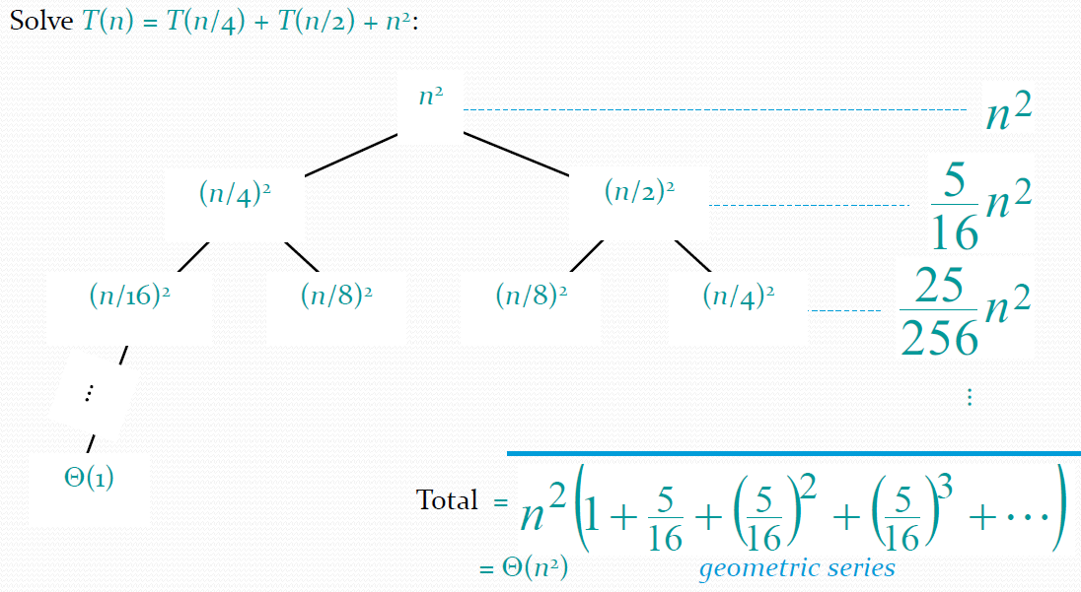
Example of recursion tree

Slide 29
The Master Theorem
Given Recurrence
T(n)=2T(n/2)+n
Step 1: Compare with Master Theorem form
Standard form: T(n)=aT(n/b)+f(n)
From the given recurrence:
a=2
b=2
f(n)=n

Slide 30
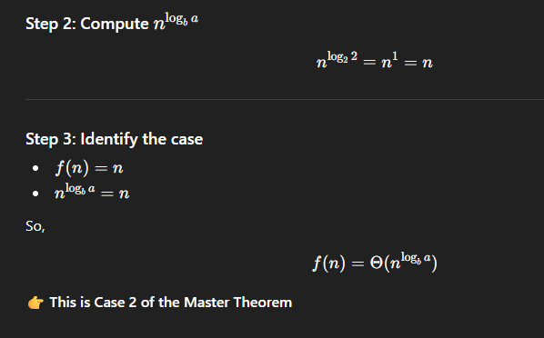

Slide 31
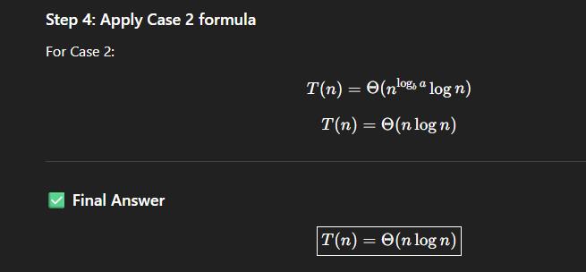

Slide 32
The Master Theorem
Given: a divide and conquer algorithm
An algorithm that divides the problem of size n into
a subproblems, each of size n/b.
Let the cost of each stage (i.e., the work to divide
the problem + combine solved subproblems) be
described by the function f(n).

Slide 33
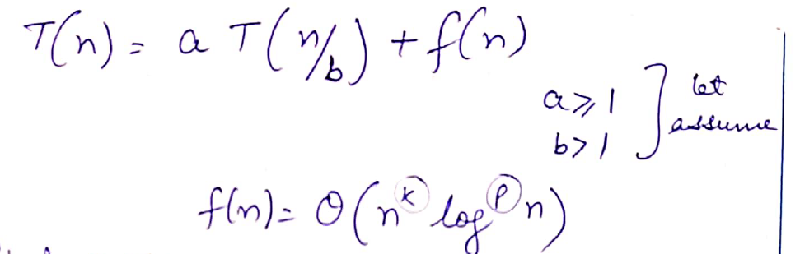

Slide 34
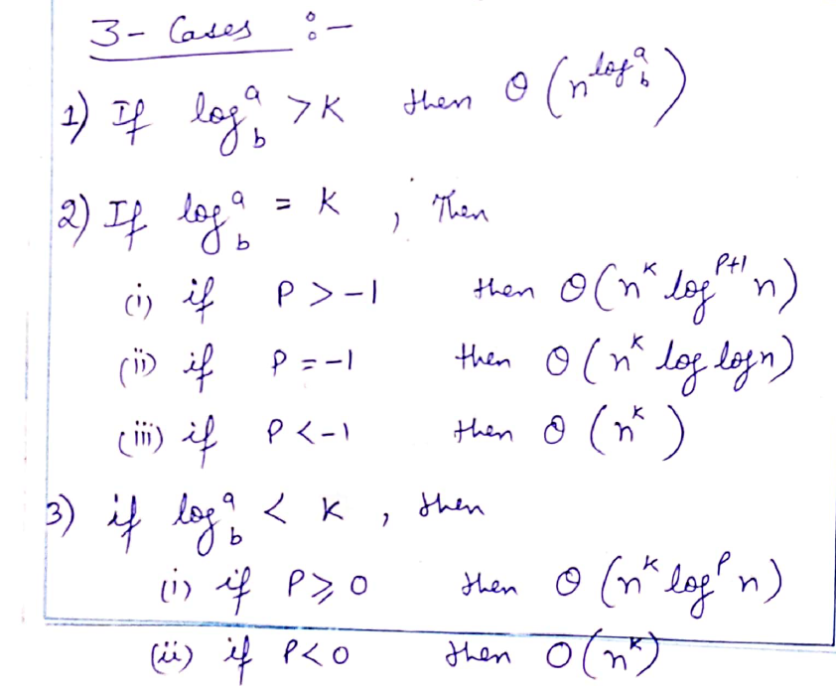

Slide 35
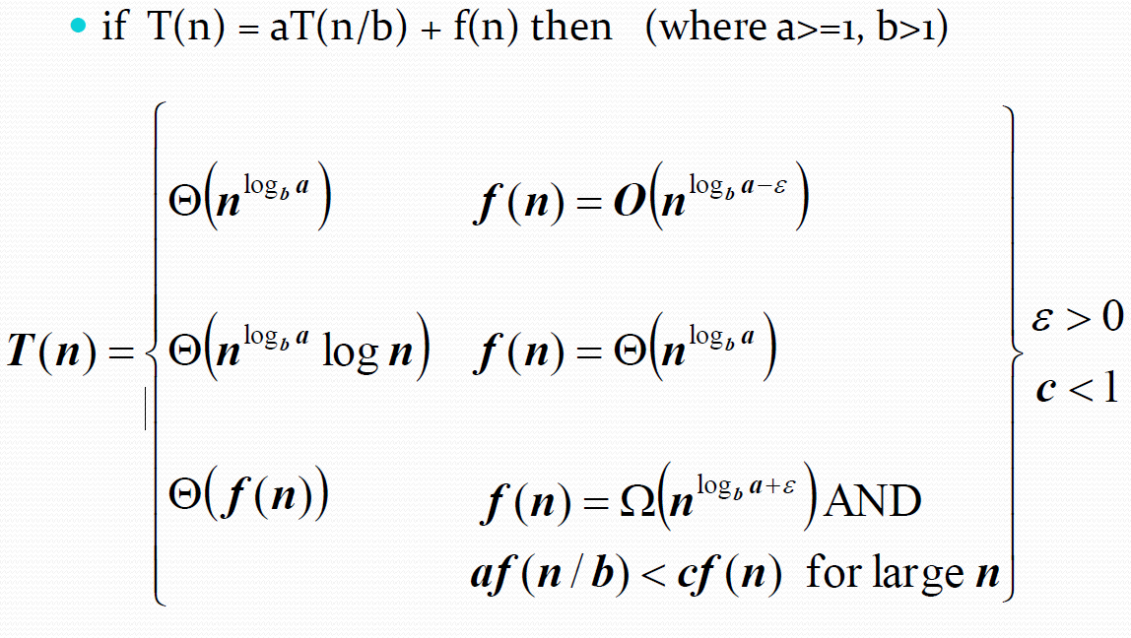
The Master Theorem (Contd..)

Slide 36
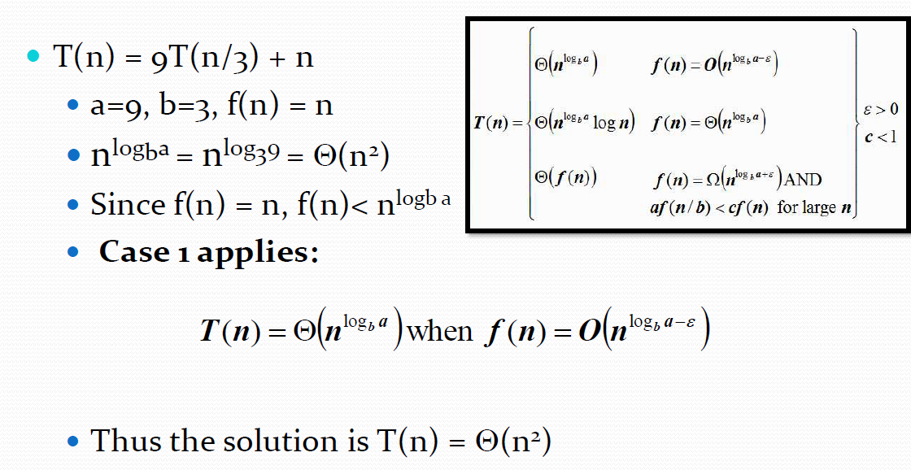
Using the Master Theorem

Slide 37
Need of Recurrence Relations
To represent the running time of recursive and divide-and-conquer algorithms.
To break complex problems into smaller subproblems mathematically.
To analyze time complexity in a systematic and structured way.
To compare efficiency of different recursive algorithms.
To predict performance for large input sizes.
To provide a foundation for methods like substitution, recursion tree, and Master Theorem.

Slide 38
Next Lecture
Greedy Algorithm: Knapsack Fractional Problem……..

Slide 39
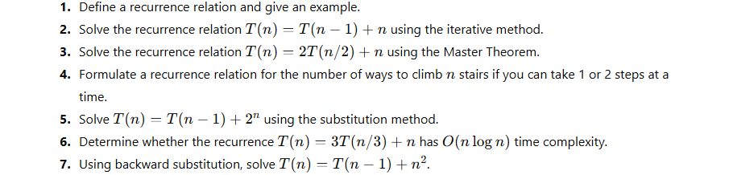
Practice Questions

Slide 40
References
Text Books:
Cormen, T. H., Leiserson, C. E., Rivest, R. L., & Stein, C. (2022). Introduction to Algorithms (4th ed.). The MIT Press.
Horowitz, E., Sahni, S., & Rajasekaran, S. (2008). Fundamentals of Computer Algorithms (2nd ed.). Universities Press (India).
Reference Books:
Tenenbaum, A. M., Augenstein, M. J., & Langsam, Y. (2009). Data Structures using C and C++ (2nd ed.). Prentice Hall of India.
Brassard, G., & Bratley, P. (1996). Fundamentals of Algorithmics. Prentice Hall of India.
Video Links:
https://youtu.be/UglQN5S9-lc?si=0g26HAB8i7TO1hFc
https://youtu.be/EolP-WNP-Zc?si=7OBaaU35ebbBzd4Y
https://youtu.be/9mjGoOBy8vs?si=aWk8KncPVCHIUD9m
https://youtu.be/GQNT0v5zKhE?si=0jfN658mPE41ZFU9

Slide 41
Faculty-curated videos, NPTEL, Coursera, LinkedIn, or other relevant learning resources
https://onlinecourses.nptel.ac.in/noc23_cs96/preview
https://nptel.ac.in/courses/106106131
https://nptel.ac.in/courses/106106208
https://www.linkedin.com/learning/learning-algorithms

Slide 42
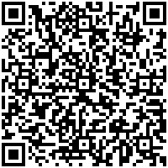
Class-Wise Feedback
https://forms.gle/hDw6VtS7k2r4amVF7
Kindly scan the QR code to fill out the feedbackform. Your input is valuable for enhancingteaching quality and course delivery.​

Slide 43
THANK YOU
For queries
Email: kriti.e13537@cumail.in

