Slide 1
Building Java Programs
Chapter 8
Classes
Copyright (c) Pearson 2013.
All rights reserved.

Slide 2
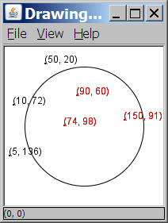
A programming problem
Given a file of cities' (x, y) coordinates,
which begins with the number of cities:
  6
  50 20
  90 60
  10 72
  74 98
  5 136
  150 91
Write a program to draw the cities on a DrawingPanel, then drop a "bomb" that turns all cities red that are within a given radius:
  Blast site x? 100
  Blast site y? 100
  Blast radius? 75
  Kaboom!

Slide 3
A bad solution
  Scanner input = new Scanner(new File("cities.txt"));
  int cityCount = input.nextInt();
  int[] xCoords = new int[cityCount];
  int[] yCoords = new int[cityCount];
  for (int i = 0; i < cityCount; i++) {
  xCoords[i] = input.nextInt(); // read each city
  yCoords[i] = input.nextInt();
  }
  ...
  parallel arrays: 2+ arrays with related data at same indexes.
    Considered poor style.

Slide 4
Observations
The data in this problem is a set of points.
It would be better stored as Point objects.
  A Point would store a city's x/y data.
  We could compare distances between Points
  to see whether the bomb hit a given city.
  Each Point would know how to draw itself.
  The overall program would be shorter and cleaner.

Slide 5

Clients of objects
client program: A program that uses objects.
  Example: Bomb is a client of DrawingPanel and Graphics.
Bomb.java (client program)
public class Bomb {
main(String[] args) {
new DrawingPanel(...)
new DrawingPanel(...)
...
}
}
DrawingPanel.java (class)
public class DrawingPanel {
...
}

Slide 6
Classes and objects
class: A program entity that represents either:
  1. A program / module, or
  2. A template for a new type of objects.
  The DrawingPanel class is a template for creating DrawingPanel objects.
object: An entity that combines state and behavior.
  object-oriented programming (OOP): Programs that perform their behavior as interactions between objects.

Slide 7
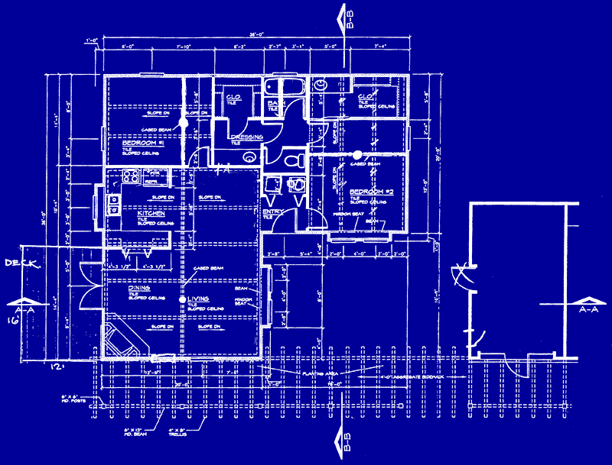
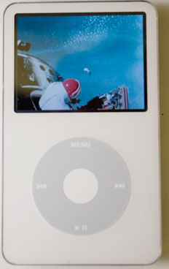
Blueprint analogy
iPod blueprint
state:
current song
volume
battery life
behavior:
power on/off
change station/song
change volume
choose random song
creates
iPod #1
state:
song = "1,000,000 Miles"
volume = 17
battery life = 2.5 hrs
behavior:
power on/off
change station/song
change volume
choose random song
iPod #2
state:
song = "Letting You"
volume = 9
battery life = 3.41 hrs
behavior:
power on/off
change station/song
change volume
choose random song
iPod #3
state:
song = "Discipline"
volume = 24
battery life = 1.8 hrs
behavior:
power on/off
change station/song
change volume
choose random song

Slide 8
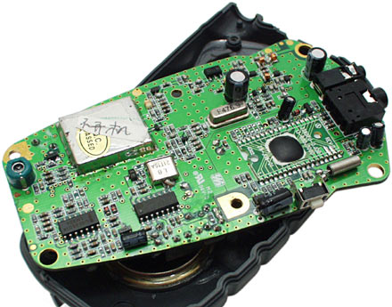
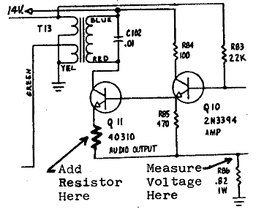
Abstraction
abstraction: A distancing between ideas and details.
  We can use objects without knowing how they work.
abstraction in an iPod:
  You understand its external behavior (buttons, screen).
  You don't understand its inner details, and you don't need to.

Slide 9
Our task
In the following slides, we will implement a Point class as a way of learning about defining classes.
  We will define a type of objects named Point.
  Each Point object will contain x/y data called fields.
  Each Point object will contain behavior called methods.
  Client programs will use the Point objects.

Slide 10
Point objects (desired)
  Point p1 = new Point(5, -2);
  Point p2 = new Point(); // origin, (0, 0)
Data in each Point object:
Methods in each Point object:
Field name | Description
x | the point's x-coordinate
y | the point's y-coordinate
Method name | Description
setLocation(x, y) | sets the point's x and y to the given values
translate(dx, dy) | adjusts the point's x and y by the given amounts
distance(p) | how far away the point is from point p
draw(g) | displays the point on a drawing panel

Slide 11
Point class as blueprint
  The class (blueprint) will describe how to create objects.
  Each object will contain its own data and methods.
Point class
state:
int x, y
behavior:
setLocation(int x, int y)
translate(int dx, int dy)
distance(Point p)
draw(Graphics g)
Point object #1
state:
x = 5, y = -2
behavior:
setLocation(int x, int y)
translate(int dx, int dy)
distance(Point p)
draw(Graphics g)
Point object #2
state:
x = -245, y = 1897
behavior:
setLocation(int x, int y)
translate(int dx, int dy)
distance(Point p)
draw(Graphics g)
Point object #3
state:
x = 18, y = 42
behavior:
setLocation(int x, int y)
translate(int dx, int dy)
distance(Point p)
draw(Graphics g)

Slide 12
Object state: Fields

Slide 13
Point class, version 1
  public class Point {
  int x;
  int y;
  }
  Save this code into a file named Point.java.
The above code creates a new type named Point.
  Each Point object contains two pieces of data:
    an int named x, and
    an int named y.
  Point objects do not contain any behavior (yet).

Slide 14
Fields
field: A variable inside an object that is part of its state.
  Each object has its own copy of each field.
Declaration syntax:
  type name;
  Example:
  public class Student {
  String name; // each Student object has a
  double gpa; // name and gpa field
  }

Slide 15
Accessing fields
Other classes can access/modify an object's fields.
  access: variable.field
  modify: variable.field = value;
Example:
  Point p1 = new Point();
  Point p2 = new Point();
  System.out.println("the x-coord is " + p1.x); // access
  p2.y = 13; // modify

Slide 16
A class and its client
Point.java is not, by itself, a runnable program.
  A class can be used by client programs.
Point.java (class of objects)
public class Point {
int x;
int y;
}
PointMain.java (client program)
public class PointMain {
main(String args) {
Point p1 = new Point();
p1.x = 7;
p1.y = 2;
Point p2 = new Point();
p2.x = 4;
p2.y = 3;
...
}
}
x | 7 | y | 2
x | 4 | y | 3

Slide 17
PointMain client example
public class PointMain {
public static void main(String[] args) {
// create two Point objects
Point p1 = new Point();
p1.y = 2;
Point p2 = new Point();
p2.x = 4;
System.out.println(p1.x + ", " + p1.y); // 0, 2
// move p2 and then print it
p2.x += 2;
p2.y++;
System.out.println(p2.x + ", " + p2.y); // 6, 1
}
}
Exercise: Modify the Bomb program to use Point objects.

Slide 18
Arrays of objects
null : A value that does not refer to any object.
  The elements of an array of objects are initialized to null.
  String[] words = new String[5];
  DrawingPanel[] windows = new DrawingPanel[3];
index | 0 | 1 | 2 | 3 | 4
value | null | null | null | null | null
words
index | 0 | 1 | 2
value | null | null | null
windows

Slide 19
Things you can do w/ null
store null in a variable or an array element
  String s = null;
  words[2] = null;
print a null reference
  System.out.println(s); // null
ask whether a variable or array element is null
  if (words[2] == null) { ...
pass null as a parameter to a method
  System.out.println(null); // null
return null from a method (often to indicate failure)
  return null;

Slide 20
Null pointer exception
dereference: To access data or methods of an object with the dot notation, such as s.length() .
  It is illegal to dereference null (causes an exception).
  null is not any object, so it has no methods or data.
  String[] words = new String[5];
  System.out.println("word is: " + words[0]);
  words[0] = words[0].toUpperCase(); // ERROR
  Output:
  word is: null
  Exception in thread "main" java.lang.NullPointerException
  at Example.main(Example.java:8)
index | 0 | 1 | 2 | 3 | 4
value | null | null | null | null | null

Slide 21
Looking before you leap
You can check for null before calling an object's methods.
  String[] words = new String[5];
  words[0] = "hello";
  words[2] = "goodbye"; // words[1], [3], [4] are null
  for (int i = 0; i < words.length; i++) {
  if (words[i] != null) {
  words[i] = words[i].toUpperCase();
  }
  }
index | 0 | 1 | 2 | 3 | 4
value | "HELLO" | null | "GOODBYE" | null | null
words

Slide 22
Two-phase initialization
  1) initialize the array itself (each element is initially null)
  2) initialize each element of the array to be a new object
  String[] words = new String[4]; // phase 1
  for (int i = 0; i < words.length; i++) {
  coords[i] = "word" + i; // phase 2
  }
index | 0 | 1 | 2 | 3
value | "word0" | "word1" | "word2" | "word3"
words

Slide 23
Bomb answer 1
import java.awt.*;
import java.io.*;
import java.util.*;
// Displays a set of cities and simulates dropping a "bomb" on them.
public class Bomb {
public static void main(String[] args) throws FileNotFoundException {
DrawingPanel panel = new DrawingPanel(200, 200);
Graphics g = panel.getGraphics();
Scanner input = new Scanner(new File("cities.txt"));
Point[] cities = readCities(input, g);
// drop the "bomb"
Scanner console = new Scanner(System.in);
Point bomb = new Point();
System.out.print("Blast site x? ");
bomb.x = console.nextInt();
System.out.print("Blast site y? ");
bomb.y = console.nextInt();
System.out.print("Blast radius? ");
int radius = console.nextInt();
boom(bomb, radius, cities, g);
}
...

Slide 24
Bomb answer 2
// Reads input file of cities and returns them as array of Points.
public static Point[] readCities(Scanner input, Graphics g) {
int numCities = input.nextInt(); // first line = # of cities
Point[] cities = new Point[numCities];
for (int i = 0; i < cities.length; i++) {
cities[i] = new Point();
cities[i].x = input.nextInt(); // read city x/y from file
cities[i].y = input.nextInt();
g.fillOval(cities[i].x, cities[i].y, 3, 3);
g.drawString("(" + cities[i].x + ", " + cities[i].y + ")",
cities[i].x, cities[i].y);
}
return cities;
}
// Simulates dropping a bomb at the given location on the given cities.
public static void boom(Point bomb, int radius, Point[] cities, Graphics g) {
g.setColor(Color.RED);
g.drawOval(bomb.x - radius, bomb.y - radius, 2 * radius, 2 * radius);
for (int i = 0; i < cities.length; i++) {
int dx = cities[i].x - bomb.x;
int dy = cities[i].y - bomb.y;
double distance = Math.sqrt(dx * dx + dy * dy);
if (distance <= radius) {
g.fillOval(cities[i].x, cities[i].y, 3, 3);
g.drawString("(" + cities[i].x + ", " + cities[i].y + ")",
cities[i].x, cities[i].y);
}
}
System.out.println("Kaboom!");
}
}

Slide 25
Object behavior: Methods

Slide 26
Client code redundancy
Our client program wants to draw Point objects:
  // draw each city
  g.fillOval(cities[i].x, cities[i].y, 3, 3);
  g.drawString("(" + cities[i].x + ", " + cities[i].y + ")",
  cities[i].x, cities[i].y);
To draw them in other places, the code must be repeated.
  We can remove this redundancy using a method.

Slide 27
Eliminating redundancy, v1
We can eliminate the redundancy with a static method:
  // Draws the given point on the DrawingPanel.
  public static void draw(Point p, Graphics g) {
  g.fillOval(p.x, p.y, 3, 3);
  g.drawString("(" + p.x + ", " + p.y + ")", p.x, p.y);
  }
main would call the method as follows:
  // draw each city
  draw(cities[i], g);

Slide 28
Problem with static method
We are missing a major benefit of objects: code reuse.
  Every program that draws Points would need a draw method.
The syntax doesn't match how we're used to using objects.
  draw(cities[i], g); // static (bad)
The point of classes is to combine state and behavior.
  The draw behavior is closely related to a Point's data.
  The method belongs inside each Point object.
  cities[i].draw(g); // inside object (better)

Slide 29
Instance methods
instance method (or object method): Exists inside each object of a class and gives behavior to each object.
  public type name(parameters) {
  statements;
  }
  same syntax as static methods, but without static keyword
  Example:
  public void shout() {
  System.out.println("HELLO THERE!");
  }

Slide 30
Instance method example
  public class Point {
  int x;
  int y;
  // Draws this Point object with the given pen.
  public void draw(Graphics g) {
  ...
  }
  }
  The draw method no longer has a Point p parameter.
  How will the method know which point to draw?
    How will the method access that point's x/y data?

Slide 31
Point objects w/ method
Each Point object has its own copy of the draw method, which operates on that object's state:
  Point p1 = new Point();
  p1.x = 7;
  p1.y = 2;
  Point p2 = new Point();
  p2.x = 4;
  p2.y = 3;
  p1.draw(g);
  p2.draw(g);
p1
public void draw(Graphics g) {
// this code can see p1's x and y
}
x | 7 | y | 2
public void draw(Graphics g) {
// this code can see p2's x and y
}
x | 4 | y | 3
p2

Slide 32
The implicit parameter
implicit parameter:
The object on which an instance method is called.
  During the call p1.draw(g);
  the object referred to by p1 is the implicit parameter.
  During the call p2.draw(g);
  the object referred to by p2 is the implicit parameter.
  The instance method can refer to that object's fields.
    We say that it executes in the context of a particular object.
    draw can refer to the x and y of the object it was called on.

Slide 33
Point class, version 2
  public class Point {
  int x;
  int y;
  // Changes the location of this Point object.
  public void draw(Graphics g) {
  g.fillOval(x, y, 3, 3);
  g.drawString("(" + x + ", " + y + ")", x, y);
  }
  }
  Each Point object contains a draw method that draws that point at its current x/y position.

Slide 34
Kinds of methods
accessor: A method that lets clients examine object state.
  Examples: distance, distanceFromOrigin
  often has a non-void return type
mutator: A method that modifies an object's state.
  Examples: setLocation, translate

Slide 35
Mutator method questions
Write a method setLocation that changes a Point's location to the (x, y) values passed.
Write a method translate that changes a Point's location by a given dx, dy amount.
  Modify the Point and client code to use these methods.

Slide 36
Mutator method answers
public void setLocation(int newX, int newY) {
x = newX;
y = newY;
}
public void translate(int dx, int dy) {
x = x + dx;
y = y + dy;
}
// alternative solution that utilizes setLocation
public void translate(int dx, int dy) {
setLocation(x + dx, y + dy);
}

Slide 37
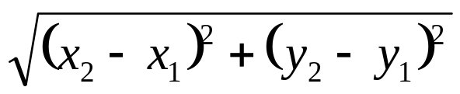
Accessor method questions
Write a method distance that computes the distance between a Point and another Point parameter.
Use the formula:
Write a method distanceFromOrigin that returns the distance between a Point and the origin, (0, 0).
  Modify the client code to use these methods.

Slide 38
Accessor method answers
public double distance(Point other) {
int dx = x - other.x;
int dy = y - other.y;
return Math.sqrt(dx * dx + dy * dy);
}
public double distanceFromOrigin() {
return Math.sqrt(x * x + y * y);
}
// alternative solution that uses distance
public double distanceFromOrigin() {
Point origin = new Point();
return distance(origin);
}

Slide 39
Printing objects
By default, Java doesn't know how to print objects:
  Point p = new Point();
  p.x = 10;
  p.y = 7;
  System.out.println("p is " + p); // p is Point@9e8c34
  // better, but cumbersome; p is (10, 7)
  System.out.println("p is (" + p.x + ", " + p.y + ")");
  // desired behavior
  System.out.println("p is " + p); // p is (10, 7)

Slide 40
The toString method
tells Java how to convert an object into a String
  Point p1 = new Point(7, 2);
  System.out.println("p1: " + p1);
  // the above code is really calling the following:
  System.out.println("p1: " + p1.toString());
Every class has a toString, even if it isn't in your code.
  Default: class's name @ object's memory address (base 16)
  Point@9e8c34

Slide 41
toString syntax
  public String toString() {
  code that returns a String representing this object;
  }
  Method name, return, and parameters must match exactly.
  Example:
  // Returns a String representing this Point.
  public String toString() {
  return "(" + x + ", " + y + ")";
  }

Slide 42
Object initialization: constructors

Slide 43
Initializing objects
Currently it takes 3 lines to create a Point and initialize it:
  Point p = new Point();
  p.x = 3;
  p.y = 8; // tedious
We'd rather specify the fields' initial values at the start:
  Point p = new Point(3, 8); // better!
  We are able to this with most types of objects in Java.

Slide 44
Constructors
constructor: Initializes the state of new objects.
  public type(parameters) {
  statements;
  }
  runs when the client uses the new keyword
  no return type is specified;
  it implicitly "returns" the new object being created
  If a class has no constructor, Java gives it a default constructor with no parameters that sets all fields to 0.

Slide 45
Constructor example
  public class Point {
  int x;
  int y;
  // Constructs a Point at the given x/y location.
  public Point(int initialX, int initialY) {
  x = initialX;
  y = initialY;
  }
  public void translate(int dx, int dy) {
  x = x + dx;
  y = y + dy;
  }
  ...
  }

Slide 46
Tracing a constructor call
What happens when the following call is made?
  Point p1 = new Point(7, 2);
public Point(int initialX, int initialY) {
x = initialX;
y = initialY;
}
public void translate(int dx, int dy) {
x += dx;
y += dy;
}
p1
x |  | y

Slide 47
Client code, version 3
public class PointMain3 {
public static void main(String[] args) {
// create two Point objects
Point p1 = new Point(5, 2);
Point p2 = new Point(4, 3);
// print each point
System.out.println("p1: (" + p1.x + ", " + p1.y + ")");
System.out.println("p2: (" + p2.x + ", " + p2.y + ")");
// move p2 and then print it again
p2.translate(2, 4);
System.out.println("p2: (" + p2.x + ", " + p2.y + ")");
}
}
OUTPUT:
p1: (5, 2)
p2: (4, 3)
p2: (6, 7)

Slide 48
Multiple constructors
A class can have multiple constructors.
  Each one must accept a unique set of parameters.
Exercise: Write a Point constructor with no parameters that initializes the point to (0, 0).
  // Constructs a new point at (0, 0).
  public Point() {
  x = 0;
  y = 0;
  }

Slide 49
Common constructor bugs
1. Re-declaring fields as local variables ("shadowing"):
  public Point(int initialX, int initialY) {
  int x = initialX;
  int y = initialY;
  }
  This declares local variables with the same name as the fields, rather than storing values into the fields. The fields remain 0.
2. Accidentally giving the constructor a return type:
  public void Point(int initialX, int initialY) {
  x = initialX;
  y = initialY;
  }
  This is actually not a constructor, but a method named Point

Slide 50
Encapsulation

Slide 51
Encapsulation
encapsulation: Hiding implementation details from clients.
  Encapsulation forces abstraction.
    separates external view (behavior) from internal view (state)
    protects the integrity of an object's data

Slide 52
Private fields
A field that cannot be accessed from outside the class
  private type name;
  Examples:
  private int id;
  private String name;
Client code won't compile if it accesses private fields:
  PointMain.java:11: x has private access in Point
  System.out.println(p1.x);
  ^

Slide 53
Accessing private state
  // A "read-only" access to the x field ("accessor")
  public int getX() {
  return x;
  }
  // Allows clients to change the x field ("mutator")
  public void setX(int newX) {
  x = newX;
  }
  Client code will look more like this:
  System.out.println(p1.getX());
  p1.setX(14);

Slide 54
Point class, version 4
  // A Point object represents an (x, y) location.
  public class Point {
  private int x;
  private int y;
  public Point(int initialX, int initialY) {
  x = initialX;
  y = initialY;
  }
  public int getX() {
  return x;
  }
  public int getY() {
  return y;
  }
  public double distanceFromOrigin() {
  return Math.sqrt(x * x + y * y);
  }
  public void setLocation(int newX, int newY) {
  x = newX;
  y = newY;
  }
  public void translate(int dx, int dy) {
  setLocation(x + dx, y + dy);
  }
  }

Slide 55
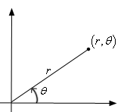
Benefits of encapsulation
Abstraction between object and clients
Protects object from unwanted access
  Example: Can't fraudulently increase an Account's balance.
Can change the class implementation later
  Example: Point could be rewritten in polar
  coordinates (r, θ) with the same methods.
Can constrain objects' state (invariants)
  Example: Only allow Accounts with non-negative balance.
  Example: Only allow Dates with a month from 1-12.

Slide 56
The this keyword
this : Refers to the implicit parameter inside your class.
  (a variable that stores the object on which a method is called)
  Refer to a field: this.field
  Call a method: this.method(parameters);
  One constructor this(parameters);
  can call another:

Slide 57
Variable shadowing
shadowing: 2 variables with same name in same scope.
  Normally illegal, except when one variable is a field.
  public class Point {
  private int x;
  private int y;
  ...
  // this is legal
  public void setLocation(int x, int y) {
  ...
  }
  In most of the class, x and y refer to the fields.
  In setLocation, x and y refer to the method's parameters.

Slide 58
Fixing shadowing
  public class Point {
  private int x;
  private int y;
  ...
  public void setLocation(int x, int y) {
  this.x = x;
  this.y = y;
  }
  }
Inside setLocation,
  To refer to the data field x, say this.x
  To refer to the parameter x, say x

Slide 59
Calling another constructor
  public class Point {
  private int x;
  private int y;
  public Point() {
  this(0, 0); // calls (x, y) constructor
  }
  public Point(int x, int y) {
  this.x = x;
  this.y = y;
  }
  ...
  }
    Avoids redundancy between constructors
    Only a constructor (not a method) can call another constructor

Slide 60
Static methods/fields

Slide 61
Multi-class systems
Most large software systems consist of many classes.
  One main class runs and calls methods of the others.
Advantages:
  code reuse
  splits up the program logic into manageable chunks
Main Class #1
main
method1
method2
Class #2
method3
method5
Class #3
method4
method6

Slide 62
Redundant program 1
  // This program sees whether some interesting numbers are prime.
  public class Primes1 {
  public static void main(String[] args) {
  int[] nums = {1234517, 859501, 53, 142};
  for (int i = 0; i < nums.length; i++) {
  if (isPrime(nums[i])) {
  System.out.println(nums[i] + " is prime");
  }
  }
  }
  // Returns the number of factors of the given integer.
  public static int countFactors(int number) {
  int count = 0;
  for (int i = 1; i <= number; i++) {
  if (number % i == 0) {
  count++; // i is a factor of the number
  }
  }
  return count;
  }
  // Returns true if the given number is prime.
  public static boolean isPrime(int number) {
  return countFactors(number) == 2;
  }
  }

Slide 63
Redundant program 2
  // This program prints all prime numbers up to a maximum.
  public class Primes2 {
  public static void main(String[] args) {
  Scanner console = new Scanner(System.in);
  System.out.print("Max number? ");
  int max = console.nextInt();
  for (int i = 2; i <= max; i++) {
  if (isPrime(i)) {
  System.out.print(i + " ");
  } }
  System.out.println();
  }
  // Returns true if the given number is prime.
  public static boolean isPrime(int number) {
  return countFactors(number) == 2;
  }
  // Returns the number of factors of the given integer.
  public static int countFactors(int number) {
  int count = 0;
  for (int i = 1; i <= number; i++) {
  if (number % i == 0) {
  count++; // i is a factor of the number
  } }
  return count;
  }
  }

Slide 64
Classes as modules
module: A reusable piece of software, stored as a class.
  Example module classes: Math, Arrays, System
  // This class is a module that contains useful methods
  // related to factors and prime numbers.
  public class Factors {
  // Returns the number of factors of the given integer.
  public static int countFactors(int number) {
  int count = 0;
  for (int i = 1; i <= number; i++) {
  if (number % i == 0) {
  count++; // i is a factor of the number
  }
  }
  return count;
  }
  // Returns true if the given number is prime.
  public static boolean isPrime(int number) {
  return countFactors(number) == 2;
  }
  }

Slide 65
More about modules
A module is a partial program, not a complete program.
  It does not have a main. You don't run it directly.
  Modules are meant to be utilized by other client classes.
Syntax:
  class.method(parameters);
Example:
  int factorsOf24 = Factors.countFactors(24);

Slide 66
Using a module
  // This program sees whether some interesting numbers are prime.
  public class Primes {
  public static void main(String[] args) {
  int[] nums = {1234517, 859501, 53, 142};
  for (int i = 0; i < nums.length; i++) {
  if (Factors.isPrime(nums[i])) {
  System.out.println(nums[i] + " is prime");
  }
  }
  }
  }
  // This program prints all prime numbers up to a given maximum.
  public class Primes2 {
  public static void main(String[] args) {
  Scanner console = new Scanner(System.in);
  System.out.print("Max number? ");
  int max = console.nextInt();
  for (int i = 2; i <= max; i++) {
  if (Factors.isPrime(i)) {
  System.out.print(i + " ");
  } }
  System.out.println();
  }
  }

Slide 67
Modules in Java libraries
  // Java's built in Math class is a module
  public class Math {
  public static final double PI = 3.14159265358979323846;
  ...
  public static int abs(int a) {
  if (a >= 0) {
  return a;
  } else {
  return -a;
  }
  }
  public static double toDegrees(double radians) {
  return radians * 180 / PI;
  }
  }
Notes:
You can even open the code for Math.java in the Java src.zip install file in the JDK folder.

Slide 68
Static members
static: Part of a class, rather than part of an object.
  Object classes can have static methods and fields.
  Not copied into each object; shared by all objects of that class.
class
state:
private static int staticFieldA
private static String staticFieldB
behavior:
public static void someStaticMethodC()
public static void someStaticMethodD()
object #1
state:
int field2
double field2
behavior:
public void method3()
public int method4()
public void method5()
object #2
state:
int field1
double field2
behavior:
public void method3()
public int method4()
public void method5()
object #3
state:
int field1
double field2
behavior:
public void method3()
public int method4()
public void method5()

Slide 69
Static fields
  private static type name;
  or,
  private static type name = value;
  Example:
  private static int theAnswer = 42;
static field: Stored in the class instead of each object.
  A "shared" global field that all objects can access and modify.
  Like a class constant, except that its value can be changed.

Slide 70
Accessing static fields
From inside the class where the field was declared:
  fieldName // get the value
  fieldName = value; // set the value
From another class (if the field is public):
  ClassName.fieldName // get the value
  ClassName.fieldName = value; // set the value
  generally static fields are not public unless they are final
Exercise: Modify the BankAccount class shown previously so that each account is automatically given a unique ID.
Exercise: Write the working version of FratGuy.

Slide 71
BankAccount solution
  public class BankAccount {
  // static count of how many accounts are created
  // (only one count shared for the whole class)
  private static int objectCount = 0;
  // fields (replicated for each object)
  private String name;
  private int id;
  public BankAccount() {
  objectCount++; // advance the id, and
  id = objectCount; // give number to account
  }
  ...
  public int getID() { // return this account's id
  return id;
  }
  }

Slide 72
Static methods
  // the same syntax you've already used for methods
  public static type name(parameters) {
  statements;
  }
static method: Stored in a class, not in an object.
  Shared by all objects of the class, not replicated.
  Does not have any implicit parameter, this;
  therefore, cannot access any particular object's fields.
Exercise: Make it so that clients can find out how many total BankAccount objects have ever been created.

Slide 73
BankAccount solution
  public class BankAccount {
  // static count of how many accounts are created
  // (only one count shared for the whole class)
  private static int objectCount = 0;
  // clients can call this to find out # accounts created
  public static int getNumAccounts() {
  return objectCount;
  }
  // fields (replicated for each object)
  private String name;
  private int id;
  public BankAccount() {
  objectCount++; // advance the id, and
  id = objectCount; // give number to account
  }
  ...
  public int getID() { // return this account's id
  return id;
  }
  }

Slide 74
Summary of Java classes
A class is used for any of the following in a large program:
  a program : Has a main and perhaps other static methods.
    example: GuessingGame, Birthday, MadLibs, CritterMain
    does not usually declare any static fields (except final)
  an object class : Defines a new type of objects.
    example: Point, BankAccount, Date, Critter, FratGuy
    declares object fields, constructor(s), and methods
    might declare static fields or methods, but these are less of a focus
    should be encapsulated (all fields and static fields private)
  a module : Utility code implemented as static methods.
    example: Math

