Slide 1
Redtag
SOLUTION GUIDE FOR
AI IMPERSONATION DETECTION

Slide 2
PROBLEM STATEMENT
The increasing sophistication of AI voice impersonation technology presents a significant challenge in combating voice impersonation attacks across various sectors, including banking and real estate. Cybercriminals now have the capability to replicate voices with alarming accuracy using advanced AI tools, leading to heightened security vulnerabilities. The utilization of deep learning algorithms, speaker verification, and voice biometrics by companies specializing in voice recognition underscores the urgent need for innovative approaches to detect and prevent voice impersonation fraud. These technologies play a crucial role in differentiating authentic human voices from artificially generated ones by analyzing intricate audio signal characteristics. The broader implications of AI voice impersonation encompass not only fraudulent activities but also extend to potential uses in entertainment, text-to-speech systems, and social engineering tactics aimed at extracting sensitive information from individuals. As the capabilities of voice cloning technology evolve, there is a pressing requirement for robust security protocols and increased awareness to address the growing risks associated with AI voice impersonation scams effectively.

Slide 3
TEAM MEMBERS
MANVI AGGARWAL
manvi29agarwal@gmail.com
SHRIA SANNUTHI
shriasannuthi@gmail.com
SWASTIKA PANDEY
swastika.pandey.shivanand@gmail.com
DHIRAJ INTI
intidhiraj3103@gmail.com
SAMRIDH ANAND
samridh.anand.paatni@gmail.com
ANUSHKA ANAND
sapanand25@gmail.com

Slide 4



HIGH LEVEL DESIGN
VDC+LDC
.WAV FILE
AIDC
EDC
BGNDC
JSON AGGREGATOR/ PROBABILITY VALUES

Slide 5
MODULE 1
AIDC(AI Detection Component)
The AI Detection Component (AIDC) is designed to differentiate between genuine human voices and AI-generated audio clips. We've developed a deep learning solution for this purpose. Initially, the audio clip is loaded using the librosa library and converted into mel spectrograms, which are visual representations of audio data. This conversion is crucial as it simplifies the complex audio signals, making them more accessible for neural network analysis. The core of our approach involves a Convolutional Neural Network (CNN) model, which is proficient in handling images and spectrogram-based tasks. Through training, our model learns to discern between AI-generated and human speech, achieving remarkable accuracy.
This component is AI detection component, which is responsible for giving the confidence scores. So it takes an audio file as input and extracts melgram features from it and uses that to predict.

Slide 6
MODULE 2
VDC(Voice Detection Component)
The audio transcription and language detection script utilizes several Python libraries to efficiently transcribe WAV audio files to text while detecting the language of the transcribed text. Leveraging 'speech_recognition' for speech recognition, 'langdetect' for language detection, and 'pydub' for audio manipulation, the script offers a seamless solution. It iterates through specified directories, transcribing each audio file using the Google Speech Recognition API, and then determines the language of the transcribed text. Alternative approaches could involve utilizing Google Cloud's Speech-to-Text API for transcription or exploring different language detection libraries like 'TextBlob' or 'fastText'. However, the chosen approach excels in its simplicity, accessibility, and integration of open-source, free-to-use libraries, making it an ideal starting point for similar projects.

Slide 7
MODULE 3
EDC(Emotion Detection Component)
This process involves using the Whisper library to convert audio into text for emotional analysis. The transcribed text is prepared as a JSON request for the Google Cloud Natural Language API. After updating the JSON object with the text content, it's sent to the API. The sentiment score from the API response, reflecting the emotional intensity of the text, is then extracted and returned. This process enables automated speech-to-text conversion and subsequent emotional analysis of the transcribed content.

Slide 8
MODULE 4
BGNDC(Background Noise Detection Component)
The BGNDC (Background Noise Detection Component) model utilizes a combination of NumPy, Librosa, Pandas, scikit-learn, and TensorFlow/Keras libraries for audio classification, specifically aimed at detecting background noise levels in audio files. It employs the cnn_extract_features function to extract Mel-frequency cepstral coefficients (MFCCs) from audio files, providing an effective representation of sound spectra. The model architecture, built with convolutional layers, max-pooling layers, and dense layers with dropout regularization, is compiled using the Adam optimizer and sparse categorical cross-entropy loss for multi-class classification. Training is conducted using the train_model function with training and validation data loaded through the load_data function. This approach capitalizes on the strengths of CNNs and MFCC features for audio classification tasks while benefiting from the ease of use and scalability offered by TensorFlow/Keras, with potential alternatives including different feature extraction techniques, model architectures, and optimization strategies to further enhance performance.

Slide 9

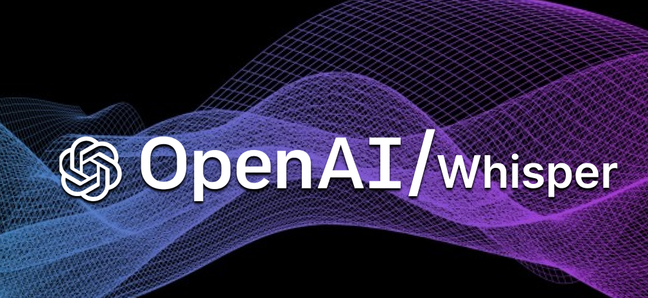




TECHNOLOGIES USED

Slide 10
REFERENENCES
https://een.ec.europa.eu/partnering-opportunities/deepfake-ai-voice-cloning-detection-against-impersonation-fraud
https://blog.hiya.com/the-rise-of-ai-voice-impersonation-scams
https://calleridreputation.com/blog/how-voice-impersonation-scams-exploit-generative-ai/
https://fliki.ai/blog/ai-voice-cloning
https://www.scientificamerican.com/article/how-to-keep-ai-from-stealing-the-sound-of-your-voice/
https://www.itweb.co.za/article/is-voice-biometrics-in-banking-secure-enough/4r1lyMR9N1N7pmda
https://www.americanbanker.com/news/banks-hear-the-eerie-echoes-of-ai-generated-voices
https://sdk.finance/hacking-voice-banking-system-why-voice-cloning-technology-is-dangerous-for-fintech-industry/
https://www.infosecinstitute.com/resources/machine-learning-and-ai/engineering-voice-impersonation-from-machine-learning/
https://www.lexology.com/library/detail.aspx?g=a65d8b92-d2aa-4b89-8935-7ed42710a9bd
https://www.mdpi.com/1999-4893/15/5/155
https://www.researchgate.net/publication/373364324_Real-time_Detection_of_AI-Generated_Speech_for_DeepFake_Voice_Conversion

Slide 11
THANKYOU

