Slide 1
Smart Routing For Urban Waste Collection
Microprocessors and
Interfacing
CSE2006 J-Component

Slide 2
Group Members
Mandar Manoj Naik (20BCE1562)
Rishank Sharma (20BCE1783)
Rishiraj Biswas (20BCE1009)
Samridh Anand Paatni (20BCE1550)

Slide 3
Introduction
Motivation and Description

Slide 4
Motivation
Urban waste collection is an enormous problem of urban logistics. Some major problems identified in their paper “Optimal Routing of Solid Waste Collection Trucks: A Review of Methods” by Sulemana et. al. are inadequate finance, lack of political will, poor operational scheduling and vehicular routing, and poor road networks[1]. Tier-1 cities in India have proper roads and relatively higher funding. What lacks is proper routing of garbage collection truck.
Wet and dry waste require different. Existing proposals[2] are still in a primitive state, not taking in consideration the types of trash and the rate of trash generation.

Slide 5
Smart Routing for Urban Waste Collection
We propose a system where segregated trash bins are fitted with sensors to measure the depth of the trash (two bins, one for recyclable waste and the other for non-recyclable waste, each with a depth sensor). The sensors, connected to an Arduino, which sends the data to a central server.
The server keep track of the trash levels, and over a number of weeks, categorizes the bins according to the following parameters:
How quickly the bin is filled
What are the levels of waste (both recyclable and non-recyclable)?
What is the kind of waste (domestic, industrial, etc), assigning them different priorities.

Slide 6
This data, along with the locations of the bins, will be combined with other data like the population of the area, to create a complete dataset.
After an initial period of data collection, the system will have a model of the rate of garbage filling and the type of waste. This data will be used to give priorities to each
This dataset will be used to dynamically create optimal routes for garbage collection trucks. This route will factor the above parameters (types and level of waste).
The trucks can then follow the generated route to collect the trash from each location.

Slide 7
Parameters Used
Amount of garbage:
Garbage is safe to be collected when it can work for 2 more days (to account for delays or public holidays)
Type of garbage:
Waste generated can be of many different types, which may require different treatment.
For example, dry waste is safer to keep in an enclosed location when compared to wet waste, thus, wet waste requires more frequent cleaning (regardless of the fill level).
Garbage Fill Rate:
Just like the type of waste generated, the amount of waste generated in a day also varies widely and knowing the areas which create more trash per day can help a lot in long-term route planning and for equal division of garbage.
As cities increase in size, and routes change, knowing the fill rates can help in breaking up routes.

Slide 8
Area population:
As the system is aimed towards Municipalities, they already have a database of population.
As populations fluctuate, that data can also be used to facilitate long term planning of waste management resources.
Traffic/Weather conditions:
During routing, the traffic and weather conditions of the city will also be taken into account.
Increased traffic may mean delays and thus, routes may need to change.
In conclusion, the inclusion of these parameters will enable us to create a long-term sustainable way of modelling urban waste collection logistics.

Slide 9
Advantages
Low Cost: As not every trash bin will be filled everyday, the daily routes of garbage collection trucks will be shortened, resulting in lower cost for the municipal corporations.
Lower Environmental Impact: Shorter routes result in lower CO2 emissions, which is better for the environment.
Lower Traffic: Although garbage collection does not usually happen during rush hours, a lower number of trucks on the road is better for congested city traffic.
Efficiency: The overall process of garbage collection and recycling becomes more streamlined and efficient.

Slide 10
Software
How does the system work

Slide 11
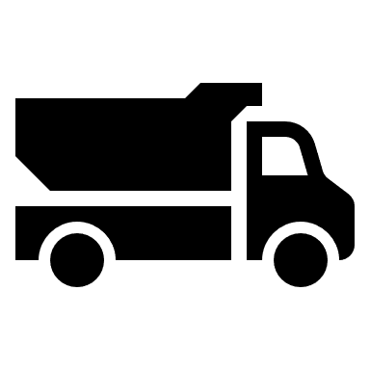
Overview
Database
Server
Routing Algorithm

Slide 12
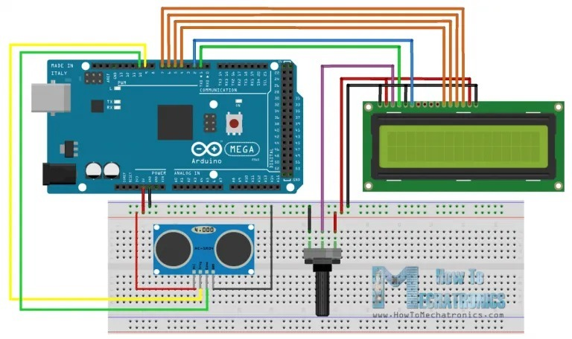

Slide 13
Arduino
void setup() {
// setting up the ultrasonic sensor
pinMode(TRIGpin, OUTPUT); // It sets the ECHO pin as OUTPUT
pinMode(ECHOpin, INPUT); // It sets the TRIG pin as INPUT
Serial.begin(9600); // Serial Communication at the rate of 9600 bps
Serial.println("The Ultrasonic sensor is live");
// setting up the humidity and temperature sensor
dht.begin();
Serial.println("The Humidity and Temperature sensor is live");
// setting up the wifi module
esp8266.begin(9600);
}
#include "DHT.h"
#include <SoftwareSeial.h>
#define DHTtype DHT22 #define DHTpin 1
#define RXpin 2
#define TXpin 3
#define ECHOpin 5
#define TRIGpin 6
float temp;
float hum; long duration;
int distance; DHT dht(DHTpin, DHTtype); SoftwareSerial esp8266(2, 3);

Slide 14
void sendWifiData() {
// still need to implement
}
void loop() {
delay(60000 * 12) { // every 12 hours
readDht();
readDist();
sendWifiData();
}
}
void readDist() {
digitalWrite(trigPin, LOW);
delayMicroseconds(2);
digitalWrite(trigPin, HIGH);
delayMicroseconds(10);
digitalWrite(trigPin, LOW);
duration = pulseIn(echoPin, HIGH);
distanceCm = duration * 0.034 / 2;
distanceInch = duration * 0.0133 / 2;
lcd.setCursor(0, 0);
lcd.print("Distance: ");
lcd.print(distanceCm);
lcd.print(" cm");
delay(10);
}
void readDht() {
do {
delay(2000);
hum = dht.readHumidity();
temp = dht.readTemperature(true);
} while (isnan(hum) || isnan(temp));
Serial.print("Temperature: ");
Serial.println(temp);
Serial.print("Humidity: ");
Serial.println(hum);
}

Slide 15
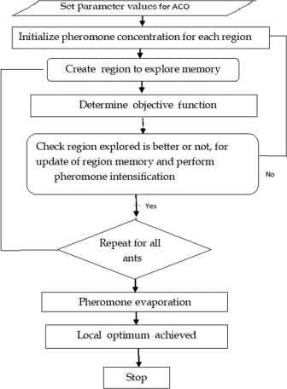
Routing Algorithm
Ant colony optimization:
Models routing using a virtual ant-colony
Ant travel the graphs, putting down pheromone trails .
Over multiple iterations, the pheromone trails get evaporated or strengthened.
The ants find the locally optimal solution using the pheromone trails.

Slide 16
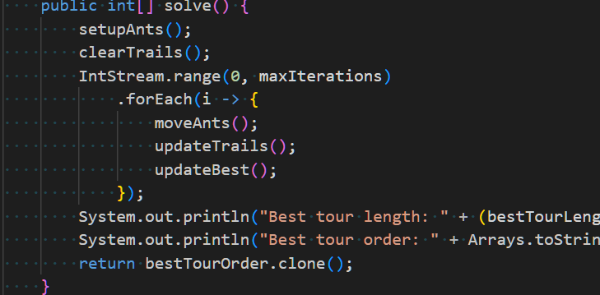

Slide 17
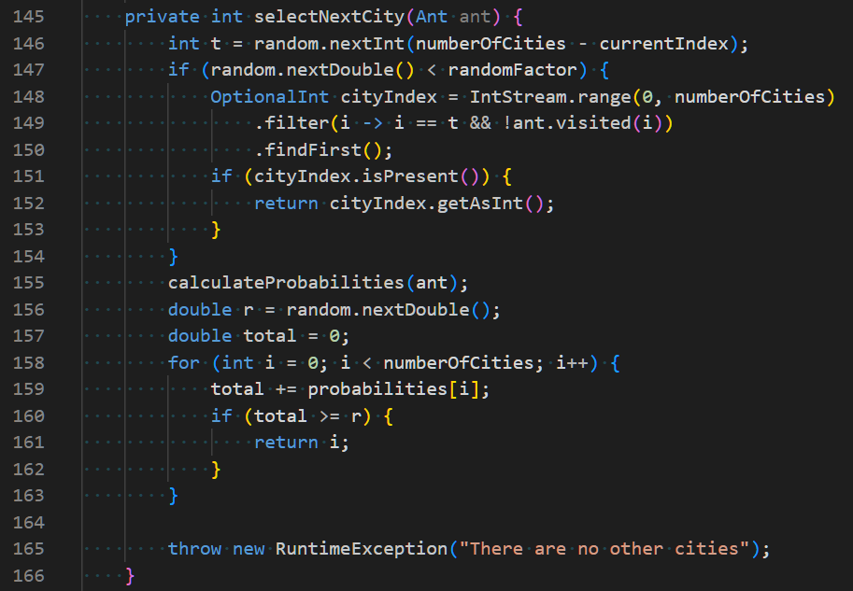

Slide 18
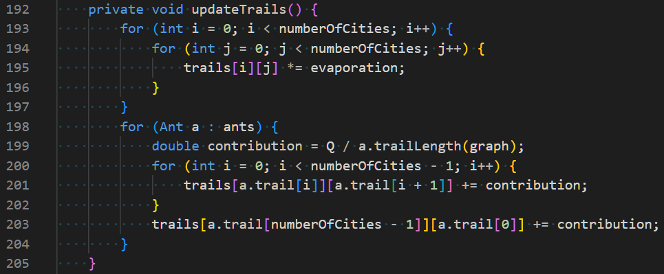

Slide 19
Components Used

Slide 20

Block Diagram
Power Supply
Garbage Truck
Central Server
Arduino
Microcontroller
Ultrasonic Depth Sensor
GSM Module
LCD Display
Temperature and Humidity Sensor
Piezo Buzzer

Slide 21
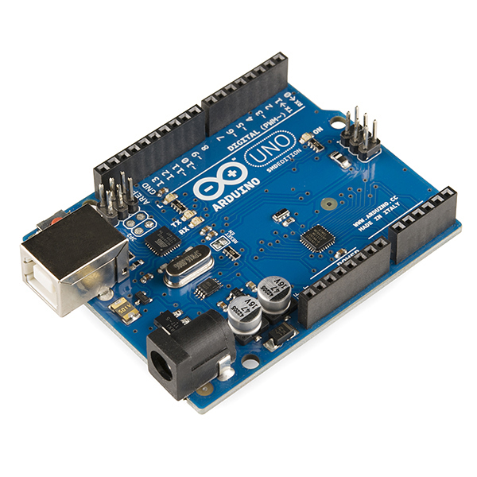
Arduino Uno
The Arduino Uno is one of the first USB-based Arduino boards.
Being an open-source microcontroller and a general purpose board, the Arduino Uno is one of the most popular microcontrollers for a vast number of applications.

Slide 22
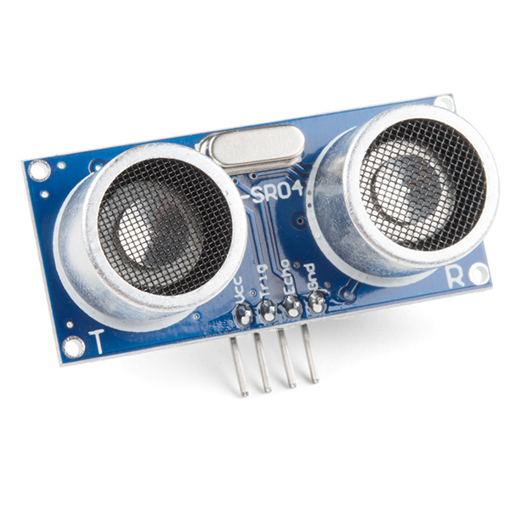
Ultrasonic Sensor
This is a sound-based sensor which can be used to the level of trash in the container.
The level of trash is one the primary parameters used in the system.

Slide 23
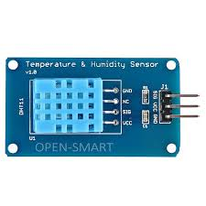
DHT11 Temperature and Humidity Sensor
It is a low-cost temperature and humidity sensor.
It will be used to determine the kind of waste in the trash can (wet waste leads to higher temperatures and humidity in enclosed spaces)

Slide 24
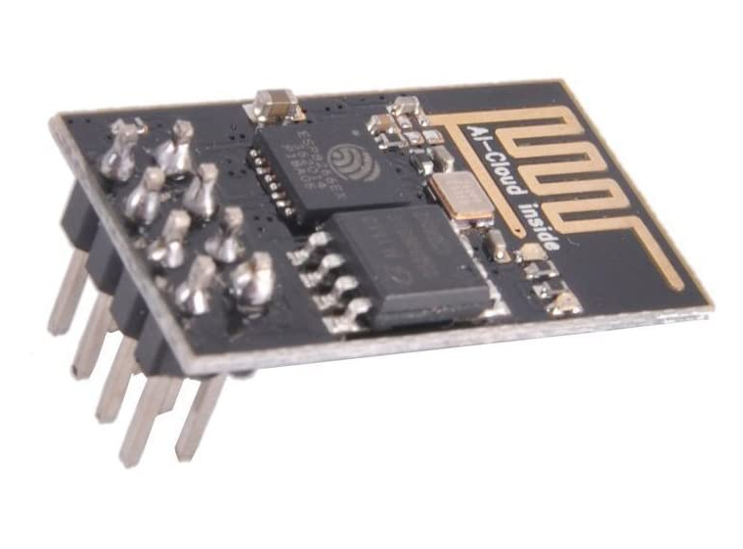
ESP8266-01 Wi-Fi Module
The ESP8266 is a very user-friendly and low-cost device to provide internet connectivity to your projects. The module can work both as an Access point and as a station.
This module will be used to interface with the ThingSpeak API to send data over the internet.

Slide 25
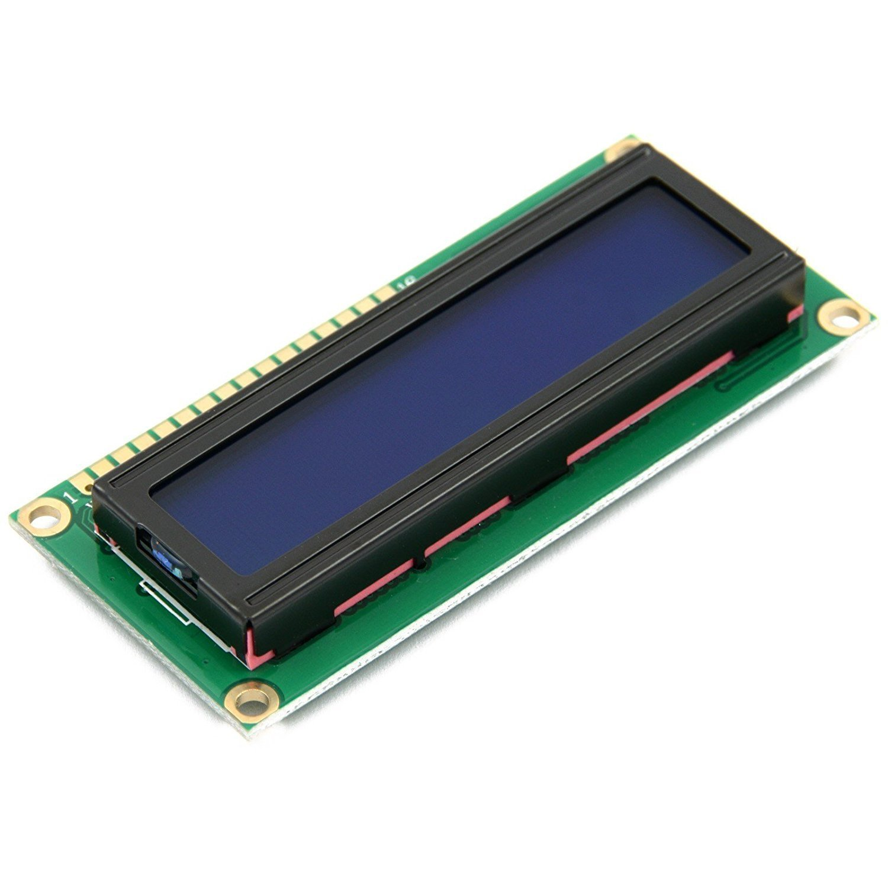
JHD162A 16X2 LCD Display
This is a low cost 16 by 2 LCD display unit.
It is used to display the trash level on the machine.
It can also show if the truck is going to visit the particular location.

Slide 26
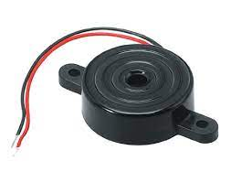
Piezo Buzzer
This is a low cost buzzer, used to produce an alarm-like sound.
It will be used as an alert for when the garbage collection truck is approaching.

Slide 27
Other Components
Jumper wires
Resistors
Breadboard/PCB

Slide 28
Conclusions

Slide 29
Optimal routing for solid waste collection and transport is very essential if sustainability in terms of cost reduction and environmental conservation is a priority in solid waste management[1].
We believe that our system is a more wholistic view on routing of solid waste collection and recycling which improves significantly over existing proposals[2].
By taking more parameters into account, we can model routing over a long period of time while being able to respond to changing needs of the city. We also provide a potential solution for treating recyclable waste.

Slide 30
References
[1] Alhassan Sulemana, Emmanuel A. Donkor, Eric K. Forkuo, Sampson Oduro-Kwarteng, "Optimal Routing of Solid Waste Collection Trucks: A Review of Methods", Journal of Engineering, vol. 2018, Article ID 4586376, 12 pages, 2018. https://doi.org/10.1155/2018/4586376
[2] Oralhan, Zeki, Burcu Oralhan, and Yavuz Yiğit. "Smart city application: Internet of things (IoT) technologies based smart waste collection using data mining approach and ant colony optimization." Internet Things 14.4 (2017): 5.

Slide 31
Thank You

Slide 32

ThingSpeak API
ThingSpeak is an online IoT analytics platform.
It can be used to visualize and track live data.
In our project, we have used it to display and keep track of health data and send emails to users.

