Slide 1
Performance Analysis Tools

Slide 2
Outline
Motivation
  Why do we care about performance
Concepts and definitions
  The performance analysis cycle
  Instrumentation
  Measurement: profiling vs. tracing
  Analysis: manual vs. automated
Tools
  PAPI: Access to hardware performance counters
  ompP: Profiling of OpenMP applications
  IPM: Profiling of MPI apps
  Vampir: Trace visualization
  KOJAK/Scalasca: Automated bottleneck detection of MPI/OpenMP applications
  TAU: Toolset for profiling and tracing of MPI/OpenMP/Java/Python applications

Slide 3
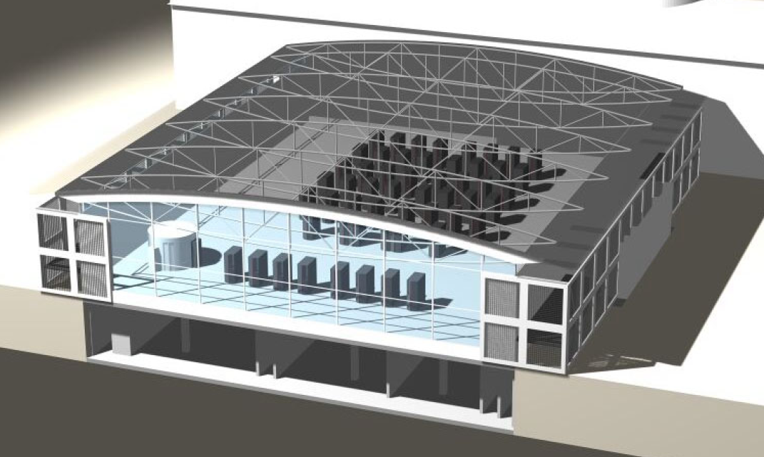
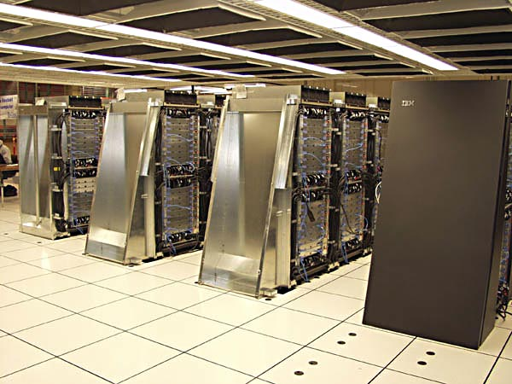
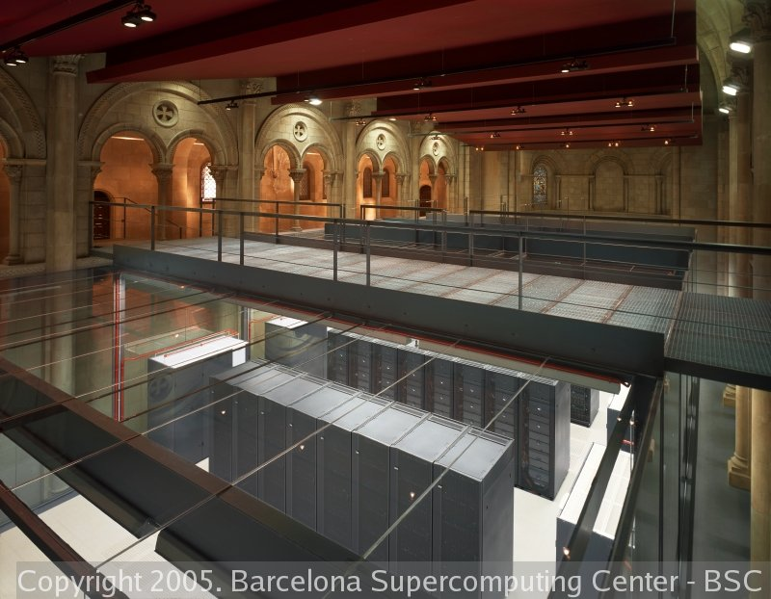
Motivation
Performance Analysis is important
  Large investments in HPC systems
    Procurement: ~$40 Mio
    Operational costs: ~$5 Mio per year
    Electricity: 1 MWyear ~$1 Mio
  Goal: solve larger problems
  Goal: solve problems faster

Slide 4
Concepts and Definitions
The typical performance optimization cycle
Code Development
functionally
complete and
correct program
instrumentation
Measure
Analyze
Modify / Tune
complete, cor-
rect and well-
performing
program
Usage / Production

Slide 5
Instrumentation
Instrumentation = adding measurement probes to the code to observe its execution
Can be done on several levels
Different techniques for different levels
Different overheads and levels of accuracy with each technique
No instrumentation: run in a simulator. E.g., Valgrind
User-level abstractions
problem domain
source code
instrumentation
preprocessor
instrumentation
source code
compiler
instrumentation
object code
libraries
instrumentation
linker
executable
instrumentation
OS
instrumentation
runtime image
instrumentation
performance
data
run
VM
instrumentation

Slide 6
Instrumentation – Examples (1)
Source code instrumentation
  User added time measurement, etc. (e.g., printf(), gettimeofday())
  Many tools expose mechanisms for source code instrumentation in addition to automatic instrumentation facilities they offer
  Instrument program phases:
    initialization/main iteration loop/data post processing
  Pramga and pre-processor based
  #pragma pomp inst begin(foo)
  #pragma pomp inst end(foo)
  Macro / function call based
  ELG_USER_START("name");
  ...
  ELG_USER_END("name");

Slide 7
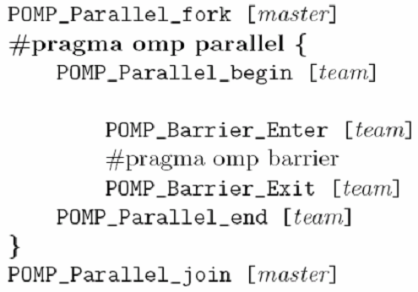
Instrumentation – Examples (2)
Preprocessor Instrumentation
  Example: Instrumenting OpenMP constructs with Opari
  Preprocessor operation
  Example: Instrumentation of a parallel region
Orignial
source code
Pre-
processor
Modified (instrumented)
source code
This is used for OpenMP analysis in tools such as KoJak/Scalasca/ompP
/* ORIGINAL CODE in parallel region */
Instrumentation
added by Opari

Slide 8
Instrumentation – Examples (3)
Compiler Instrumentation
  Many compilers can instrument functions automatically
  GNU compiler flag: -finstrument-functions
  Automatically calls functions on function entry/exit that a tool can capture
  Not standardized across compilers, often undocumented flags, sometimes not available at all
  GNU compiler example:
void __cyg_profile_func_enter(void *this, void *callsite)
{
/* called on function entry */
}
void __cyg_profile_func_exit(void *this, void *callsite)
{
/* called just before returning from function */
}

Slide 9
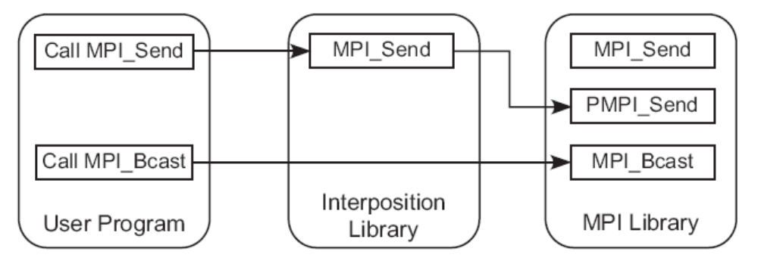
Instrumentation – Examples (4)
Library Instrumentation:
MPI library interposition
  All functions are available under two names: MPI_xxx and PMPI_xxx, MPI_xxx symbols are weak, can be over-written by interposition library
  Measurement code in the interposition library measures begin, end, transmitted data, etc… and calls corresponding PMPI routine.
  Not all MPI functions need to be instrumented

Slide 10
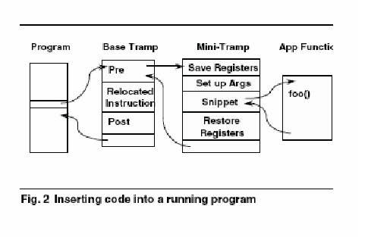
Instrumentation – Examples (5)
Binary Runtime Instrumentation
  Dynamic patching while the program executes
  Example: Paradyn tool, Dyninst API
Base trampolines/Mini trampolines
  Base trampolines handle storing current state of program so instrumentations do not affect execution
  Mini trampolines are the machine-specific realizations of predicates and primitives
  One base trampoline may handle many mini-trampolines, but a base trampoline is needed for every instrumentation point
Binary instrumentation is difficult
  Have to deal with
    Compiler optimizations
    Branch delay slots
    Different sizes of instructions for x86 (may increase the number of instructions that have to be relocated)
    Creating and inserting mini trampolines somewhere in program (at end?)
    Limited-range jumps may complicate this
Figure by Skylar Byrd Rampersaud
PIN: Open Source dynamic binary instrumenter from Intel

Slide 11
Measurement
Profiling vs. Tracing
Profiling
  Summary statistics of performance metrics
    Number of times a routine was invoked
    Exclusive, inclusive time/hpm counts spent executing it
    Number of instrumented child routines invoked, etc.
    Structure of invocations (call-trees/call-graphs)
    Memory, message communication sizes
Tracing
  When and where events took place along a global timeline
    Time-stamped log of events
    Message communication events (sends/receives) are tracked
    Shows when and from/to where messages were sent
    Large volume of performance data generated usually leads to more perturbation in the program

Slide 12
Measurement: Profiling
Profiling
  Recording of summary information during execution
    inclusive, exclusive time, # calls, hardware counter statistics, …
  Reflects performance behavior of program entities
    functions, loops, basic blocks
    user-defined “semantic” entities
  Very good for low-cost performance assessment
  Helps to expose performance bottlenecks and hotspots
  Implemented through either
    sampling: periodic OS interrupts or hardware counter traps
    measurement: direct insertion of measurement code

Slide 13
Profiling: Inclusive vs. Exclusive
int main( )
{ /* takes 100 secs */
f1(); /* takes 20 secs */
/* other work */
f2(); /* takes 50 secs */
f1(); /* takes 20 secs */
/* other work */
}
/* similar for other metrics, such
as hardware performance counters, etc. */
Inclusive time for main
  100 secs
Exclusive time for main
  100-20-50-20=10 secs
Exclusive time sometimes called “self”

Slide 14
Tracing Example: Instrumentation, Monitor, Trace
Event definition
CPU A:
1
master
void master {
trace(ENTER, 1);
...
trace(SEND, B);
send(B, tag, buf);
...
trace(EXIT, 1);
}
2
slave
3
...
timestamp
MONITOR
...
58
A
ENTER
1
CPU B:
60
B
ENTER
2
void slave {
trace(ENTER, 2);
...
recv(A, tag, buf);
trace(RECV, A);
...
trace(EXIT, 2);
}
62
A
SEND
B
64
A
EXIT
1
68
B
RECV
A
69
B
EXIT
2
...

Slide 15
Measurement: Tracing
Tracing
  Recording of information about significant points (events) during program execution
    entering/exiting code region (function, loop, block, …)
    thread/process interactions (e.g., send/receive message)
  Save information in event record
    timestamp
    CPU identifier, thread identifier
    Event type and event-specific information
  Event trace is a time-sequenced stream of event records
  Can be used to reconstruct dynamic program behavior
  Typically requires code instrumentation

Slide 16
Performance Data Analysis
Draw conclusions from measured performance data
Manual analysis
  Visualization
  Interactive exploration
  Statistical analysis
  Modeling
Automated analysis
  Try to cope with huge amounts of performance by automation
  Examples: Paradyn, KOJAK, Scalasca

Slide 17
ompP

Slide 18
OpenMP
OpenMP
  Threads and fork/join based programming model
  Worksharing constructs
Master Thread
Parallel Regions
Characteristics
  Directive based (compiler pragmas, comments)
  Incremental parallelization approach
  Well suited for loop-based parallel programming
  Less well suited for irregular parallelism (tasking included in version 3.0 of the OpenMP specification).
  One of the contending programming paradigms for the “mutlicore era”

Slide 19





OpenMP Performance Analysis with ompP
ompP: Profiling tool for OpenMP
  Based on source code instrumentation
  Independent of the compiler and runtime used
  Tested and supported: Linux, Solaris, AIX and Intel,
  Pathscale, PGI, IBM, gcc, SUN studio compilers
  Supports HW counters through PAPI
  Leverages source code instrumenter opari from
  the KOJAK/SCALASCA toolset
  Available for download (GLP):
  http://www.ompp-tool.com
Source Code
Automatic instrumentation of OpenMP
constructs, manual region instrumentation
Executable
Settings (env. Vars)
HW Counters,
output format,…
Execution on
parallel machine
Profiling Report

Slide 20
Usage example
Normal build process:
$> icc –openmp –o test test.c
$> ./test
$> hello world
$> hello world
...
void main(int argc, char* argv[])
{
#pragma omp parallel
{
#pragma omp critical
{
printf(„hello world\n“);
sleep(1)
}
}
}
Build with profiler:
$> kinst-ompp icc –openmp –o test test.c
$> ./test
$> hello world
$> hello world
...
$> cat test.2-0.ompp.txt
test.2-0.ompp.txt:
----------------------------------------------------------------------
---- ompP General Information --------------------------------
----------------------------------------------------------------------
Start Date : Thu Mar 12 17:57:56 2009
End Date : Thu Mar 12 17:57:58 2009
.....

Slide 21
ompP’s Profiling Report
Header
  Date, time, duration of the run, number of threads, used hardware counters,…
Region Overview
  Number of OpenMP regions (constructs) and their source-code locations
Flat Region Profile
  Inclusive times, counts, hardware counter data
Callgraph
Callgraph Profiles
  With Inclusive and exclusive times
Overhead Analysis Report
  Four overhead categories
  Per-parallel region breakdown
  Absolute times and percentages

Slide 22
Profiling Data
Example profiling data
Components:
  Region number
  Source code location and region type
  Timing data and execution counts, depending on the particular construct
  One line per thread, last line sums over all threads
  Hardware counter data (if PAPI is available and HW counters are selected)
  Data is exact (measured, not based on sampling)
Code:
#pragma omp parallel
{
#pragma omp critical
{
sleep(1)
}
}
Profile:
R00002 main.c (34-37) (default) CRITICAL
TID execT execC bodyT enterT exitT PAPI_TOT_INS
0 3.00 1 1.00 2.00 0.00 1595
1 1.00 1 1.00 0.00 0.00 6347
2 2.00 1 1.00 1.00 0.00 1595
3 4.00 1 1.00 3.00 0.00 1595
SUM 10.01 4 4.00 6.00 0.00 11132

Slide 23
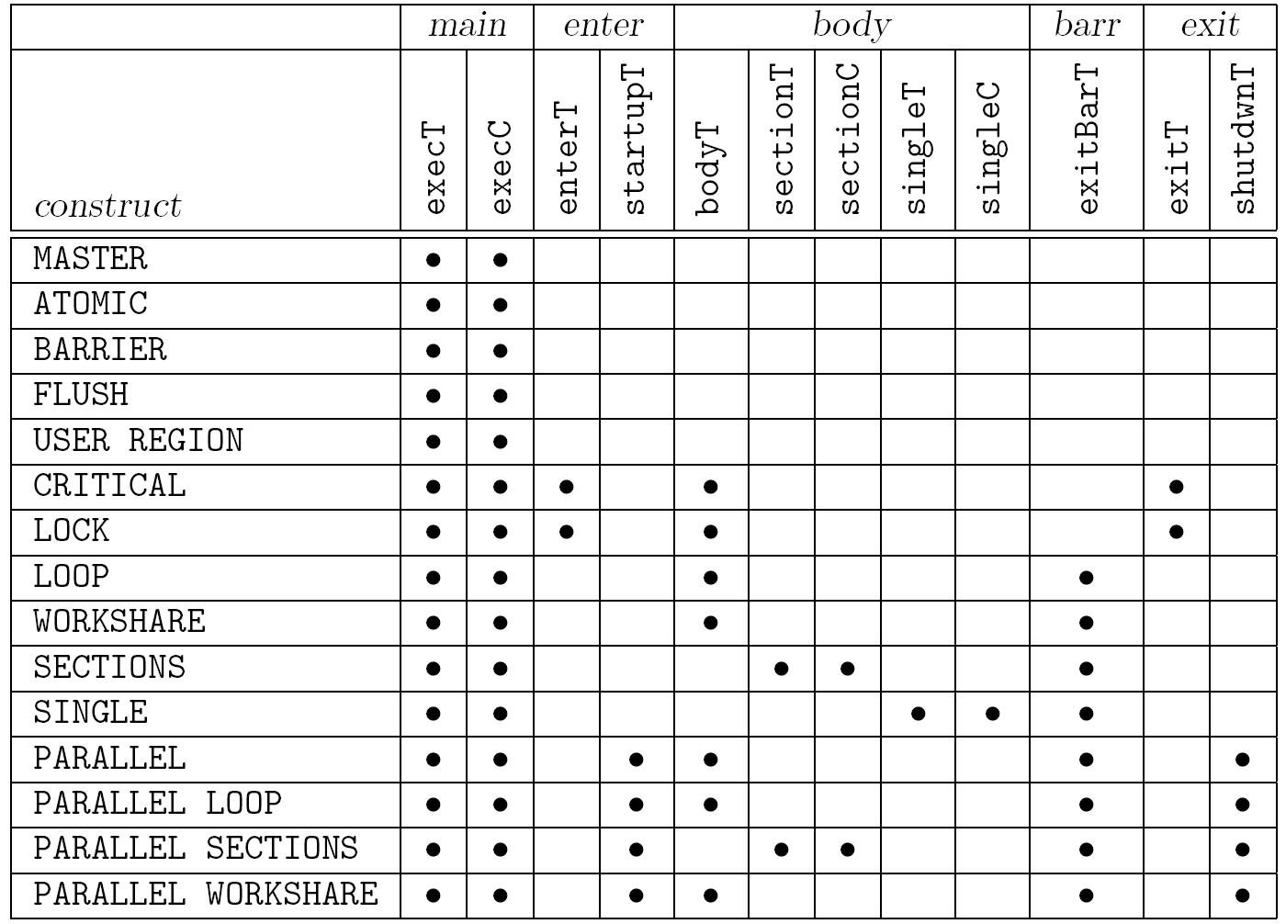
Flat Region Profile (2)
Times and counts reported by ompP for various OpenMP constructs
____T: time
____C: count
Main =
enter +
body +
barr +
exit

Slide 24
Callgraph
Callgraph View
  ‘Callgraph’ or ‘region stack’ of OpenMP constructs
  Functions can be included by using Opari’s mechanism to instrument user defined regions: #pragma pomp inst begin(…), #pragma pomp inst end(…)
Callgraph profile
  Similar to flat profile, but with inclusive/exclusive times
Example:
void foo1()
{
#pragma pomp inst begin(foo1)
bar();
#pragma pomp inst end(foo1)
}
main()
{
#pragma omp parallel
{
foo1();
foo2();
}
}
void bar()
{
#pragma omp critical
{
sleep(1.0);
}
}
void foo2()
{
#pragma pomp inst begin(foo2)
bar();
#pragma pomp inst end(foo2)
}

Slide 25
Callgraph (2)
Callgraph display
Callgraph profiles (execution with four threads)
Incl. CPU time
32.22 (100.0%) [APP 4 threads]
32.06 (99.50%) PARALLEL +-R00004 main.c (42-46)
10.02 (31.10%) USERREG |-R00001 main.c (19-21) ('foo1')
10.02 (31.10%) CRITICAL | +-R00003 main.c (33-36) (unnamed)
16.03 (49.74%) USERREG +-R00002 main.c (26-28) ('foo2')
16.03 (49.74%) CRITICAL +-R00003 main.c (33-36) (unnamed)
[*00] critical.ia64.ompp
[+01] R00004 main.c (42-46) PARALLEL
[+02] R00001 main.c (19-21) ('foo1') USER REGION
TID execT/I execT/E execC
0 1.00 0.00 1
1 3.00 0.00 1
2 2.00 0.00 1
3 4.00 0.00 1
SUM 10.01 0.00 4
[*00] critical.ia64.ompp
[+01] R00004 main.c (42-46) PARALLEL
[+02] R00001 main.c (19-21) ('foo1') USER REGION
[=03] R00003 main.c (33-36) (unnamed) CRITICAL
TID execT execC bodyT/I bodyT/E enterT exitT
0 1.00 1 1.00 1.00 0.00 0.00
1 3.00 1 1.00 1.00 2.00 0.00
2 2.00 1 1.00 1.00 1.00 0.00
3 4.00 1 1.00 1.00 3.00 0.00
SUM 10.01 4 4.00 4.00 6.00 0.00

Slide 26
Overhead Analysis (1)
Certain timing categories reported by ompP can be classified as overheads:
  Example: exitBarT: time wasted by threads idling at the exit barrier of work-sharing constructs. Reason is most likely an imbalanced amount of work
Four overhead categories are defined in ompP:
  Imbalance: waiting time incurred due to an imbalanced amount of work in a worksharing or parallel region
  Synchronization: overhead that arises due to threads having to synchronize their activity, e.g. barrier call
  Limited Parallelism: idle threads due not enough parallelism being exposed by the program
  Thread management: overhead for the creation and destruction of threads, and for signaling critical sections, locks as available

Slide 27
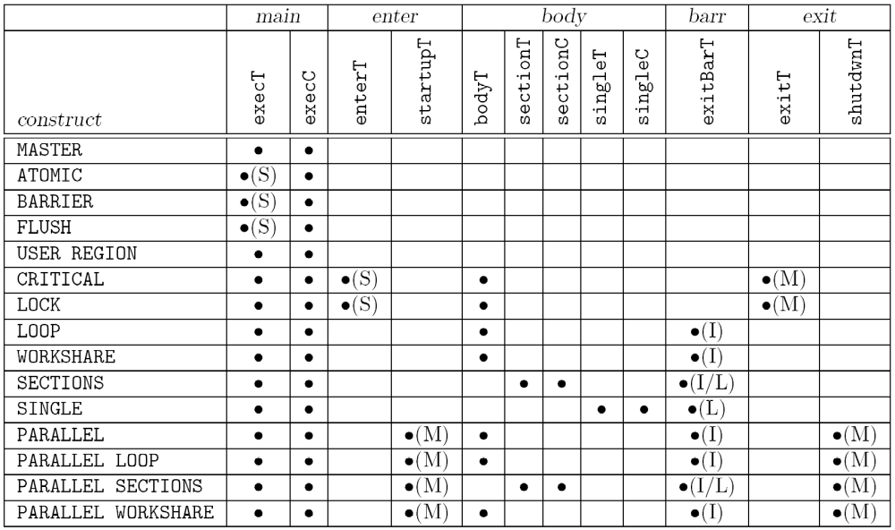
Overhead Analysis (2)
S: Synchronization overhead I: Imbalance overhead
M: Thread management overhead L: Limited Parallelism overhead

Slide 28
ompP’s Overhead Analysis Report
----------------------------------------------------------------------
---- ompP Overhead Analysis Report ----------------------------
----------------------------------------------------------------------
Total runtime (wallclock) : 172.64 sec [32 threads]
Number of parallel regions : 12
Parallel coverage : 134.83 sec (78.10%)
Parallel regions sorted by wallclock time:
Type Location Wallclock (%)
R00011 PARALL mgrid.F (360-384) 55.75 (32.29)
R00019 PARALL mgrid.F (403-427) 23.02 (13.34)
R00009 PARALL mgrid.F (204-217) 11.94 ( 6.92)
...
SUM 134.83 (78.10)
Overheads wrt. each individual parallel region:
Total Ovhds (%) = Synch (%) + Imbal (%) + Limpar (%) + Mgmt (%)
R00011 1783.95 337.26 (18.91) 0.00 ( 0.00) 305.75 (17.14) 0.00 ( 0.00) 31.51 ( 1.77)
R00019 736.80 129.95 (17.64) 0.00 ( 0.00) 104.28 (14.15) 0.00 ( 0.00) 25.66 ( 3.48)
R00009 382.15 183.14 (47.92) 0.00 ( 0.00) 96.47 (25.24) 0.00 ( 0.00) 86.67 (22.68)
R00015 276.11 68.85 (24.94) 0.00 ( 0.00) 51.15 (18.52) 0.00 ( 0.00) 17.70 ( 6.41)
...
Overheads wrt. whole program:
Total Ovhds (%) = Synch (%) + Imbal (%) + Limpar (%) + Mgmt (%)
R00011 1783.95 337.26 ( 6.10) 0.00 ( 0.00) 305.75 ( 5.53) 0.00 ( 0.00) 31.51 ( 0.57)
R00009 382.15 183.14 ( 3.32) 0.00 ( 0.00) 96.47 ( 1.75) 0.00 ( 0.00) 86.67 ( 1.57)
R00005 264.16 164.90 ( 2.98) 0.00 ( 0.00) 63.92 ( 1.16) 0.00 ( 0.00) 100.98 ( 1.83)
R00007 230.63 151.91 ( 2.75) 0.00 ( 0.00) 68.58 ( 1.24) 0.00 ( 0.00) 83.33 ( 1.51)
...
SUM 4314.62 1277.89 (23.13) 0.00 ( 0.00) 872.92 (15.80) 0.00 ( 0.00) 404.97 ( 7.33)
Number of threads, parallel regions, parallel coverage
Wallclock time x number of threads
Overhead percentages wrt. this particular parallel region
Overhead percentages wrt. whole program

Slide 29
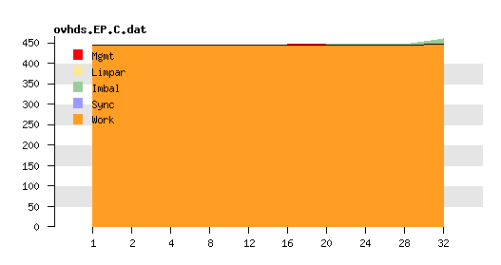
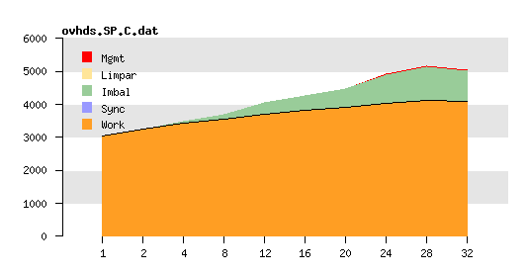
OpenMP Scalability Analysis
Methodology
  Classify execution time into “Work” and four overhead categories: “Thread Management”, “Limited Parallelism”, “Imbalance”, “Synchronization”
  Analyze how overheads behave for increasing thread counts
  Graphs show accumulated runtime over all threads for fixed workload (strong scaling)
  Horizontal line = perfect scalability
Example: NAS parallel benchmarks
  Class C, SGI Altix machine (Itanium 2, 1.6 GHz, 6MB L3 Cache)
EP
SP

Slide 30
Documentation, Manuals, User Guides
PAPI
  http://icl.cs.utk.edu/papi/
ompP
  http://www.ompp-tool.com
IPM
  http://ipm-hpc.sourceforge.net/
TAU
  http://www.cs.uoregon.edu/research/tau/
VAMPIR
  http://www.vampir-ng.de/
Scalasca
  http://www.scalasca.org

