Slide 1

Collective Communication in
MPI and Advanced Features

Slide 2
Outline
Collective group communication
Application examples
  Pi computation
  Summation of long vectors
More applications
  Matrix-vector multiplication
    performance evaluation
Safety and other MPI issues.
Notes:
The University of Adelaide, School of Computer Science
Chapter 2 — Instructions: Language of the Computer

Slide 3
What MPI Functions are commonly used
For simple applications, these are common:
  Startup
    MPI_Init, MPI_Finalize
  Information on the processes
    MPI_Comm_rank, MPI_Comm_size, MPI_Get_processor_name
  Point-to-point communication
    MPI_Irecv, MPI_Isend, MPI_Wait, MPI_Send, MPI_Recv
  Collective communication
    MPI_Allreduce, MPI_Bcast, MPI_Allgather
http://mpitutorial.com/mpi-broadcast-and-collective-communication/
Notes:
CS267 Lecture 2

Slide 4
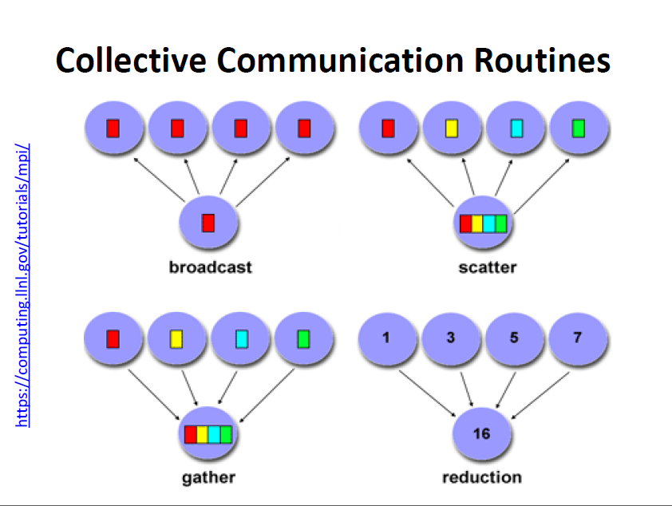
MPI Collective Communication
Collective routines provide a higher-level way to organize a parallel program
  Each process executes the same communication operations
  Communication and computation is coordinated among a group of processes in a communicator
  Tags are not used
  No non-blocking collective operations.
Three classes of operations: synchronization, data movement, collective computation.
Notes:
CS267 Lecture 2

Slide 5
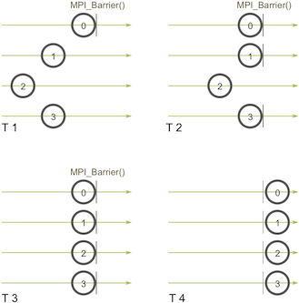
Synchronization
MPI_Barrier( comm )
Blocks until all processes in the group of the communicator comm call it.
Not used often. Sometime
used in measuring
performance and
load balancing
Notes:
CS267 Lecture 2

Slide 6
Collective Data Movement: Broadcast, Scatter, and Gather
P0
A
A
P1
Broadcast
A
P2
A
P3
A
P0
A
B
C
D
Scatter
A
P1
B
P2
C
Gather
P3
D
Notes:
CS267 Lecture 2

Slide 7
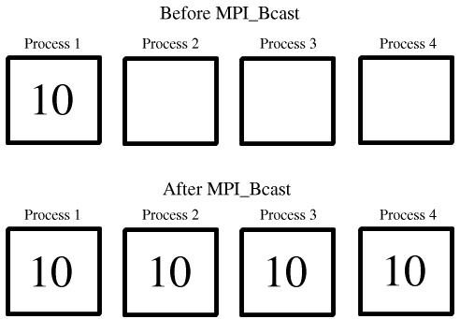
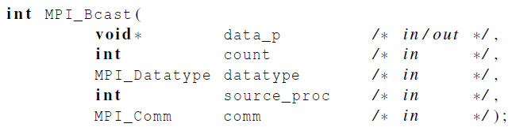
Broadcast
Data belonging to a single process is sent to all of the processes in the communicator.

Slide 8
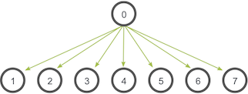
Comments on Broadcast
All collective operations must be called by all processes in the communicator
MPI_Bcast is called by both the sender (called the root process) and the processes that are to receive the broadcast
  MPI_Bcast is not a “multi-send”
  “root” argument is the rank of the sender; this tells MPI which process originates the broadcast and which receive
Notes:
CS267 Lecture 2
If one processor does not call collective, program hangs

Slide 9

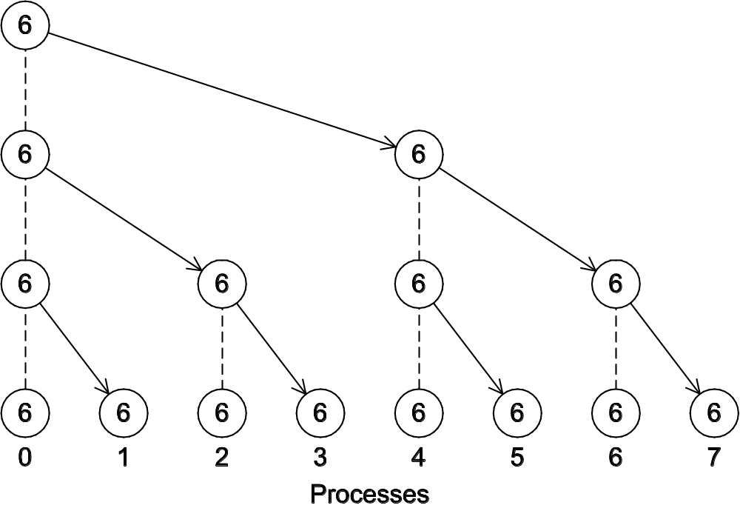
Implementation View: A tree-structured broadcast of a number 6 from Process 0

Slide 10
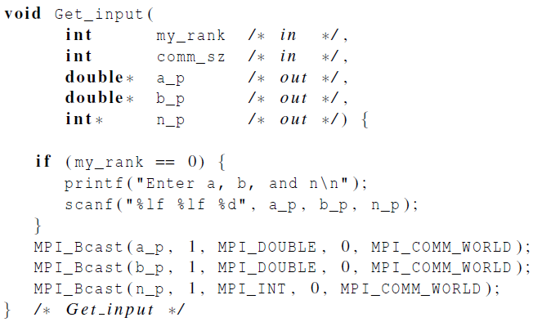
A version of Get_input that uses MPI_Bcast in the trapezoidal program

Slide 11
Collective Data Movement: Allgather and AlltoAll
P0
A
A
B
C
D
P1
B
Allgather
A
B
C
D
P2
C
A
B
C
D
P3
D
A
B
C
D
P0
A0
A1
A2
A3
A0
B0
C0
D0
P1
B0
B1
B2
B3
Alltoall
A1
B1
C1
D1
P2
C0
C1
C2
C3
A2
B2
C2
D2
P3
D0
D1
D2
D3
A3
B3
C3
D3
Notes:
CS267 Lecture 2
All-to-all is transpose

Slide 12
Collective Computation: Reduce vs. Scan
P0
A
R(ABCD)
P1
Reduce
B
P2
C
P3
D
P0
A
R(A)
P1
B
R(AB)
Scan
P2
C
R(ABC)
P3
D
R(ABCD)
Notes:
CS267 Lecture 2
Lecture on scan later, aka parallel prefix

Slide 13
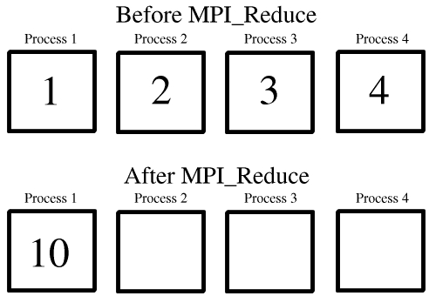
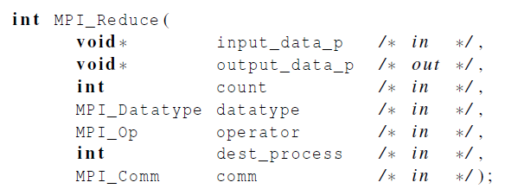
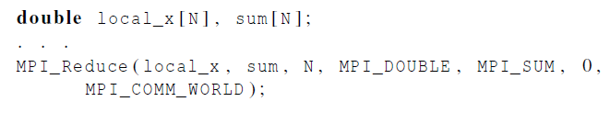
MPI_Reduce

Slide 14
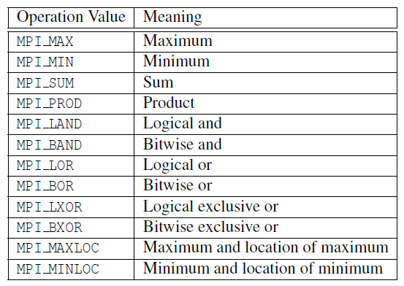
Predefined reduction operators in MPI

Slide 15
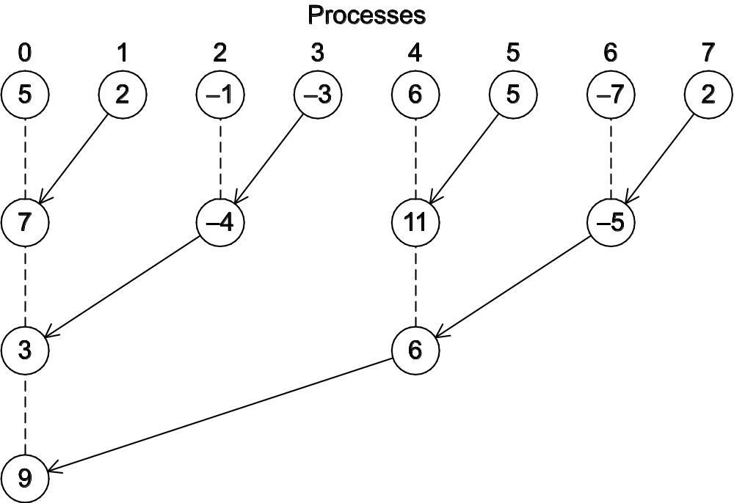
Implementation View of Global Reduction using a tree-structured sum

Slide 16
Implementation view: Tree-structured global reduction with sum operator
In the first phase:
(a) Process 1 sends to 0, 3 sends to 2, 5 sends to 4, and 7 sends to 6.
(b) Processes 0, 2, 4, and 6 add in the received values.
(c) Processes 2 and 6 send their new values to processes 0 and 4, respectively.
(d) Processes 0 and 4 add the received values into their new values.
(a) Process 4 sends its newest value to process 0.
(b) Process 0 adds the received value to its newest value.

Slide 17
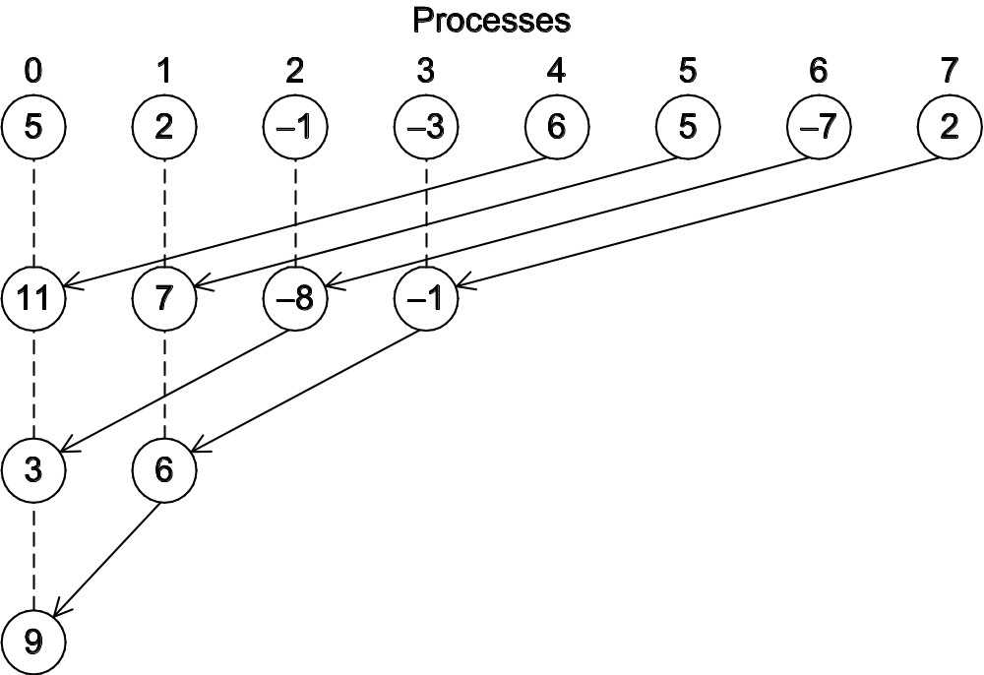
An alternative tree-structured global sum

Slide 18
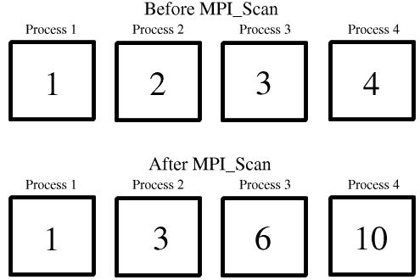
MPI Scan
MPI_Scan( void *sendbuf, void *recvbuf, int count,
MPI_Datatype datatype, MPI_Op op, MPI_Comm comm );

Slide 19
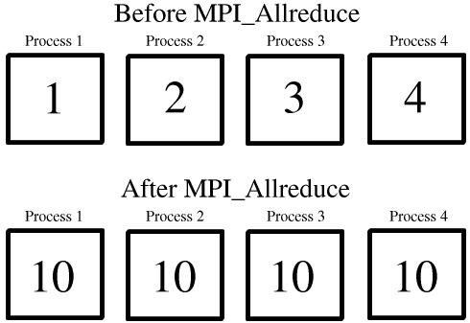
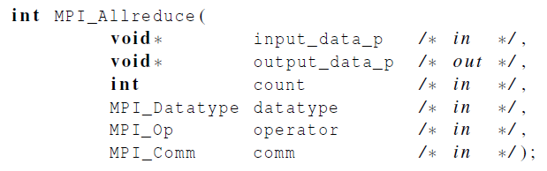
MPI_Allreduce
Useful in a situation in which all of the processes need the result of a global sum in order to complete some larger computation.

Slide 20
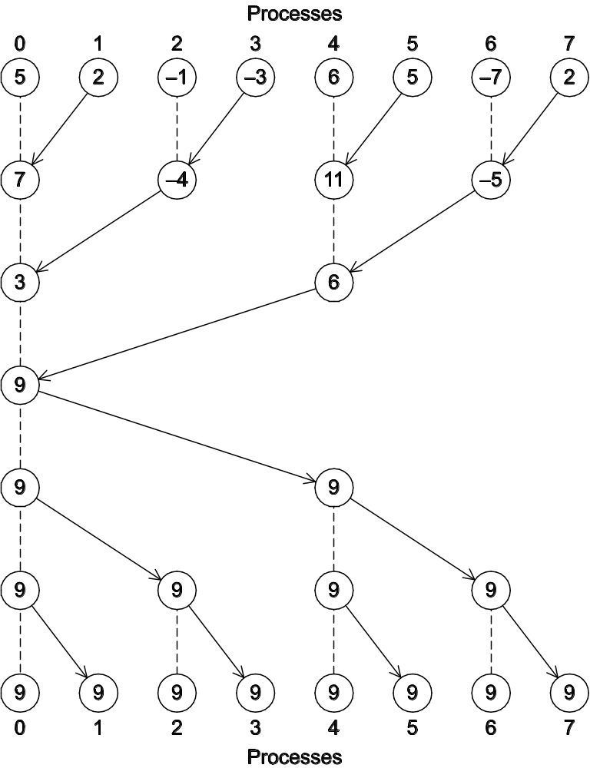
A global sum followed
by distribution of the
result.

Slide 21

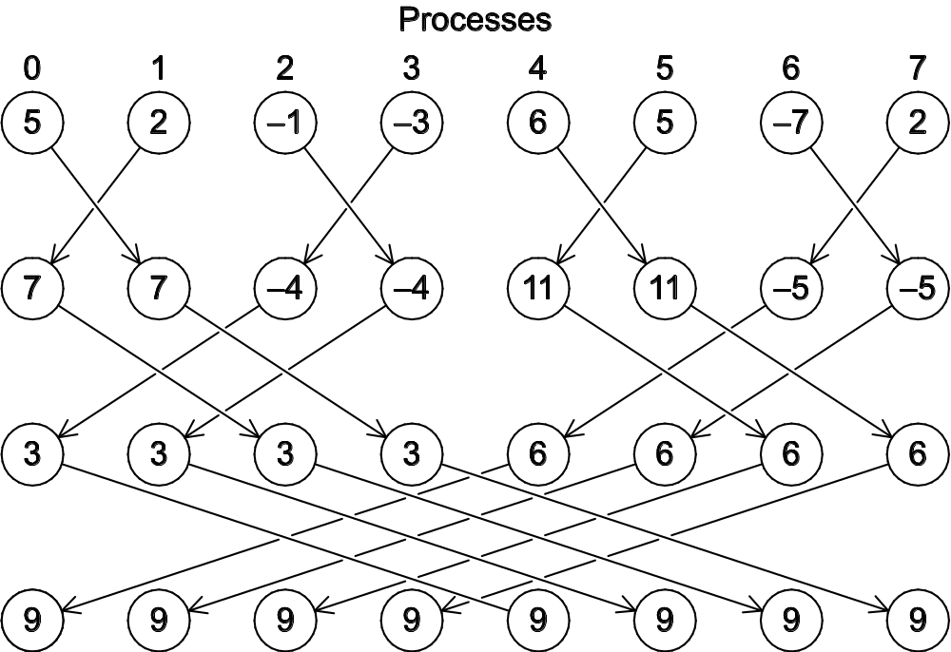
A butterfly-structured global sum.

Slide 22
MPI Collective Routines: Summary
Many Routines: Allgather, Allgatherv, Allreduce, Alltoall, Alltoallv, Bcast, Gather, Gatherv, Reduce, Reduce_scatter, Scan, Scatter, Scatterv
All versions deliver results to all participating processes.
V versions allow the hunks to have variable sizes.
Allreduce, Reduce, Reduce_scatter, and Scan take both built-in and user-defined combiner functions.
MPI-2 adds Alltoallw, Exscan, intercommunicator versions of most routines
Notes:
CS267 Lecture 2
Allgatherv –variable amounts of data on each processor
Allreduce – everyone gets copy of sum

Slide 23
Example of MPI PI program using 6 Functions
Using basic MPI functions:
  MPI_INIT
  MPI_FINALIZE
  MPI_COMM_SIZE
  MPI_COMM_RANK
Using MPI collectives:
  MPI_BCAST
  MPI_REDUCE
Slide source: Bill Gropp, ANL
Notes:
CS267 Lecture 2

Slide 24
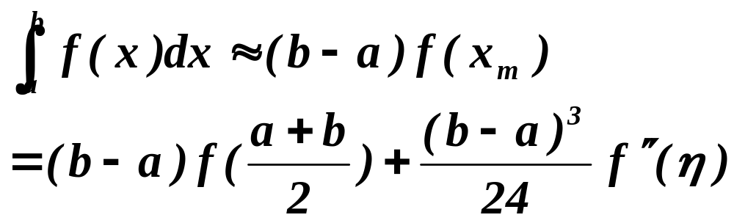
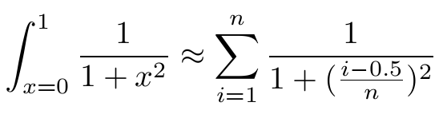
Midpoint Rule for
f(x)
a
x_{m}
b
x

Slide 25
Example: PI in C - 1
#include "mpi.h"
#include <math.h>
#include <stdio.h>
int main(int argc, char *argv[])
{
int done = 0, n, myid, numprocs, i, rc;
double PI25DT = 3.141592653589793238462643;
double mypi, pi, h, sum, x, a;
MPI_Init(&argc,&argv);
MPI_Comm_size(MPI_COMM_WORLD,&numprocs);
MPI_Comm_rank(MPI_COMM_WORLD,&myid);
while (!done) {
if (myid == 0) {
printf("Enter the number of intervals: (0 quits) ");
scanf("%d",&n);
}
MPI_Bcast(&n, 1, MPI_INT, 0, MPI_COMM_WORLD);
if (n == 0) break;
Input and broadcast parameters
Slide source: Bill Gropp, ANL
Notes:
CS267 Lecture 2

Slide 26
Example: PI in C - 2
h = 1.0 / (double) n;
sum = 0.0;
for (i = myid + 1; i <= n; i += numprocs) {
x = h * ((double)i - 0.5);
sum += 4.0 / (1.0 + x*x);
}
mypi = h * sum;
MPI_Reduce(&mypi, &pi, 1, MPI_DOUBLE, MPI_SUM, 0,
MPI_COMM_WORLD);
if (myid == 0)
printf("pi is approximately %.16f, Error is .16f\n",
pi, fabs(pi - PI25DT));
}
MPI_Finalize();
return 0;
}
Compute local pi values
Compute summation
Slide source: Bill Gropp, ANL
Notes:
CS267 Lecture 2

Slide 27
Collective vs. Point-to-Point Communications
All the processes in the communicator must call the same collective function.
  Will this program work?
  if(my_rank==0) MPI_Reduce(&a,&b,1, MPI_INT, MPI_SUM, 0, MPI_COMM_WORLD);
  else MPI_Recv(&a, MPI_INT, MPI_SUM,0,0, MPI_COMM_WORLD);

Slide 28
Collective vs. Point-to-Point Communications
All the processes in the communicator must call the same collective function.
  For example, a program that attempts to match a call to MPI_Reduce on one process with a call to MPI_Recv on another process is erroneous, and, in all likelihood, the program will hang or crash.
  if(my_rank==0) MPI_Reduce(&a,&b,1, MPI_INT, MPI_SUM, 0, MPI_COMM_WORLD);
  else MPI_Recv(&a, MPI_INT, MPI_SUM,0,0, MPI_COMM_WORLD);

Slide 29
Collective vs. Point-to-Point Communications
The arguments passed by each process to an MPI collective communication must be “compatible.”
  Will this program work?
  if(my_rank==0) MPI_Reduce(&a,&b,1, MPI_INT, MPI_SUM, 0, MPI_COMM_WORLD);
  else MPI_Reduce(&a,&b,1, MPI_INT, MPI_SUM, 1, MPI_COMM_WORLD);

Slide 30
Collective vs. Point-to-Point Communications
The arguments passed by each process to an MPI collective communication must be “compatible.”
  For example, if one process passes in 0 as the dest_process and another passes in 1, then the outcome of a call to MPI_Reduce is erroneous, and, once again, the program is likely to hang or crash.
  if(my_rank==0) MPI_Reduce(&a,&b,1, MPI_INT, MPI_SUM, 0, MPI_COMM_WORLD);
  else MPI_Reduce(&a,&b,1, MPI_INT, MPI_SUM, 1, MPI_COMM_WORLD);

Slide 31
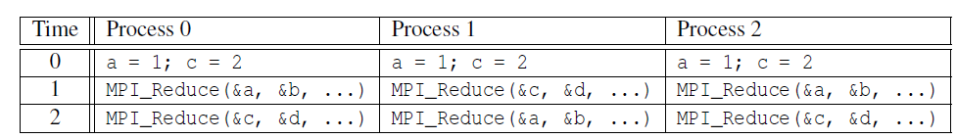
Example of MPI_Reduce execution
Multiple calls to MPI_Reduce with MPI_SUM and Proc 0 as destination (root)
Is b=3 on Proc 0 after two MPI_Reduce() calls?
Is d=6 on Proc 0?

Slide 32
Example: Output results
However, the names of the memory locations are irrelevant to the matching of the calls to MPI_Reduce.
The order of the calls will determine the matching so the value stored in b will be 1+2+1 = 4, and the value stored in d will be 2+1+2 = 5.

Slide 33
Parallel Matrix Vector Multiplication

Slide 34
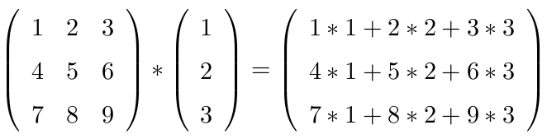
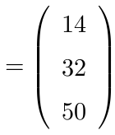

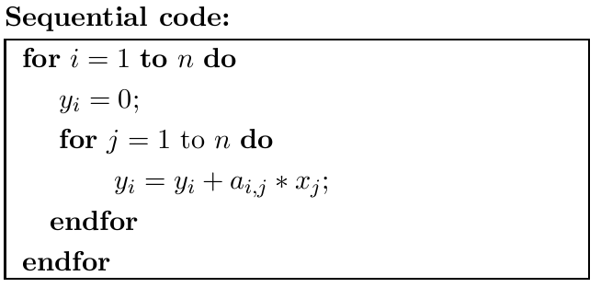
Matrix-vector multiplication: y= A * x

Slide 35
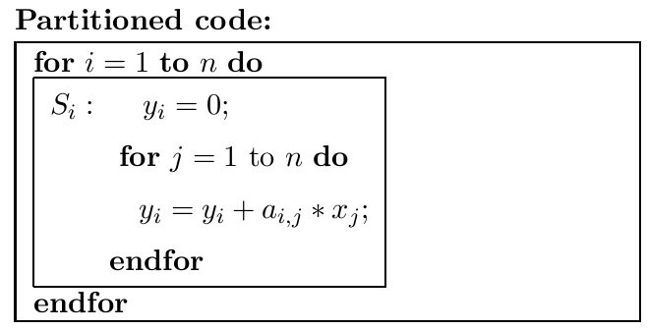
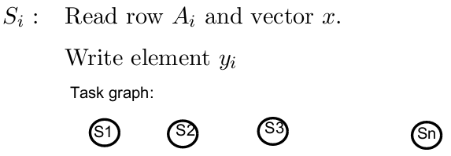
Partitioning and Task graph for matrix-vector multiplication
y_{i}= Row A_{i} * x

Slide 36
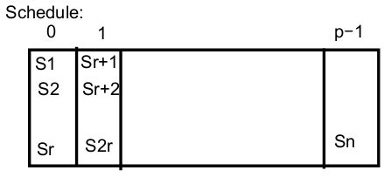
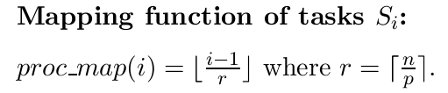
Execution Schedule and Task Mapping
y_{i}= Row A_{i} * x

Slide 37
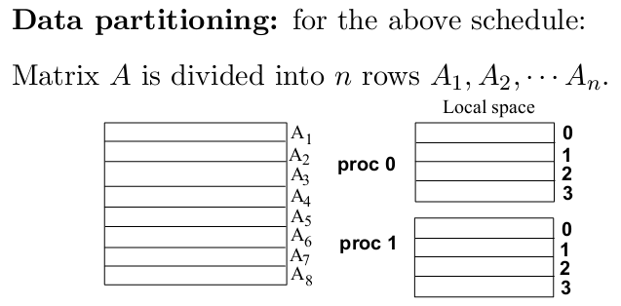
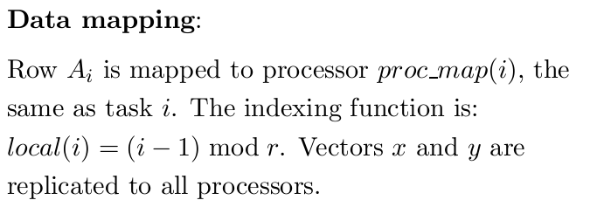
Data Partitioning and Mapping for y= A*x

Slide 38
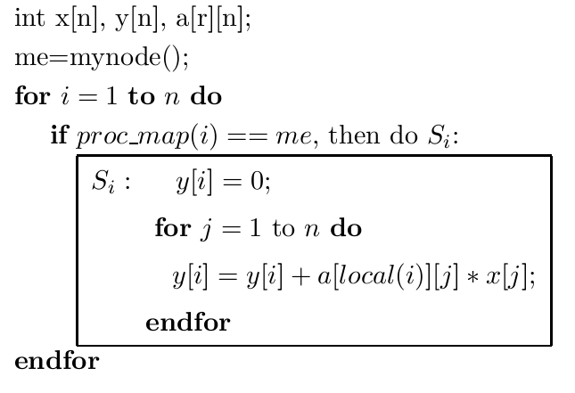
SPMD Code for y= A*x

Slide 39

Evaluation: Parallel Time
Ignore the cost of local address calculation.
Each task performs n additions and n multiplications.
Each addition/multiplication costs ω
The parallel time is approximately

Slide 40
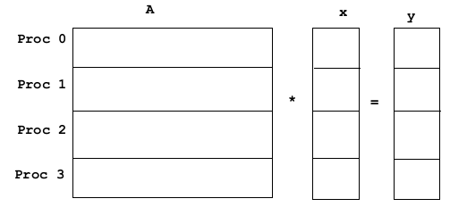
How is initial data distributed?
Assume initially matrix A and vector x are distributed
evenly among processes
Need to redistribute vector x to everybody in order to perform
parallel computation!
What MPI collective communication is needed?

Slide 41
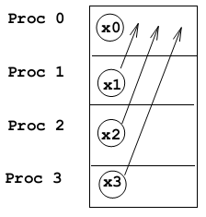
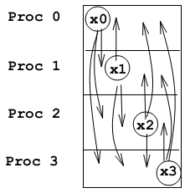
Communication Pattern for Data Redistribution
Data requirement for
Process 0
MPI_Gather
Data requirement for
all processes
MPI_Allgather

Slide 42

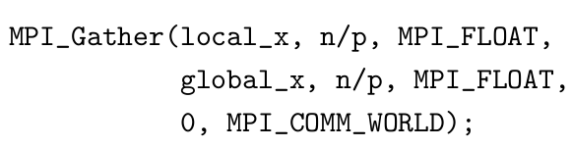
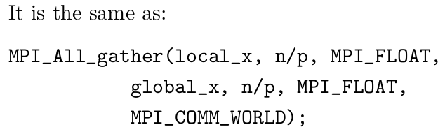
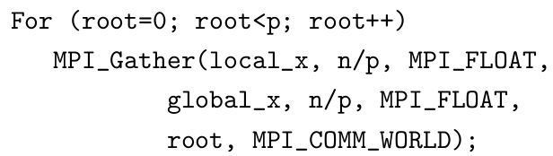
MPI Code for Gathering Data
Data gather for
Process 0
Repeat for all processes

Slide 43
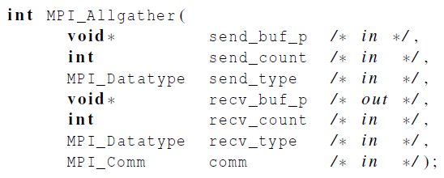
Allgather
A
A
B
C
D
B
Allgather
A
B
C
D
C
A
B
C
D
D
A
B
C
D
Concatenates the contents of each process’ send_buf_p and stores this in each process’ recv_buf_p.
As usual, recv_count is the amount of data being received from each process.

Slide 44
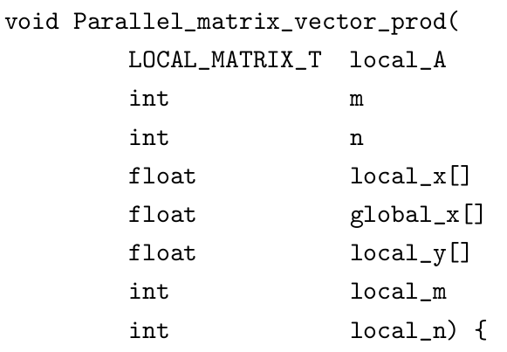
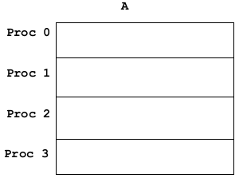

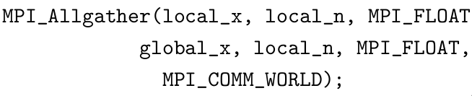
MPI SPMD Code for y=A*x

Slide 45
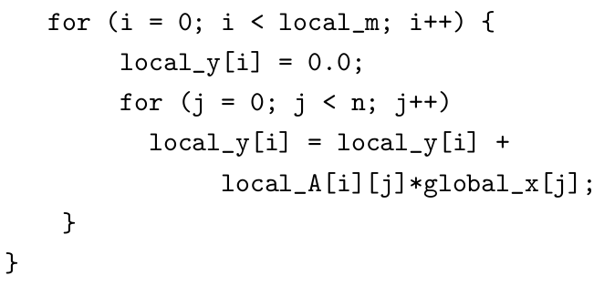
MPI SPMD Code for y=A*x

Slide 46
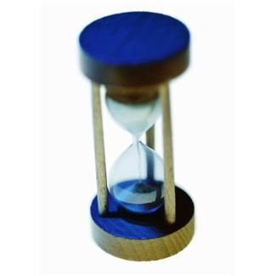
Performance Evaluation of Matrix Vector Multiplication

Slide 47

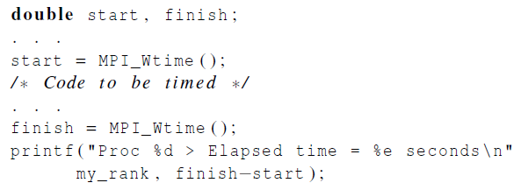
How to measure elapsed parallel time
Use MPI_Wtime() that returns the number of seconds that have elapsed since some time in the past.

Slide 48

Measure elapsed sequential time in Linux
This code works for Linux without using MPI functions
Use GET_TIME() which returns time in microseconds elapsed from some point in the past.
Sample code for GET_TIME()
#include <sys/time.h>
/* The argument now should be a double (not a pointer to a double) */
#define GET_TIME(now) {
struct timeval t;
gettimeofday(&t, NULL);
now = t.tv_sec + t.tv_usec/1000000.0;
}

Slide 49
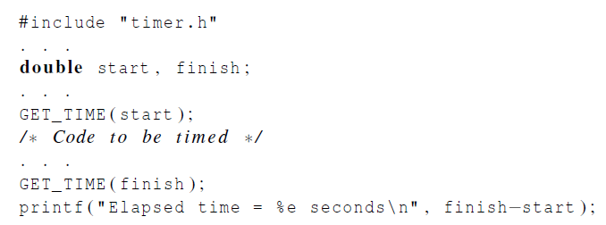
Measure elapsed sequential time

Slide 50
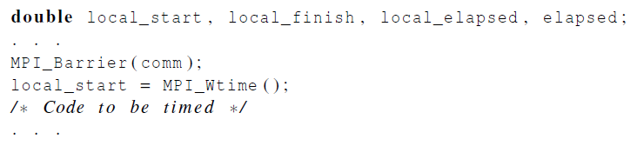
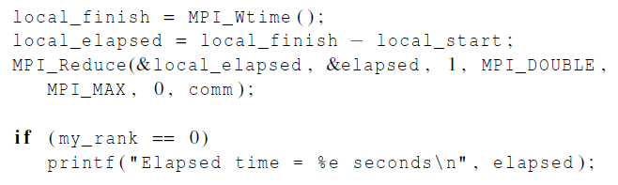
Use MPI_Barrier() before time measurement
Start timing until every process in the communicator has reached the same time stamp

Slide 51
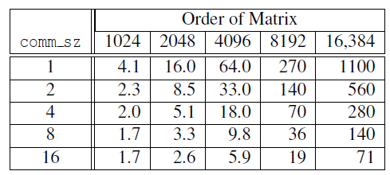
Run-times of serial and parallel matrix-vector multiplication
(Seconds)

Slide 52


Speedup and Efficiency

Slide 53
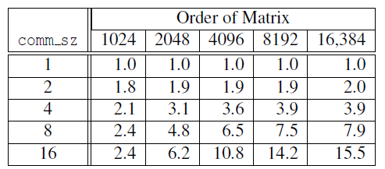
Speedups of Parallel Matrix-Vector Multiplication

Slide 54
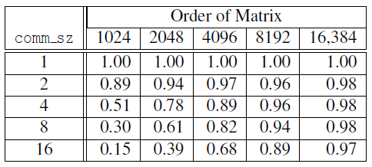
Efficiencies of Parallel Matrix-Vector Multiplication

Slide 55

Scalability
A program is scalable if the problem size can be increased at a rate so that the efficiency doesn’t decrease as the number of processes increase.
Programs that can maintain a constant efficiency without increasing the problem size are sometimes said to be strongly scalable.
Programs that can maintain a constant efficiency if the problem size increases at the same rate as the number of processes are sometimes said to be weakly scalable.

Slide 56
Safety Issues in MPI programs

Slide 57

Safety in MPI programs
Is it a safe program? (Assume tag/process ID is assigned properly)
Process 0
Send(1)
Recv(1)
Process 1
Send(0)
Recv(0)
)

Slide 58
Safety in MPI programs
Is it a safe program? (Assume tag/process ID is assigned properly)
May be unsafe because MPI standard allows MPI_Send to behave in two different ways:
  it can simply copy the message into an MPI managed buffer and return,
  or it can block until the matching call to MPI_Recv starts.
Process 0
Send(1)
Recv(1)
Process 1
Send(0)
Recv(0)

Slide 59
Buffer a message implicitly during MPI_Send()
When you send data, where does it go? One possibility is:
Process 0
Process 1
User data
Local buffer
the network
Local buffer
User data
Slide source: Bill Gropp, ANL
Notes:
CS267 Lecture 2
Doubles storage, but safe

Slide 60
Avoiding Buffering
Avoiding copies uses less memory
May use more time
Process 0
Process 1
User data
the network
User data
MPI_Send() waits until a matching receive is executed.
Slide source: Bill Gropp, ANL
Notes:
CS267 Lecture 2
Time-space tradeoff

Slide 61
Safety in MPI programs
Many implementations of MPI set a threshold at which the system switches from buffering to blocking.
  Relatively small messages will be buffered by MPI_Send.
  Larger messages, will cause it to block.
If the MPI_Send() executed by each process blocks, no process will be able to start executing a call to MPI_Recv, and the program will hang or deadlock.
  Each process is blocked waiting for an event that will never happen.

Slide 62
Example of unsafe MPI code with possible deadlocks
Send a large message from process 0 to process 1
  If there is insufficient storage at the destination, the send must wait for the user to provide the memory space (through a receive)
Process 0
Send(1)
Recv(1)
Process 1
Send(0)
Recv(0)
This may be “unsafe” because it depends on the availability of system buffers in which to store the data sent until it can be received
Slide source: Bill Gropp, ANL
Notes:
CS267 Lecture 2
Doubles the memory to be able to continue computing past send()

Slide 63
Safety in MPI programs
A program that relies on MPI provided buffering is said to be unsafe.
Such a program may run without problems for various sets of input, but it may hang or crash with other sets.

Slide 64


How can we tell if a program is unsafe
Replace MPI_Send() with MPI_Ssend()
The extra “s” stands for synchronous and MPI_Ssend is guaranteed to block until the matching receive starts.
If the new program does not hang/crash, the original program is safe.
MPI_Send() and MPI_Ssend() have the same arguments

Slide 65
Some Solutions to the “unsafe” Problem
Order the operations more carefully:
Process 0
Send(1)
Recv(1)
Process 1
Recv(0)
Send(0)
Simultaneous send and receive in one call
Process 0
Sendrecv(1)
Process 1
Sendrecv(0)
Slide source: Bill Gropp, ANL
Notes:
CS267 Lecture 2
Trouble with sendrecv: need to be paired up, called about the same time

Slide 66

Restructuring communication in odd-even sort

Slide 67


Use MPI_Sendrecv() to conduct a blocking send and a receive in a single call.

Slide 68
More Solutions to the “unsafe” Problem
Supply own space as buffer for send
Process 0
Bsend(1)
Recv(1)
Process 1
Bsend(0)
Recv(0)
Use non-blocking operations:
Process 0
Isend(1)
Irecv(1)
Waitall
Process 1
Isend(0)
Irecv(0)
Waitall
Notes:
CS267 Lecture 2
Buffered send: Bsend: supply buffer space yourself
Immediate send: you promise not to touch it until done (need to call waitall later)
Immediate recv: returns right away, you promise not to touch it until done (need to call waitall later)
Riskier (race conditions possible) but allows more overlap

Slide 69
Concluding Remarks (1)
MPI works in C, C++, or Fortran.
A communicator is a collection of processes that can send messages to each other.
Many parallel programs use the SPMD approach.
Most serial programs are deterministic: if we run the same program with the same input we’ll get the same output.
  Parallel programs often don’t possess this property.
Collective communications involve all the processes in a communicator.

Slide 70
Concluding Remarks (2)
Performance evaluation
  Use elapsed time or “wall clock time”.
  Speedup = sequential/parallel time
  Efficiency = Speedup/ p
  If it’s possible to increase the problem size (n) so that the efficiency doesn’t decrease as p is increased, a parallel program is said to be scalable.
An MPI program is unsafe if its correct behavior depends on the fact that MPI_Send is buffering its input.

