Slide 1
Systematic Literature Review: GPS-Denied Drone Navigation
Project Finalisation & Progress Report
Abhishek Raj

Slide 2

Current Project Status
Phase 1-4
Planning, Search, Extraction, Cleaning
COMPLETED
check_circle
Phase 5
Analysis & Figure Generation
COMPLETED
check_circle
Phase 6
Manuscript Writing & Formatting
COMPLETED
check_circle
Phase 7
Supplementary Files & Verification
COMPLETED
check_circle
Pending Tasks
Supervisor Review, Zenodo Upload, Journal Submission
IN PROGRESS
pending

Slide 3

Key Highlights & Statistics
article
speed
grid_view
track_changes
Dataset
231
Peer-reviewed papers included in final analysis.
Median RMSE
0.080m
Overall translation error achieved in real-flight testing.
Dominant
23.4%
Monocular + IMU remains the most common hardware choice.
Most Accurate
Fusion
Multi-sensor setups combining LiDAR, Event, and Thermal.

Slide 4
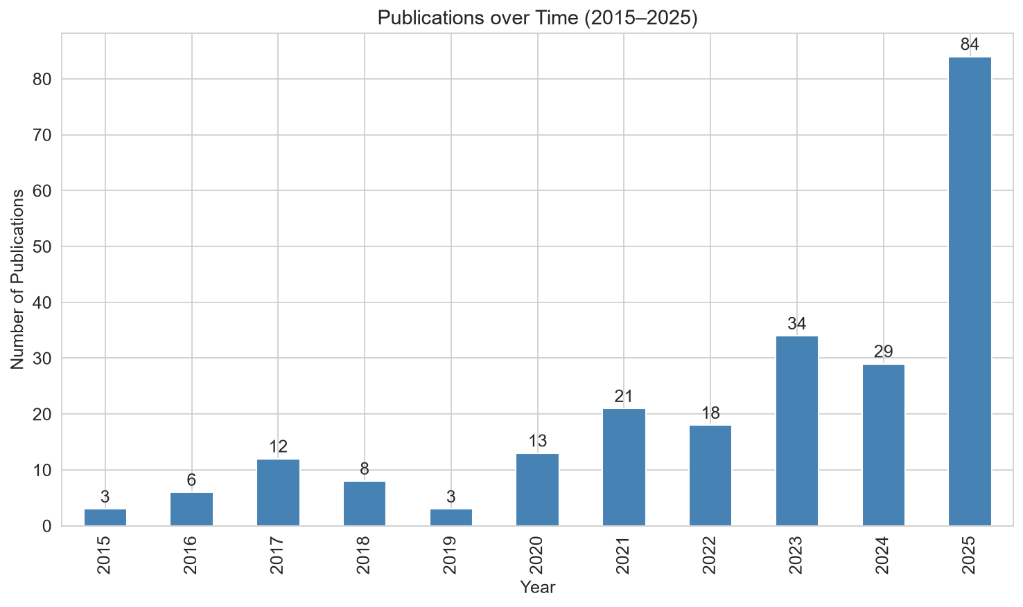
Publication Trend (2015-2025)

Slide 5
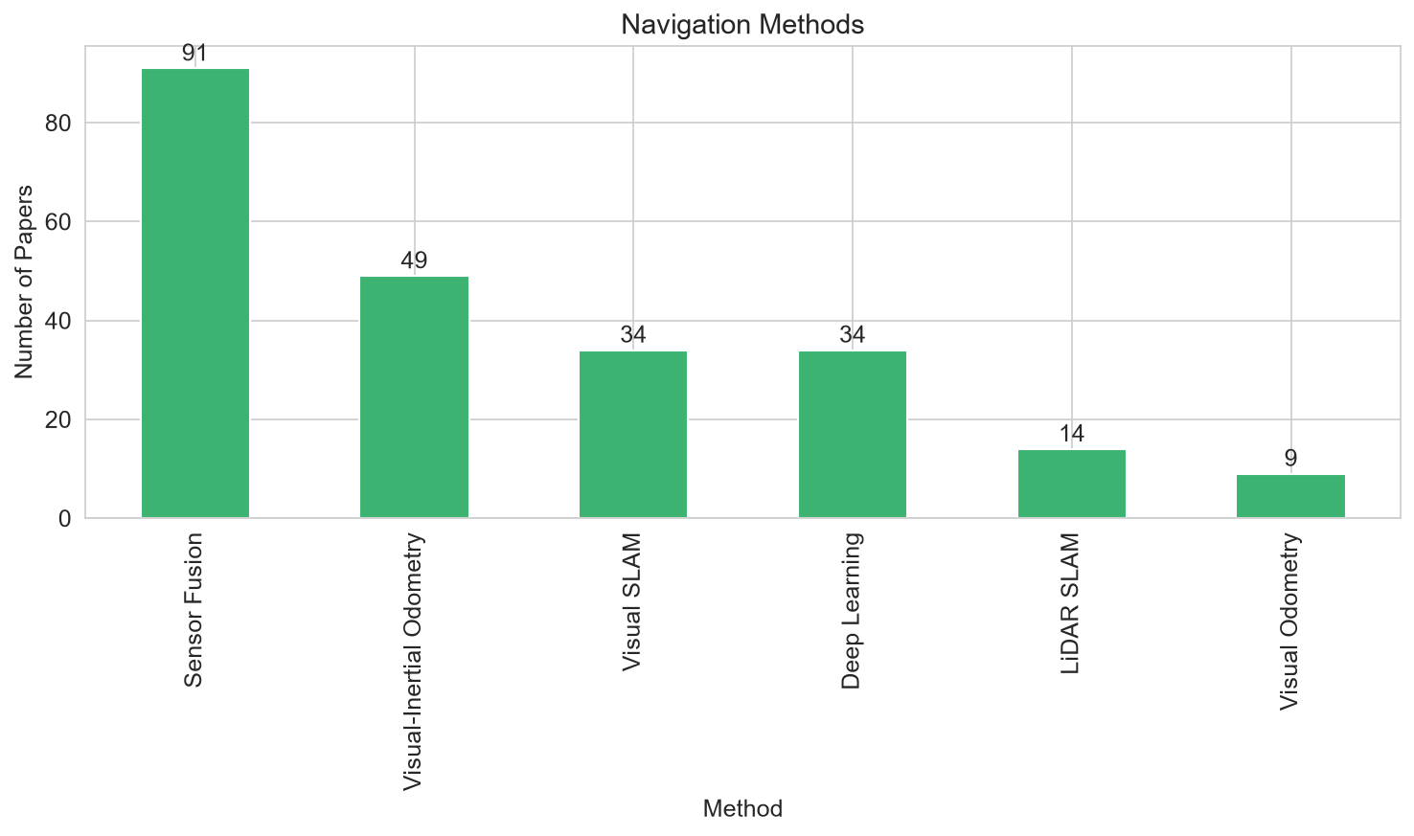
Navigation Methods Distribution

