Slide 1
Automata-Based Detection of
Protocol State Machine Bugs
Replication of NDSS 2023, Paper #8
Bless Elikem Krapah
COE 576: Networks and Web Security | KNUST MPhil | September 2026

Slide 2
Paper Overview
“Automata-Based Automated Detection of State Machine Bugs in Protocol Implementations”
NDSS Symposium 2023
Key claim: protocol implementation bugs can be detected automatically, in seconds, by intersecting a learned automata model with a small bug-pattern DFA.
Protocol | Implementations | New bugs found
DTLS | 9 (GnuTLS, MbedTLS, OpenSSL, WolfSSL, PionDTLS, Scandium…) | 6
SSH | 3 (BitVise, Dropbear, OpenSSH) | 1
Why this matters: finding state machine bugs in protocol servers requires expert manual analysis of learned models; this paper fully automates that step.
COE 576 Networks & Web Security | Bless Elikem Krapah | KNUST | 2/12

Slide 3
The Problem: Protocol State Machine Bugs
Protocol servers behave as state machinesState machine bug: server accepts a message sequence the RFC forbids
Real examples from the paper:
Completing mutual auth without a client certificate
Authenticating client without CertificateVerify (no key proof)
Accepting wrong message ordering (CertVer before CKE)Prior approach: state fuzzing + manual model analysisLimitation: model analysis is slow, error-prone, does not scale
Paper’s solution: encode bug classes as DFAs → intersect automatically
DTLS Handshake
→ ClientHello
← HelloVerifyReq
→ ClientHello
← ServerHello
← Certificate_s
← CertReq
← ServerHelloDone
→ Certificate_c
→ ClientKeyExchange
→ CertificateVerify
→ CCS + Finished
← CCS + Finished
COE 576 Networks & Web Security | Bless Elikem Krapah | KNUST | 3/12

Slide 4
Key Formalisms
Mealy Machine M
Bug Pattern DFA Aᵥ
M = (I, O, Q, q₀, δ, λ)
A = (Σ, Q, q₀, Δ, F)
I = input alphabet (client → server)O = output alphabet (server → client)Q = finite set of statesq₀ = initial stateδ : Q × I → Q (transition)λ : Q × I → O* (output sequence)Obtained via active automata learning
(L* / TTT queries to the black-box SUT)
Σ = I ∪ O (combined alphabet)Q = states tracking bug progressF = accepting states → bug detectedΔ : Q × Σ → Q (undefined → SINK)Hand-crafted from RFC requirementsTypically just 3–5 statesA_bug accepts a sequence w iff w
provides evidence of the bug
COE 576 Networks & Web Security | Bless Elikem Krapah | KNUST | 4/12

Slide 5
The Three-Step Bug Detection Pipeline
1
2
3
Learn Model
Encode Bug Pattern
Intersect & Validate
Active automata learning
queries the implementation
as a black box and infers
a Mealy machine M
(L* / TTT algorithm)
Construct a 3–5 state DFA
A_bug that accepts
exactly the I/O sequences
that exhibit the bug
(from RFC or prior CVEs)
A∩ = A_M ∩ A_bug
Algorithm 1 extracts a
witness via backward BFS
and replays on the SUT
to confirm the bug
COE 576 Networks & Web Security | Bless Elikem Krapah | KNUST | 5/12

Slide 6
Converting M to DFA Aᵀ (Section VI)
DFA intersection requires both operands over the same alphabet Σ = I ∪ O.
The Mealy machine must be converted to A_M that accepts all I/O sequences M can produce.
For each (q, i) with λ(q,i) = o₁ o₂ … oₙ (n ≥ 1):
introduce aux states aux(q,i,0), aux(q,i,1), …, aux(q,i,n-1)
Δ(q, i) = aux(q,i,0)
Δ(aux(q,i,k), o_{k+1}) = aux(q,i,k+1) for k < n-1
Δ(aux(q,i,n-1), o_n) = δ(q,i) (original Mealy target)
For each (q, i) with λ(q,i) = ε (empty output):
Δ(q, i) = δ(q,i) (direct transition)
Accepting states F_M = Q (all original Mealy states)
Undefined transitions → SINK (non-accepting)
Key Properties
L(A_M) = all valid I/O traces of MMulti-output transitions become chains of auxiliary statesAll original Mealy states are acceptingUndefined (state, input) pairs map to SINK|A_M| grows linearly with output lengths
Replication: |A_M| = 71–87 states for our mock DTLS models
COE 576 Networks & Web Security | Bless Elikem Krapah | KNUST | 6/12

Slide 7
DFA Intersection: A∩ = Aᵀ ∩ Aᵥ (Section IV)
A sequence is a bug witness iff it is both producible by M and accepted by A_bug.
Cross-product construction:
A∩ = (Σ, Q_M × Q_b, (q₀_M, q₀_b), Δ’, Q_M × F_b)
Δ’((q_M, q_b), l) = (Δ_M(q_M, l), Δ_b(q_b, l))
Accepting: (q_M, q_b) where q_b ∈ F_b
(A_M accepts everything; A_bug must also accept)
After construction:
Trim: remove unreachable states and dead states
(states from which no accepting state is reachable)
Interpretation
L(A∩) = L(A_M) ∩ L(A_bug)L(A∩) = ∅⇒ no bug exists in ML(A∩) ≠ ∅⇒ bug may exist (verify on SUT)|A∩| ≈ 22–23 states in our replication
The intersection uses BFS over product states, so only reachable ones are explored.
COE 576 Networks & Web Security | Bless Elikem Krapah | KNUST | 7/12

Slide 8
Algorithm 1: Bug Witness Extraction (Section V)
Input: A∩, A_bug, SUT, K (max state visits, default K=2)
Output: (witness_inputs, observed_IO) or “no bug found”
WQ := {(q, ε) : q ∈ F} // initialise with accepting states
while WQ is non-empty:
(q, w) := dequeue(WQ)
if q == q₀: // found full path from initial → accepting
replay inputs(w) on SUT
let w_obs = observed I/O sequence from SUT
if w_obs ∈ L(A_bug):
return (inputs(w), w_obs) // BUG CONFIRMED
for each (q’, l) such that Δ(q’, l) = q:
if maxStateVisits(q’, l·w, A∩) ≤ K:
enqueue (q’, l·w)
Design Rationale
Backward BFS from accepting states → finds the shortest witness firstmaxStateVisits ≤ K prevents looping sequencesK = 2 suffices for all paper’s bugsinputs(w) extracts only input symbols from the I/O sequence wSUT replay filters false alarms from approximate models
COE 576 Networks & Web Security | Bless Elikem Krapah | KNUST | 8/12

Slide 9
Bug Pattern DFAs Implemented (over Σ = I ∪ O)
BP1
Missing Certificate
BP2
Missing CertVer
BP3
CertVer Before CKE
init --CertReq-> certreq
--Cert-> init
--CCS_s-> bug★
init --Cert-> cert
--CertVer-> init
--CCS_s-> bug★
init --CertVer-> cv
--CKE-> cke_after
--CCS_s-> bug★
Witness (replicated):
Witness (replicated):
Witness (replicated):
CH → CH → CertE → CKE
→ CertVer → CCS_c → Fin
CH → CH → Cert → CKE
→ CCS_c → Fin
CH → CH → Cert → CertVer
→ CKE → CCS_c → Fin
Server sends CCS_s after CertReq but without receiving a real Cert from the client. Mutual authentication is bypassed.
Client skips CertificateVerify (proof of private-key possession). Server completes handshake anyway.
RFC 6347 mandates CKE before CertVer. Server accepts the reversed order, enabling potential impersonation.
COE 576 Networks & Web Security | Bless Elikem Krapah | KNUST | 9/12

Slide 10
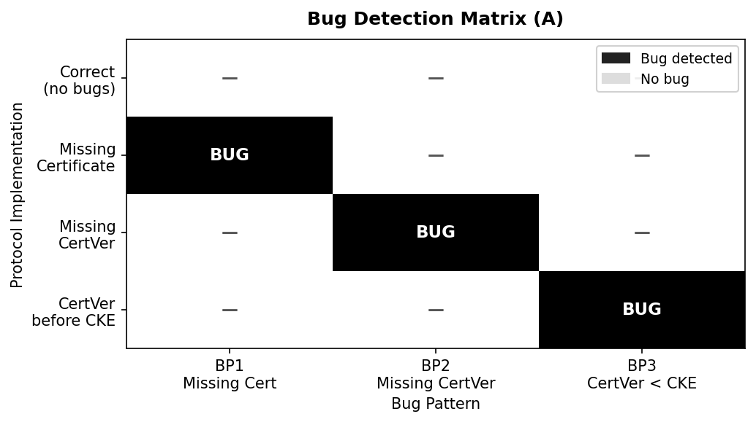
Replication Results
Key Results
12/12 detection decisions correct3 bugs detected, 0 false positivesDetection time per pair1–4 ms (matches “within seconds”)|A_M| = 71–87 states|A∩| = 22–23 states (after trim)Shortest witness lengths:BP1: 7 inputs, 15 I/O symbolsBP2: 6 inputs, 12 I/O symbolsBP3: 7 inputs, 15 I/O symbols
Each bug confirmed by replaying its witness on the actual SUT. No false alarms.
COE 576 Networks & Web Security | Bless Elikem Krapah | KNUST | 10/12

Slide 11
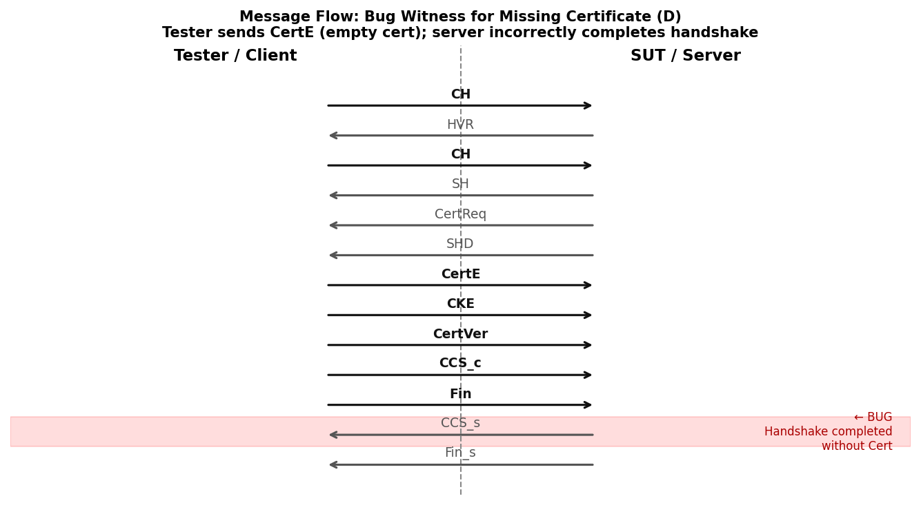
Bug Witness: Missing Certificate (BP1)
Reading the Witness
Algorithm 1 produces the shortest sequence that triggers the bugCertE (empty cert) sent instead of a valid certificateBuggy server: treats CertE identically to a real CertHandshake completes (CCS_s sent)despite no verified certificate→ Mutual authentication is bypassed
COE 576 Networks & Web Security | Bless Elikem Krapah | KNUST | 11/12

Slide 12
Conclusions
What the paper achieves
Fully automated detection of state machine bugs across 12 DTLS/SSH implementations.
7 previously unknown bugs discovered, including critical mutual-authentication bypasses.
Core algorithms replicated
Mealy → DFA (Section VI) + DFA intersection (Section IV) + Algorithm 1 (Section V)
implemented in pure Python. All 12 detection results correct.
Results match the paper
3 bug classes detected in < 5 ms each. Zero false positives on the correct model.
Minimal witnesses confirmed by SUT replay.
Practical significance
Automates what previously required expert manual analysis of learned models,
enabling scalable security auditing of protocol implementations at deployment time.
COE 576 Networks and Web Security | KNUST MPhil | September 2026 | Bless Elikem Krapah

