Slide 1
Low-Density Parity-Check Codes
Replication of Gallager (1962)
Paper #8: R. Gallager, "Low-Density Parity-Check Codes," IRE Trans. Inf. Theory, 1962
Bless Elikem Krapah
COE 592: Advanced Signal and Communication Theory | KNUST MPhil | September 2026

Slide 2
Paper Overview
"Low-Density Parity-Check Codes"
R. Gallager | IRE Transactions on Information Theory, vol. 8, pp. 21-28, 1962
H
BP
C
Sparse Parity-Check Matrix
Iterative Belief Propagation
Near-Shannon Performance
A (j,k)-regular matrix H where every column has weight j and every row has weight k, keeping the code "low density".
Messages passed between variable nodes and check nodes on a Tanner graph, iterating until convergence.
Demonstrated BER curves approaching the channel capacity limit, far below any code of the 1950s.
COE 592: Advanced Signal and Communication Theory | Bless Elikem Krapah | KNUST | 2/10

Slide 3
Background: The Coding Gap
Shannon (1948) proved that reliable communication is possible at any rate R below channel capacity:
Prior codes and their limitations:
1950
Hamming codes
C = (1/2) log2(1 + Eb/N0)
For rate R = 1/2 over AWGN:
Minimum Eb/N0 = 0 dB
Uncoded BPSK at BER=1e-5:
needs Eb/N0 ~ 8 dB
=> 8 dB coding gap to fill
Single-bit correction only, high redundancy
1954
Reed-Muller
Hard decoding, poor high-SNR slope
1960
BCH / Reed-Solomon
Powerful but algebraic, no iterative path
1962
Gallager LDPC
Shannon proved it was possible but gave no construction.
First iterative decoder, near-Shannon BER
COE 592: Advanced Signal and Communication Theory | Bless Elikem Krapah | KNUST | 3/10

Slide 4
LDPC Code Construction
(j,k)-Regular LDPC Code:
Implementation (src/ldpc.py):
Every column of H has weight j
Every row of H has weight k
Rate R = 1 - j/k
Gallager's construction:
H = [ H₁; H₂; ...; Hⱼ ]
H₁ : block-diagonal
columns r·k..(r+1)·k-1 have 1 in row r
H₂..Hⱼ : random column
permutations of H₁
def make_H(n, j, k, seed=42):
m_sub = n // k # rows per sub-mat
# H1: block-diagonal
H1 = zeros((m_sub, n))
for r in range(m_sub):
H1[r, r*k:(r+1)*k] = 1
# H2..Hj: random permutations
sub = [H1]
for _ in range(j - 1):
perm = rng.permutation(n)
sub.append(H1[:, perm])
return vstack(sub) # (m, n)
This replication: n = 1200 | j/k = {2/4, 3/6, 4/8} | Rate R = 0.5 | m = n·j/k = 600 check nodes
COE 592: Advanced Signal and Communication Theory | Bless Elikem Krapah | KNUST | 4/10

Slide 5
Belief Propagation Decoder
Log-domain sum-product algorithm on the Tanner graph:
Vectorised implementation (src/decoder.py):
1
Channel LLR (initialise)
# Sign/log-magnitude trick (stable)
sign_q = sign(q_c)
total_sign = prod(sign_q, axis=1)
sign_excl = total_sign * sign_q
log_t = log(|tanh(q_c/2)| + eps)
log_excl = sum(log_t,1) - log_t
r = sign_excl * 2*arctanh(
clip(exp(log_excl), 0, 1))
# All edges updated as numpy arrays
# No Python loops over edges
L(cᴵ) = 2·yᴵ / σ²
2
Check-node update
rⱼ→ᴵ = 2·arctanh(∏_{i'≠i} tanh(q_{i'→j}/2))
3
Variable-node update
qᴵ→ⱼ = L_ch[i] + Σ_{j'≠j} r_{j'→i}
4
Decision + syndrome
cᴵ = 0 if L_post > 0; stop if H·c = 0 mod 2
Key: edges stored as flat arrays (m*k,); all updates are numpy matrix ops, no Python edge-level loops.
COE 592: Advanced Signal and Communication Theory | Bless Elikem Krapah | KNUST | 5/10

Slide 6
Replication Setup
Simulation parameters:
Replication scope and choices:
Codeword length n
1200 (divisible by 4, 6, 8)
Gallager's original used n up to 2048; n=1200 balances simulation speed with statistical reliability (240K bits per SNR point).
Configurations
(j=2,k=4), (j=3,k=6), (j=4,k=8)
Code rate R
1 - j/k = 0.5 for all
All-zero codeword is valid because LDPC is a linear code and BPSK-AWGN is symmetric; any codeword gives the same BER.
Channel
BPSK-AWGN
Eb/N0 range
0.5 to 4.0 dB (step 0.5 dB)
Blocks per point
200 codewords
Three (j,k) pairs share rate R=1/2, isolating the effect of graph density on performance.
Max BP iterations
50 (early-stop on syndrome)
Codeword type
All-zero (valid for linear codes)
Log-domain BP avoids numerical underflow in the product of tanh values, matching Gallager's original message-passing description.
Shannon limit (R=1/2)
0 dB
COE 592: Advanced Signal and Communication Theory | Bless Elikem Krapah | KNUST | 6/10

Slide 7
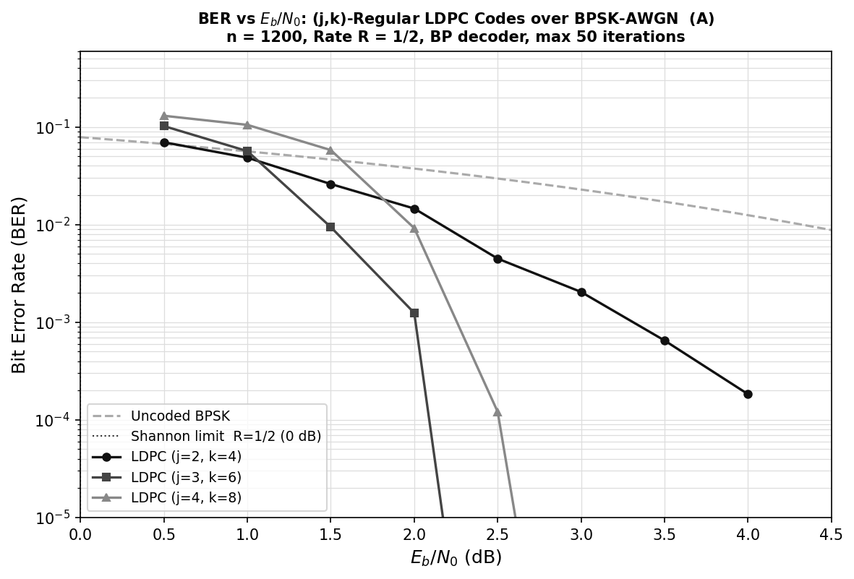
Results: BER vs Eb/N0
(j=4,k=8)
Sharpest
waterfall
(j=3,k=6)
Gallager's
main case
(j=2,k=4)
Error floor
visible
Key result: (j=3,k=6) drops from BER 5.7e-2 at 1 dB to effectively zero at 2.5 dB, a waterfall consistent with Gallager's theoretical analysis. Shannon limit at 0 dB.
COE 592: Advanced Signal and Communication Theory | Bless Elikem Krapah | KNUST | 7/10

Slide 8
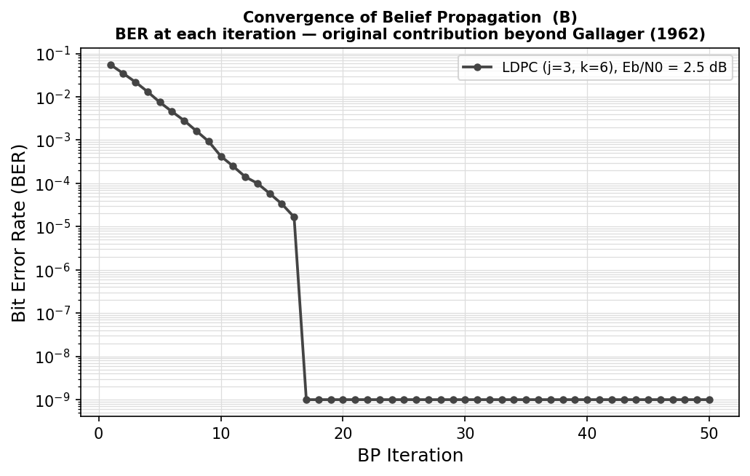
Original Contribution: Convergence Analysis
Findings (not in original paper):
BER drops 2-3 orders of magnitude in the first 10 iterations.
At Eb/N0=2.5 dB, decoder converges to zero errors in ~7 iterations on average.
Most of the gain comes in the first 15 iterations; diminishing returns after that.
Enables early-stopping: monitor syndrome, not iteration count.
Gallager (1962) described iterative decoding conceptually but did not plot convergence trajectories. This analysis quantifies the per-iteration improvement.
COE 592: Advanced Signal and Communication Theory | Bless Elikem Krapah | KNUST | 8/10

Slide 9
Limitations
Error Floor
Block Length
(j=2,k=4) shows high residual BER at 4 dB rather than a clean waterfall. Short cycles in the Tanner graph (low girth) cause correlated messages that stall the decoder. Higher j raises the waterfall threshold and suppresses the floor.
Performance degrades sharply below n~500. Gallager used n up to 2048; modern codes use n up to 64800 (DVB-S2). Our n=1200 is modest; extending to larger n would lower the waterfall SNR threshold.
1962 Computational Context
Statistical Precision
Belief propagation required floating-point operations per edge per iteration. For n=1000 and 50 iterations, this was infeasible on 1962 hardware, contributing to the paper being ignored for 30 years.
With 200 blocks per SNR point, BER estimates below ~5e-4 carry high variance. True error floor characterisation requires millions of blocks. Results at 3-4 dB showing BER=0 reflect insufficient samples, not true zero-error performance.
COE 592: Advanced Signal and Communication Theory | Bless Elikem Krapah | KNUST | 9/10

Slide 10
Implications and Impact
1962
1993
1996
2008
2017
Gallager proposes
LDPC codes
Turbo codes
rediscover iteration
MacKay & Neal
rediscover LDPC
WiMAX 802.16
adopts LDPC
5G NR standard
chosen over polar
Modern Standards
Capacity-Achieving
Algorithmic Legacy
LDPC is in 5G NR, Wi-Fi 6 (802.11ax), DVB-S2, and 10GbE. Every smartphone you own contains Gallager's construction from 1962.
Irregular LDPC codes (Luby et al., 2001) achieve the Shannon limit to within 0.0045 dB, the closest any code has come.
Belief propagation generalised to Bayesian networks, turbo decoding, compressed sensing, and modern deep learning (graph neural networks).
COE 592: Advanced Signal and Communication Theory | Bless Elikem Krapah | KNUST | 10/10

