Slide 1
16-bit RISC Processor Design
• Design • Simulation
• Debug • Synthesis

Slide 2
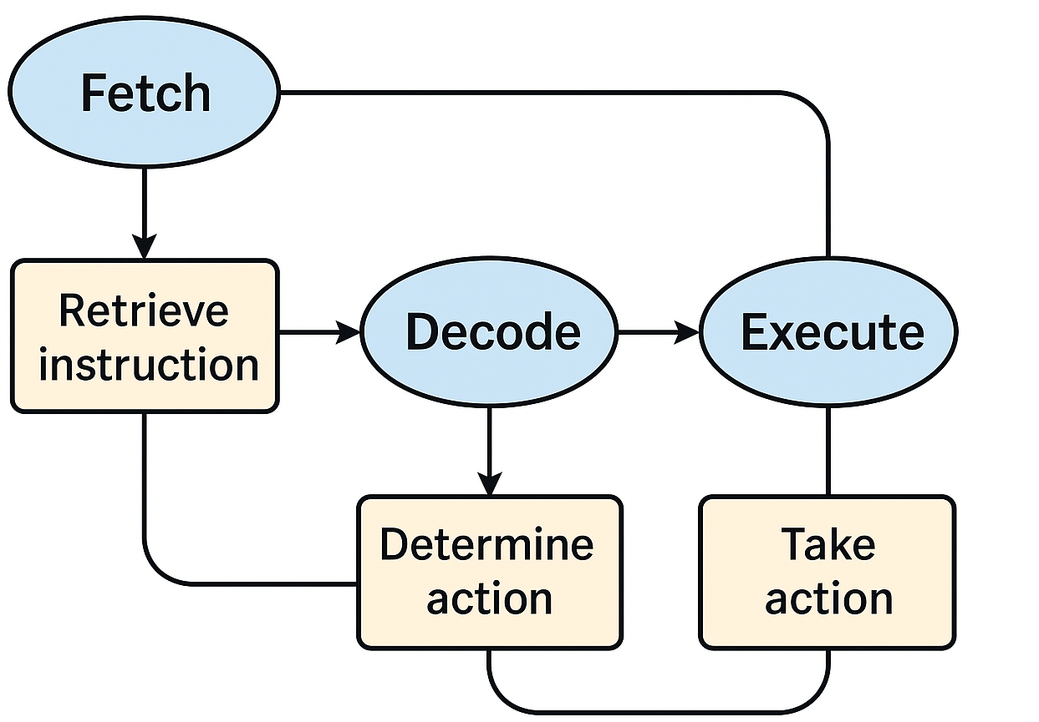
Overview
  Objective: To Build a simple 16‑bit RISC processor
  Tools: Verilog, Vivado
  Pipeline: Fetch, Decode, Execute, Write‑Back

Slide 3
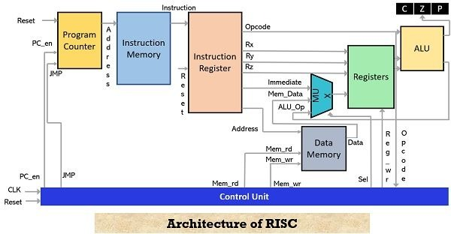
Architecture
  Components:
  ALU, ALU Control Unit
  Register File
  Instruction Memory
  Data Memory
  Control Unit
  Data Path Unit
  Pipeline Stages
  16-bit RISC ISA, single-cycle datapath
  Top-level: Risc_16_bit instantiates Control_Unit + Datapath_Unit
  Memory init via $readmemb; simulation in Vivado

Slide 4
Pipeline Stages
  1. Fetch – Instruction read
  2. Decode – Register file read
  3. Execute – ALU operations
  4. Memory Access – Accesses data memory
  5. Write‑Back – Store results

Slide 5
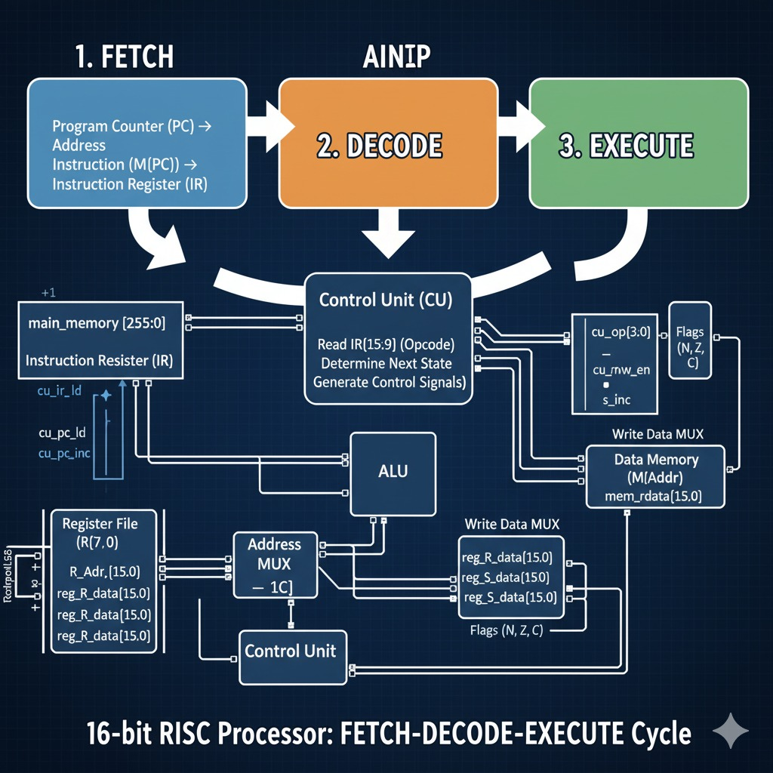

Slide 6
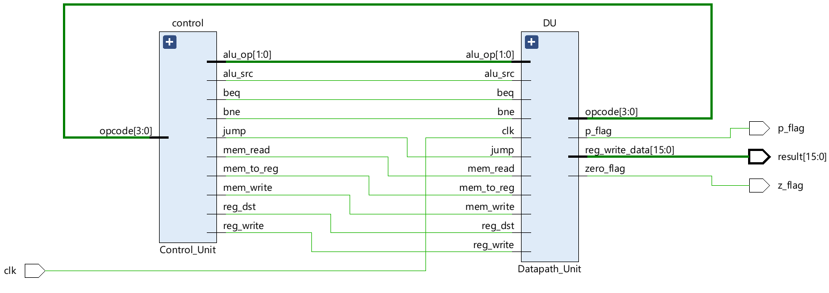
SCHEMATIC

Slide 7
INSTRUCTION SET
  Operations:
  ADD, SUB, AND, OR, NOT
  Right Shift, Left Shift
  LOAD WORD, STORE WORD
  BRANCH instructions
  The instruction set of the RISC processor:
  A. Memory Access Instructions
  1. Load word LW ws, offset(rs1) ws:=Mem16[rs1 + offset]
  2. Store Word: SW rs2, offset(rs1) Mem16[rs1 + offset]=rs2

Slide 8
  B. Data Processing Instructions
  1. Add: ADD ws, rs1, rs2 ws:=rs1 + rs2
  2. Subtract: SUB ws, rs1, rs2 ws:=rs1 – rs2
  3. Invert (1‘s complement): INV ws, rs1 ws:=!rs1
  4. Logical Shift Left: LSL ws, rs1, rs2 ws:=rs1 << rs2
  5. Logical Shift Right: LSR ws, rs1, rs2 ws:=rs1 >> rs2
  6. Bitwise AND: AND ws, rs1, rs2 ws:=rs1 • rs2
  7. Bitwise OR: OR ws, rs1, rs2 ws:=rs1 | rs2
  8. Set on Less Than:
  SLT ws, rs1, rs2 ws:=1 if rs1 < rs2; ws:=0 if rs1 ≥ rs2

Slide 9
  C. Control Flow Instructions
  1. Branch on Equal: BEQ rs1, rs2, offset
  Branch to (PC + 2 + (offset << 1)) when rs1 = rs2
  2. Branch on Not Equal: BNE rs1, rs2, offset
  Branch to (PC + 2 + (offset << 1)) when rs1 != rs2
  3. Jump: JMP offset Jump to {PC [15:13], (offset << 1)}

Slide 10
INSTRUCTION MEMORY
The Instruction Memory stores the program that the processor executes.
It outputs the 16-bit instruction corresponding to the current Program Counter (PC) value.
📌 Key Features
16-bit wide ROM
Stores up to 16 instructions (memory[0] to memory[15])
Program loaded from external file (test.prog)
Combinational access → instruction available immediately when PC changes
Addressing uses PC bits [4:1] to index instruction memory
Implements the Fetch stage of the processor pipeline
Allows easy program changes through the .prog file
Provides a clean interface for the Control Unit and Datapath to decode and execute instructions
Helps understand instruction flow inside a simple RISC CPU

Slide 11
Instructions used (test.prog)
• 0000_000_001_000000 // LW R0 <-Mem(R0 + 0)
• 0000_000_001_000001 // LW R1 <-Mem(R0 + 1)
• 0010_000_001_010_000 // ADD R2 <-R0 + R1
• 0110_000_001_010_000 // logical shift right R2 <-R0>>R1
• 0000_000_011_000010 // LW R3 <-Mem(R0 + 2)
• 0100_011_000_100_000 // NOT R4 <-~R3
• 1000_000_001_110_000 // OR R6 <-R0 | R1
• 1001_000_001_111_100 // Selecton less thanR7 <-(R0 < R1)

Slide 12
Datapath
  Flow:
  PC → Instruction Memory
  Register Read
  ALU Execute
  Memory Access
  Write‑Back to Register File

Slide 13
DATA MEMORY
The Data Memory block stores and retrieves 16-bit data during program execution.
It supports both read and write operations and is used by load/store instructions in the RISC processor.
Key Features
8 × 16-bit memory array (memory[0] to memory[7])
Synchronous write on the rising edge of clock
Combinational read when mem_read = 1
Address mapped using lower 3 bits (mem_access_addr[2:0])
Memory contents initialized from external file (test.data)
Live monitoring of memory values using $fmonitor for debug/logging

Slide 14
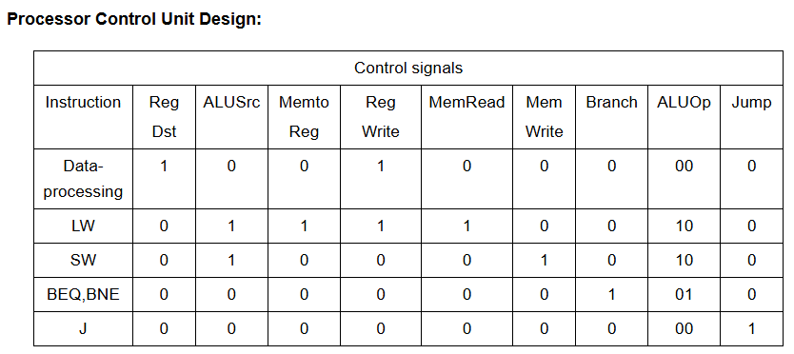
Control Unit
  Generates control signals:
  ALU Op, RegWrite, MemWrite
  MemRead, MemToReg

Slide 15
ALU
`timescale 1ns / 1ps
module ALU(
input [15:0] a,b, //src1 AND //src2
input [2:0] alu_control, //function sel
output reg [15:0] result, //result
output zero, Negative, Parity );
always @(*)
begin
case(alu_control)
3'b000: result = a + b; // add
3'b001: result = a - b; // sub
3'b010: result = ~a;
3'b011: result = a<<b;
3'b100: result = a>>b;
3'b101: result = a & b; // and
3'b110: result = a | b; // or
3'b111: begin if (a<b) result = 16'd1;
else result = 16'd0;
end
default:result = a + b; // add
endcase
end
assign zero = (result==16'd0) ? 1'b1: 1'b0;
assign Negative = result[15]; // MSB indicates sign
assign Parity = ^(result); // XOR of all bits → odd parity = 1, even = 0
endmodule

Slide 16
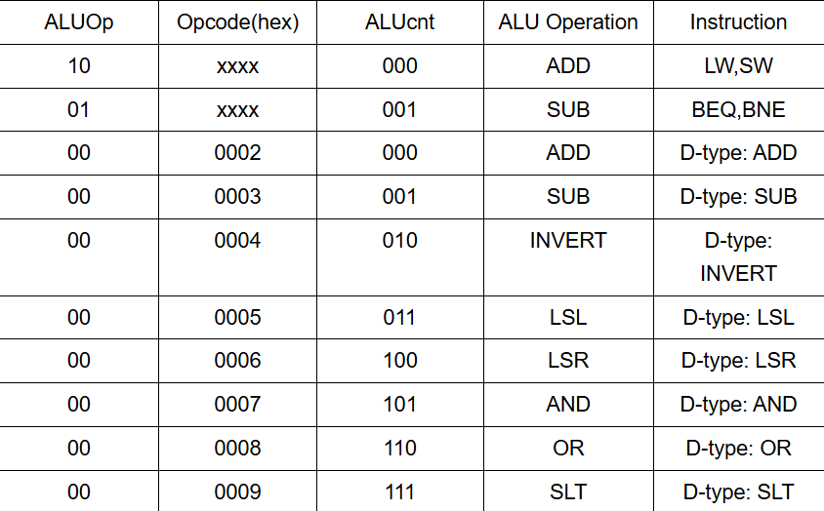
ALU CONTROL UNIT

Slide 17
ALU_Control Verilog code
`timescale 1ns / 1ps module alu_control( ALU_Cnt, ALUOp, Opcode); output reg[2:0] ALU_Cnt; input [1:0] ALUOp; input [3:0] Opcode; wire [5:0] ALUControlIn; assign ALUControlIn = {ALUOp,Opcode}; always @(ALUControlIn) casex (ALUControlIn)
6'b10xxxx: ALU_Cnt=3'b000;
6'b01xxxx: ALU_Cnt=3'b001;
6'b000010: ALU_Cnt=3'b000;
6'b000011: ALU_Cnt=3'b001;
6'b000100: ALU_Cnt=3'b010;
6'b000101: ALU_Cnt=3'b011;
6'b000110: ALU_Cnt=3'b100;
6'b000111: ALU_Cnt=3'b101;
6'b001000: ALU_Cnt=3'b110;
6'b001001: ALU_Cnt=3'b111; default: ALU_Cnt=3'b000; endcase endmodule

Slide 18
TESTBENCH
`timescale 1ns / 1ps
`include "Parameter.v"
module tb;
reg clk ;
wire [15:0] result;
initial
begin
clk <=0;
`simulation_time;
$finish;
end
always
begin
#5 clk = ~clk;
end
Risc_16_bit uut(.clk(clk), .result(result),.z_flag(z_flag),.p_flag( p_flag));
endmodule

Slide 19
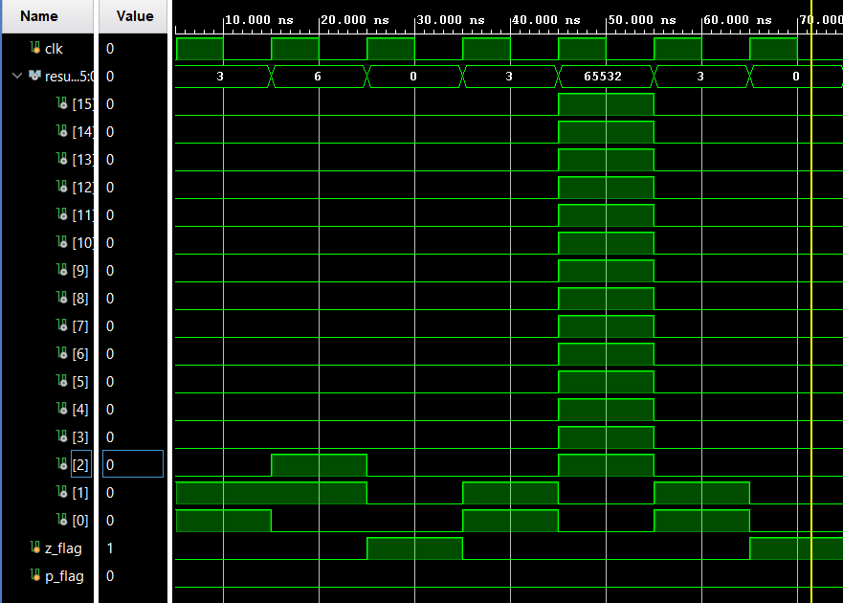
Vivado Waveform

Slide 20
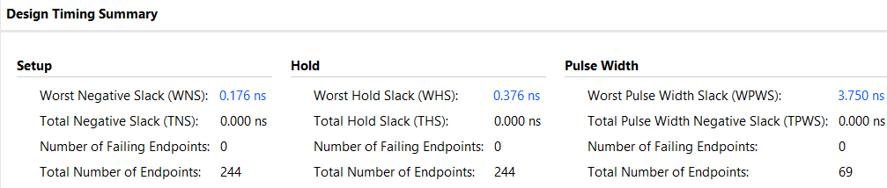
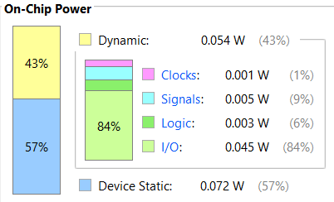
SYNTHESIS and implementation

Slide 21
Hazards Handling
  Structural hazards avoided
  No data hazards due to simplified design
  Control hazards handled by PC update logic

Slide 22
outcome
  Working 16‑bit processor implemented
  Reinforced understanding of CPU architecture
  Hands‑on experience with RTL, simulation & synthesis
  Foundation for advanced VLSI/CPU projects

Slide 23
References
Source: isroset.org https://share.google/KBrFRzuKuID7NFgjf
The Berkeley RISC Project: · Patterson, D. A., & Ditzel, D. R. (1980). "The Case for the Reduced Instruction Set Computer." ACM SIGARCH Computer Architecture News, 8(6), 25-33.2.
The Stanford MIPS Project: · Hennessy, J. L., et al. (1982). "The MIPS Machine." Proceedings of the COMPCON Spring ‘82.
3.The IBM 801 Project (The Predecessor): · Radin, G. (1982). "The 801 Minicomputer." ACM SIGARCH Computer Architecture News, 10(2), 39–47.
Text books:1. Hennessy, J. L., & Patterson, D. A. · Computer Architecture: A Quantitative Approach (Now in its 6th or 7th edition).
M. Morris Mano

Slide 24
THANKYOU
SUBMITTED TO:
Dr Nitesh Kashyap
Assistant Professor (Grade-I)
ECE, NIT Jalandhar
SUBMITTED BY:
Sathwik 25204132
Aditya 25904138
Vishnu 25904150
M.Tech VLSI Design
1st Semester

