Slide 1




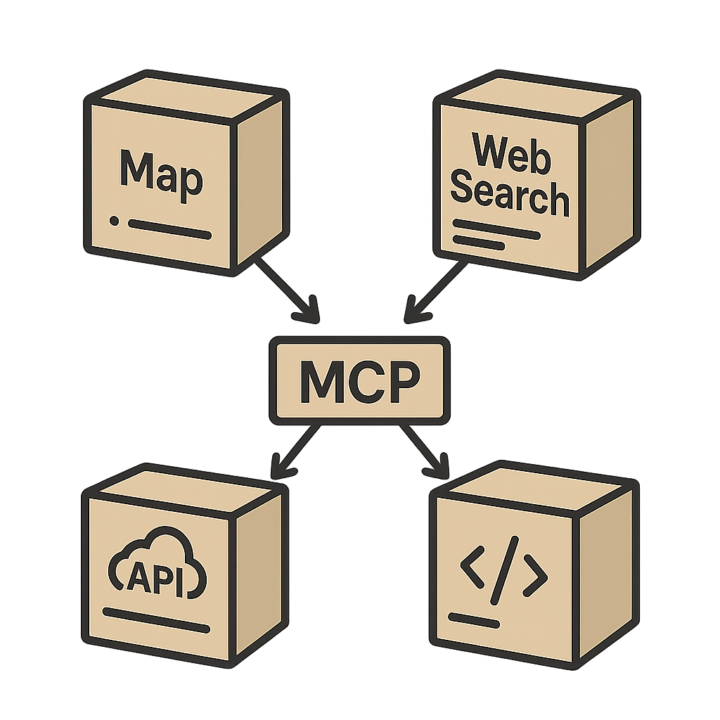




Ext.2
Persona-based Diversification
1
Server Onboarding
Task
Synthesis
LLM-Based Pre-Filtering
Trajectory Generation
Rule & LLM-based Post-Filtering
2
3
4
5
Ext.1
Irrelevance
Verifiable
Q1
Q2
MCP Server
Question Quality
MCP
MCP
Server name:
Descriptions:
Tools:
- Tool Name
- Tool Info
Scenario Realism
Stability
Single Turn
Teacher
LLMs
Multi-Tool Tasks
Tool Uniqueness
Tool Difficulty
Tool Match
LLM Score
U¹
T¹
A¹
U²
…
User
Tool
Ans
User
Ext.3
Multi-Turn
1.5M+ Instances!

Slide 2

Qwen3
OSS
Kimi-K2

Slide 3
Tool Selection
Difficulty
Tool Selection
Uniqueness
Question
Quality
Scenario
Realism
Verifiability
Stability
Response
Completeness
Response
Conciseness

