Slide 1
Generalized Linear Models

Slide 2

Generalized Linear Models (GLM)
General class of linear models that are made up of 3 components: Random, Systematic, and Link Function
  Random component: Identifies dependent variable (Y) and its probability distribution
  Systematic Component: Identifies the set of explanatory variables (X₁,...,X_{k})
  Link Function: Identifies a function of the mean that is a linear function of the explanatory variables

Slide 3
Random Component
Conditionally Normally distributed response with constant standard deviation - Regression models we have fit so far.
Binary outcomes (Success or Failure)- Random component has Binomial distribution and model is called Logistic Regression.
Count data (number of events in fixed area and/or length of time)- Random component has Poisson distribution and model is called Poisson Regression
When Count data have V(Y) > E(Y), model fit can be Negative Binomial Regression
Continuous data with skewed distribution and variation that increases with the mean can be modeled with a Gamma distribution

Slide 4
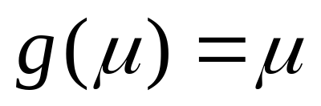
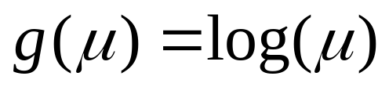
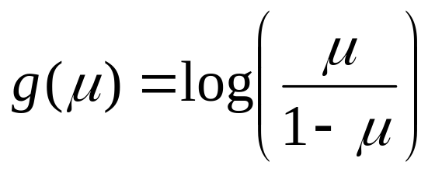
Common Link Functions
Identity link (form used in normal and gamma regression models):
Log link (used when μ cannot be negative as when data are Poisson counts):
Logit link (used when μ is bounded between 0 and 1 as when data are binary):

Slide 5
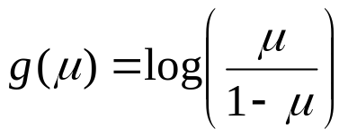
Logistic Regression
Logistic Regression - Dichotomous Response variable and numeric and/or categorical explanatory variable(s)
  Goal: Model the probability of a particular outcome as a function of the predictor variable(s)
  Problem: Probabilities are bounded between 0 and 1
Distribution of Responses: Binomial
Link Function:

Slide 6
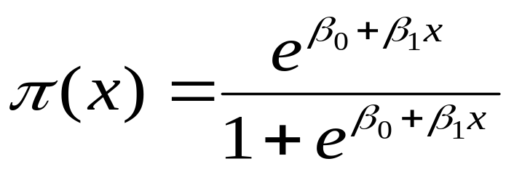
Logistic Regression with 1 Predictor
Response - Presence/Absence of characteristic
Predictor - Numeric variable observed for each case
Model - π(x) ≡ Probability of presence at predictor level x
β₁ = 0 ⇒ P(Presence) is the same at each level of x
β₁ > 0 ⇒ P(Presence) increases as x increases
β ₁< 0 ⇒ P(Presence) decreases as x increases

Slide 7
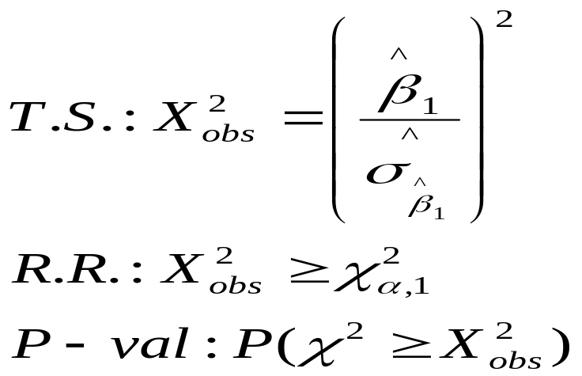
Logistic Regression with 1 Predictor
β₀, β₁ are unknown parameters and must be estimated using statistical software such as SPSS, SAS, R or STATA (or in a matrix language)
Primary interest in estimating and testing hypotheses regarding β₁
  Large-Sample test (Wald Test):
  H₀: β₁ = 0 H_{A}: β₁ ≠ 0
Note: Some software packages perform this as an equivalent Z-test or t-test

Slide 8
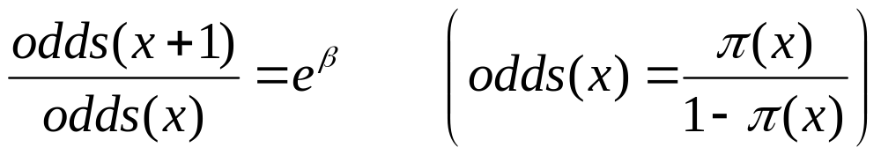
Odds Ratio
Interpretation of Regression Coefficient (β):
  In linear regression, the slope coefficient is the change in the mean response as x increases by 1 unit
  In logistic regression, we can show that:
Thus e^{β} represents the change in the odds of the outcome (multiplicatively) by increasing x by 1 unit
If β = 0, the odds and probability are the same at all x levels (e^{β}=1)
If β > 0 , the odds and probability increase as x increases (e^{β}>1)
If β < 0 , the odds and probability decrease as x increases (e^{β}<1)

Slide 9
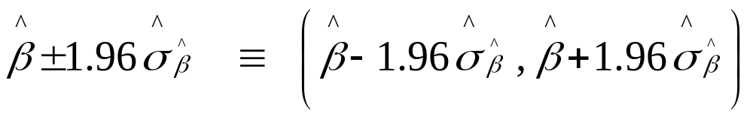
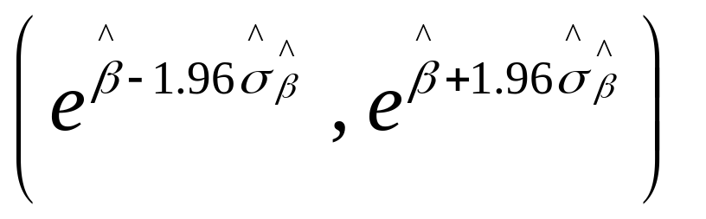
95% Confidence Interval for Odds Ratio
Step 1: Construct a 95% CI for β :
Step 2: Raise e = 2.718 to the lower and upper bounds of the CI:
If entire interval is above 1, conclude positive association
If entire interval is below 1, conclude negative association
If interval contains 1, cannot conclude there is an association

Slide 10
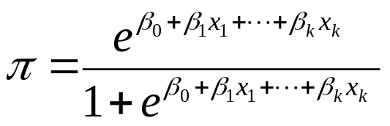
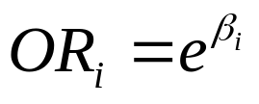
Multiple Logistic Regression
Extension to more than one predictor variable (either numeric or dummy variables).
With k predictors, the model is written:
Adjusted Odds ratio for raising x_{i} by 1 unit, holding all other predictors constant:
Many models have nominal/ordinal predictors, and widely make use of dummy variables

Slide 11
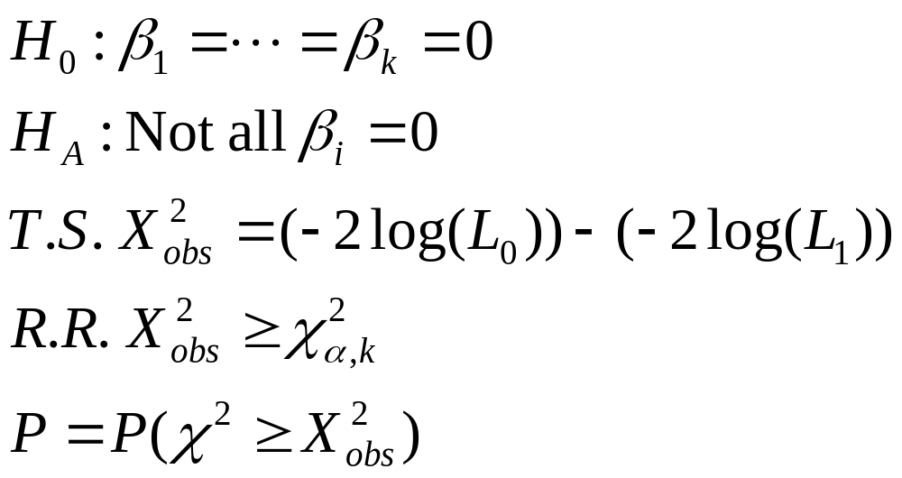
Testing Regression Coefficients
Testing the overall model:
L₀, L₁ are values of the maximized likelihood function, computed by statistical software packages. This logic can also be used to compare full and reduced models based on subsets of predictors. Testing for individual terms is done as in model with a single predictor.

Slide 12
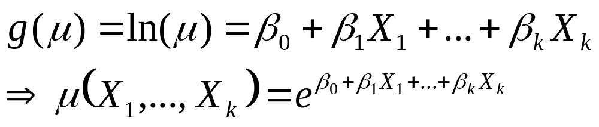
Poisson Regression
Generally used to model Count data
Distribution: Poisson (Restriction: E(Y)=V(Y))
Link Function: Can be identity link, but typically use the log link:
Tests are conducted as in Logistic regression
When the mean and variance are not equal (over-dispersion), often replace the Poisson Distribution replaced with Negative Binomial Distribution

