Slide 1

Boot Camp
Understanding and building large language model (LLM) applications

Slide 2

Our Vision
Empower high school students with the skills, knowledge, and critical thinking to thrive in AI driven future

Slide 3
Before we begin
Introduce yourself
Your interest in AI
Current understanding of AI and coding
What you wish to achieve from this class

Slide 4
AGENDA
Class 1
Subsequent classes
Introduction
Crash course in AI Models
HuggingFace Playground
Model, roles, control parameters
Understanding AI models
English, algebra and geometry of a model
AI vs programming
Basics of language model
Language tasks
Key models and publishers
Building a real life LLM application via vibe coding
IDEs, Repositories , web hosting
Prompt engineering
American High Question Answering Chatbot - Problem definition
Requirement analysis
Implementation
Testing and debugging
Publishing
Limitation analysis and roadmap
Digging deeper into language models
Word embeddings and tokenization
Positional encoding
Transformer
Autoregression
Limitations of language models
Context
Hallucinations
Problem definition
Requirement analysis
Implementation
Testing
Publishing
Roadmap analysis
Prompt engineering
Debugging and testing
Publishing
Project
Students are encouraged to come up with real-world problem

Slide 5
AI models on HuggingFace

Slide 6
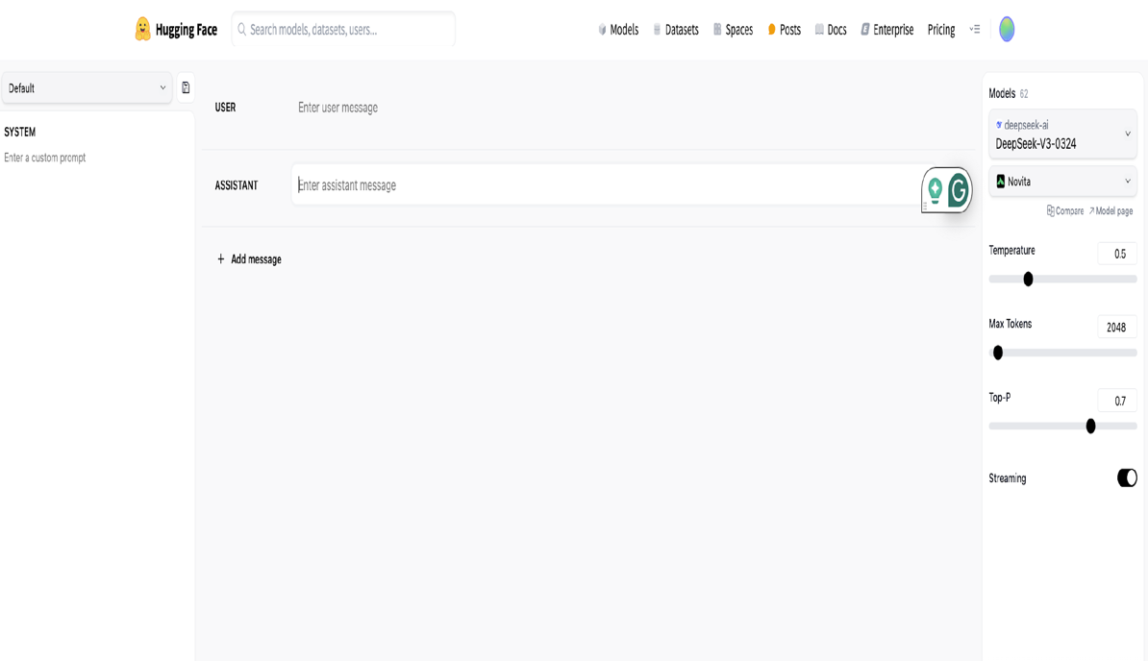
HF PLAYGROUND
https://huggingface.co/PLAYGROUND
Role
User
Assistant
System
Temperature
Max Tokens
Top-P

Slide 7
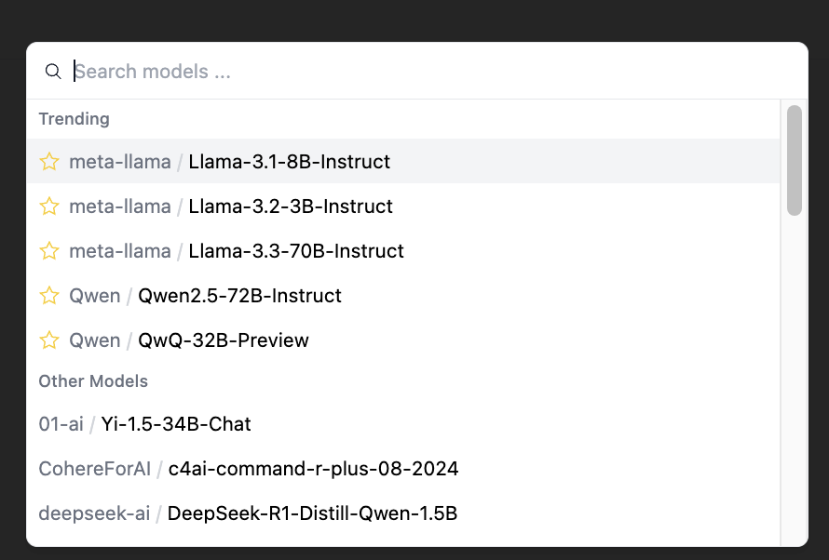
MODELS

Slide 8
AI MODEL FLOW
Data
Question
Start of a sentence
Role
Temperature
Top-P
Output length
Controls
Model
Type
Task

Slide 9
WHO ARE TOP PLAYERS IN LLM
OpenAI
Google
Anthropic
Microsoft
Replicate
IBM …

Slide 10
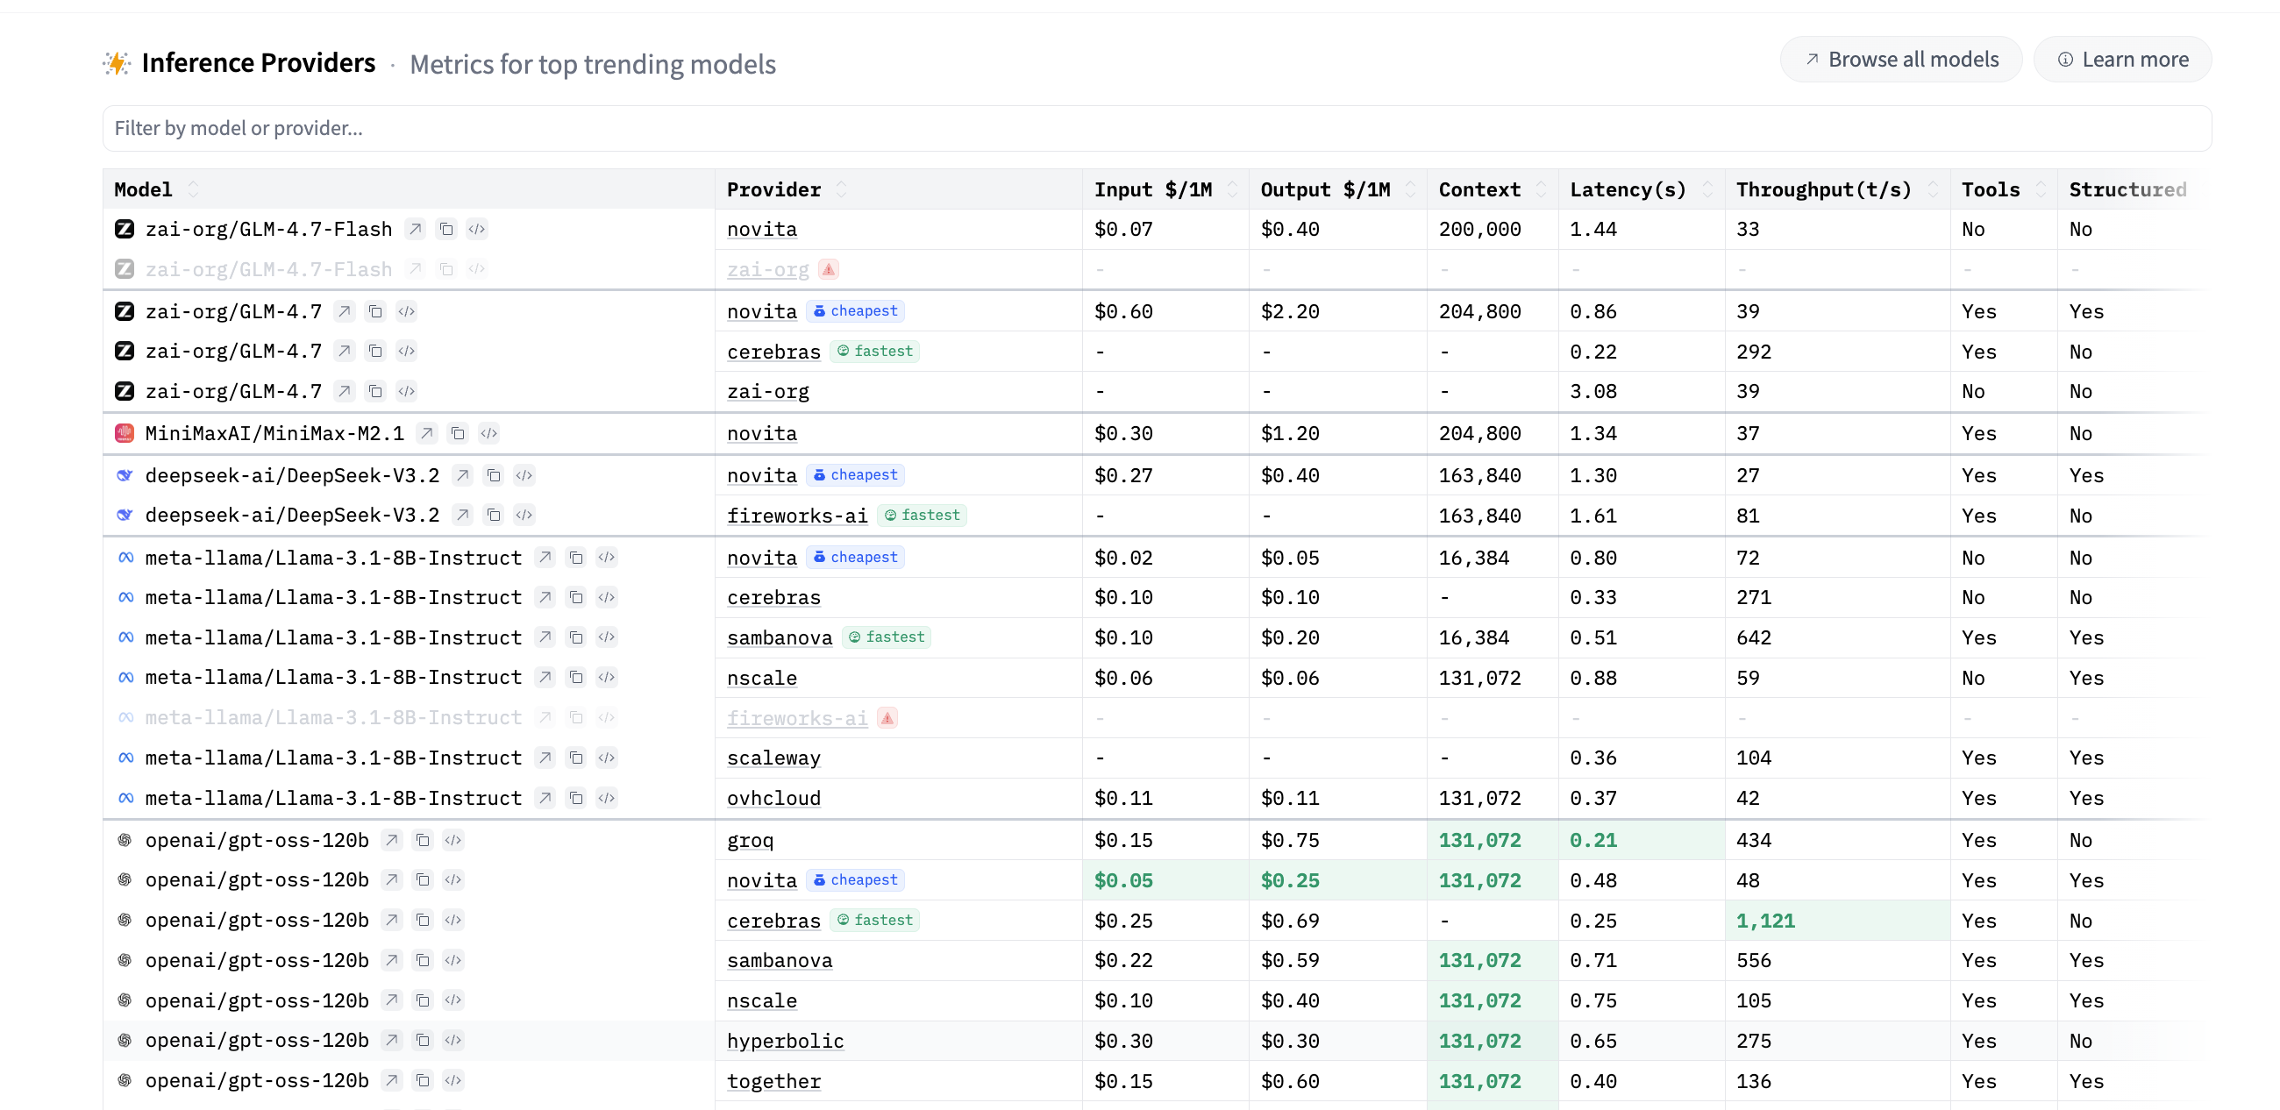
https://huggingface.co/inference/models

Slide 11
ROLES
messages=[
{"role": "system", "content": "<instructions>"},
{"role": "user", "content": "<User query>"},
{"role": "assistant", "content": "<response>"},
]
System role: Allows you to specify the way the model answers questions. Classic example: “You are a helpful assistant.”
User role: queries made by the user.
Assistant role: model’s responses (based on the user messages)

Slide 12
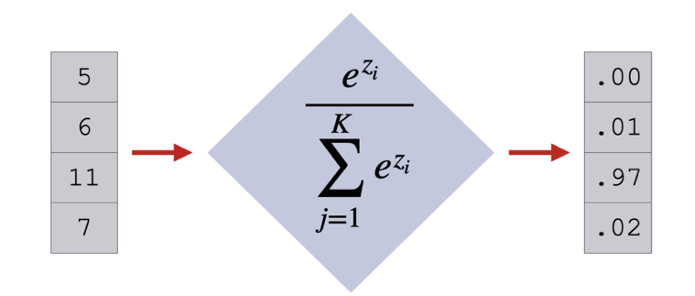
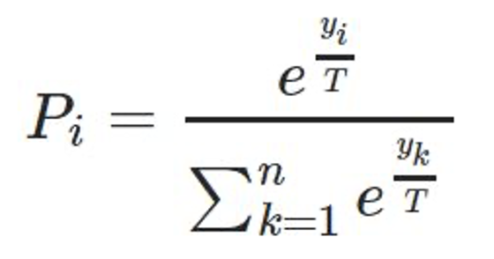
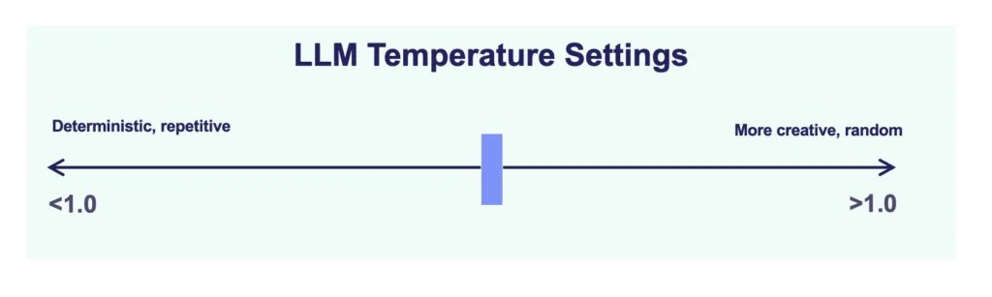
TEMPERATURE (T)
>

Slide 13
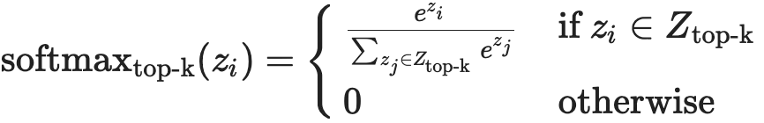
TOP-P
Temperature should be the first place to start when tuning a language model. It’s an intuitive scaling factor that applies to all tokens, where higher temperatures lead to more creative output, and lower temperatures result in more predictable output. The choice will really vary on how much creativity you need in your task. Gemini models currently provide a temperature range from 0–1, or 0–2, each with different default values.

Slide 14
Exercise
Create an Huggingface account.
Come up with a complicated question.
Select different models.
Why are answers different for different models?

Slide 15
AI = ARTIFICIAL INTELLIGENCE
AI – Artificial Intelligence also known as Machine Learning
Allows machines to see
Allows machines to hear
Allows machines to think
Allows machines to talk
Allows machines to drive

Slide 16
AI is different from programming
Logic and Rules: Traditional programming is rule-based; a programmer writes explicit, step-by-step instructions for every possible scenario. AI, on the other hand, is data-driven, meaning it learns patterns and rules from vast datasets, without being explicitly programmed for every outcome.
Adaptability: A traditional program is static and can't adapt to new data or situations unless a programmer manually updates its code. An AI system is dynamic and can continuously learn from new information, improving its performance and adapting to unseen scenarios.
Problem-Solving: Traditional programming is best for deterministic problems with clear, well-defined rules, such as a calculator or a database query. AI excels at complex, non-deterministic problems where the rules are not easily defined, like recognizing faces in an image, translating languages, or recommending products

Slide 17
AI KEY CONCEPTS
Data
Model
Task
Training
Inference
Training Data
Data
Model
Model
Result
Result
Inference
Training

Slide 18
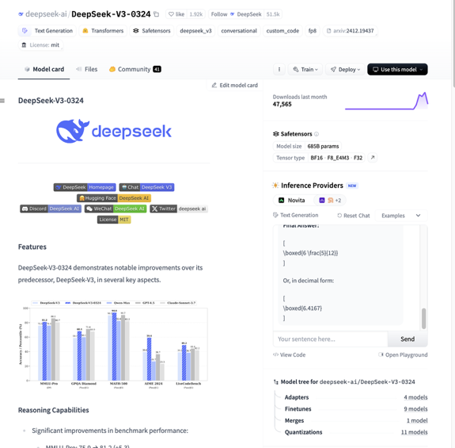
https://huggingface.co/models
200K+ models
Deepseek
Qwen
Llama
Mistral
Phi
Gemma
Model Size – 685 billion
Tensor Type BF16, F8, F32
FineTunes – 9
Quantizations - 11
Dataset
Task = TEXT GENERATION

Slide 19
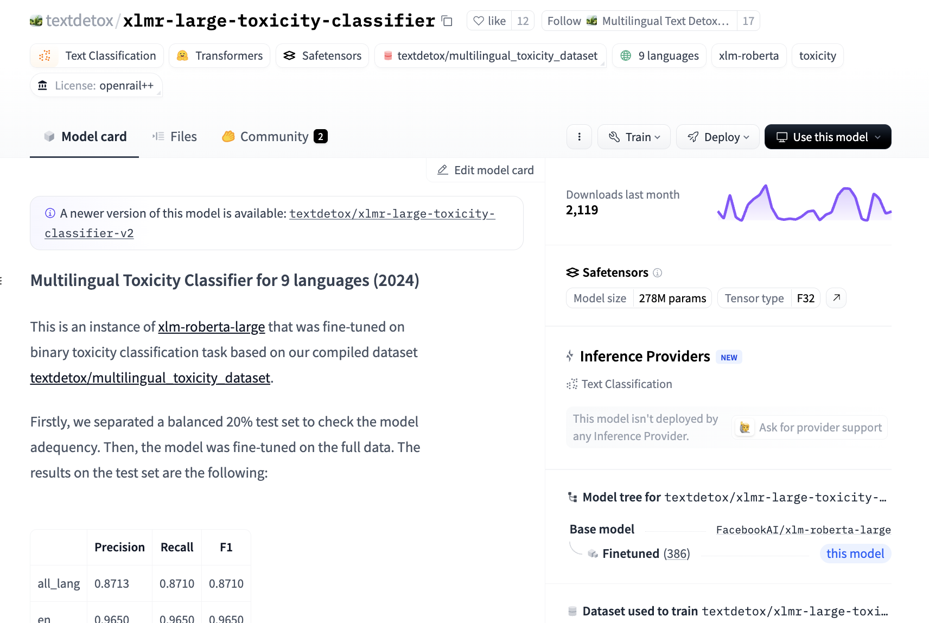
https://huggingface.co/models
90K+ models
Finbert
Emotion-text-classifier
Hallucination-evaluation-model
Sentiment analysis
Tone detector
Toxicity classifier
Task = TEXT CLASSIFICATION

Slide 20
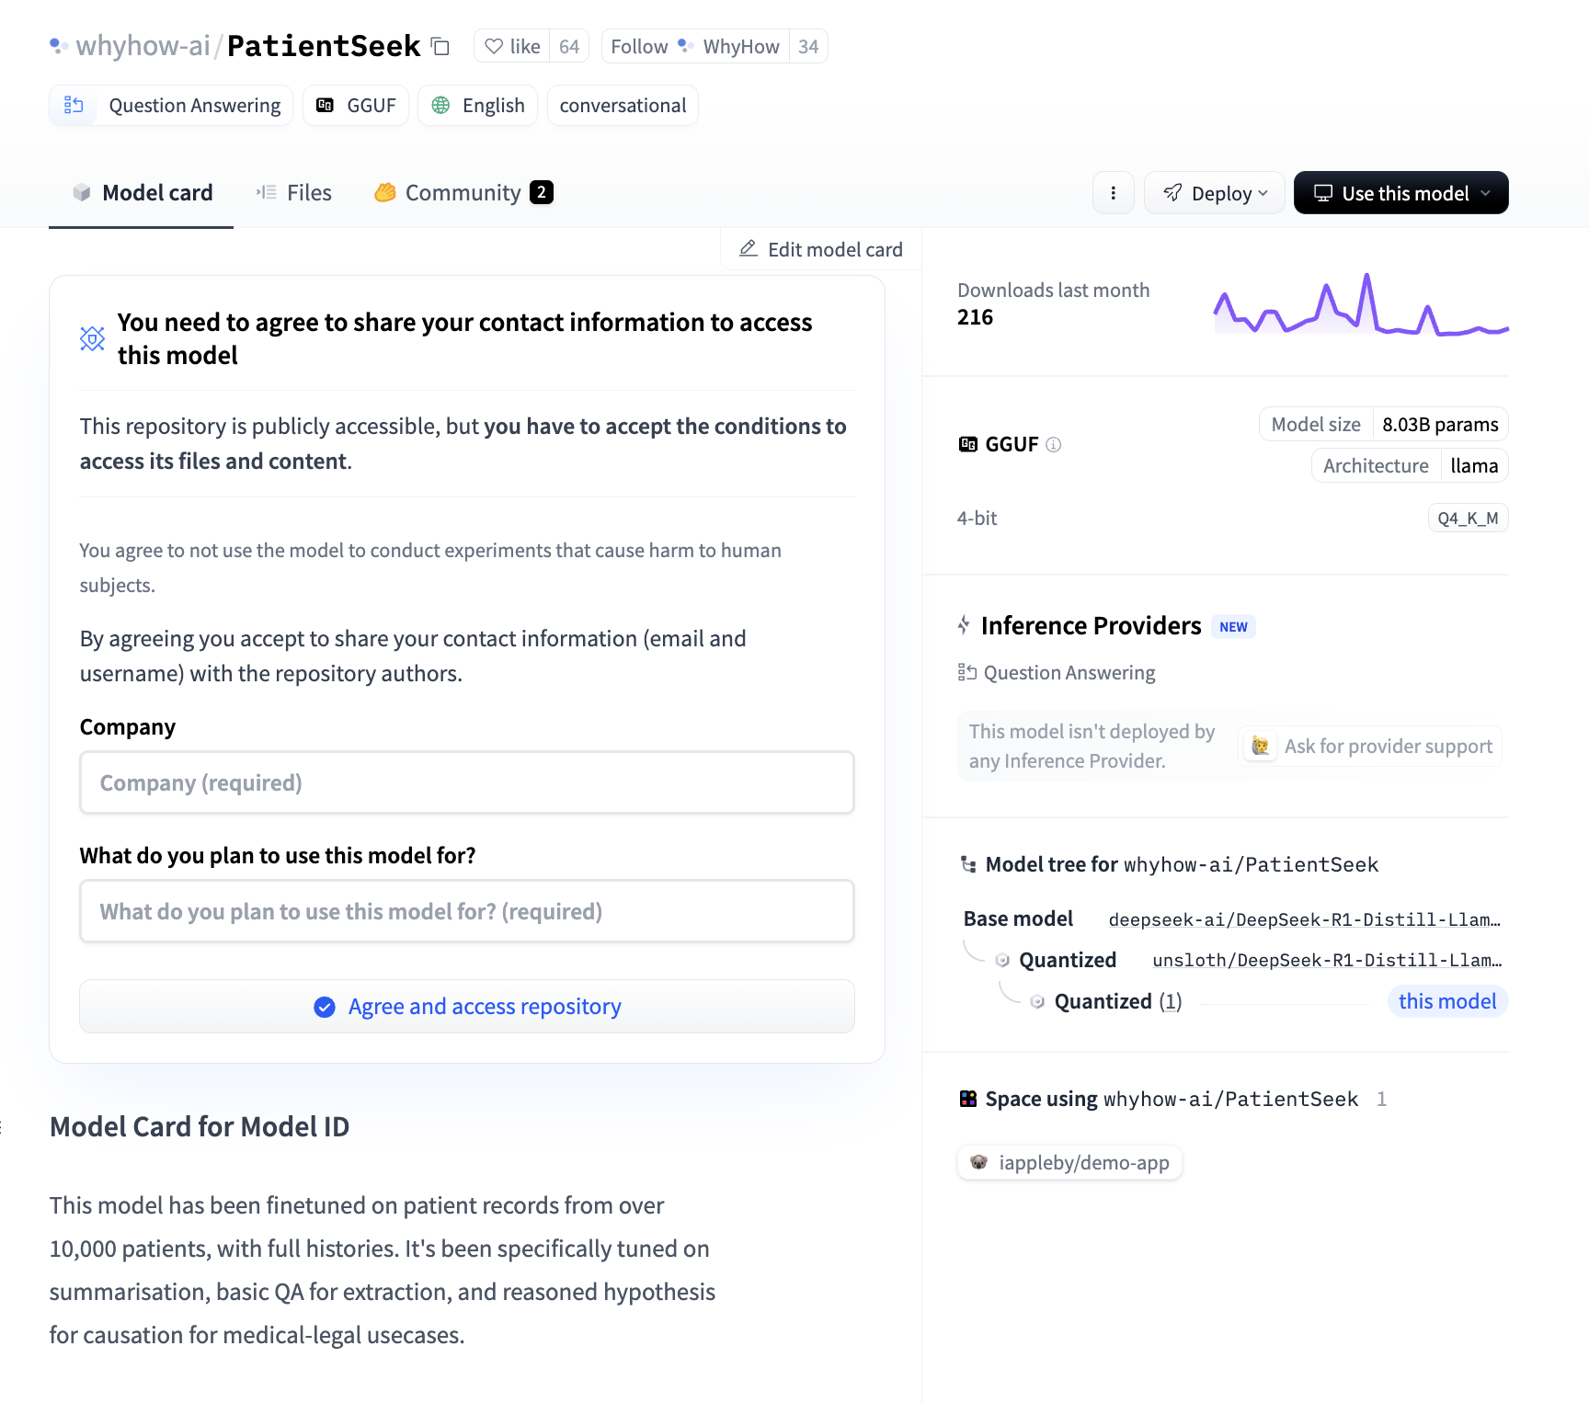
https://huggingface.co/models
Roberta-base-squad
PatientSeek
Indobert-QA
Task = QUESTION ANSWERING

Slide 21
Understanding AI models

Slide 22
WHAT IS A MODEL?
Y = 3x+1
Suppose you are playing a game
If A gives 1 Banana to B, B gives 4 Apples to A
If A gives 2 Banana to B, B gives 7 Apples to A
If A gives 3 Banana to B, B gives 10 Apples to A
How many apples will B give to A, if A gives 4 Bananas to B?
A model solves the given question using mathematical equation
Model’s task is to predict a set of numbers that will give you answer to the question above

Slide 23
Training data
Y = number of apples
X = number of banana
If A gives 1 Banana to B, B gives 4 Apples to A
If A gives 2 Banana to B, B gives 7 Apples to A
If A gives 3 Banana to B, B gives 10 Apples to A
X=1 Y= 4
X=2 Y=7
X=3 Y=10
Goal is to find and equation
Y= W*X + b
That works for any number of X
Find W and b

Slide 24
Training Process
Y = number of apples
X = number of banana
Y= W*X + b
Find W and b
Computer says:
Training data
Is W=0 and b =0?
Y = 0*x + 0
1 4
2 7
3 10
0*1+0 = 0
Error = 4
0*2+0 = 0
Error = 7
0*3+ 0 = 0
Error = 10
1 4
2 7
3 10
1*1+0 = 1
Error = 3
Is w=1 and b=0?
Y = 1*x + 0
1*2+0 = 2
Error = 5
1*3+ 0 = 3
Error = 7

Slide 25
Training Process
Y = number of apples
X = number of banana
Y= W*X + b
Find W
Training data
Is W=1 and b =1?
Y = 1*x + 1
1 4
2 7
3 10
1*1+1 = 2
Error = 2
1*2+1 = 3
Error = 4
1*3+ 1 = 4
Error = 6
1 4
2 7
3 10
2*1+1 = 3
Error = 1
Is w=2 and b=1?
Y = 2*x + 1
2*2+1 = 5
Error = 2
2*3+ 1 = 7
Error = 4

Slide 26
Training Process
Y = number of apples
X = number of banana
Y= W*X + b
Find W, b
Training data
Is W=2 and b =2?
Y = 2*x + 2
1 4
2 7
3 10
2*1+1 = 3
Error = 1
2*2+1 = 5
Error = 2
2*3+ 1 = 7
Error = 3
3*1+1 = 4
Error = 0
1 4
2 7
3 10
3*2+1 = 7
Is w=3 and b=1?
Error = 0
3*3+ 1 = 10
Error = 0
Y = 3*X + 1
Y = 3*X + 1

Slide 27
Our model
Our Model
Y = 3*X + 1
3 and 1 are called weights and bias
“3 and 1” is where intelligence lies

Slide 28
Inference (Using our model)
if A gives 4 Bananas to B, How many apples will A get?
Our Model
Y = 3*X + 1
With X=3, Y=3*3+1 = 10
B will give 10 Apples to A

Slide 29
To recap
Model is
Y = W*X + b
Y= output
X= Input
W= Intelligence
X= Data
Y= Expected Results
W = Weights
X= Text, Image, Speech, Table data…
Y= expected output (word, image, story, …)
X, Y and W are all HUGE matrices

Slide 30
Neural network in practice

Slide 31
In practice
The training data is HUGE
100s of thousands or even billion, trillion points
Data could be multidimensional
Y, X and W are matrix
Y and X are given for training data set
Computer’s job is to estimate W (often referred as weights or parameters)
W could be in millions, billions or even trillions
This number gives you the “size” of the model
Training doesn’t start with 0, 0
A random seed is used as a starting point
Training algorithm’s job is to estimate the value of W an b that minimize the error for training data
Training can take weeks or even months
Inference
Can take several seconds to run on a PC if the number of parameters is large

Slide 32
AI Model has three distinct representations
English:
if A gives 4 Bananas to B, How many apples will A get?
Do you see a car in this image?
What is the capital of USA?
Linear algebra
If Y= W*X+b, estimate W and b
W and b should be such that the error between actual training data and predicted data should be as close to zero as possible
Geometry
Plot Y and X using training data
Plot Y and X using the model
Estimate how good the model is

Slide 33
Visualization
https://rowenchris.github.io/LearnCurve/

Slide 34
Need volunteers to enhance LearnCurve
Play with multiple inputs
X1, X2, X3…
Allow playing with features
X1= x**2, X2=2*x …
Enhance to create probability distribution output
Y= softmax(Xi)
….

Slide 35
Data representation for models

Slide 36
Model generalization
Computer only understands numbers
A model must be given a set of numbers that is meaningful to it to it can estimate the best values for W
The key in building the intelligence is how the data is ‘encoded’ so model understands it
The data representation takes different forms depending on the type of problem you are trying to solve
Computer vision
Language
Tabular data
Speech
…

Slide 37
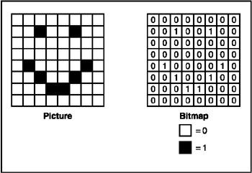
DATA REPRESENTATION
Zero = no fill
One = black fill
Question to model: What is represented in this picture?
Answer: A smily face
Picture is represented as matrix

Slide 38
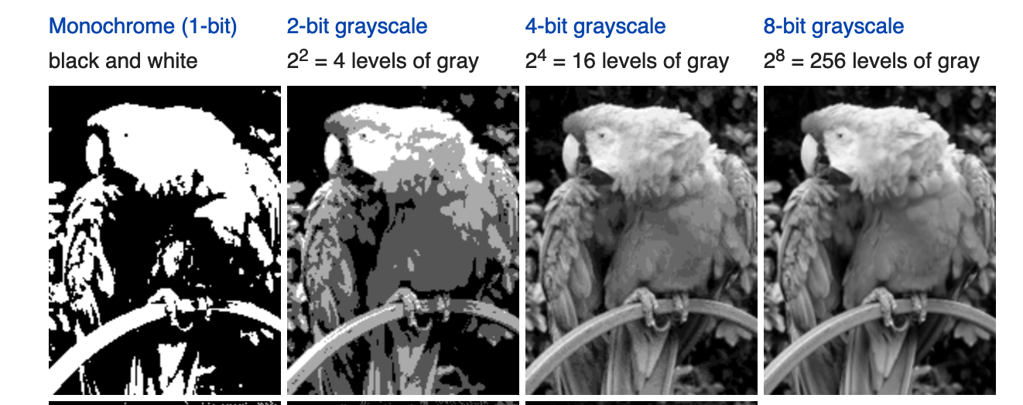
Picture representation
Do you see parrot in this picture?
0 or 1
0 to 7
0 to 15
0 to 255
Picture becomes a 2-D matrix with a number for each pixel

Slide 39
Language models

Slide 40
Language representation
The quick brown fox jumps over the lazy dog
The 19, 7, 4
Quick 16, 20, 8, 2, 10
Brown 1, 17, 14, 22, 13
Fox 5, 14, 23
Jumps 9, 20, 12, 15, 18
Over 14, 21, 4, 17
The 19, 7, 4
Lazy 11, 0, 25, 24
Dog 3, 14, 6
a 0 h 7 o 14 u 20
b 1 i 8 p 15 v 21
c 2 j 9 q 16 w 22
d 3 k 10 r 17 x 23
e 4 l 11 s 18 y 24
f 5 m 12 t 19 z 25
g 6 n 13

Slide 41
HOW LANGUAGE MODELS WORK
Text Encoder
Numbers
AI Model
Numbers
Text Decoder
15 123 12 274 1111
87 345
Trump
Who is the president of US?
ChatGPT
1245
Model is made up of weights, but applied in a slightly different fashion
Y = W*X + b

Slide 42
HOW LANGUAGE MODELS WORK
Text Encoder
Numbers
AI Model
Numbers
Text Decoder
15 123 12 274 1111
87 345
Trump
Who is the president of US?
ChatGPT
1245
Tokenization
Decoding
Task= question and answer

Slide 43
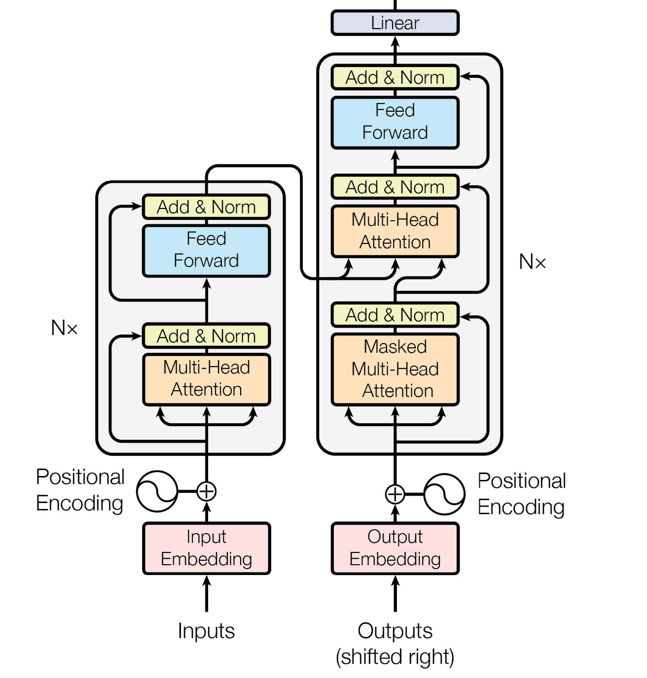
Peek inside GPT

Slide 44
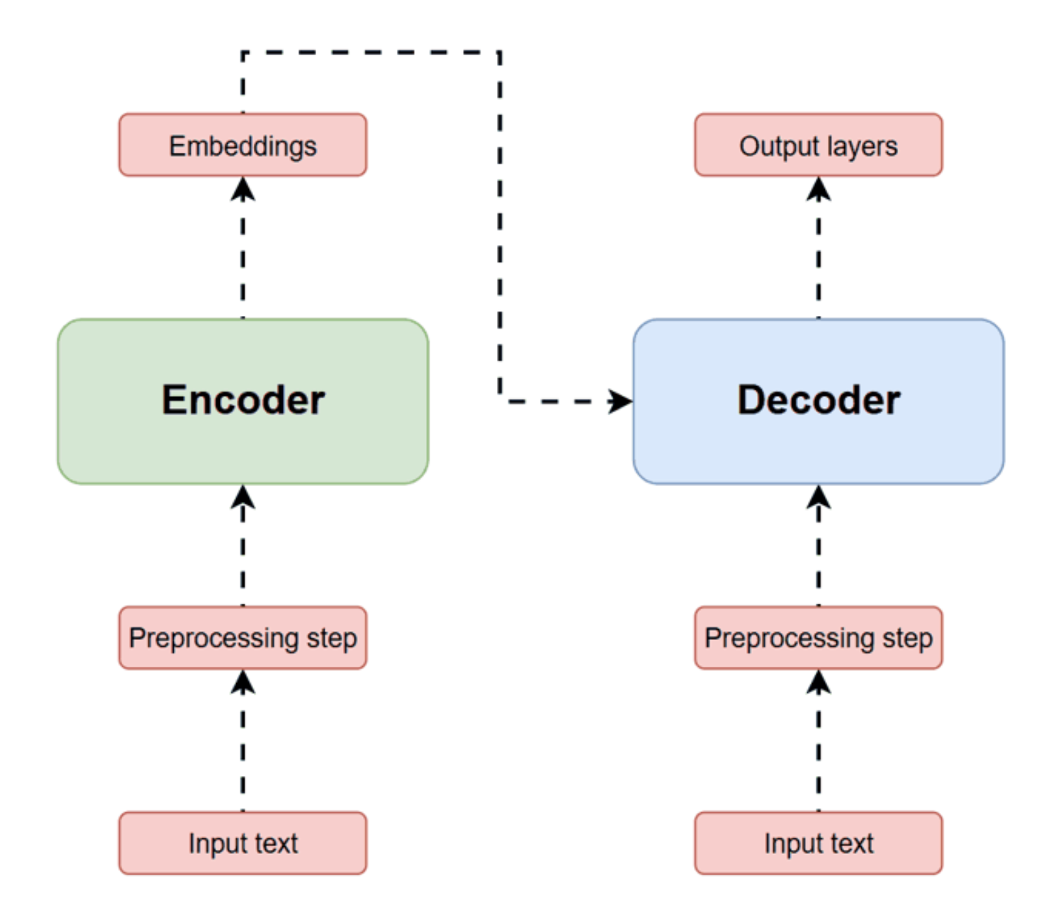
Simplified GPT model

Slide 45
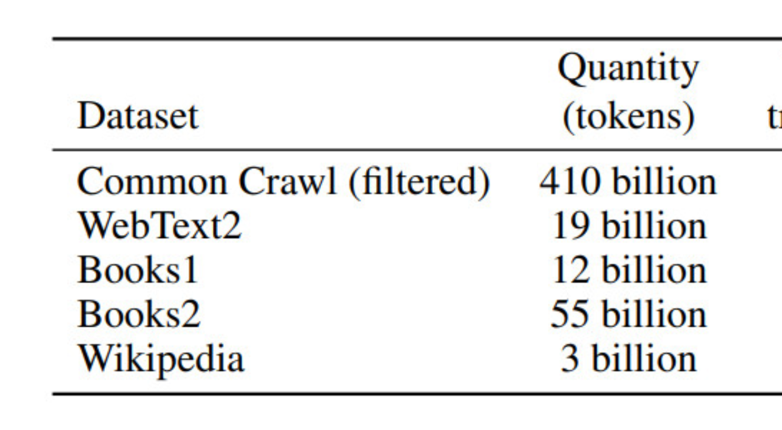
Training datasets

Slide 46
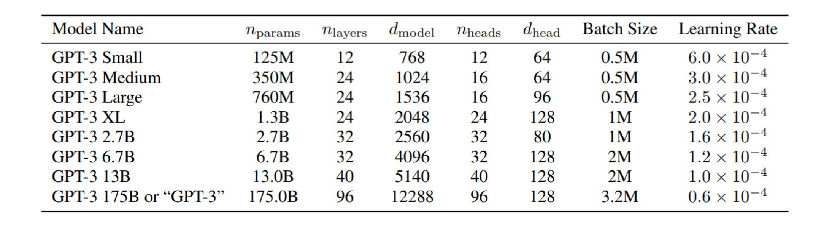
GPT3 Variants

Slide 47
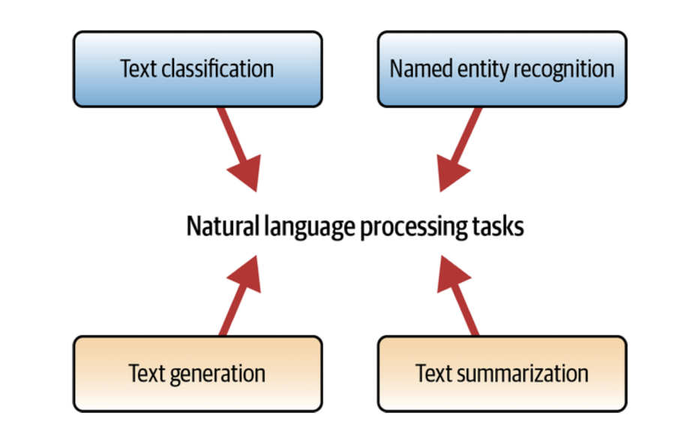
Tasks play a key role in model structure

Slide 48
Text Classification
Text classification is a supervised learning task in Natural Language Processing (NLP) that involves automatically assigning predefined categories or labels to open-ended text. It is one of the most fundamental tasks used to organize, structure, and filter data.
Common Use Cases
Sentiment Analysis: Identifying the emotion behind a text (e.g., Positive, Negative, Neutral).
Spam Detection: Filtering emails into "Spam" or "Ham."
Topic Labeling: Categorizing news articles into sections like "Sports," "Politics," or "Tech."
Intent Detection: Recognizing the goal of a user in a chatbot (e.g., "Book a flight," "Check balance").

Slide 49
Text generation
Text generation is a generative AI task that involves producing new, coherent, and contextually relevant sequences of text. Unlike classification (which predicts a label), generation models predict the next most likely token (word or character) based on a given prompt or input.
Common Use Cases
Creative Writing: Generating stories, poems, or song lyrics.
Code Generation: Assisting developers by writing or debugging snippets (e.g., GitHub Copilot).
Conversational AI: Powering chatbots and virtual assistants like Gemini or ChatGPT.

Slide 50
Text generation challenges
Hallucination: The model may generate facts that sound confident but are factually incorrect.
Repetition: Models can sometimes get stuck in a loop, repeating the same phrases.
Coherence: Maintaining a logical thread over very long passages of text.

Slide 51
Text summarization
Text summarization is the NLP task of shortening a long document into a concise version while retaining its core meaning and key information. In the era of "information overload," this task is critical for making large volumes of data digestible for human readers and downstream AI processes.
Common Use Cases
Legal & Compliance: Reducing document review time by up to 70% by summarizing contracts and case law.
Medical Informatics: Distilling patient histories and clinical notes for faster physician review.
Recursive Context: Modern LLMs use "context compression" to summarize previous parts of a long conversation, preventing "context rot" in long sessions.
News Aggregation: Generating snippets for news feeds and newsletters.

Slide 52
Named entity recognition
Named Entity Recognition (NER) is a subtask of Information Extraction that involves identifying and categorizing key entities within a text into predefined classes. It transforms unstructured text into structured data by pinpointing "who," "where," and "what."
Core Entity Categories
Most NER systems are trained to recognize standard categories, though they can be customized for specific industries:
PERSON: Names of people (e.g., Marie Curie, Sundar Pichai).
ORG (Organization): Companies, agencies, or institutions (e.g., Google, United Nations).
GPE/LOC (Location): Countries, cities, or geographic features (e.g., Tokyo, Mount Everest).
DATE/TIME: Specific dates or time periods (e.g., January 1st, 2026).
MONEY/PERCENT: Monetary values and percentages.
The Mechanism: Sequence Labeling
NER is treated as a sequence labeling problem, typically using the BIO tagging scheme:
B- (Beginning): The first word of an entity.
I- (Inside): Subsequent words of the same entity.
O (Outside): Words that do not belong to any entity.
Example: "Apple is based in Cupertino."
Apple (B-ORG) | is (O) | based (O) | in (O) | Cupertino (B-GPE).

Slide 53
Building practical language applications
Application requirements, problem statement, analysis, prompt engineering, testing, iterate

Slide 54
Language-Based Applications
Applications that rely on natural language understanding and generation.
Examples: chatbots, summarizers, translators, sentiment analyzers.
Powered by large language models (LLMs).

Slide 55
Typical Application Pipeline
User Input → Preprocessing → Model Inference → Postprocessing → Output Delivery
User Input: User query
Preprocessing: cleaning text, formatting prompts.
Model inference: LLM generates predictions or responses.
Postprocessing: filtering, formatting, or structuring output.
Delivery: UI, API, or embedded system.

Slide 56
Key Components of Language Applications
Input handling: text, voice, or structured data.
Prompt engineering: instructions, examples, constraints.
Model selection: general-purpose or domain-specific.
Output shaping: summaries, answers, classifications.

Slide 57
Example Use Cases
Customer support chatbots.
Document summarization tools.
Code generation assistants.
Knowledge extraction from large corpora.
What is the input for each?

Slide 58
Challenges and Considerations
Hallucinations and factual accuracy.
Context window limitations.
Latency and cost.
Data privacy and compliance.

Slide 59
Website basics

Slide 60
What Is a Website?
A website is a collection of interconnected web pages accessible through the internet
Delivered by a web server and viewed through a web browser
Built using standard web technologies
Can contain text, images, documents, audio, video, and interactive elements

Slide 61
Core Technologies Behind Every Website
HTML — Structure: Defines layout and content
CSS — Style: Controls colors, fonts, spacing, layout
JavaScript — Behavior: Adds interactivity and dynamic features

Slide 62
Structure of a Webpage
Head Section: metadata, title, CSS/scripts
Body Section: visible content
DOM: browser’s internal tree representation

Slide 63
Types of Content Websites Include
Documents: PDFs, Word files, spreadsheets
Images: JPEG, PNG, SVG, GIF
Videos: MP4, WebM, embeds
Audio: MP3, WAV
Interactive elements: forms, maps, charts

Slide 64
How Websites Are Created
Planning, design, development, testing
Frontend: HTML/CSS/JS
Backend: servers, databases, APIs
CMS platforms

Slide 65
Tools Used to Build Websites
Frontend tools: VS Code, Figma, DevTools
Backend tools: Node.js, Python, PHP
CMS: WordPress, Squarespace, Shopify

Slide 66
How Websites Are Maintained
Content updates, security patches, server updates
Performance optimization, SEO, analytics
Content is added using a
CMS: upload media, publish pages
Code: update files, deploy via Git
Automation: APIs, scheduled publishing

Slide 67
How a Page Loads
1. User enters URL
2. Browser requests server
3. Server returns HTML
4. Browser loads CSS/JS/media
5. Page becomes interactive
6. Dynamic content loads

Slide 68
Web scraping

Slide 69
Web Scraping
What is it?
Automated extraction of data from websites
Useful for research, analytics, automation, and monitoring
Typically involves sending HTTP requests and parsing HTML content
BeautifulSoup
A Python library for parsing and navigating HTML/XML
Makes it easy to locate elements, extract text, and clean data
Often used with requests for end‑to‑end scraping workflows
Basic Workflow
Send a request to a webpage
Load the HTML into BeautifulSoup
Locate elements using tags, classes, or CSS selectors
Extract and structure the data

Slide 70
Web Scraping Overview
Extracting data from websites automatically.
Used for analytics, research, automation, and AI pipelines.
Handles structured and unstructured content.

Slide 71
Tools for Web Scraping
BeautifulSoup: HTML parsing and extraction.
Scrapy: full-featured scraping framework.
Selenium: browser automation for dynamic sites.
Playwright: modern automation for JavaScript-heavy pages.
Requests: simple HTTP retrieval.

Slide 72
Handling Different File Types
HTML pages: parsed with BeautifulSoup or Scrapy.
PDFs: extracted using PyPDF2, pdfplumber, or OCR tools.
Images: downloaded and processed with Pillow or OCR.
Videos: metadata extraction; downloading via APIs or tools like youtube-dl.
JSON/XML: parsed directly as structured data.

Slide 73
Challenges in Web Scraping
Dynamic content requiring JavaScript execution.
Anti-bot protections (CAPTCHAs, rate limits).
Changing website structures.
Legal and ethical considerations.
Large-scale scraping performance issues.

Slide 74
Typical Scraping Pipeline (ASCII Diagram)
User Request → Fetch → Parse Content → Extract Data → Clean/Transform → Store or Feed to Model
- Fetch: HTTP requests or browser automation.
- Parse: HTML, JSON, PDF, or media processing.
- Extract: text, tables, metadata.
- Transform: cleaning, normalization.
- Output: database, file, or AI model input.

Slide 75
Feeding Scraped Data into Applications
Analytics dashboards.
Search indexes.
Machine learning training data.
LLM context or fine-tuning datasets.
Automated workflows and alerts.

Slide 76
Connecting AI model to a ‘scraped’ web content

Slide 77
Using Scraped Data With a GPT-Like Model
Scraped data becomes reference material for the chatbot.
Data is pre-processed and injected directly into the prompt.
Model reads system instructions, context, and user question.
This approach is known as context injection.

Slide 78
How Context Injection Works
Clean and normalize scraped text.
Break text into manageable sections.
Insert selected sections into the model prompt.
Example: system instructions + context + user question.

Slide 79
Context Window Limitations
GPT-like models can only read a limited number of tokens.
Small models: 4k–8k tokens; mid-size: 16k–32k; large: 128k–1M.
Long documents cannot be fully included.
Summaries may lose detail; hallucination risk increases.

Slide 80
Other Limitations of a Simple Chatbot
No retrieval logic; model cannot search data.
No memory; each question must include needed context.
Higher hallucination risk when context is incomplete.
Poor scalability as data grows.

Slide 81
Model Choices
General-purpose GPT-like models: broad reasoning but not QA-optimized.
QA-optimized models: trained on QA datasets; better grounding and accuracy.
Domain-specific models: tuned for legal, medical, financial, or technical content.

Slide 82
Why Use a QA-Trained Model
QA models locate relevant information in provided text.
They avoid answering when context is missing.
They follow grounding rules and reduce hallucinations.
Improve accuracy, reliability, and user trust.

Slide 83
Building User Interface (UI) for human consumption

Slide 84
Core Components of a Chatbot UI
User input box for messages.
Chat history display.
Backend call to an LLM or local model.
Output area for responses.
Optional: system prompt, model selector, temperature slider.

Slide 85
UI Options for a Chatbot
Web-based interfaces
Mobile interfaces
Chat-style integrations
Embedded UI widgets
Developer-focused interfaces
Voice-enabled interfaces
Enterprise integrations

Slide 86
Web-Based UI Options
Streamlit: fast prototyping, built-in chat components
Gradio: plug-and-play chat interface, easy sharing
React / Next.js: fully customizable, production-ready
Vue / Svelte: lightweight alternatives for custom UIs
Flask / FastAPI + HTML/CSS: simple backend-driven UI

Slide 87
Mobile UI Options
Native iOS/Android apps: polished consumer experiences
React Native / Flutter: cross-platform development
Mobile web app: simplest, no app store deployment

Slide 88
Chat-Style Integrations
Slack bot: great for internal assistants
Microsoft Teams bot: fits enterprise workflows
Discord bot: ideal for communities
WhatsApp / SMS bots: broad accessibility

Slide 89
Embedded UI Options
Website chat widget: similar to Intercom or Drift
Iframe-based chatbot panel: easy embedding
In-product dashboard integration: ideal for SaaS tools

Slide 90
Developer-Oriented Interfaces
CLI chatbot: fast, ideal for debugging
Jupyter notebook interface: interactive demos
VS Code extension: integrated into developer workflow

Slide 91
Voice-Enabled Interfaces
Alexa / Google Assistant skills: voice-first interactions
Web Speech API: browser-based voice input/output
Custom mic + TTS UI: hands-free experience

Slide 92
Enterprise UI Options
SharePoint / Intranet integration
CRM-embedded chatbot (Salesforce, HubSpot)
Internal dashboards with authentication

Slide 93
Streamlit Chatbot Basics
Uses st.chat_message for chat-style UI.
Session state stores conversation history.
Real-time updates and simple layout tools.
Typical flow: init history → render → capture input → call model → append response.

Slide 94
Gradio Chatbot Basics
ChatInterface provides plug-and-play chat UI.
Automatically manages chat history.
Minimal boilerplate—define a function and return a response.
Clean, modern UI out of the box.

Slide 95
Example Architecture
Frontend: Streamlit or Gradio.
Backend: local model or cloud API.
Optional enhancements: logging, prompt templates, session memory.

Slide 96
Limitations of Simple Chatbot UIs
No long-term memory.
No retrieval or document search.
Limited control over conversation flow.
Not ideal for high-traffic production apps.

Slide 97
When to Use Streamlit or Gradio
Great for prototypes, teaching, demos, internal tools.
Not suited for complex, multi-user, or highly customized frontends.

Slide 98
A SIMPLE CHATBOT IN LESS THAN10 LINES
HuggingFace Spaces – for compute hardware
Python – for coding
HuggingFace Transformer library – for model
Gradio – for user interface
GPT2 – AI model
Task – Generate a short story starting with the words (text generation)
Max length of the story - customizable

Slide 99
BRING UP GOOGLE COLAB
Goto: https://colab.research.google.com/
Login using your name
Click on +Code
Type print (“hello world”)
Click Play button

Slide 100
Chatbot for American High Web Site using Vibe Coding

Slide 101
Vibe Coding
Vibe coding is an approach to software development using AI assistance. Instead of writing detailed code, you describe the desired outcome using natural language. This allows you to focus on the problem-solving aspect while the AI handles the implementation.
While it’s great for rapid development, it’s important to remain aware of its limitations, especially in larger, more complex projects.
Vibe coding is excellent for quick prototypes and learning, it complicates things with larger projects and poses security risks. It’s most effective for smaller, standalone projects rather than challenging and complex projects.
Vibe coding is a method of AI-assisted software development that focuses on writing as little code as possible instead of using natural language to describe what you want built.
Unlike traditional AI-assisted programming where developers review and understand all AI-generated code before committing it, vibe coding involves accepting AI-generated code without full comprehension to prioritize speed and experimentation over code understanding.

Slide 102
Vibe Coding Requirements
Cursor IDE for Vibe Coding
One of the most popular tools in the vibe coding ecosystem
Works on entire codebases
Offers contextual suggestions
Provides suggestions and prompts
providing in-depth analysis
Github for storing code
Cloudflare for publishing
Jupyter for Python
Download and install

Slide 103
Jupyter Notebook

