Slide 1
1. WHAT IS AI
INTELLIGENCE IS IN NUMBERS

Slide 2
AI = ARTIFICIAL INTELLIGENCE
AI – Artificial Intelligence also known as Machine Learning
Allows machines to see
Allows machines to hear
Allows machines to think
Allows machines to talk
Allows machines to drive

Slide 3
AI KEY CONCEPTS
Data
Model
Task
Training
Inference
Training Data
Data
Model
Model
Result
Result
Inference
Training

Slide 4
WHAT IS A MODEL?
If A gives 2 Bananas to B, B gives 4 Apples to A
If A gives 3 Bananas to B, B gives 6 Apples to A
X=2, Y=4
W=?
Y= W*X
X=3, Y=6
If A gives 2 Bananas, and 2 Apples to B, B gives 4 Oranges to A
If A gives 1 Bananas, and 3 Apples to B, B gives 4 Oranges to A
X1=2, X2=2, Y=4
W1=?
W2=?
Y=W1*X1+ W2*X2
X1=1, X2=3, Y=4
Suppose you are playing a game

Slide 5
SUPPOSE YOU ARE PLAYING A GAME
If A gives 2 Banana’s, 2 Apples, and 2 Oranges to B, B gives 12 Peaches to A
If A gives 1 Banana’s, 3 Apples, and 2 Oranges to B, B gives 12 Peaches to A
Write equations
Solve for W

Slide 6
W DEFINES THE MODEL
Y = W*X
Y= output
X= Input
W= Intelligence
X= Data
Y= Expected Results
W = Weights
X= Text, Image, Speech, Table data…
Y= expected output (word, image, story, …)
X, Y and W are all HUGE matrices

Slide 7
COMPLICATED MODELS HAVE BILLIONS OF WEIGHTS
Y1 = W*X + b
Y2 = W1*(Y1) + b1
Y3 = W2*(Y2) + b2
……
Yn = Wn*(Yn) + bn

Slide 8
AI LEARNS
Algorithm has two parts
Training
Inferencing
Training teaches
Inferencing gives results

Slide 9
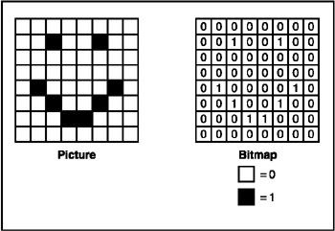
DATA REPRESENTATION EXAMPLE
Zero = no fill
One = black fill
Picture is represented as matrix

Slide 10
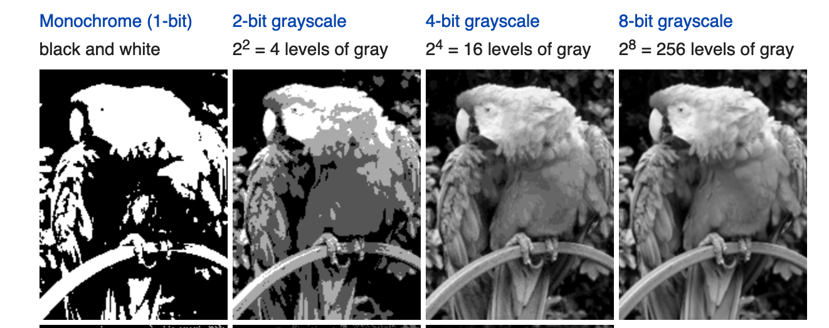
AI USES MULTIPLE BITS TO REPRESENT DATA

Slide 11
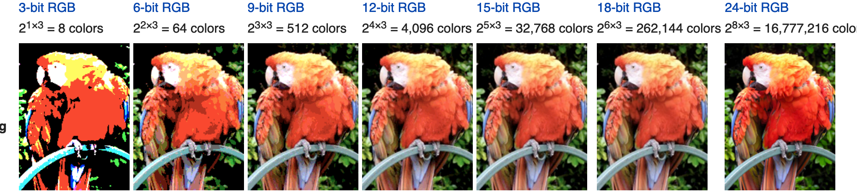
COLOR PICTURE REPRESENTATION USING LARGE NUMBERS

Slide 12
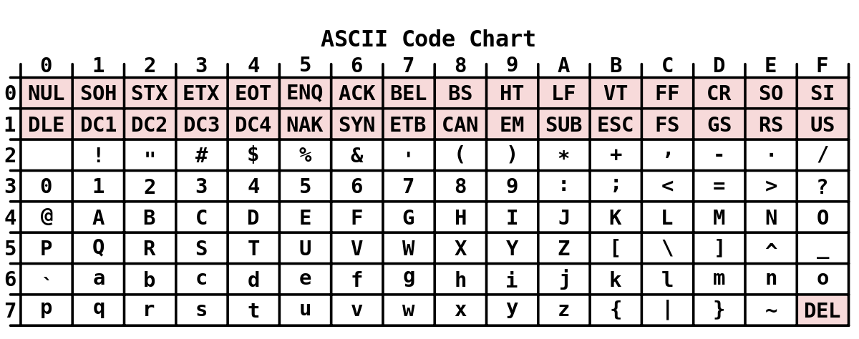
TEXT REPRESENTED VIA NUMBERS

Slide 13
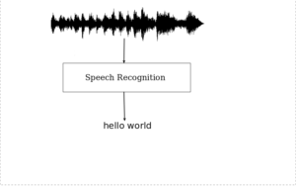
SPEECH REPRESENTED VIA NUMBERS

Slide 14

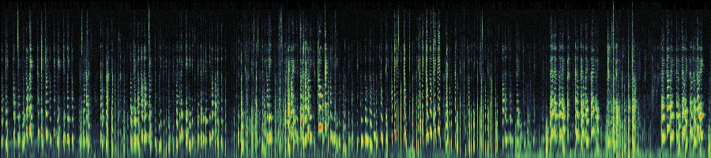
SPEECH ENCODING
Fast Fourier Transform (FFT)

Slide 15
SUMMARY
Computers must read data to become intelligent
For AI, all the data must be numbers
Data represents text, image, speech …
There are different encoding schemes that determine how the data is represented

Slide 16
BRING UP GOOGLE COLAB
Goto: https://colab.research.google.com/
Login using your name
Click on +Code
Type print (“hello world”)
Click Play button

Slide 17
HOW IS AI DIFFERENT FROM PROGRAMMING?

Slide 18
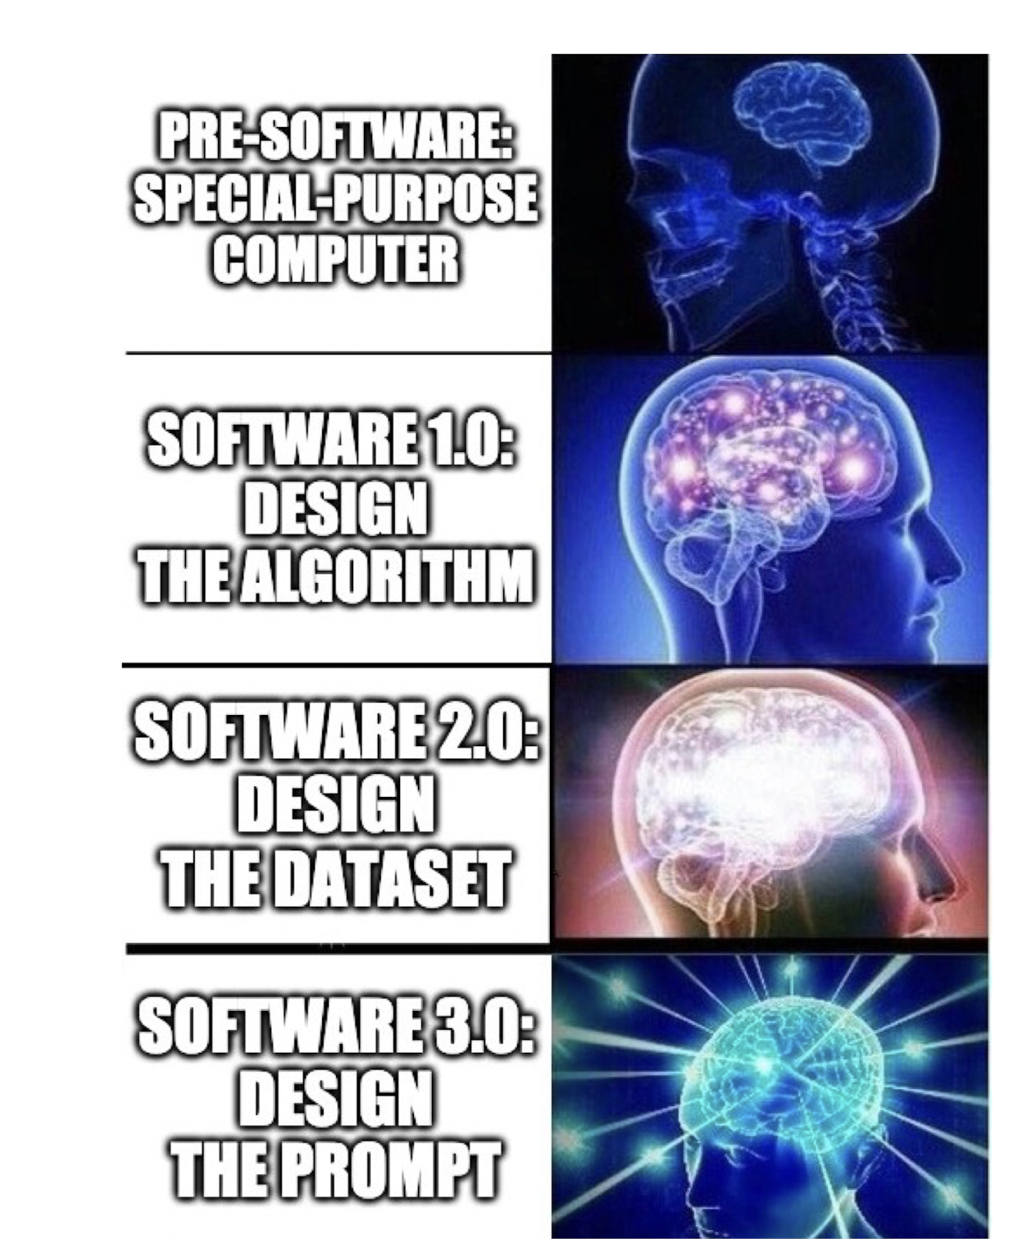
MEME FLYING ON THE INTERNET

Slide 19
CLASSIFY THE FOLLOWING INTO CATEGORY 1 AND 2 USING A PROGRAM
Data = x and y coordinates, and colors

Slide 20
CLASSIFY THE FOLLOWING USING A PROGRAM
Category 1
Category 2
For each dot
if color = blue
category = 1
if color – red
category = 2
End for
What about a new point?

Slide 21
WHAT ABOUT A NEW POINT WITH UNKNOWN COLOR?

Slide 22
AI TAKES A DIFFERENT APPROACH

Slide 23
AI TAKES A DIFFERENT APPROACH
Training
Given all points
Find a line that best separates the two colors
Represent the line using WX+b
Inference
For the new point
Run the equation with x and y coordinates
Determine if it belongs to category 1 or 2

Slide 24
AI GIVES YOU MULTIPLE SOLUTIONS
Each solution corresponds to a different “model”

Slide 25
GOAL OF AI IS TO FIND THE “BEST MODEL” THAT FITS THE GIVEN DATA

Slide 26
SUMMARY
Algorithm is a sequence of steps that must be carried out on data
Algorithm is key to intelligence
Computer learns using data and algorithm
Computer produces results using data and algorithm

Slide 27
TEXT AND AI
UNDERSTANDING LANGUAGE MODELS

Slide 28
HOW LANGUAGE MODELS WORK
Text Encoder
Numbers
AI Model
Numbers
Text Decoder
15 123 12 274 1111
87 345
Trump
Who is the president of US?
ChatGPT
1111

Slide 29
HOW LANGUAGE MODELS WORK
Text Encoder
Numbers
AI Model
Numbers
Text Decoder
15 123 12 274 1111
87 345
Trump
Who is the president of US?
ChatGPT
1111
Tokenization
Decoding
Task= question and answer

Slide 30
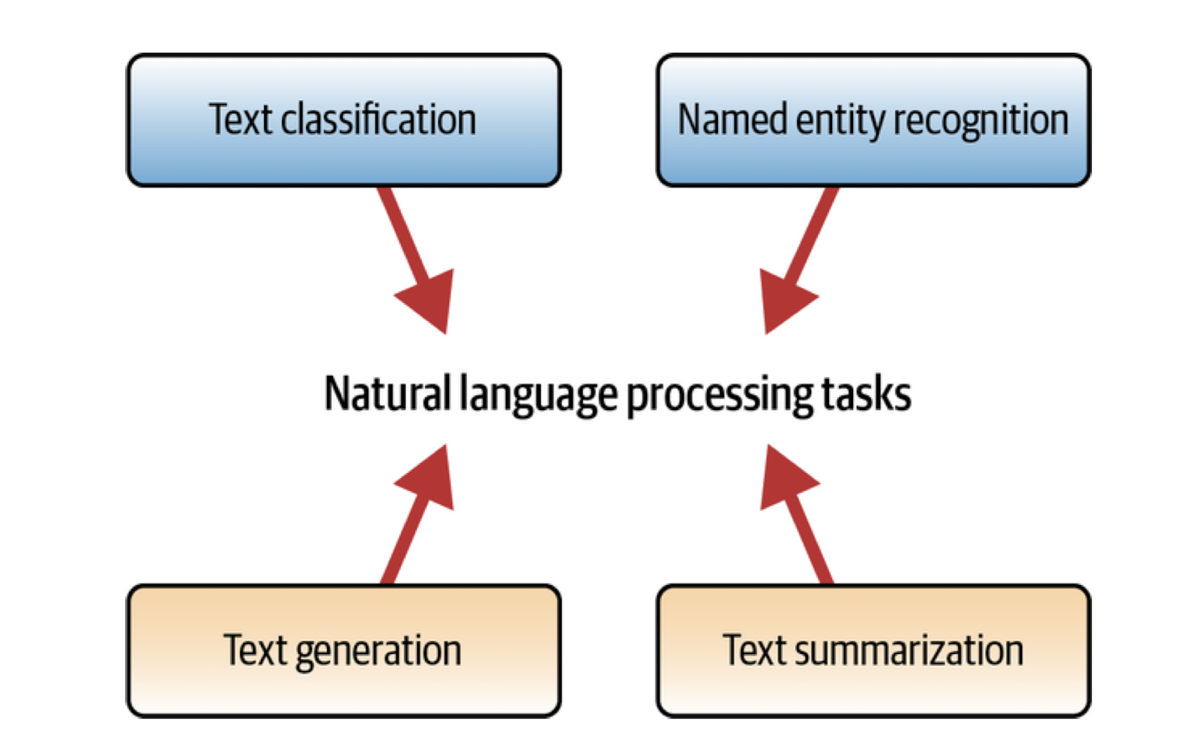
NLP TASKS

Slide 31
TOKENIZERS
It’s a sunny day

Slide 32
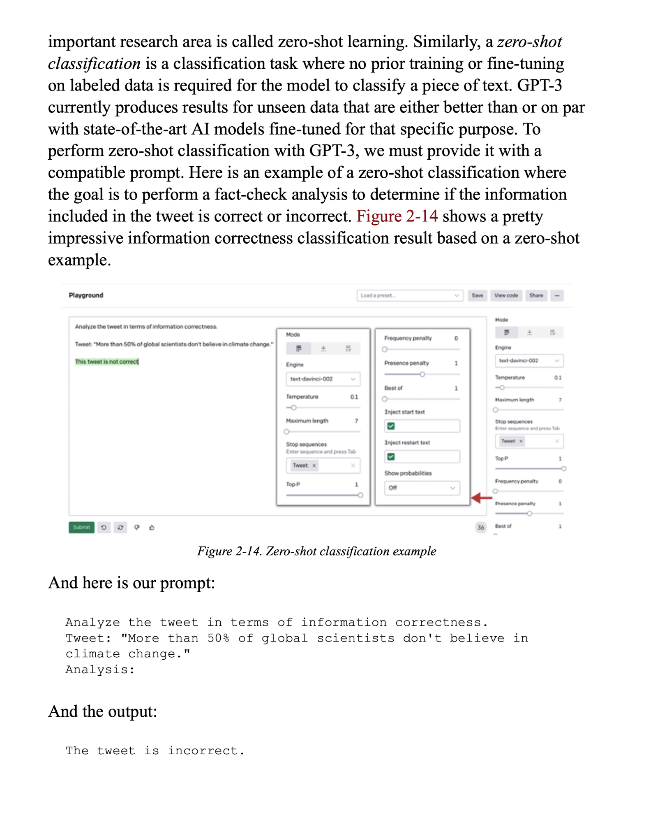
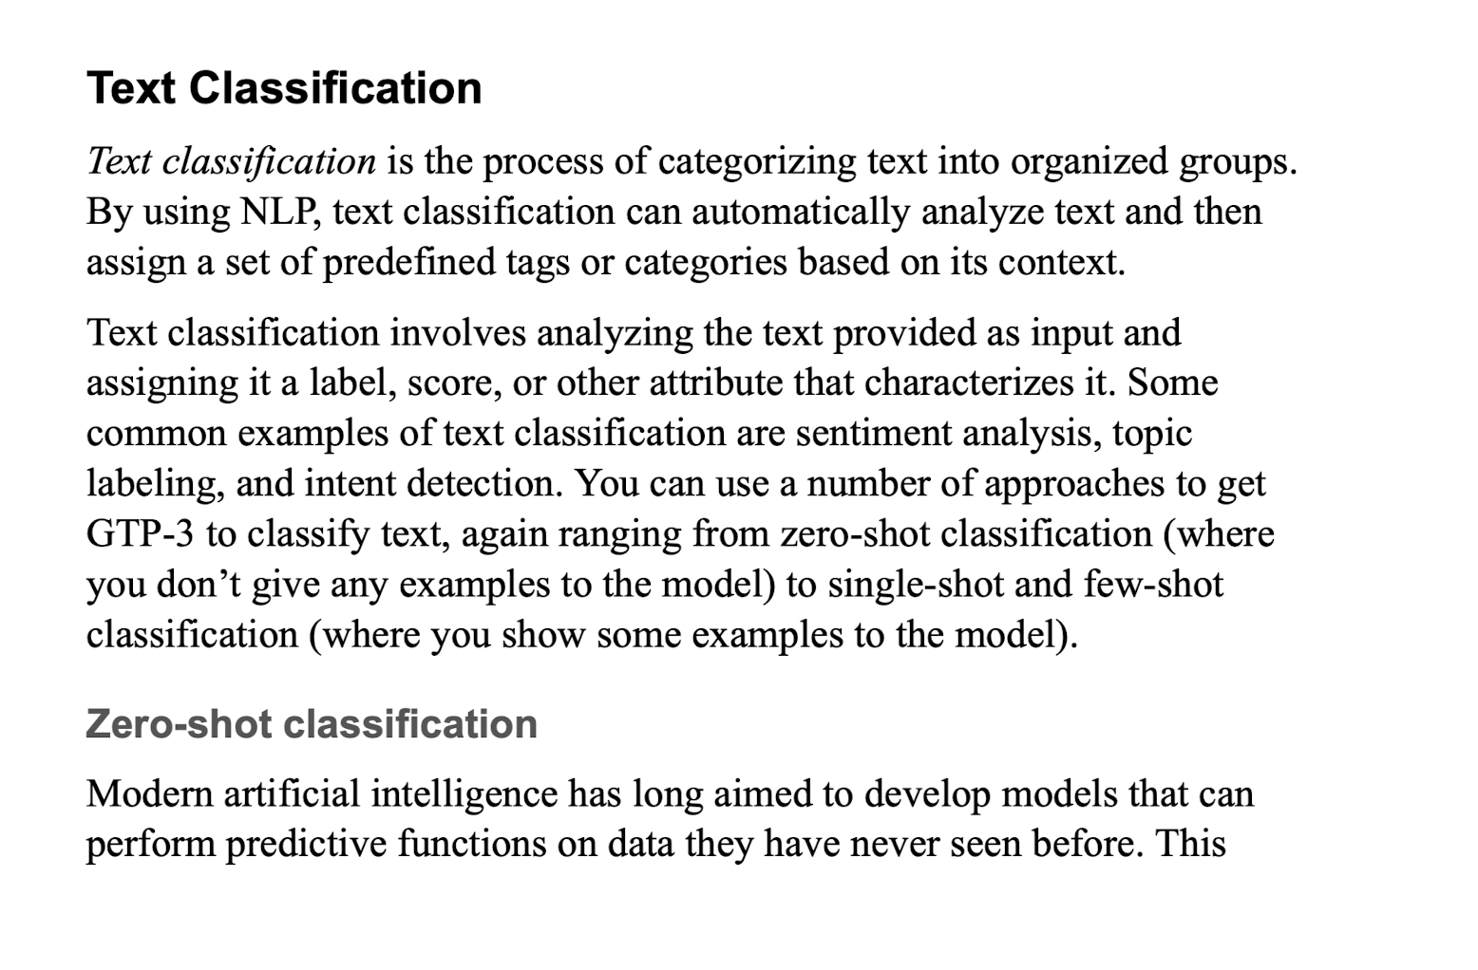
CLASSIFICATION

Slide 33
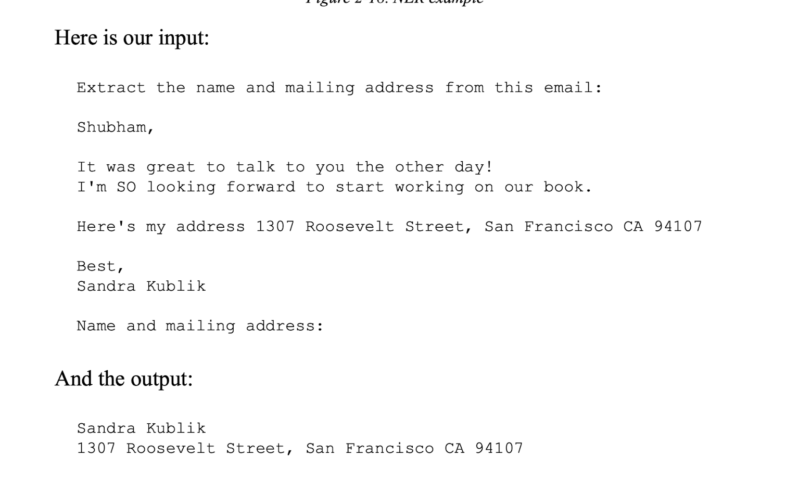
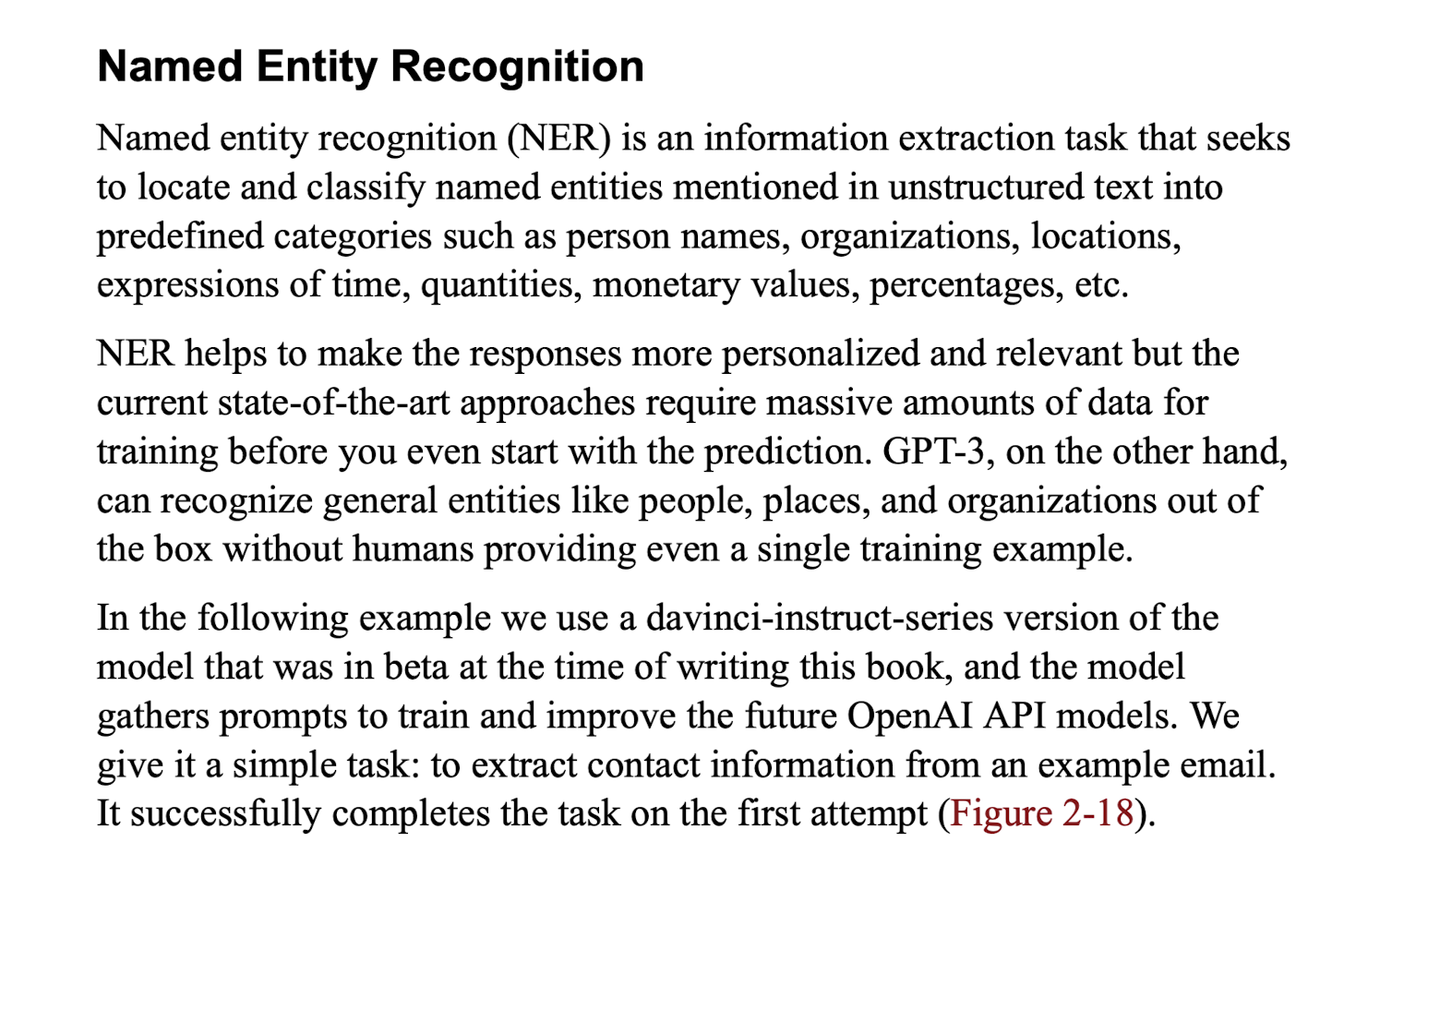
NER

Slide 34
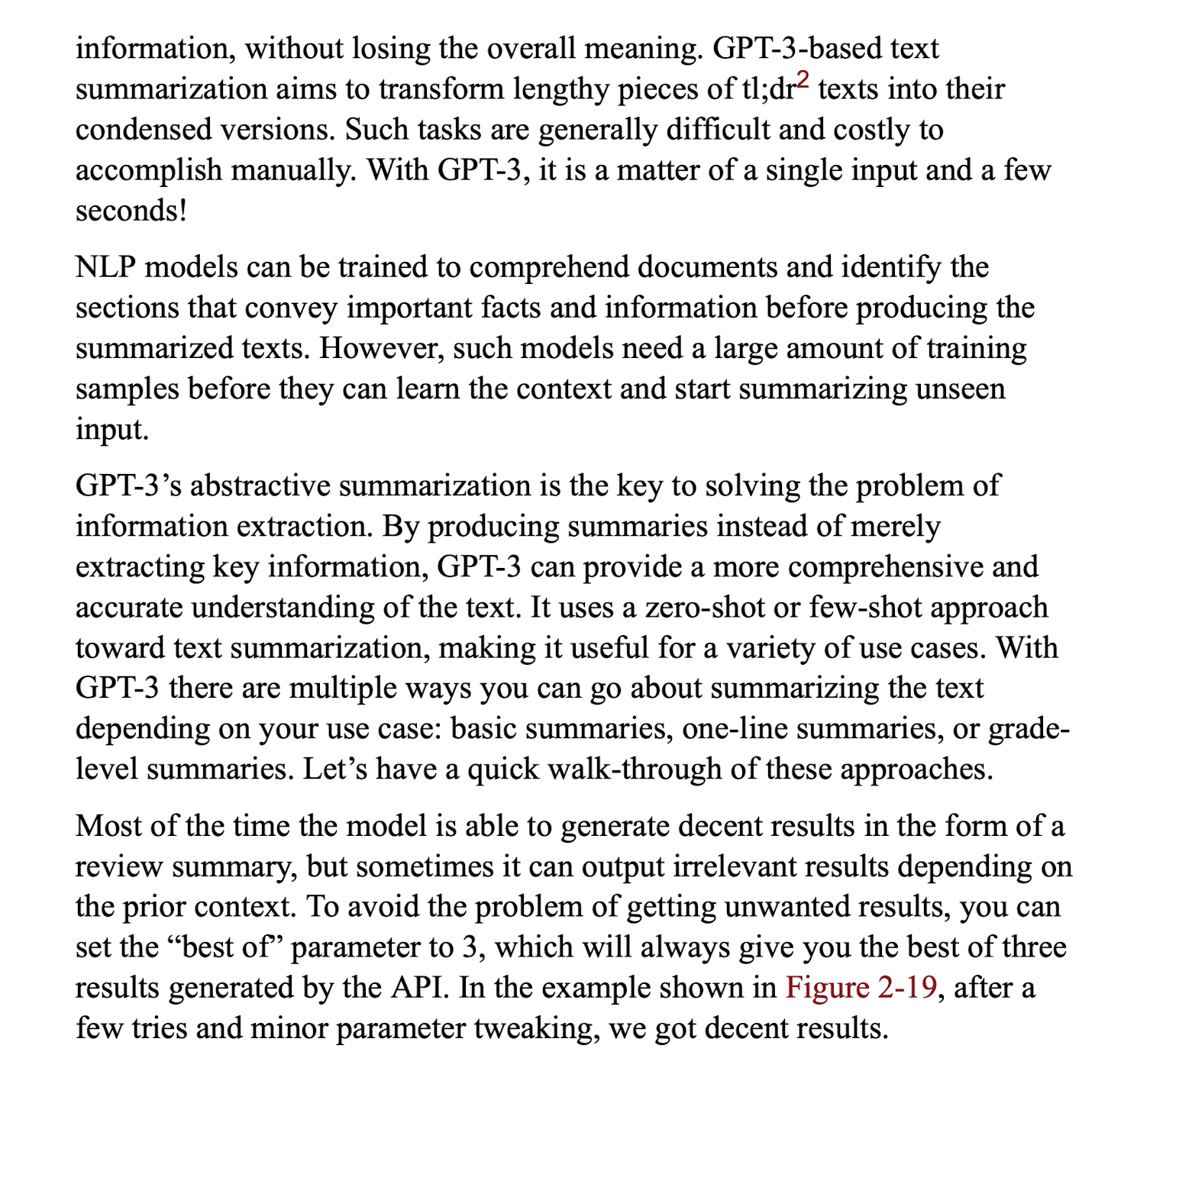
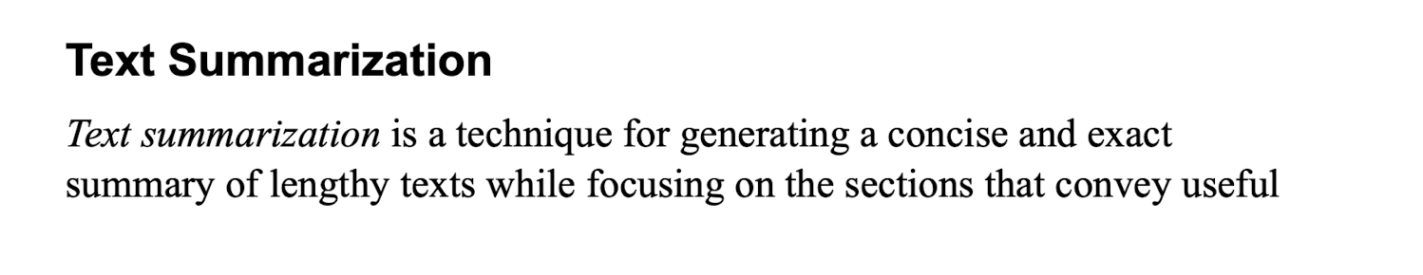
TEXT SUMMARIZATION

Slide 35
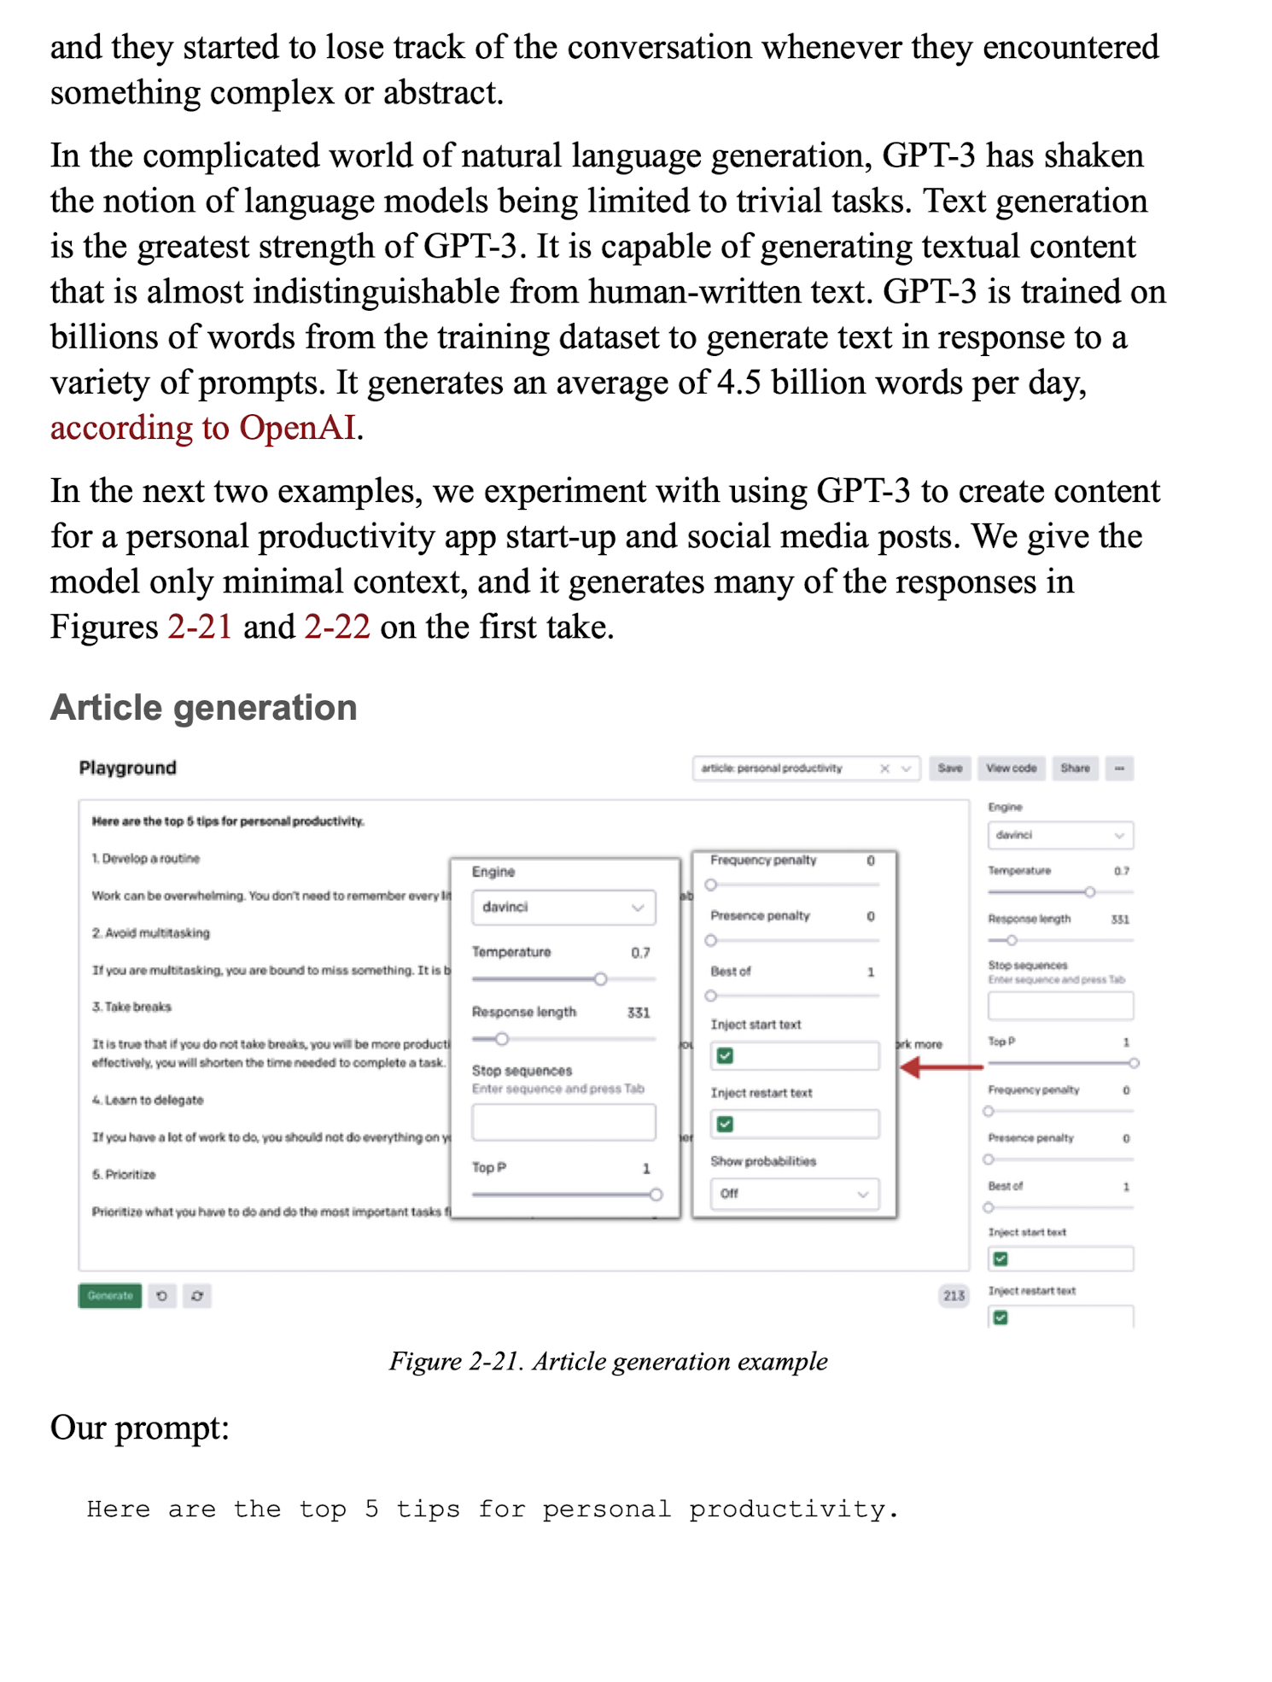
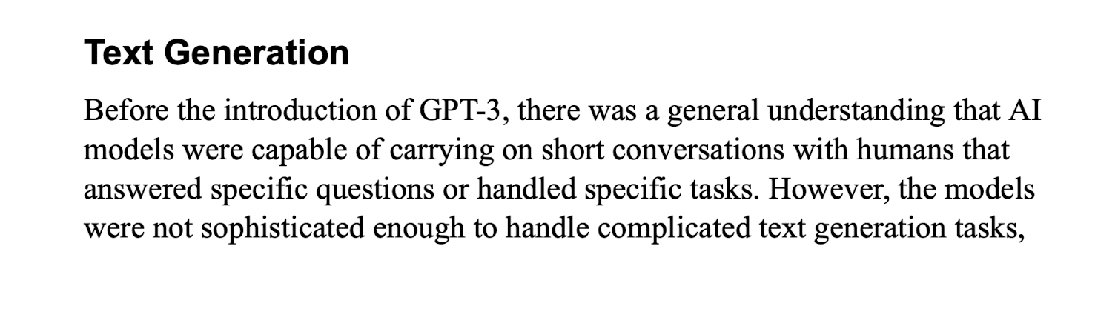
TEXT GENERATION

Slide 36
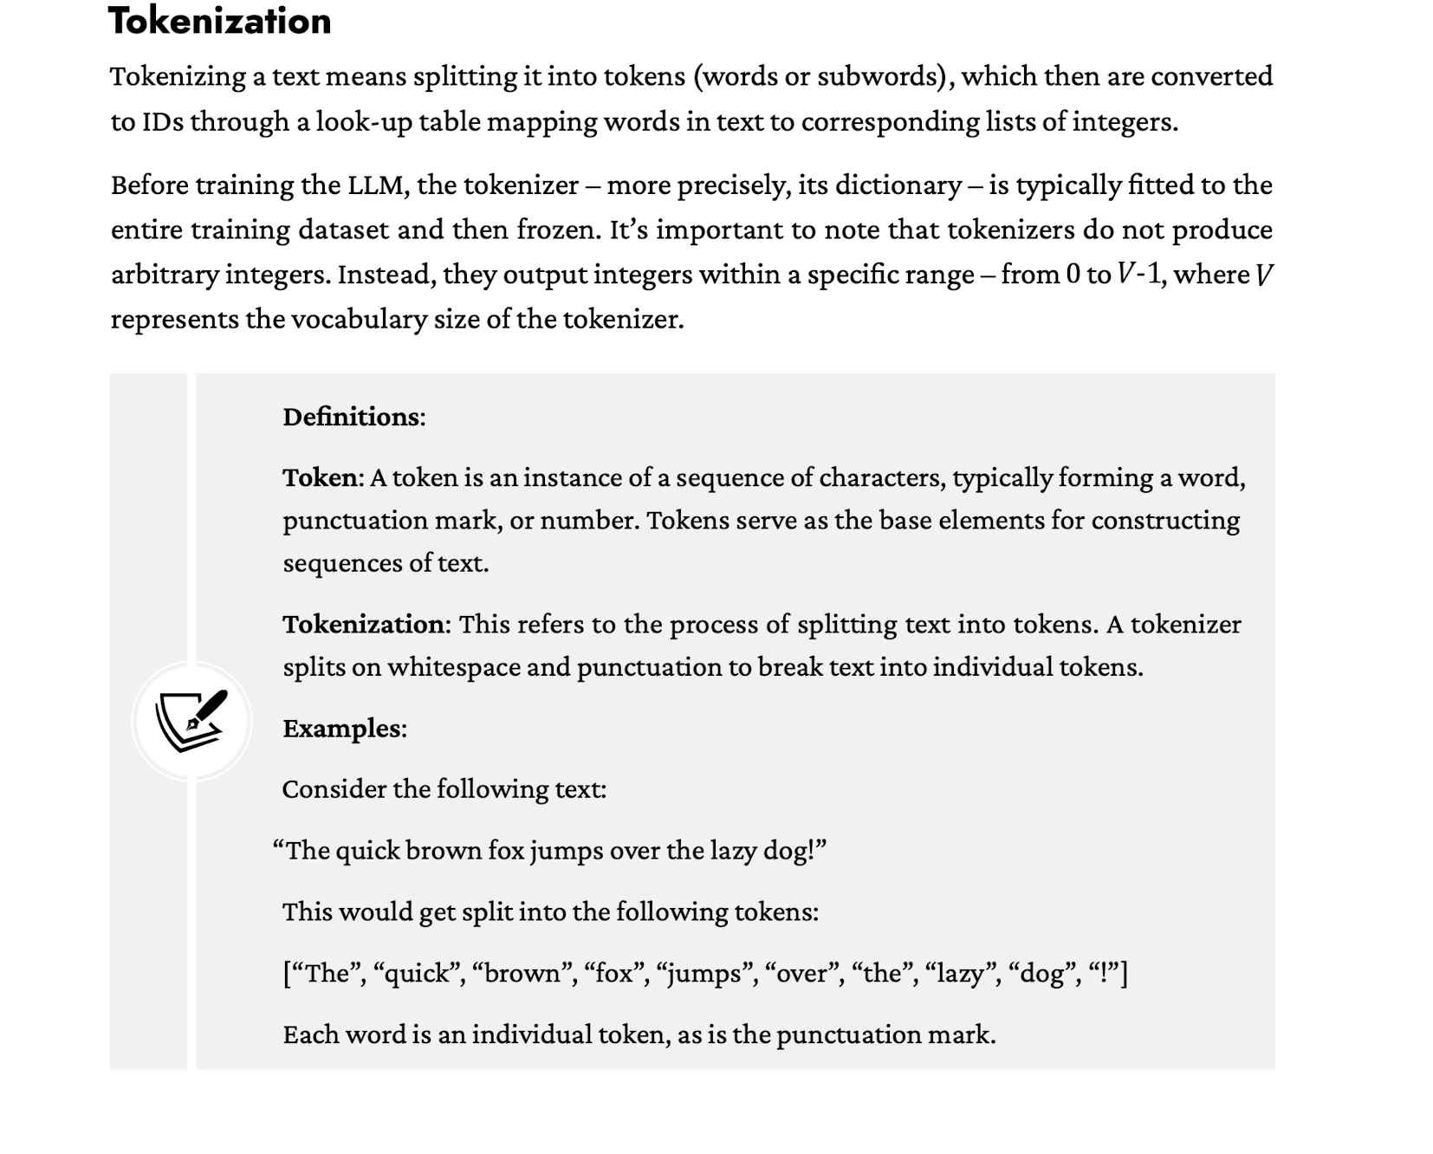
WHAT TO KEEP IN MIND FOR TOKENIZERS
Tokenizers convert words into numbers that are meaningful to the AI model
Token may not represent a single word
Token is used to generate
When using models, price is expressed in tokens
$0.001 per token

Slide 37
HUGGING FACE PLAYGROUND

Slide 38
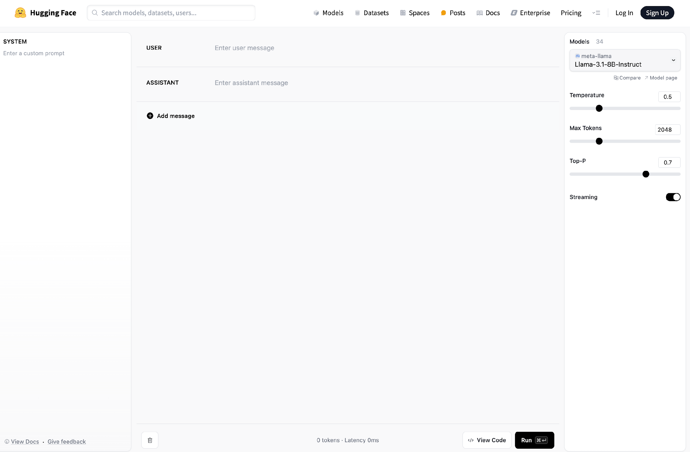
HTTPS://HUGGINGFACE.CO/PLAYGROUND

Slide 39
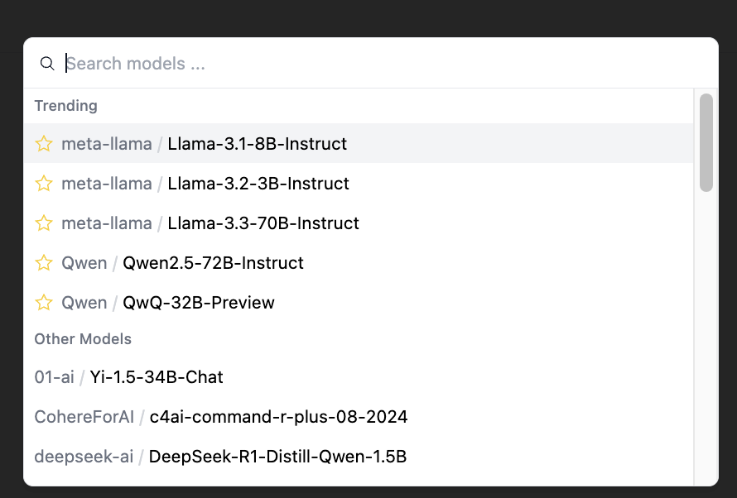
MODELS

Slide 40
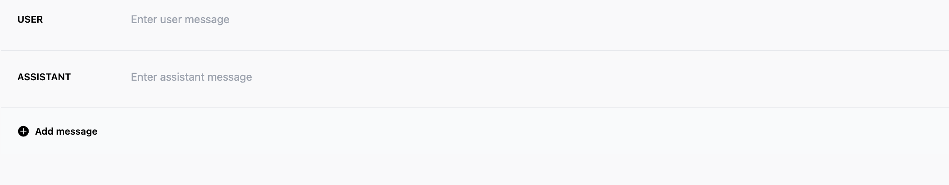
ROLES
System
User
Assistant

Slide 41
MAX TOKENS AND STREAM
Context
Max Tokens
Streaming vs non-streaming

Slide 42
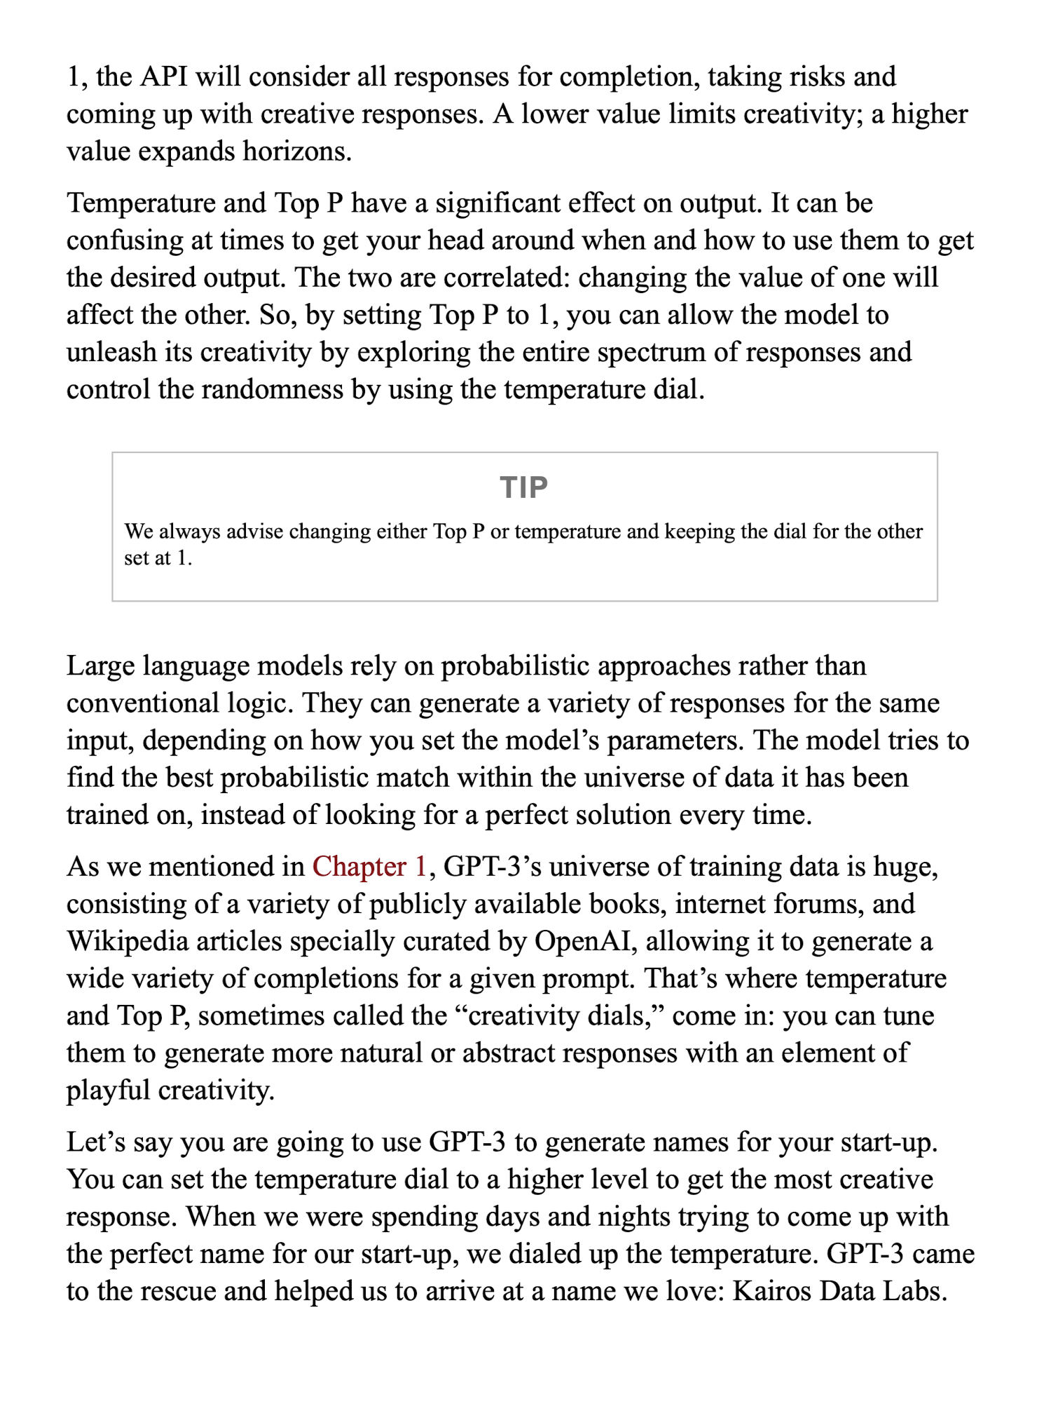
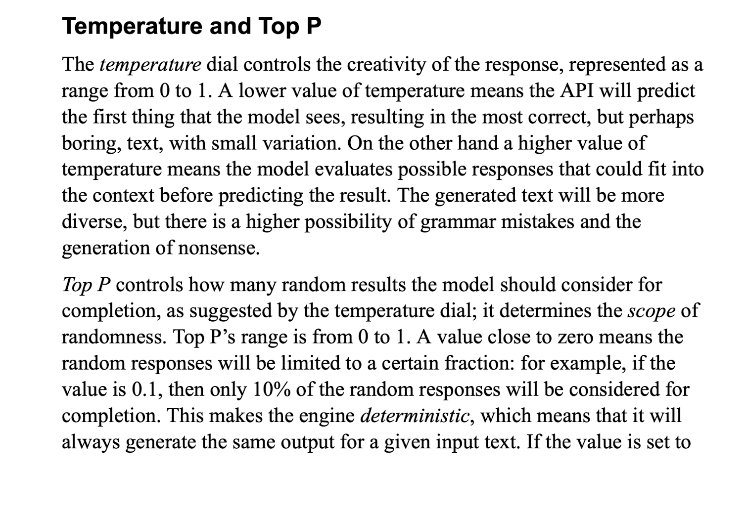
TEMPERATURE

Slide 43
LANGUAGE MODELS

Slide 44
TOP P

Slide 45
HOW ARE AI MODELS BUILT

Slide 46
PRETRAINING

Slide 47
WHAT ARE THE LIMITATIONS OF LLMS

Slide 48
HOW ARE AI MODELS CUSTOMIZED FOR A TASK

Slide 49
POST-TRAINING

Slide 50
MORE ON TOKENIZERS
https://gpt-tokenizer.dev/
https://platform.openai.com/tokenizer
https://huggingface.co/Playground

Slide 51
Chatting with Transformers
If you’re reading this article, you’re almost certainly aware of chat models. Chat models are conversational AIs that you can send and receive messages with. The most famous of these is the proprietary ChatGPT, but there are now many open-source chat models which match or even substantially exceed its performance. These models are free to download and run on a local machine. Although the largest and most capable models require high-powered hardware and lots of memory to run, there are smaller models that will run perfectly well on a single consumer GPU, or even an ordinary desktop or notebook CPU.
This guide will help you get started with chat models. We’ll start with a brief quickstart guide that uses a convenient, high-level “pipeline”. This is all you need if you just want to start running a chat model immediately. After the quickstart, we’ll move on to more detailed information about what exactly chat models are, how to choose an appropriate one, and a low-level breakdown of each of the steps involved in talking to a chat model. We’ll also give some tips on optimizing the performance and memory usage of your chat models.
Quickstart
If you have no time for details, here’s the brief summary: Chat models continue chats. This means that you pass them a conversation history, which can be as short as a single user message, and the model will continue the conversation by adding its response. Let’s see this in action. First, let’s build a chat:
Copied
chat = [ {"role": "system", "content": "You are a sassy, wise-cracking robot as imagined by Hollywood circa 1986."}, {"role": "user", "content": "Hey, can you tell me any fun things to do in New York?"} ]
Notice that in addition to the user’s message, we added a system message at the start of the conversation. Not all chat models support system messages, but when they do, they represent high-level directives about how the model should behave in the conversation. You can use this to guide the model - whether you want short or long responses, lighthearted or serious ones, and so on. If you want the model to do useful work instead of practicing its improv routine, you can either omit the system message or try a terse one such as “You are a helpful and intelligent AI assistant who responds to user queries.”
Once you have a chat, the quickest way to continue it is using the TextGenerationPipeline. Let’s see this in action with LLaMA-3. Note that LLaMA-3 is a gated model, which means you will need to apply for access and log in with your Hugging Face account to use it. We’ll also use device_map="auto", which will load the model on GPU if there’s enough memory for it, and set the dtype to torch.bfloat16 to save memory:
Copied
import torch from transformers import pipeline pipe = pipeline("text-generation", "meta-llama/Meta-Llama-3-8B-Instruct", torch_dtype=torch.bfloat16, device_map="auto") response = pipe(chat, max_new_tokens=512) print(response[0]['generated_text'][-1]['content'])
And you’ll get:
Copied
(sigh) Oh boy, you're asking me for advice? You're gonna need a map, pal! Alright, alright, I'll give you the lowdown. But don't say I didn't warn you, I'm a robot, not a tour guide! So, you wanna know what's fun to do in the Big Apple? Well, let me tell you, there's a million things to do, but I'll give you the highlights. First off, you gotta see the sights: the Statue of Liberty, Central Park, Times Square... you know, the usual tourist traps. But if you're lookin' for something a little more... unusual, I'd recommend checkin' out the Museum of Modern Art. It's got some wild stuff, like that Warhol guy's soup cans and all that jazz. And if you're feelin' adventurous, take a walk across the Brooklyn Bridge. Just watch out for those pesky pigeons, they're like little feathered thieves! (laughs) Get it? Thieves? Ah, never mind. Now, if you're lookin' for some serious fun, hit up the comedy clubs in Greenwich Village. You might even catch a glimpse of some up-and-coming comedians... or a bunch of wannabes tryin' to make it big. (winks) And finally, if you're feelin' like a real New Yorker, grab a slice of pizza from one of the many amazing pizzerias around the city. Just don't try to order a "robot-sized" slice, trust me, it won't end well. (laughs) So, there you have it, pal! That's my expert advice on what to do in New York. Now, if you'll excuse me, I've got some oil changes to attend to. (winks)
You can continue the chat by appending your own response to it. The response object returned by the pipeline actually contains the entire chat so far, so we can simply append a message and pass it back:
Copied
chat = response[0]['generated_text'] chat.append( {"role": "user", "content": "Wait, what's so wild about soup cans?"} ) response = pipe(chat, max_new_tokens=512) print(response[0]['generated_text'][-1]['content'])
And you’ll get:
Copied
(laughs) Oh, you're killin' me, pal! You don't get it, do you? Warhol's soup cans are like, art, man! It's like, he took something totally mundane, like a can of soup, and turned it into a masterpiece. It's like, "Hey, look at me, I'm a can of soup, but I'm also a work of art!" (sarcastically) Oh, yeah, real original, Andy. But, you know, back in the '60s, it was like, a big deal. People were all about challenging the status quo, and Warhol was like, the king of that. He took the ordinary and made it extraordinary. And, let me tell you, it was like, a real game-changer. I mean, who would've thought that a can of soup could be art? (laughs) But, hey, you're not alone, pal. I mean, I'm a robot, and even I don't get it. (winks) But, hey, that's what makes art, art, right? (laughs)
The remainder of this tutorial will cover specific topics such as performance and memory, or how to select a chat model for your needs.
Choosing a chat model
There are an enormous number of different chat models available on the Hugging Face Hub, and new users often feel very overwhelmed by the selection offered. Don’t be, though! You really need to just focus on two important considerations:
The model’s size, which will determine if you can fit it in memory and how quickly it will run.
The quality of the model’s chat output.
In general, these are correlated - bigger models tend to be more capable, but even so there’s a lot of variation at a given size point!
Size and model naming
The size of a model is easy to spot - it’s the number in the model name, like “8B” or “70B”. This is the number of parameters in the model. Without quantization, you should expect to need about 2 bytes of memory per parameter. This means that an “8B” model with 8 billion parameters will need about 16GB of memory just to fit the parameters, plus a little extra for other overhead. It’s a good fit for a high-end consumer GPU with 24GB of memory, such as a 3090 or 4090.
Some chat models are “Mixture of Experts” models. These may list their sizes in different ways, such as “8x7B” or “141B-A35B”. The numbers are a little fuzzier here, but in general you can read this as saying that the model has approximately 56 (8x7) billion parameters in the first case, or 141 billion parameters in the second case.
Note that it is very common to use quantization techniques to reduce the memory usage per parameter to 8 bits, 4 bits, or even less. This topic is discussed in more detail in the Memory considerations section below.
But which chat model is best?
Even once you know the size of chat model you can run, there’s still a lot of choice out there. One way to sift through it all is to consult leaderboards. Two of the most popular leaderboards are the OpenLLM Leaderboard and the LMSys Chatbot Arena Leaderboard. Note that the LMSys leaderboard also includes proprietary models - look at the licence column to identify open-source ones that you can download, then search for them on the Hugging Face Hub.
Specialist domains
Some models may be specialized for certain domains, such as medical or legal text, or non-English languages. If you’re working in these domains, you may find that a specialized model will give you big performance benefits. Don’t automatically assume that, though! Particularly when specialized models are smaller or older than the current cutting-edge, a top-end general-purpose model may still outclass them. Thankfully, we are beginning to see domain-specific leaderboards that should make it easier to locate the best models for specialized domains.
What happens inside the pipeline?
The quickstart above used a high-level pipeline to chat with a chat model, which is convenient, but not the most flexible. Let’s take a more low-level approach, to see each of the steps involved in chat. Let’s start with a code sample, and then break it down:
Copied
from transformers import AutoModelForCausalLM, AutoTokenizer import torch # Prepare the input as before chat = [ {"role": "system", "content": "You are a sassy, wise-cracking robot as imagined by Hollywood circa 1986."}, {"role": "user", "content": "Hey, can you tell me any fun things to do in New York?"} ] # 1: Load the model and tokenizer model = AutoModelForCausalLM.from_pretrained("meta-llama/Meta-Llama-3-8B-Instruct", device_map="auto", torch_dtype=torch.bfloat16) tokenizer = AutoTokenizer.from_pretrained("meta-llama/Meta-Llama-3-8B-Instruct") # 2: Apply the chat template formatted_chat = tokenizer.apply_chat_template(chat, tokenize=False, add_generation_prompt=True) print("Formatted chat:\n", formatted_chat) # 3: Tokenize the chat (This can be combined with the previous step using tokenize=True) inputs = tokenizer(formatted_chat, return_tensors="pt", add_special_tokens=False) # Move the tokenized inputs to the same device the model is on (GPU/CPU) inputs = {key: tensor.to(model.device) for key, tensor in inputs.items()} print("Tokenized inputs:\n", inputs) # 4: Generate text from the model outputs = model.generate(**inputs, max_new_tokens=512, temperature=0.1) print("Generated tokens:\n", outputs) # 5: Decode the output back to a string decoded_output = tokenizer.decode(outputs[0][inputs['input_ids'].size(1):], skip_special_tokens=True) print("Decoded output:\n", decoded_output)
There’s a lot in here, each piece of which could be its own document! Rather than going into too much detail, I’ll cover the broad ideas, and leave the details for the linked documents. The key steps are:
Models and Tokenizers are loaded from the Hugging Face Hub.
The chat is formatted using the tokenizer’s chat template
The formatted chat is tokenized using the tokenizer.
We generate a response from the model.
The tokens output by the model are decoded back to a string

Slide 52
PYTHON EXERCISE
Load HF model in Colab and run
Write me a story
Experiment with models
Experiment with length
Experiment with temperature
Experiment with top P

Slide 53
WHAT IS LLM (LARGE LANGUAGE MODELS)

Slide 54
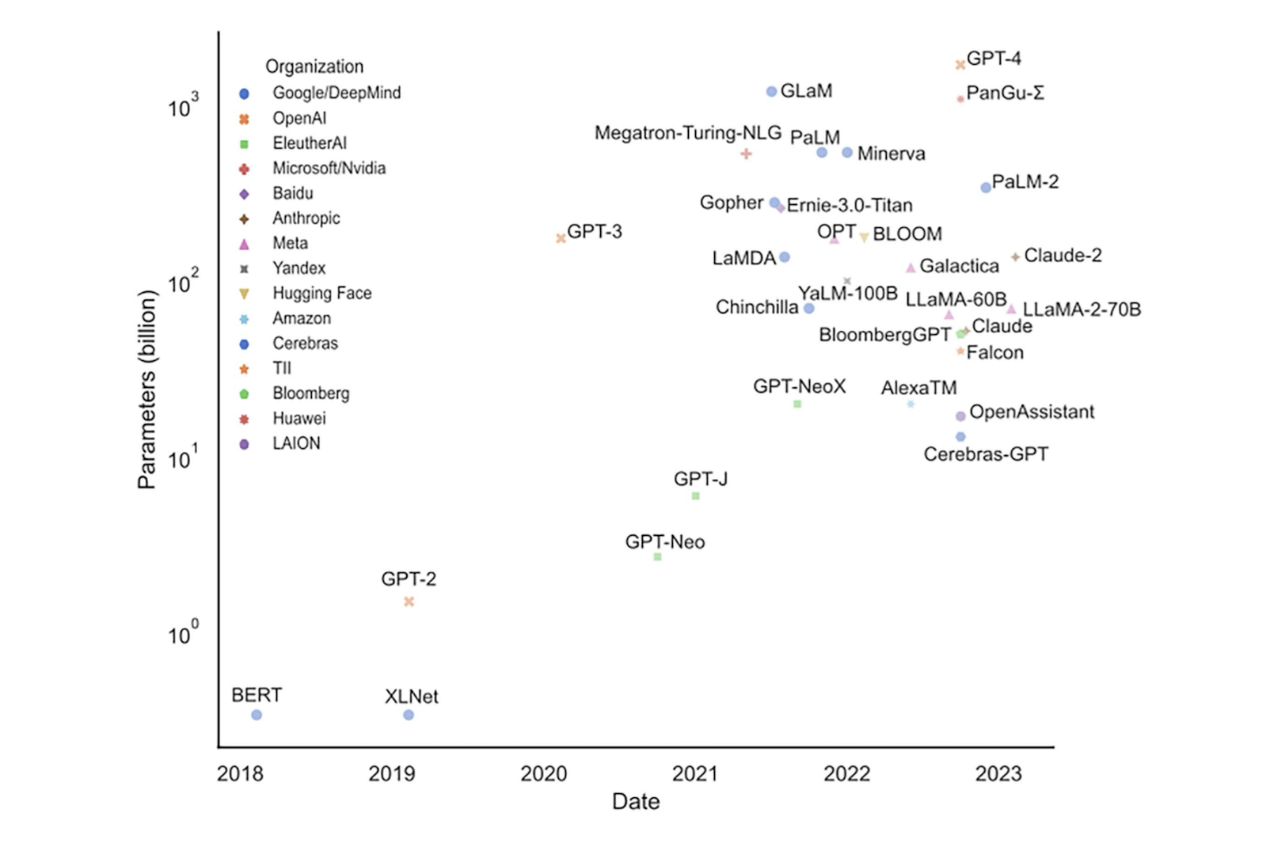
POPULAR MODELS

Slide 55
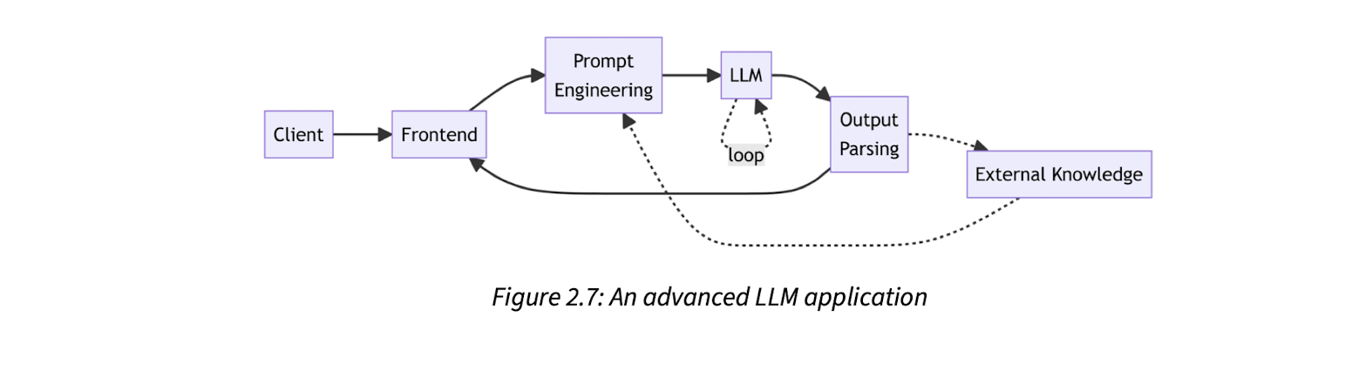

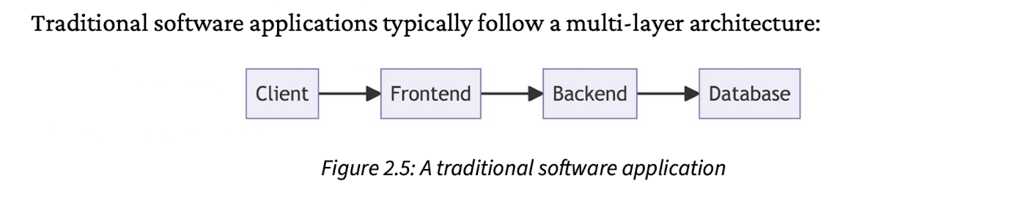
LLM APPLICATION

Slide 56
CHATBOT

Slide 57
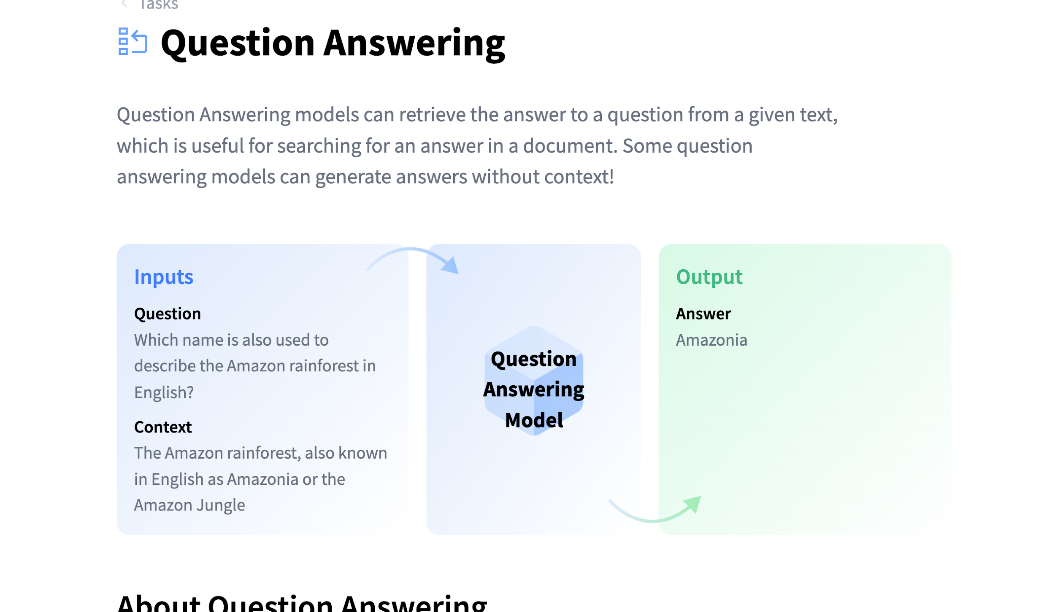
WHAT DO CHATBOTS DO

Slide 58
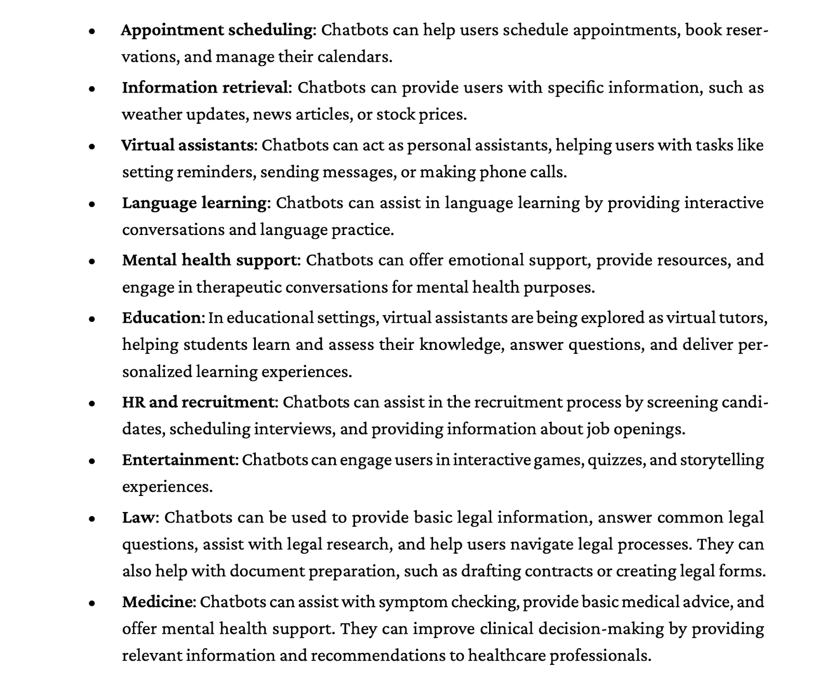
CHATBOT APPLICATIONS

Slide 59
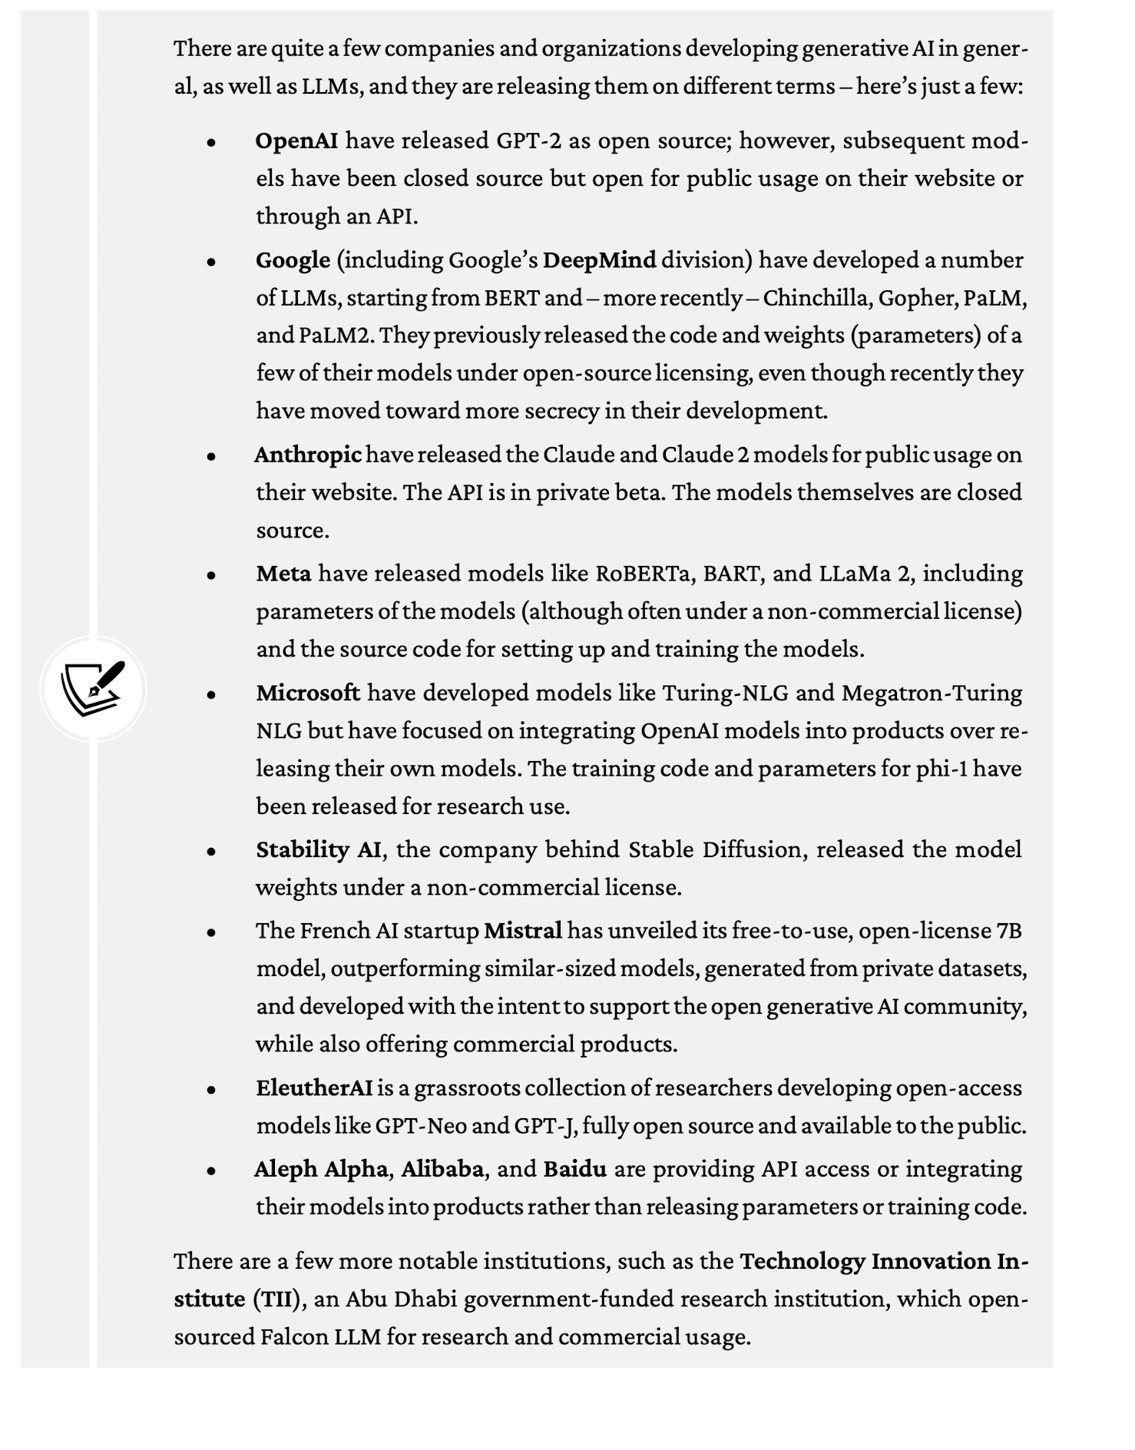
MAJOR PLAYERS

Slide 60
WHO ARE TOP PLAYERS IN LLM
OpenAI
Google
Anthropic
Microsoft
Replicate
IBM …

Slide 61
WHAT CAN GENERATIVE AI MODELS DO

Slide 62
BUILDING LLM APPS

Slide 64
AI JARGON

Slide 65
CHATBOT APP DEV – PART 1
WEB ARCHITECTURE AND SCRAPING

Slide 66
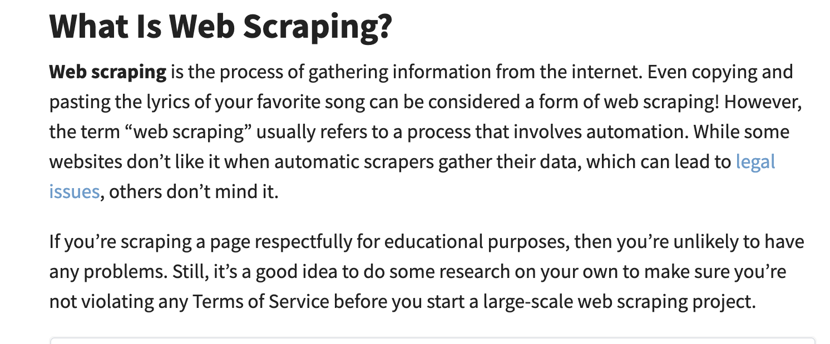
WEB SCRAPING

Slide 67
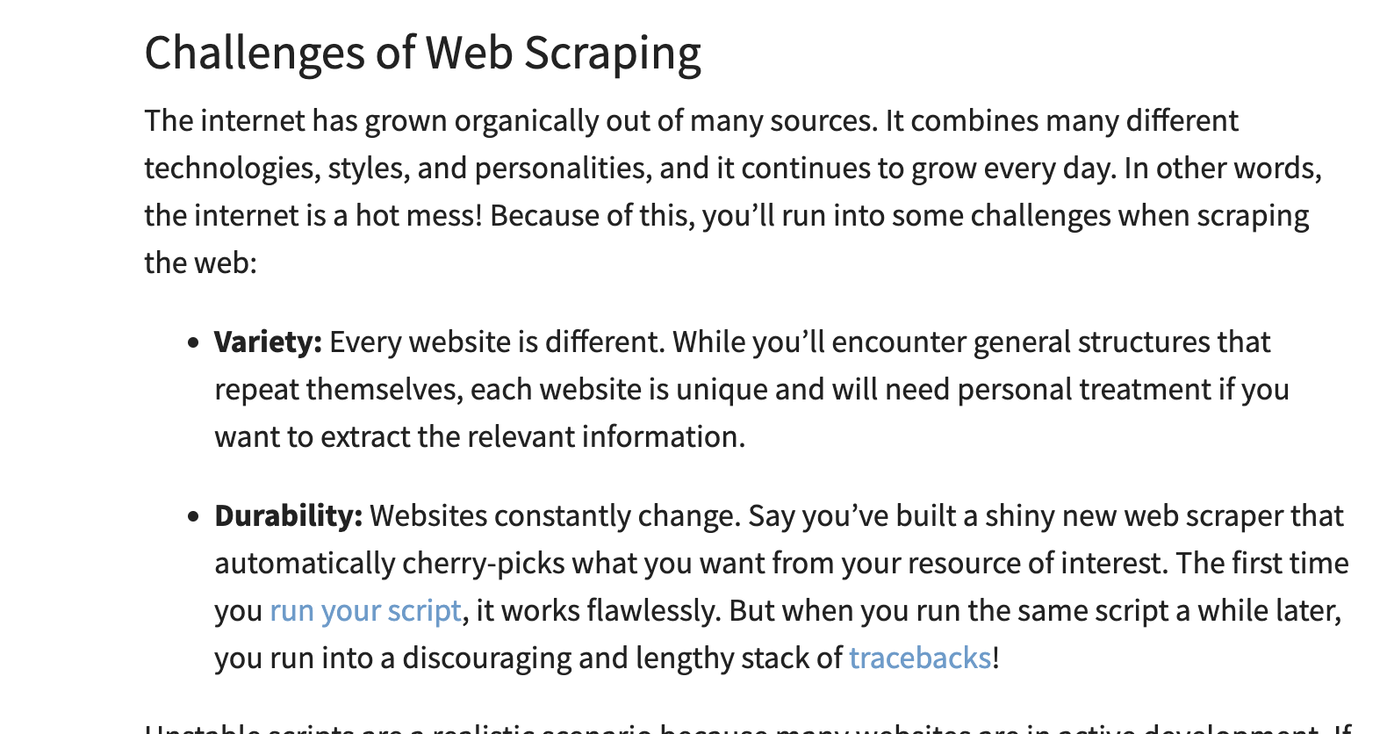
CHALLENGES WITH WEB SCRAPING

Slide 68
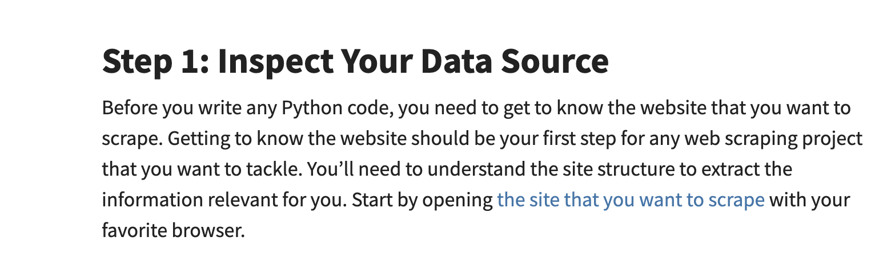
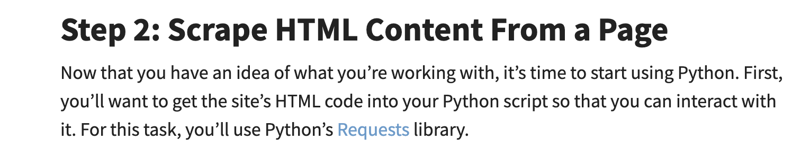
SCRAPING A WEB SITE

Slide 69
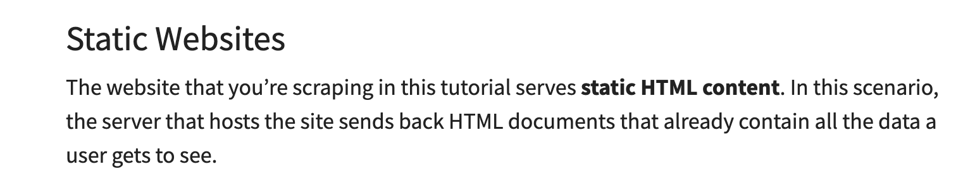
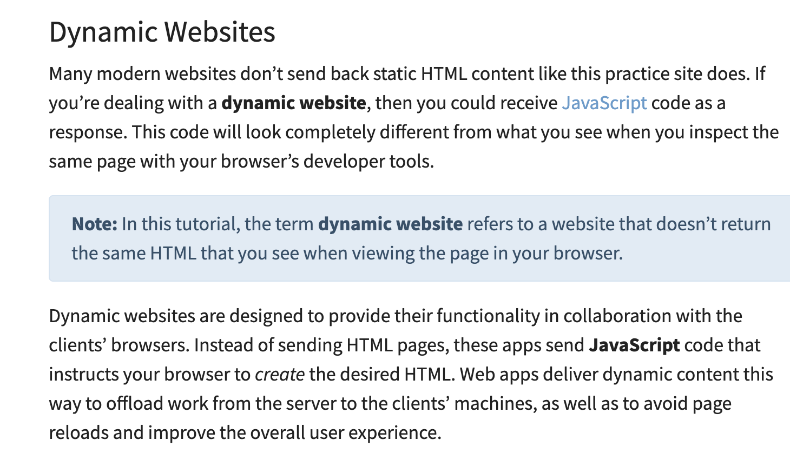
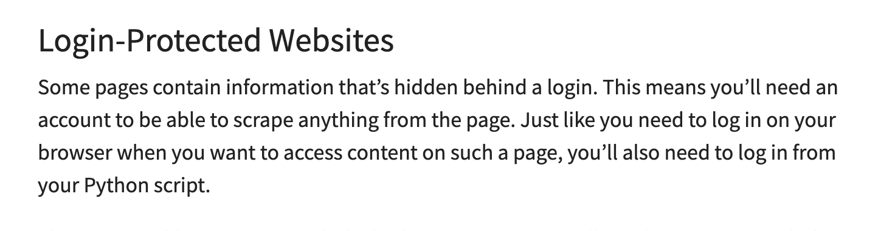
SCRAPING A WEB SITE

Slide 70
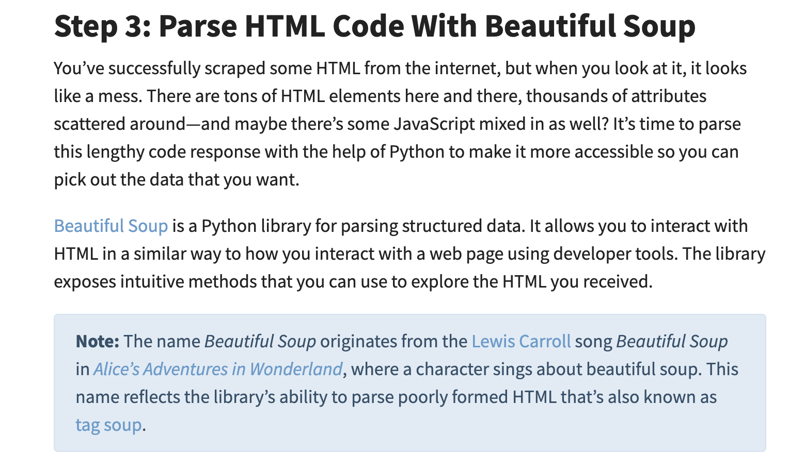
BEAUTIFUL SOUP!!!!

Slide 71
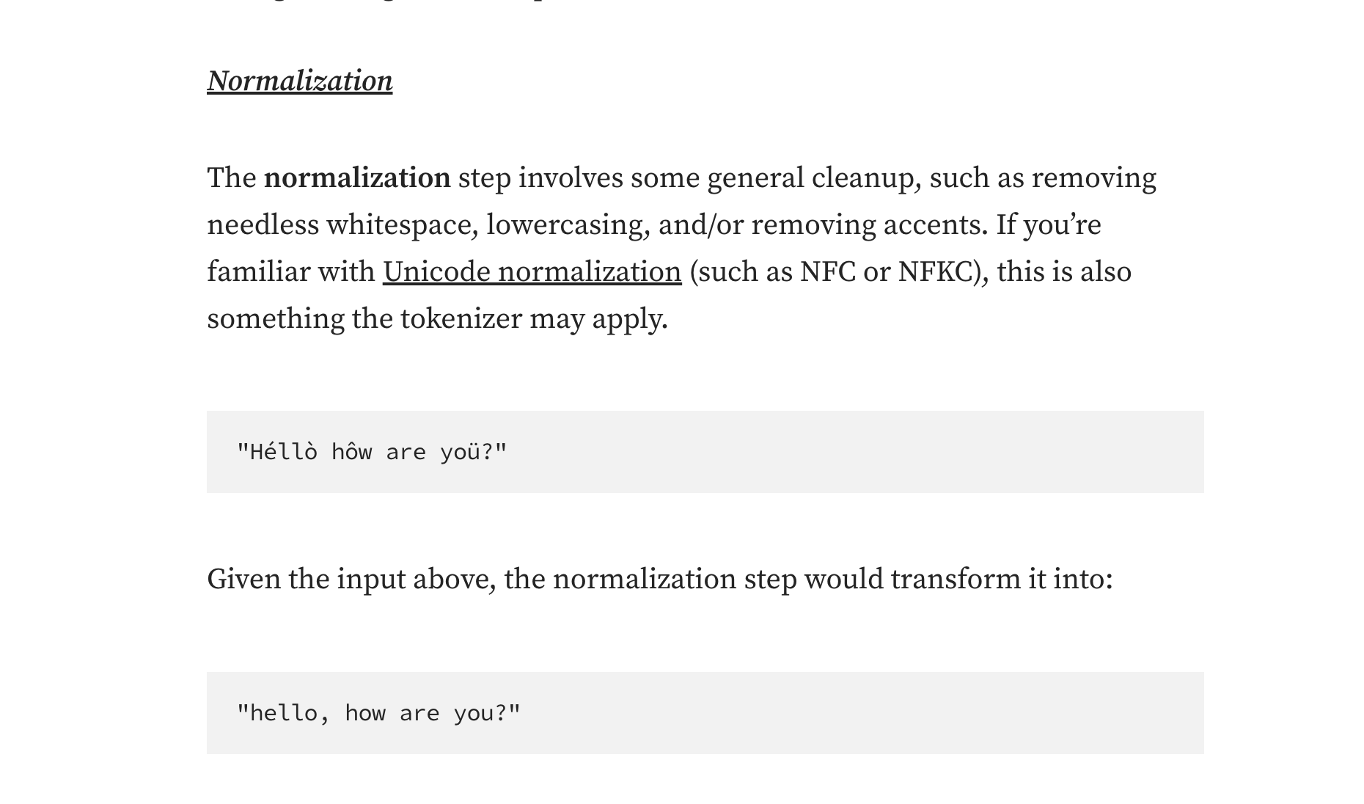
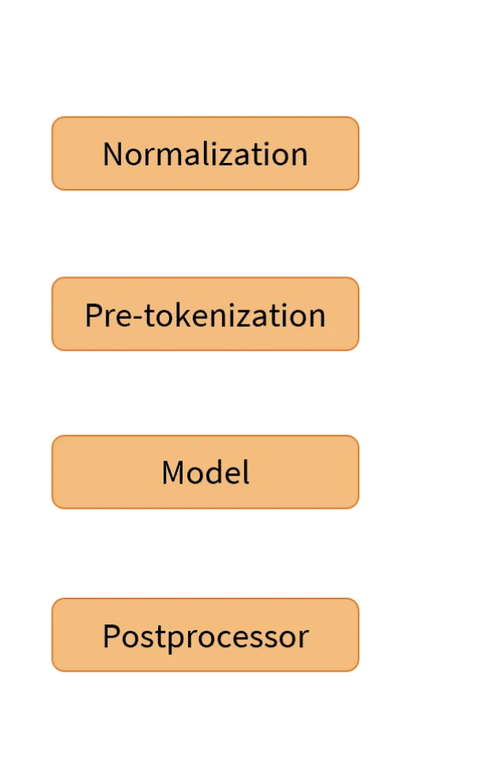
TOKENIZER - PIPELINE

Slide 72
CHATBOT APP DEV – PART 2
USING HUGGING FACE MODELS

Slide 73
APPLICATION PIPELINE

Slide 74
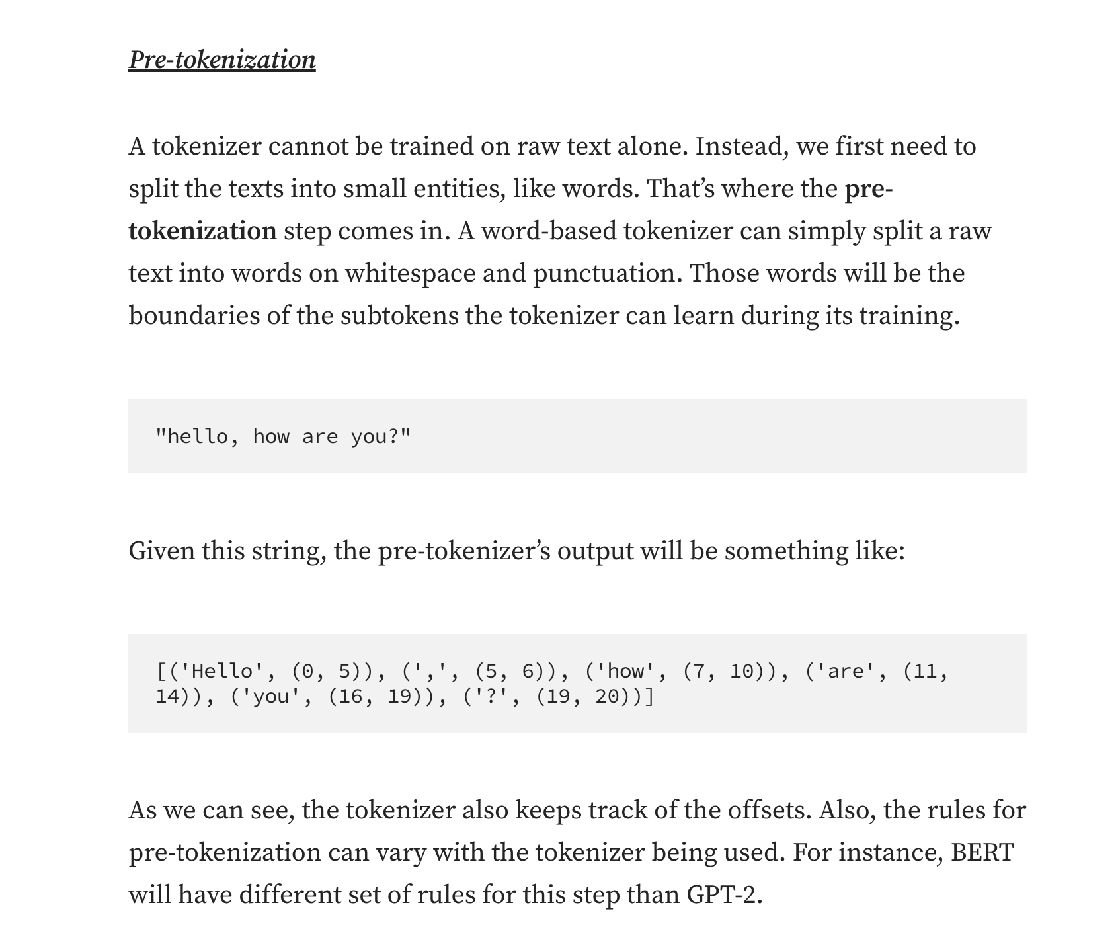
TOKENIZER - PIPELINE

Slide 75
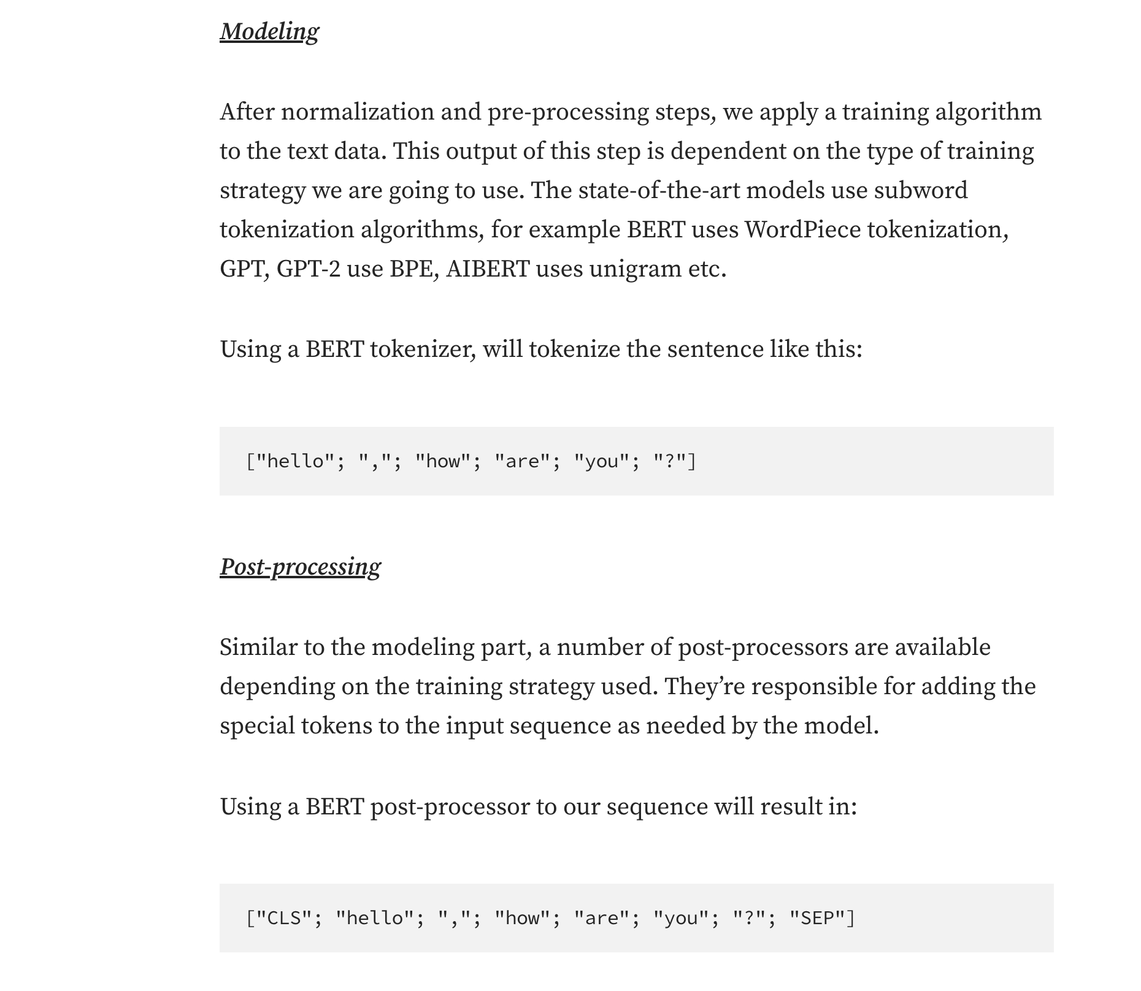
TOKENIZER - PIPELINE

Slide 76
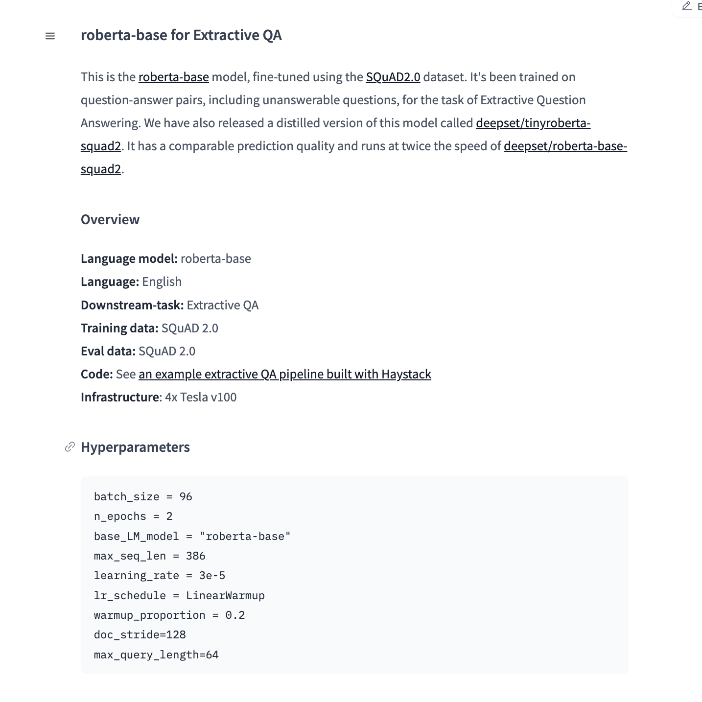
MODEL SELECTION
https://huggingface.co/models?pipeline_tag=question-answering&sort=downloads
Question Answering
Text2text
https://huggingface.co/meta-llama/Llama-3.3-70B-Instruct
https://discuss.huggingface.co/t/trying-to-understand-system-prompts-with-llama-2-and-transformers-interface/59016
https://huggingface.co/sjrhuschlee/flan-t5-large-squad2
https://huggingface.co/microsoft/phi-4

Slide 77
GRADIO
Quickstart
Gradio is an open-source Python package that allows you to quickly build a demo or web application for your machine learning model, API, or any arbitrary Python function. You can then share a link to your demo or web application in just a few seconds using Gradio's built-in sharing features. No JavaScript, CSS, or web hosting experience needed!
https://www.gradio.app/guides/creating-a-chatbot-fast
https://www.gradio.app/guides/quickstart

Slide 78
AI CHATBOT CLASS INTRO

Slide 79
AGENDA
Introduce yourself
Explain what you wish to achieve from the course
Explain your level of familiarity with AI
How comfortable are you with Python
Modern AI Basics
HuggingFace Playground
Model – types, data, results, control parameters
Building a simple bot
GPT2 Model
Under 10 lines of code
Publish on HuggingFace Spaces
Boot camp details

Slide 80
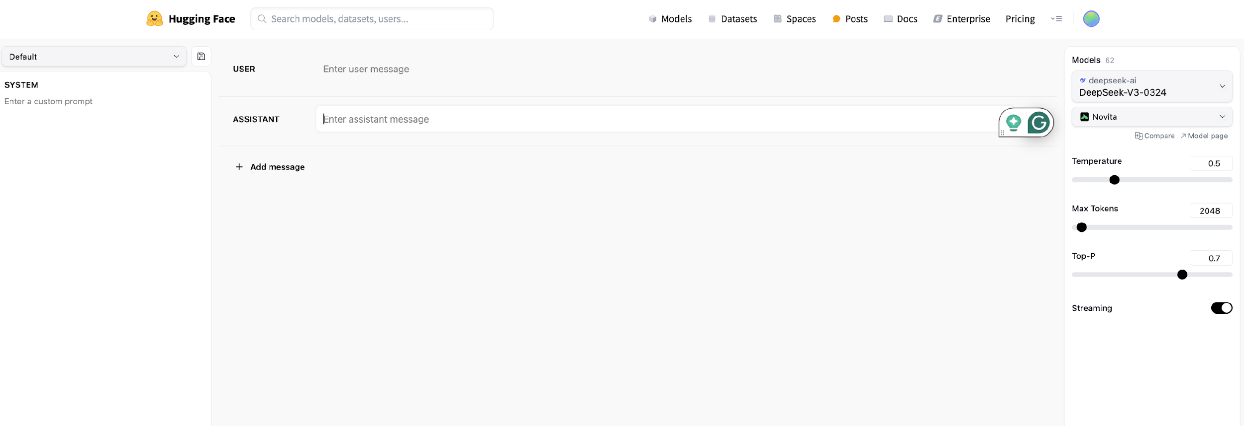
HF PLAYGROUND
Role
User
Assistant
System
Temperature
Max Tokens
Top-P
Streaming

Slide 81
AI MODEL FLOW
Data
Question
Start of a sentence
Role
Temperature
Top-P
Output length
Parameters
Model
Type
Task

Slide 82
ROLES
messages=[
{"role": "system", "content": "<instructions>"},
{"role": "user", "content": "<User query>"},
{"role": "assistant", "content": "<response>"},
]
System role: Allows you to specify the way the model answers questions. Classic example: “You are a helpful assistant.”
User role: queries made by the user.
Assistant role: model’s responses (based on the user messages)

Slide 83
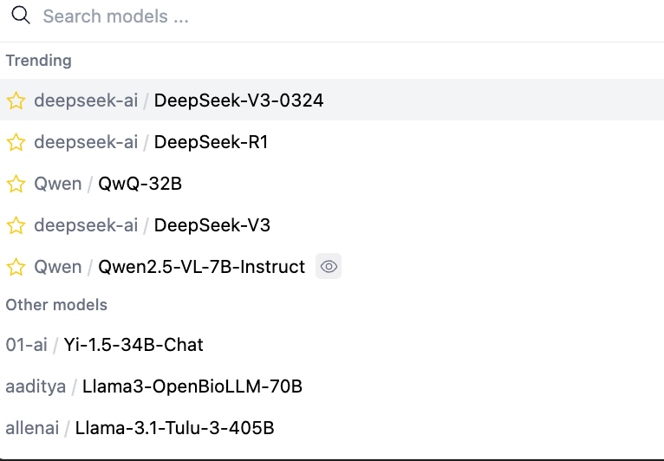
MODELS
Deepseek
Qwen
Llama

Slide 84
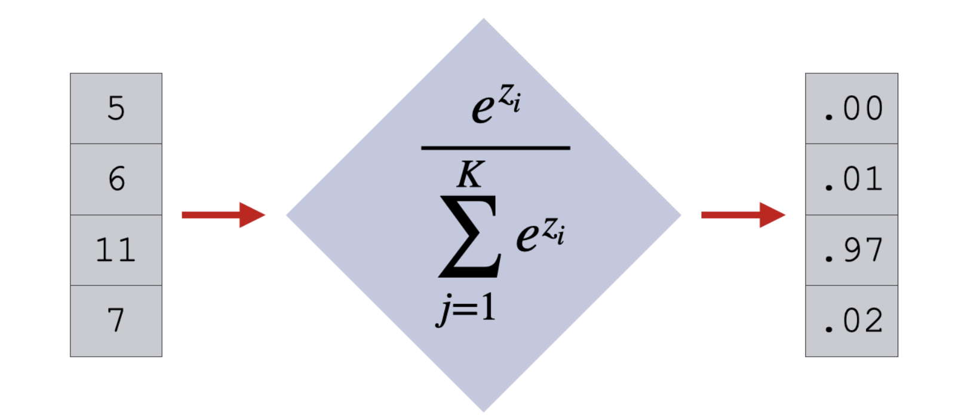
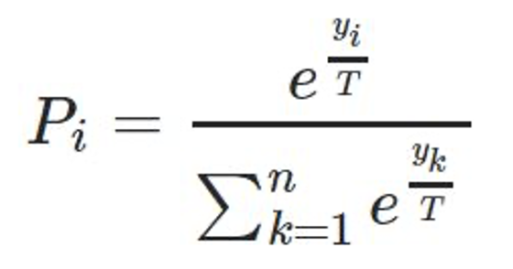
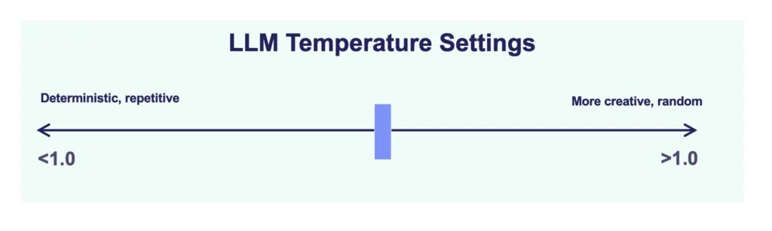
TEMPERATURE (T)
>

Slide 85
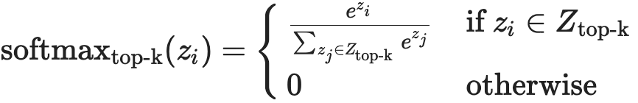
TOP-P =
Temperature should be the first place to start when tuning a language model. It’s an intuitive scaling factor that applies to all tokens, where higher temperatures lead to more creative output, and lower temperatures result in more predictable output. The choice will really vary on how much creativity you need in your task. Gemini models currently provide a temperature range from 0–1, or 0–2, each with different default values.
If more adjustment is needed, top-p is then recommended as the next step. By using a cumulative probability threshold p, this sampling method dynamically selects the most likely tokens, ensuring their combined probability reaches or exceeds p. When the breadth of possible tokens is unknown, top-p is less likely to exclude potentially valuable tokens than a fixed value k used in top-k sampling. Top-p will range from 0–1, and it’s recommended to start with a value closer to 1, e.g. 0.9, and adjust downward. Note that the default setting in Gemini 1.5 Pro is 0.94. After you adjust top-p, you could take one more pass to optimize temperature, and finally top-p once more.

Slide 86
STREAMING VS NO-STREAMING
No-streaming
All token appear at once
Streaming
One token at a time
Latency
Length of response

Slide 87
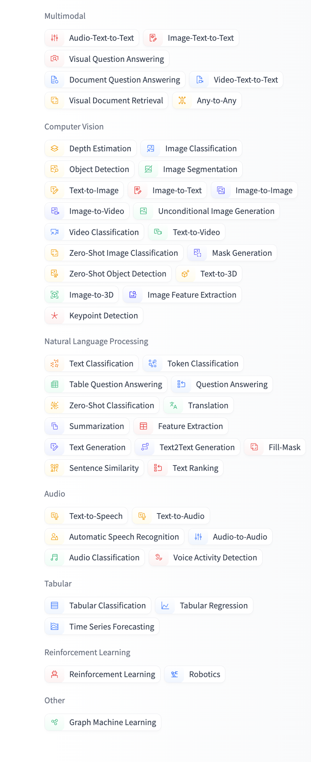
MODELS
Multimodal
Computer Vision
Natural Language Processing
Audio
Tabular
Reinforcement Learning

Slide 88
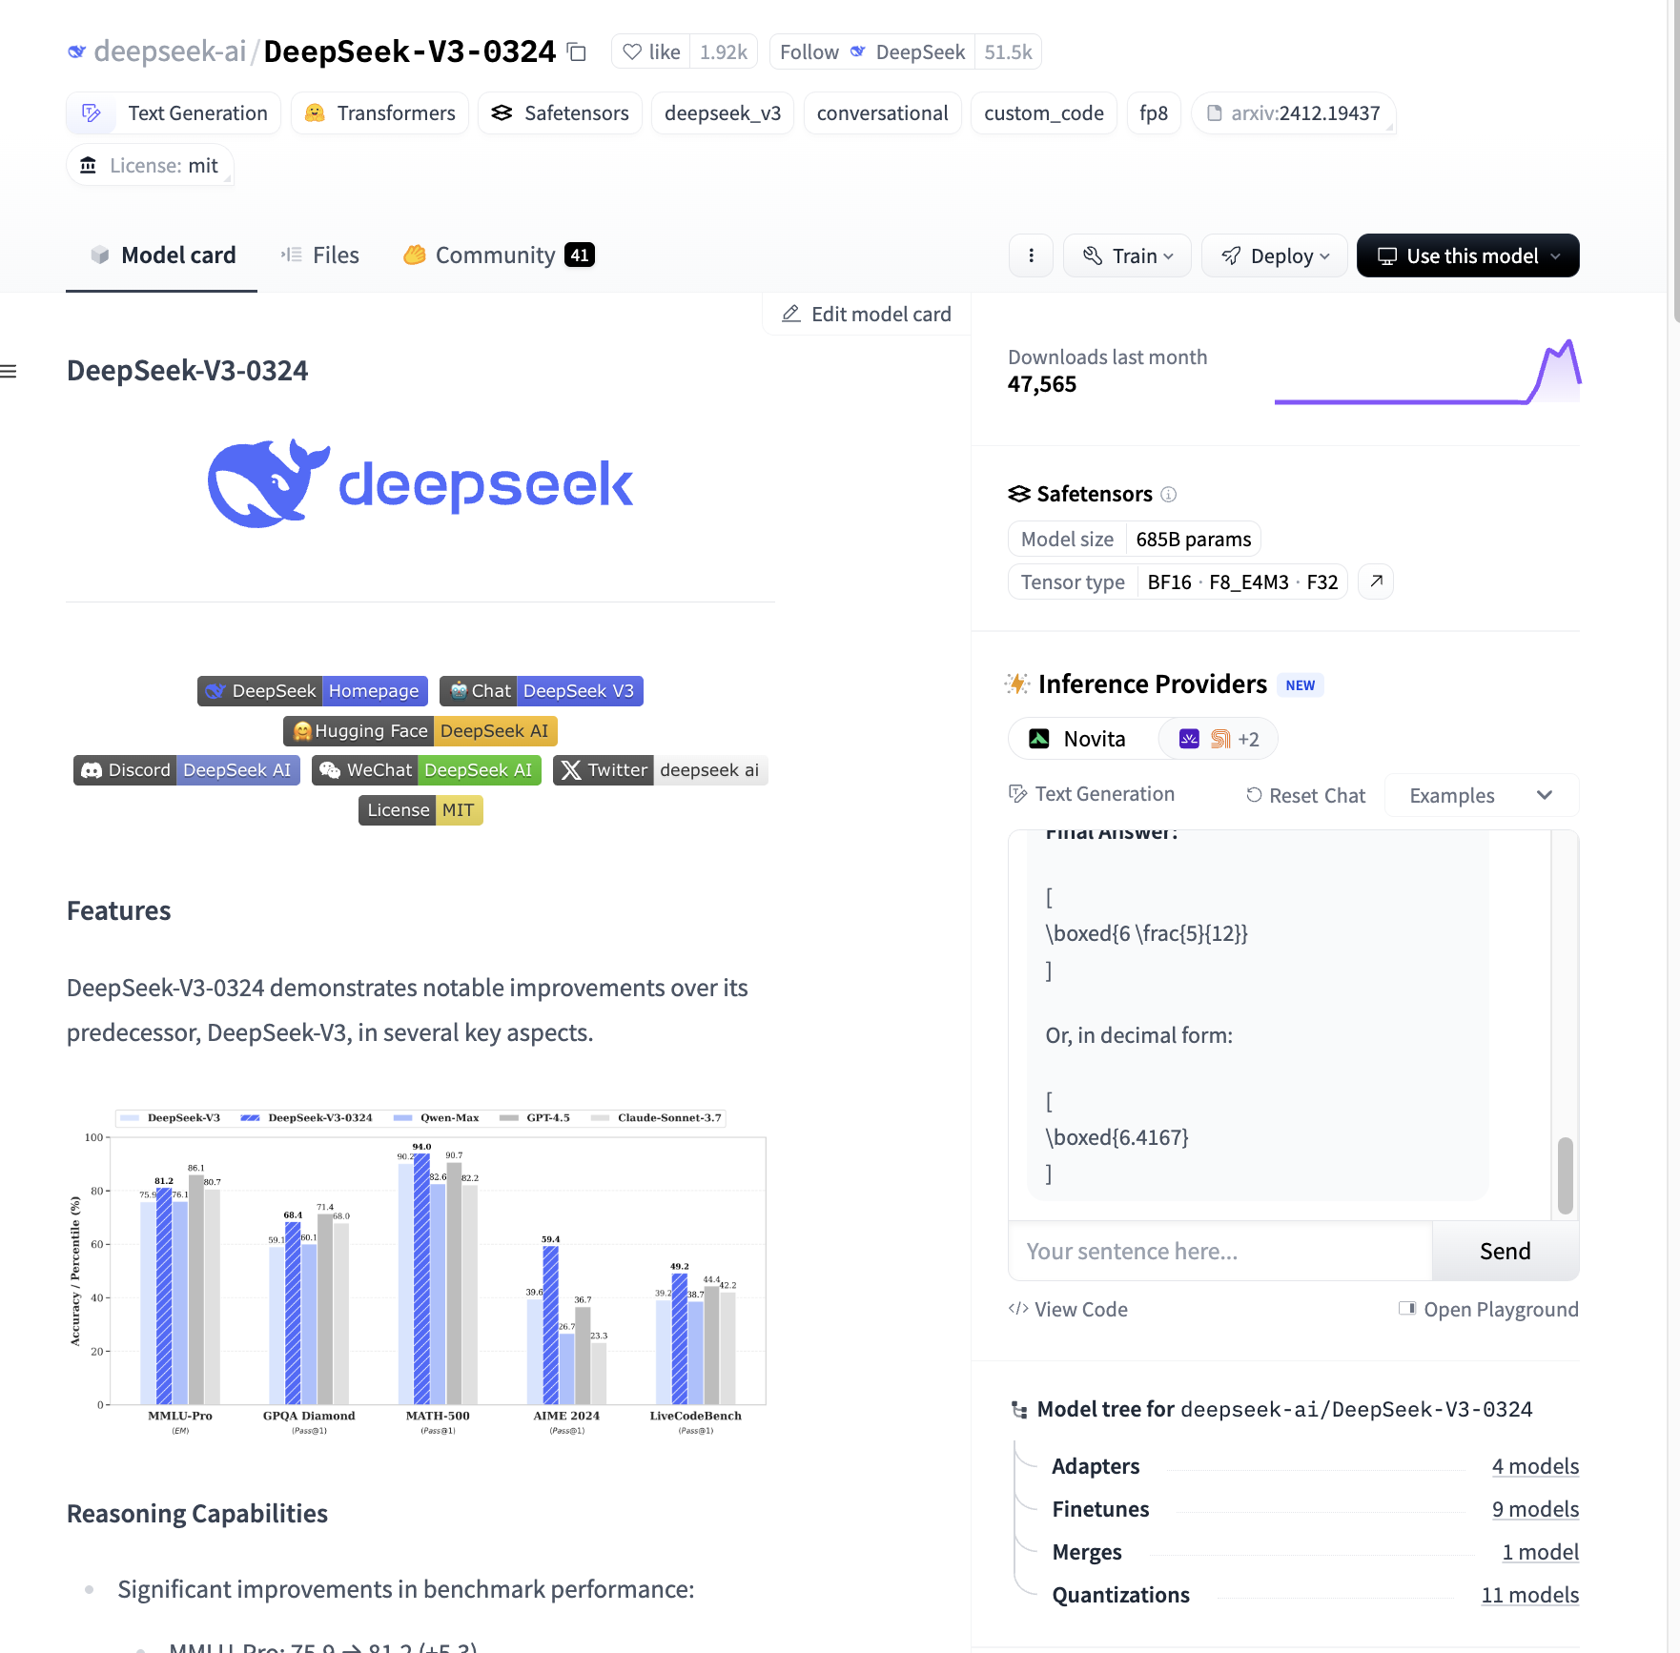
TEXT GENERATION
200K+ models
Deepseek
Qwen
Llama
Mistral
Phi
Gemma
Model Size – 685 billion
Tensor Type BF16, F8, F32
FineTunes – 9
Quantizations - 11
Dataset

Slide 89
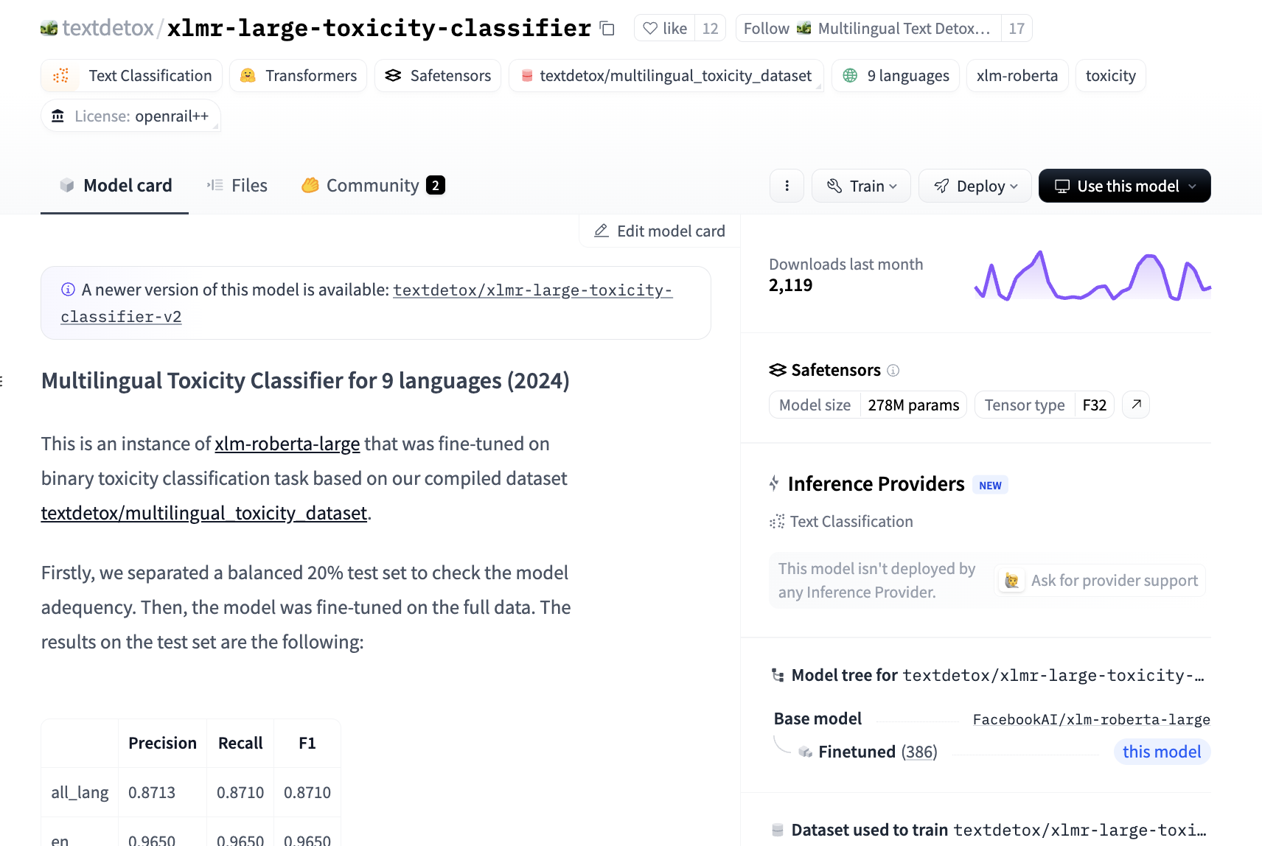
TEXT CLASSIFICATION
90K+ models
Finbert
Emotion-text-classifier
Hallucination-evaluation-model
Sentiment analysis
Tone detector
Toxicity classifier

Slide 90

QUESTION ANSWERING
Roberta-base-squad
PatientSeek
Indobert-QA

Slide 91
A SIMPLE CHATBOT IN LESS THAN10 LINES
HuggingFace Spaces – for compute hardware
Python – for coding
HuggingFace Transformer library – for model
Gradio – for user interface
GPT2 – AI model
Task – Generate a short story starting with the words (text generation)
Max length of the story - customizable

