Slide 1


MYSORE UNIVERSITY SCHOOL OF ENGINEERING Manasagangotri Campus, Mysore (Approved by AICTE, New Delhi) DEPARTMENT OF ARTIFICIAL INTELLIGENCE AND DATA SCIENCE
A PRESENTATION OF
MINI PROJECT
(21ADP67)
ON
Revolutionizing Database Interaction using
Agentic AI.
PRESENTED BY, UNDER THE GUIDANCE OF,
RANJAN U
ROHTIH DS
SUDHANVA H KASHYAP
Dr. Sayeda Umera Almas
ASST. PROFESSOR
MUSE.

Slide 2
Chapter 1
Introduction to Agentic AI for Databases
1
2
3
Database Complexity
Natural Language Gap
Agentic AI Solution
Traditional querying is complex.
Users prefer simple language.
Intelligent agents automate tasks.
Requires SQL expertise.
AI bridges this gap.
Ensures accuracy, efficiency.

Slide 3
Chapter 2
Current Challenges in NL-to-SQL
Natural language database querying faces significant hurdles:
Ambiguity in user intent.
Schema Understanding Issues.
Complex Query Generation.
Ensuring SQL Correctness.
Handling Dynamic Contexts.

Slide 4


Chapter 3
Multi-Agent Architecture Overview
Our system employs a sophisticated multi-agent architecture:
Multi-LLM Core
RAG-Based Retrieval
Orchestrates Gemini, Codestral
& DeepSeek R1.
ChromaDB for Schema Knowledge.
Efficient context retrieval.
LangGraph Workflow
Verification Layer
Orchestrates agent interactions.
Production-grade correctness.
LangGraph Memory, Validation, Sequential/Cyclic

Slide 5






Chapter 4
Implementation Flow
A visual representation of the key stages in our system's implementation:
Data Scraping
Automated collection of relevant knowledge from diverse sources.
Schema Preprocessing
Structuring and refining database schemas for efficient RAG integration.
Agent Coordination
Designing the intelligent logic for agents to interact and collaborate effectively.
Multi-LLM Integration
Seamlessly combining various Large Language Models for enhanced capabilities.
LangGraph Flow Control
Implementing robust workflows to manage agent interactions and decision-making.
Streamlit UI
Developing an intuitive user interface with Grok design principles for optimal experience.

Slide 6
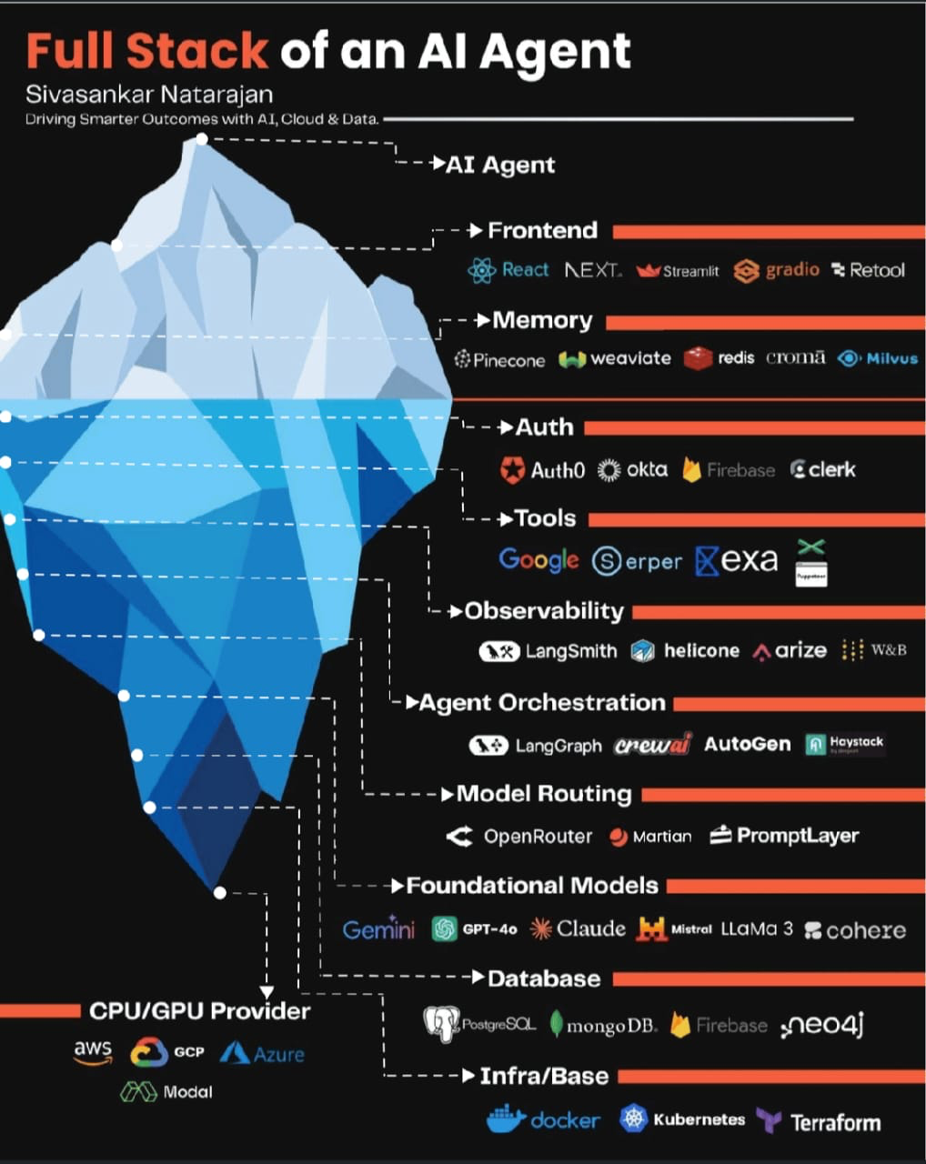
What is Agentic AI ?

Slide 7
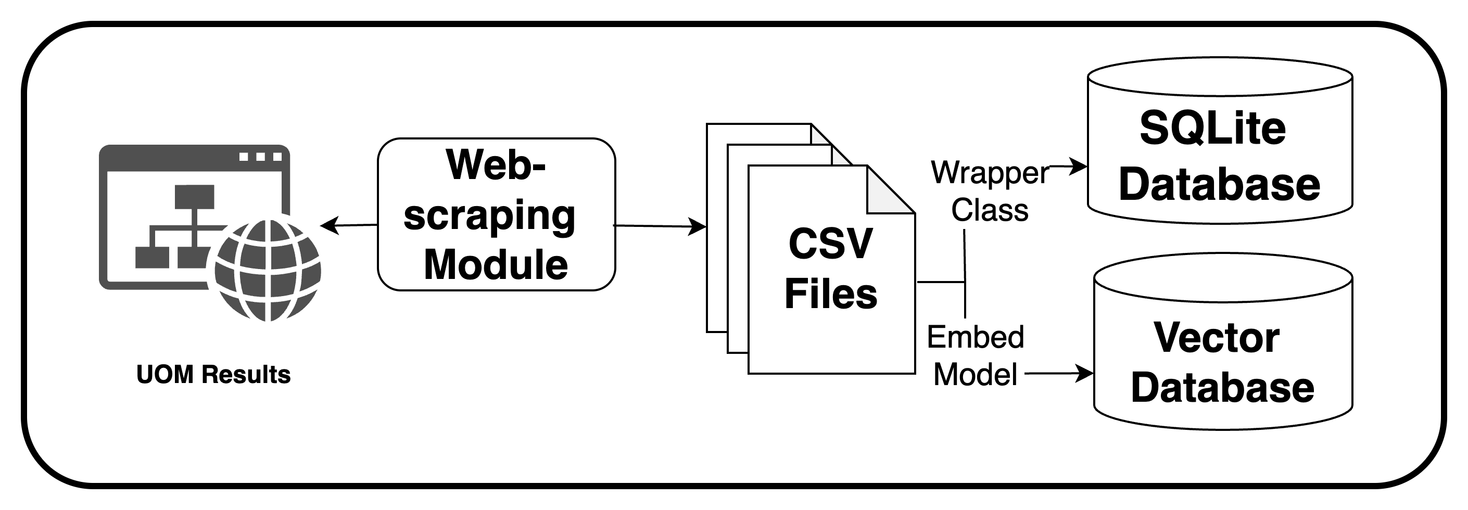
Chapter 5
Data Creation Pipeline.
Selenium Module
CSV files to SQLite Database
Chroma DB for Vector Database
Embedding model for vector generation

Slide 8
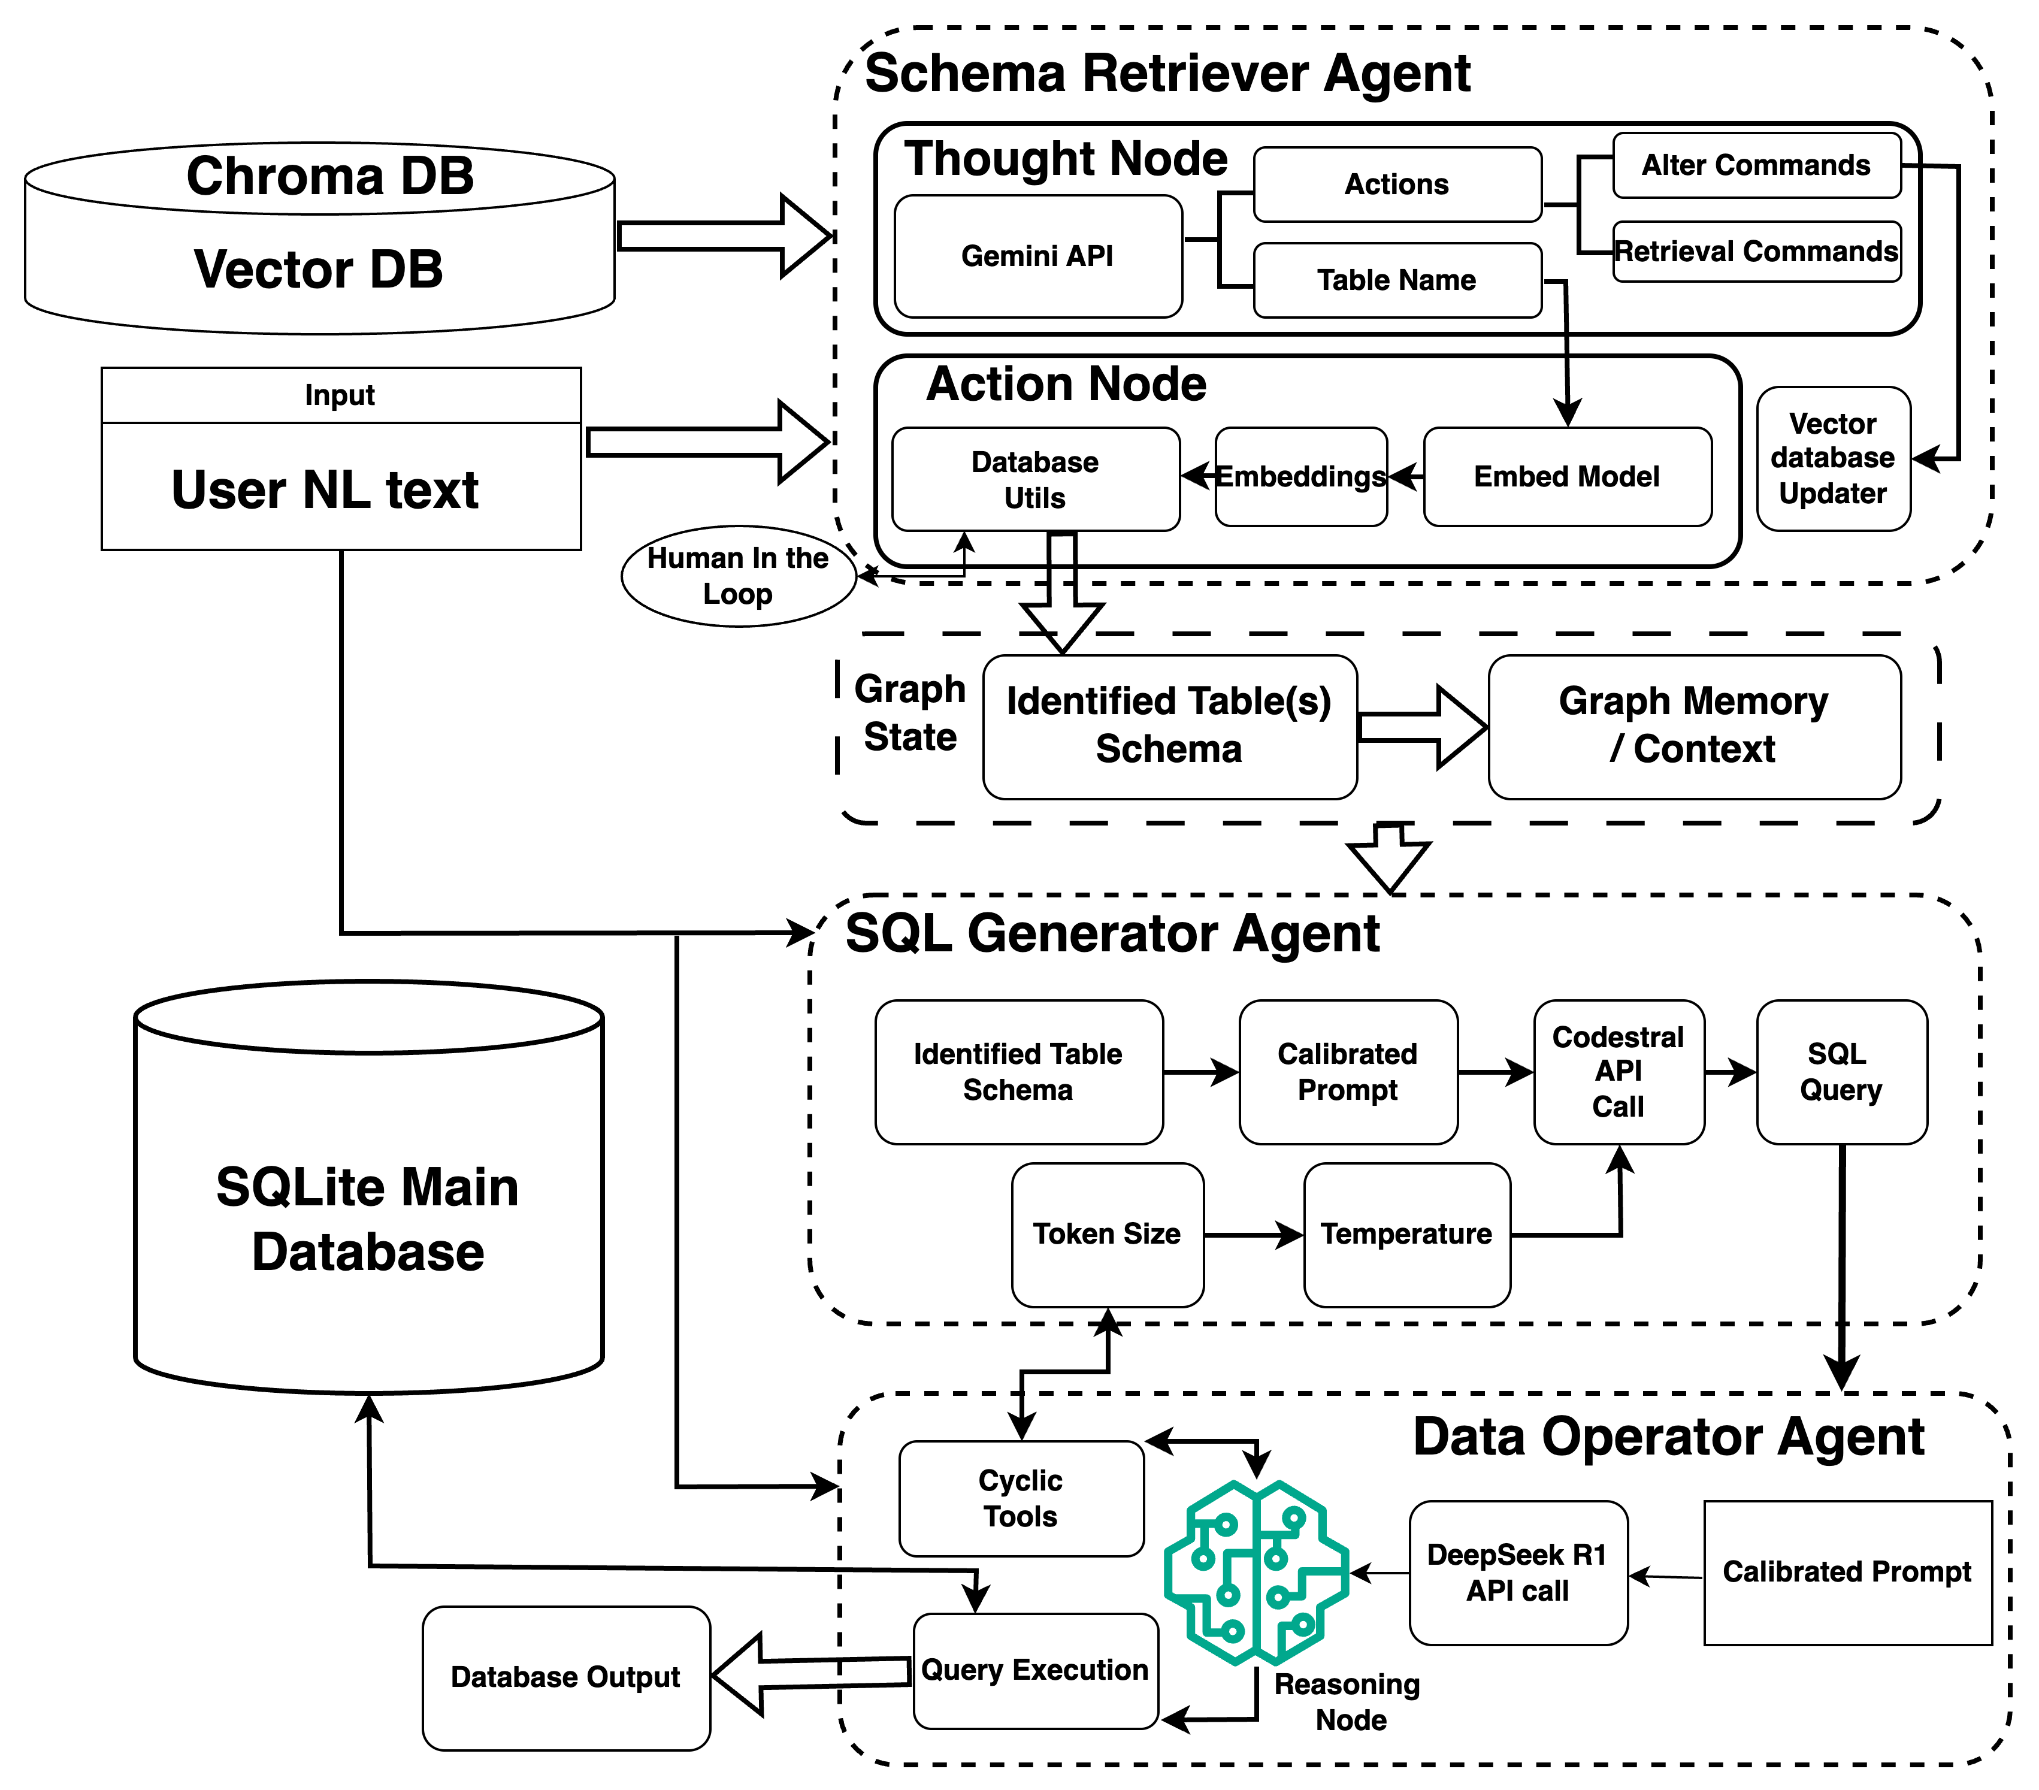
Chapter 6
Agent Architecture: NL to SQL

Slide 9
Chapter 7
Hardware & Software Requirements
GPUs
Ample RAM & Storage
Vector database needs.
Minimum System Requirements with no GPU requirements.
Model loading memory.
Python Ecosystem
CPU
Key libraries: LangChain.
Modern CPU recommendation for:
Streamlit for UI.
Faster Vector Indexing

Slide 10

Chapter 8
User Interface Effectiveness
Intuitive conversational interface.
Grok Style Minimalistic Design.
Real time surfacing of LLM Reasoning.
Human in the loop intervention in Agentic Work-Flow.

Slide 11



Chapter 9
Conclusion & Future Work
Key Takeaways
Agentic AI transforms database access.
Enhanced accuracy, user experience.
Future Enhancements
Integrate VL models.
Adaptive agent routing.
Next Steps
Expand to more databases.
Develop advanced features.

