Slide 1
RESEARCH PARTNERSHIP PROPOSAL / 14 OCTOBER 2026
Bayesian Relativities
× Mobility Insurance Profit Testing
A worked, auditable KES illustration for mobility fleets, insurance partners and driver outcomes
Illustrative synthetic case · 100 vehicles · 12 months
Prepared from the Bayesian Relativities paper and its reproducible research case
Notes:
Opening: this is a research partnership proposal, not an offer, quote, or claim about Moove’s own performance. All KES results are synthetic. The public Moove context is cited in the notes and in the source slide.

Slide 2
PARTNERSHIP QUESTION
Can risk, uptime and driver cash improve together?
The proposed work joins actuarial evidence with vehicle operations and driver economics.
01
Risk
How can exposure, claims and vehicle-use data produce credible estimates of expected loss with useful uncertainty?
02
Intervention
Which combination of insurance design, safety support, repairs and incentives changes outcomes over time?
03
Profit test
How do claim development, reinsurance, capital, operating costs and customer cash shape full-term value?
Research partnership proposal · Illustrative synthetic KES case · 14 Oct 2026
02
Notes:
These three questions structure the article and proposed collaboration. They separate estimation, intervention evaluation and commercial sustainability. Sources: [1]–[7] in the source notes.

Slide 3
PUBLIC OPERATING CONTEXT
Moove’s public mobility context motivates a test
Public product and CGAP material motivate the question; the case uses synthetic KES assumptions.
Public product context
Research motivation
Moove UK describes vehicle access with weekly payments and packages that include insurance and servicing. Market, contract and payer determine the actual economics.
A 2023 CGAP study discusses use of gig-work data in expanding access to credit and includes Moove. That motivates careful evidence design for mobile work.
What is proposed: test whether exposure-normalised insurance estimates, service reliability and driver outcomes can be assessed together using a jointly defined market and dataset.
UK public example
Kenya KES case
Synthetic KES illustration
Sources: CGAP [1]; Moove UK Customer Hub [2]; Moove UK Privacy Policy [3].
Research partnership proposal · Illustrative synthetic KES case · 14 Oct 2026
03
Notes:
The public sources establish the business context and publicly described data classes. They do not establish current terms for a different market, insured portfolio results, pricing, driver outcomes or causal effects. A partner would select the target market and appropriate insurer/product. [1] M. Anand and G. Murthy, CGAP, 2023. [2] Moove UK Customer Hub. [3] Moove UK Privacy Policy.

Slide 4
RESEARCH ARCHITECTURE
Three workstreams connect into a Moove test
Each workstream supplies a distinct analytical input.
Bayesian
Relativities
Mwendo
Pamoja
Underwrite for
Collection
Potential
Moove application
Expected loss, exposure,
posterior uncertainty
Vehicle operation, finance,
receivables and downtime
Decision timing, experiments,
servicing and realised cash
Market-specific insurance,
operations and driver outcomes
Explicit data definitions, decision rights and outcome measures connect model evidence to approved market decisions and customer terms.
Research partnership proposal · Illustrative synthetic KES case · 14 Oct 2026
04
Notes:
This is a proposed research architecture. Bayesian Relativities estimates risk distributions; Mwendo Pamoja connects financing and vehicle operating flows; Underwrite for Collection contributes evidence governance and intervention evaluation. The Moove lane denotes a possible application, subject to partnership and local terms. Sources: Bayesian Relativities paper [5]; Underwrite for Collection and Mwendo materials supplied in the shared project corpus.

Slide 5
ACTUARIAL MODEL
Price expected loss from exposure, frequency and severity
Keep exposure, underlying expected loss and commercial premium visible as separate quantities.
ELᵢₜ = Eᵢₜ × λ₀ × θᵢₜ × μ₀ × ωᵢₜ + Lᵢₜ⁽non-drive⁾
Exposure
Frequency
Severity
Expected loss
km / covered days
claims per unit
cost given claim
risk estimate
Commercial premium = expected loss + claim / operating expense + reinsurance + capital + tax + approved margin
qᵢ is an exposure-normalised risk relativity; the insurer applies it within approved premium terms and profit tests.
Research partnership proposal · Illustrative synthetic KES case · 14 Oct 2026
05
Notes:
Equation terms: E is insured exposure; λ₀ is base claim frequency; θ is a frequency relativity; μ₀ is base severity; ω is severity relativity; L(non-drive) represents separately modelled non-driving expected losses. The specific model permits frequency–severity dependence, so joint posterior draws are used where appropriate. [4] Lee and Shi, 2019; [5] Bayesian Relativities paper.

Slide 6
POSTERIOR DESIGN
Partial pooling supports credible risk estimates
Cohort experience informs individual estimates as relevant exposure and mature claims accumulate.
Frequency model
Severity is modelled separately, then combined with frequency draws.
Nᵢ | θᵢ ~ Poisson(Eᵢ λ₀ θᵢ)
Group structure enables partial pooling across driver, vehicle, territory and time.
θᵢ ~ Gamma(a, b)
θᵢ | Nᵢ,Eᵢ ~ Gamma(a + Nᵢ, b + Eᵢ λ₀)
Review outputs include posterior intervals and future-claim predictive ranges.
Useful outputs: calibrated relativities · exposure support · posterior uncertainty · predictive loss · refresh lineage
Research partnership proposal · Illustrative synthetic KES case · 14 Oct 2026
06
Notes:
The frequency illustration uses Gamma–Poisson conjugacy. Severity updates use the case’s inverse-Gamma/Gamma model. Partial pooling links individual experience to group-level information; the credible interval describes uncertainty in underlying expected loss, while a predictive interval additionally includes random future claims. This supports human review with distributions, not just a point score. [5]–[7].

Slide 7
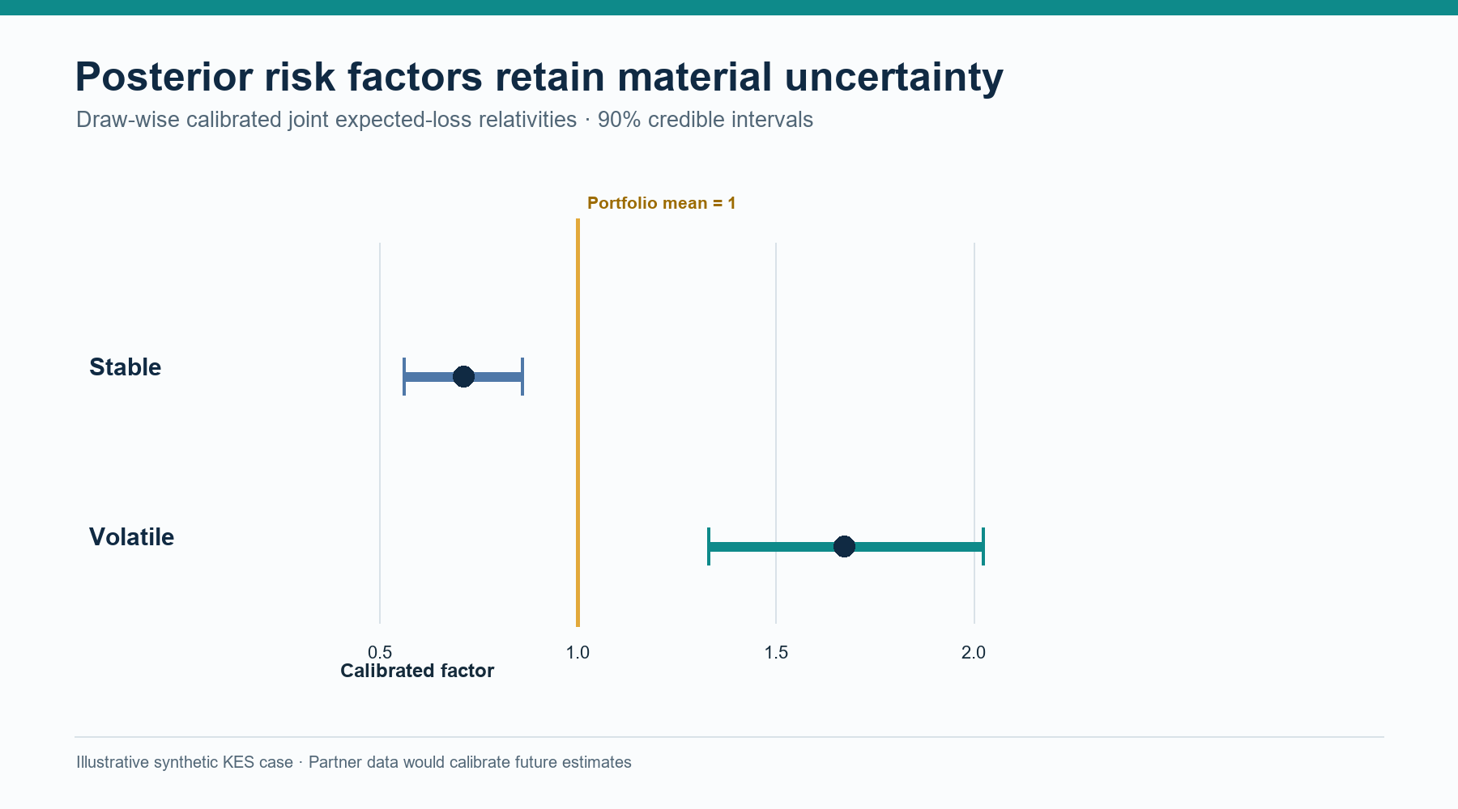
POSTERIOR RESULTS
Credible intervals show group risk and uncertainty
Draw-wise calibrated joint expected-loss relativities · synthetic 100-vehicle case
Stable cohort
0.711 factor
90% CrI: 0.561–0.859
Volatile cohort
1.674 factor
90% CrI: 1.329–2.023
The intervals quantify model uncertainty; future claims also vary around expected loss.
Research partnership proposal · Illustrative synthetic KES case · 14 Oct 2026
07
Notes:
The posterior means are frequency factors 0.7843 / 1.5401 and severity factors 0.9462 / 1.1340. Joint factors are calibrated draw-wise to a portfolio mean of one. Reported 90% intervals: stable 0.561–0.859; volatile 1.329–2.023. These are synthetic case results based on selected priors and claim summaries; they are not Moove pricing indicators. Sources: Bayesian Relativities paper [5], Belhadj et al. [6], Bühlmann [7].

Slide 8
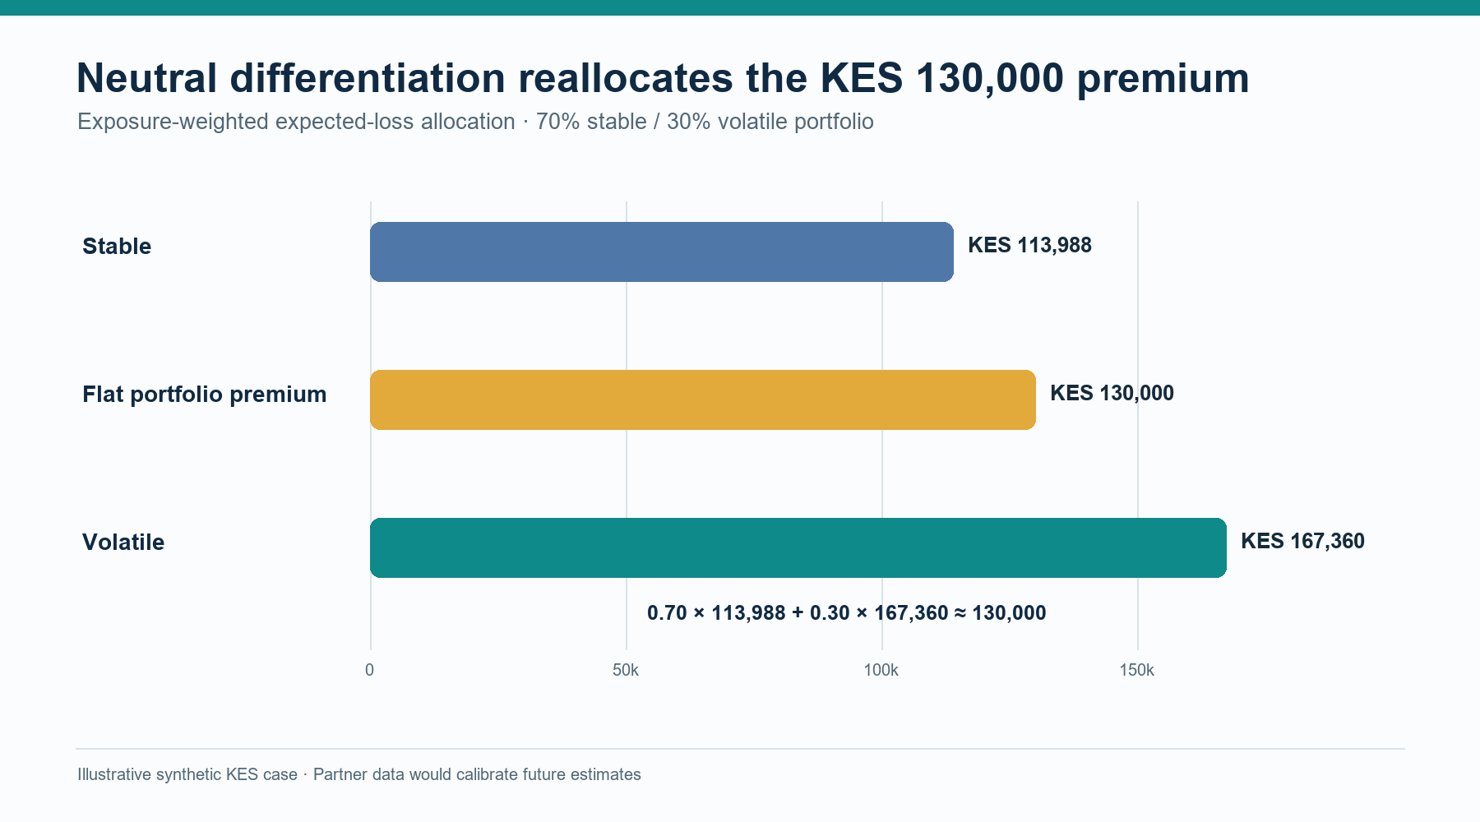
TARIFF INTERPRETATION
Neutral rates change allocation, not total loss
Exposure-weighted average stays KES 130,000; the commercial layer is held constant in this comparison.
Stable indicated premium: KES 113,988
Volatile indicated premium: KES 167,360
70% × stable + 30% × volatile = KES 130,000
Risk-tier prices are illustrative allocations. Contract terms, taxes and expenses would need market-specific calibration.
Research partnership proposal · Illustrative synthetic KES case · 14 Oct 2026
08
Notes:
Group premiums are KES 113,988 and KES 167,360, weighted 70/30 to KES 130,000. In the profit test, flat and neutral designs have identical aggregate premium and claims distributions: neutral differentiation reallocates expected loss, not portfolio risk. It may affect participation, retention or selection in practice, which should be tested separately. [5]–[7].

Slide 9
INTERVENTION DESIGN
Treat safety and service effects as hypotheses to test
Separate a pricing allocation from an action that is expected to change claim frequency.
Relativity
Intervention
Observed outcome
Reallocates expected loss
within selected portfolio
Safety / service support
may change behaviour
Exposure-adjusted claims,
downtime and driver cash
Sensitivity input: 10% lower volatile-group frequency. If validated, 75% of the modelled loss saving reduces premium and 25% funds an operator-paid driver incentive.
This effect is assumed for analysis. A pilot with mature, comparable claims estimates the treatment effect.
Research partnership proposal · Illustrative synthetic KES case · 14 Oct 2026
09
Notes:
Do not interpret the 10% frequency change as an observed or promised outcome. A lower premium or changed tariff does not itself reduce loss. The simulation separately stipulates a 10% reduction in volatile-group frequency, and allocates the expected loss saving 75% to premium reduction and 25% to an operator-funded incentive. Estimate the intervention effect from a pre-specified design. [5], [11].

Slide 10
PROFIT TEST
Profit testing needs three separate ledgers
Each party carries a different contractual cash flow, risk and decision horizon.
INSURER
MOBILITY OPERATOR
DRIVER
Premium · claims · expenses
Reinsurance · reserves · capital
Investment cash · shareholder return
Insurance cost · retained loss
Repairs · downtime · funding
Package, collections · retention
Fares · energy · package
Insurance / excess · incentives
Working days · take-home cash
ΔCFᴹₜ = insurance savings + avoided retained losses + uptime / retention value − incentives − intervention / funding costs
Research partnership proposal · Illustrative synthetic KES case · 14 Oct 2026
10
Notes:
Insurer profit after capital is a distinct result from operator contribution and driver take-home. Insurance pricing allocation belongs to the insurer-product terms; operator economics include contracted insurance costs and retention; driver economics include fees, costs, working days, incentives and take-home. Avoid adding the 156-week Mwendo financing illustration to the separate annual 100-vehicle insurance portfolio. [5], [8]–[11].

Slide 11
CASE DESIGN
Synthetic KES case: 100 vehicles, 12 months
Selected model assumptions are explicit and reproducible.
Portfolio
History
100 vehicles · 12 months · 70% stable / 30% volatile
3 synthetic years · 756 / 324 exposure units of 10,000 km
Claims
Posterior
47 stable / 41 volatile · mean severities KES 170k / 205k
12,000 draws · Gamma–Poisson + inverse-Gamma/Gamma severity
Projection
Shared shock
8,000 predictive paths · 20% quota share · fixed seed 20261014
2% probability; frequency ×1.8 and severity ×1.25 when triggered
Partner exposure, claims and contract data would calibrate a future application.
Research partnership proposal · Illustrative synthetic KES case · 14 Oct 2026
11
Notes:
The simulation uses a three-year synthetic history. Stable cohort: 756 10,000-km exposure units, 47 claims, KES 170,000 mean severity. Volatile: 324 units, 41 claims, KES 205,000 mean severity. Posterior draws: 12,000; predictive paths: 8,000; fixed seed: 20261014. A 2% common-shock probability with frequency 1.8 and severity 1.25 yields an expected shock load of 1.025, used consistently in indication and simulation. See case README and assumptions.json.

Slide 12
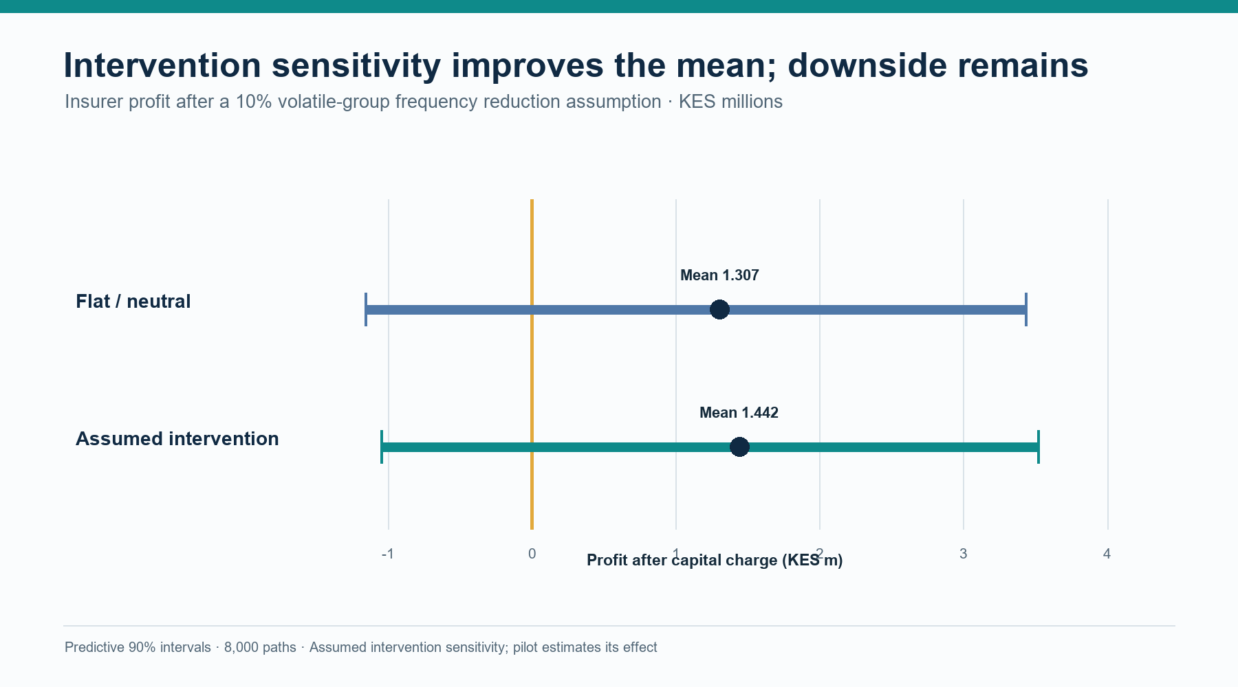
INSURER LEDGER
Intervention improves mean profit; risk remains
Mean after-capital profit and predictive 90% range · 100-vehicle annual portfolio
Flat / neutral
Mean KES 1.307m
90% range −1.158m to 3.434m
Assumed intervention
Mean KES 1.442m
90% range −1.048m to 3.518m
Probability of loss after capital: 15.8% → 13.4%
Break-even gross premium: KES 107,852 → 103,473 / vehicle-year
Research partnership proposal · Illustrative synthetic KES case · 14 Oct 2026
12
Notes:
Flat and neutral have identical aggregate insurer P&L. Intervention is a synthetic frequency sensitivity. Flat/neutral: mean after-capital profit KES 1.307m; 90% predictive interval −KES 1.158m to KES 3.434m; probability below zero 15.8%; break-even gross annual premium KES 107,852/vehicle. Intervention: KES 1.442m; interval −KES 1.048m to KES 3.518m; loss probability 13.4125%; break-even KES 103,473. Predictive intervals include parameter and process variation. [11] for capital/reinsurance profit-testing context; underlying case files for figures.

Slide 13
CLAIMS AND RISK TRANSFER
Claims, reserves and reinsurance run on separate cash calendars
Annual insurer baseline · gross ultimate claims KES 6.739m
Gross ultimate
claims
20% quota share
Paid by year-end
Outstanding
KES 6.739m
Net claims
KES 5.391m
KES 4.437m
Reported + IBNR
KES 2.302m
Ceded recoverable at year-end: KES 0.683m · report lag: 1–3 months · settlement: 1–9 months (assumptions)
Premium, incurred claims, paid claims, reserve movement, reinsurance recovery and available cash should be projected by period and reconciled.
Research partnership proposal · Illustrative synthetic KES case · 14 Oct 2026
13
Notes:
Baseline: gross ultimate claims KES 6.739m; net claims after the 20% quota share KES 5.391m. By year-end, gross claims paid KES 4.437m, reported outstanding KES 1.462m, IBNR KES 0.840m, total outstanding KES 2.302m, ceded recoverable KES 0.683m. The model reconciles paid plus outstanding to ultimate claims (maximum error KES 0). Reporting and settlement delays are elected assumptions. Model incurred, paid and recoverable cash separately. Sources: ASOP 43 [8], IFRS 17 reinsurance guide [9], IAIS [10].

Slide 14
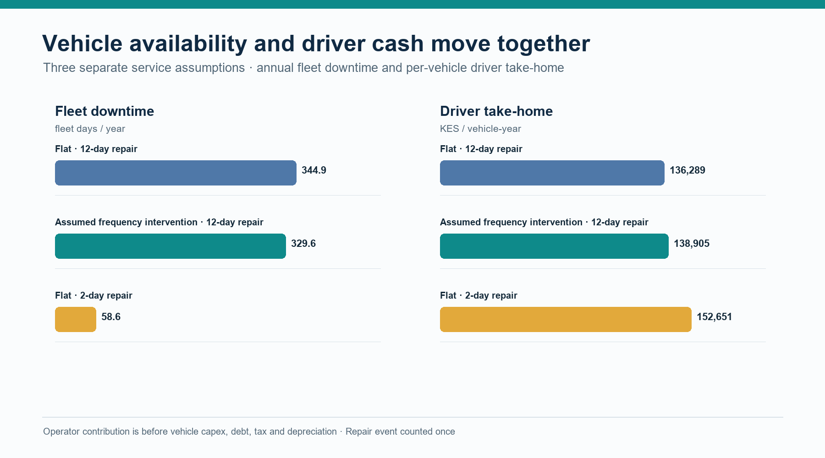
OPERATOR AND DRIVER LEDGERS
Repairs change fleet uptime and driver cash
Annual portfolio case · downtime is fleet-wide; take-home is per vehicle-year.
Standard service
Operator contribution
KES 1.026m / vehicle-year
Two-day repair
Driver take-home rises to
KES 152,651 / vehicle-year
Expedite cash: KES 146,871 / fleet. Operator contribution excludes vehicle capex, debt, tax and depreciation.
Research partnership proposal · Illustrative synthetic KES case · 14 Oct 2026
14
Notes:
Flat standard 12-day repair case: 344.95 total fleet downtime days (3.45/vehicle); operator contribution before vehicle capex, debt, tax and depreciation KES 102.599m across the portfolio; driver take-home KES 136,289/vehicle-year. Intervention standard repair: 329.61 fleet days; contribution KES 102.673m; driver take-home KES 138,905. Flat 2-day repair scenario: 58.61 fleet downtime days; take-home KES 152,651; fleet expedite cash KES 146,871 and contribution KES 102.452m. This is a separate 100-vehicle annual case. [2] gives public package context; numbers are entirely synthetic.

Slide 15
MODEL RISK AND SENSITIVITY
The 99.5% tail is a coarse illustration at 8,000 paths
Treat the capital lens as a scenario result; precision and calibration need further work.
VaR₉₉.₅
TVaR₉₉.₅
KES 13.093m
flat / neutral
KES 14.491m
flat / neutral
Economic capital
Tail support
KES 7.702m
VaR − mean net claims
≈ 40 paths
upper 0.5% of 8,000
Next sensitivity runs: common-shock size and frequency · reporting / settlement lag · treaty share and recovery delay · capital charge · claims maturity
8,000 paths leave only about 40 observations beyond the 99.5th percentile. Increase runs and assess convergence before using tail values for decisions.
Research partnership proposal · Illustrative synthetic KES case · 14 Oct 2026
15
Notes:
Baseline empirical 99.5% net-loss VaR: KES 13.093m; TVaR: KES 14.491m; economic capital VaR minus mean net claims: KES 7.702m. The case has 8,000 predictive paths, so only about 40 paths support the upper 0.5% tail. These are coarse illustrative economic-capital estimates, not a regulatory capital result. Required next steps include larger-run convergence checks and scenario sensitivity over common shocks, treaty terms/recovery delays, claim maturity and capital cost. [8]–[10].

Slide 16
EVALUATION PLAN
Measure the treatment effect with a pre-specified pilot
Start with the claims and operational data needed to support a fair comparison.
1
Define
2
Assign
3
Measure
4
Review
Eligible drivers, treatment,
standard service and exposure
Randomise or cluster by depot;
maintain the agreed baseline
Claims / distance, severity,
downtime, earnings, retention
Intention-to-treat effect,
uncertainty and maturity
Pre-register endpoints, claim maturity windows, exclusions, subgroup analysis and benefit-sharing rules; report costs and customer outcomes with insurer results.
Research partnership proposal · Illustrative synthetic KES case · 14 Oct 2026
16
Notes:
A future pilot should estimate the intervention effect rather than reusing the assumed 10%. Define eligibility, intervention, treatment fidelity, exposure, claims development, comparison group and primary endpoints before launch. If driver-level randomisation is unsuitable, consider depot or time-based cluster assignment with appropriate design. Report intention-to-treat effects and uncertainty; claims must have sufficient maturity. Include customer outcomes, complaints and operational costs. [11].

Slide 17
IMPLEMENTATION
A data and decision contract makes the pilot traceable
Agree data purpose, integration, decision rights and review before connecting systems.
Evidence contract
Exposure units · claim/event dates · repair milestones · payment / reserve basis
Governance
Purpose and access · minimisation / pseudonymisation · retention · model version
Traceability
Correlation ID · event timestamp · decision record · approver · action / outcome
Interfaces
Insurer claims / policy · fleet servicing · driver package / collections · analytics
Use controlled market-specific data access and a documented human review route for exceptions.
Research partnership proposal · Illustrative synthetic KES case · 14 Oct 2026
17
Notes:
This slide describes a proposed data contract, not a production architecture or legal opinion. Specify permitted purpose, minimum necessary fields, access roles, retention, linkage, security, data quality, model/version lineage, approver and event outcome. Establish integration with the selected insurer and operator systems through documented interfaces. Data-protection review and a human review route are part of pilot design.

Slide 18
PROPOSED NEXT STEPS
A focused first phase can test the partnership
The first deliverable is a jointly agreed, market-specific data and economics blueprint.
01
Select the market, vehicle product and underwriting / claims partner.
02
Agree anonymised, exposure-linked claims, telematics-quality and repair fields.
03
Rebuild baseline rates, reserves and cash flows using mature partner experience.
04
Run a shadow validation; jointly decide whether a controlled pilot is justified.
Research collaboration proposal · No Moove data or performance claims assumed
Research partnership proposal · Illustrative synthetic KES case · 14 Oct 2026
18
Notes:
Suggested first engagement: a scoping workshop with actuarial/pricing, claims, fleet operations, driver support, data and legal teams. The concrete output can be a market-specific data dictionary, baseline reconstruction plan, pre-analysis plan and pilot-readiness decision. The case makes no assertion that Moove has agreed to share data or run a pilot.

Slide 19
EVIDENCE BASE
Sources and reproducibility
Public context, actuarial literature, standards and research-case artefacts.
[1] Anand & Murthy, CGAP (2023), Putting Gig Data to Work.
[7] Bühlmann (1967), ASTIN Bulletin 4(3).
[2] Moove UK Customer Hub · uk.moove.io/customer-hub/
[8] Actuarial Standards Board, ASOP 43: Property/Casualty Unpaid Claim Estimates.
[3] Moove UK Privacy Policy · uk.moove.io/privacy-policy/
[9] IFRS Foundation, IFRS 17 Pocket Guide: Reinsurance Contracts Held.
[4] Lee & Shi (2019), Insurance: Mathematics and Economics, doi:10.1016/j.insmatheco.2019.04.004.
[10] IAIS, Insurance Core Principles and ComFrame (2024).
[5] Maloba, Bayesian Credibility and Exposure-Normalised Telematics Relativities (2026).
[11] Robbin & Malhotra (2023), CAS Forum, capital management and reinsurance profit testing.
[6] Belhadj, Goulet & Ouellet (2009), ASTIN Bulletin 39(2).
Reproducible case: research_lab/mobility_insurance_profit_case/ (seed 20261014).
Full IEEE references, URLs, model assumptions and validation checks are in SOURCE_AND_VALIDATION_NOTES.md.
Research partnership proposal · Illustrative synthetic KES case · 14 Oct 2026
19
Notes:
Full source details and direct URLs are listed in SOURCE_AND_VALIDATION_NOTES.md. Model files: research_lab/mobility_insurance_profit_case/assumptions.json, model.py, run_case.py, test_model.py, output/summary.json and output/results.json. The 12,000 posterior / 8,000 predictive run passed eight unit tests and seeded reproducibility checks; claim reconciliation maximum error is zero.

