Slide 1
RESEARCH PARTNERSHIP PROPOSAL
4G Capital × Underwrite for Collection
Follow the working-capital cycle from funded stock through settled sales, repayment, support and recovery.
4G Capital and IFC portfolio-finance case · Kenya
Nevil Maloba · Research and quantitative finance · 14 October 2026
Notes:
Purpose: open a focused discussion about a research and operating partnership. All modeled examples are clearly identified as synthetic unless stated otherwise.

Slide 2
PARTNERSHIP FOCUS
The trading cycle sets the repayment question
Which financing and support decisions help a viable microbusiness turn stock into settled cash and meet the next cycle’s obligations?
Operating lens
Research lens
Track order, supplier payment, delivery, sales, cost, repayment, remaining trading cash and renewal.
Test timing, support and collection using borrower cash and portfolio outcomes across the facility life.
Research partnership concept · Nevil Maloba · 14 October 2026
02
Notes:
4G public product material describes working-capital finance and delivery support. This proposal treats product details as items to verify against current customer agreements.

Slide 3
PUBLIC PRODUCT CONTEXT
UPIA and KUZA provide two observable cycles
UPIA
KUZA
Public description: 30-day unsecured working-capital loan, branch support and training, flexible repayment and loyalty-linked pricing; published amount range KES 5,000–149,999.
Public description: 21-day stock credit paid to participating distributors, with partner and product criteria; published amount range KES 5,000–360,000.
Study evidence: signed offer, product charge, draw date, supplier settlement, delivery, actual repayment schedule and amendments.
Research partnership concept · Nevil Maloba · 14 October 2026
03
Notes:
Source: 4G Capital public product pages included in the research source pack. Product terms and ranges require confirmation against the current signed offer and programme rules.

Slide 4
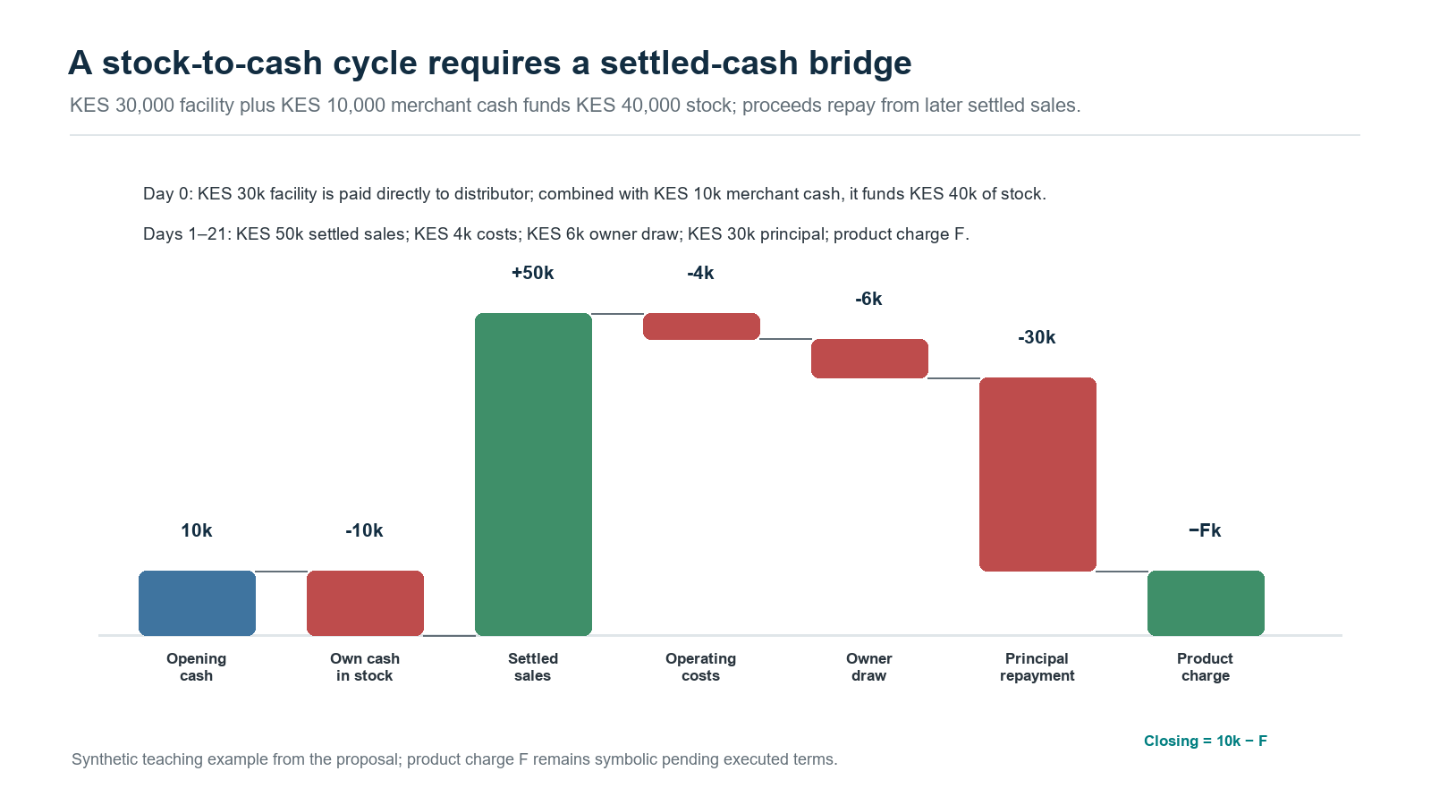
SYNTHETIC KUZA TEACHING CASE
The KES 30,000 advance funds stock before sales settle
Research partnership concept · Nevil Maloba · 14 October 2026
04
Notes:
Synthetic teaching inputs: KES 10,000 merchant opening cash; KES 30,000 credit paid directly to supplier; KES 40,000 stock; KES 50,000 settled sales over 21 days; KES 4,000 costs; KES 6,000 owner draw; KES 30,000 principal due. Product charge F remains symbolic until the signed offer sets the amount. Closing cash equals KES 10,000 minus F before tax and other liabilities.

Slide 5
EVIDENCE CHAIN
Match every payment to a source and event date
Order → credit draw → distributor receipt → delivery → sale → settled receipt → operating outflow → repayment → next-cycle cash
Separate credit from merchant cash; direct-to-supplier funding is not sales revenue.
Match ordered stock to delivered quantity and the merchant’s trading record.
Reconcile sales with settled receipts across payment channels.
Deduct operating costs, existing debt and essential working-capital needs.
Track due date, repayment, cure, renewal and the customer’s remaining cash.
Research partnership concept · Nevil Maloba · 14 October 2026
05
Notes:
These are proposed data requirements for a research collaboration. Customer and distributor records would be shared only under an approved data and governance design.

Slide 6
CREDIT LIFECYCLE
Underwrite for Collection connects approval to recovery
Before funding
After funding
Purpose, entity, cash provenance, stock plan, obligations, affordability and facility structure.
Delivery, sales, collections, changing capacity, hardship, servicing, restructuring and realised recovery.
The same case identifier should connect evidence, offer, approval, disbursement, servicing events and outcome.
Research partnership concept · Nevil Maloba · 14 October 2026
06
Notes:
The Underwrite for Collection whitepaper is the evidence and decision framework for this proposed partnership. Zenodo record: https://doi.org/10.5281/zenodo.23343888

Slide 7
PROPOSED PILOT
Test support that 4G can operationally deliver
Among eligible customers, compare current support with one specified enhancement: a timed stock-planning or repayment-support intervention.
Measure
Balance
Delivery and stock fill; settled sales; repayment timing; cure; cash retained for next-cycle trading.
Customer cost and complaints; staff workload; repeat borrowing; arrears, recovery and portfolio concentration.
Pre-register eligibility, assignment, customer safeguards, follow-up and analysis before launch.
Research partnership concept · Nevil Maloba · 14 October 2026
07
Notes:
This is a proposed evaluation design. Any enhancement must be approved by 4G and delivered within existing customer, operational and regulatory processes.

Slide 8
PUBLIC PROJECT SII/53511
The IFC guarantee has separate first-loss and pari-passu layers
Public SII describes an unfunded financial guarantee, approved 29 June and signed 30 June 2026; status displayed Pending Disbursement on 14 October 2026.
Eligible portfolio: up to USD 44.4 million equivalent in Kenyan shillings for a new eligible MSME portfolio.
Narrative first-loss amount: up to USD 2.2 million, with IFC up to USD 2.0 million and 4G bearing the balance.
Further USD 42.2 million layer described as pari passu; IFC exposure capped at USD 4.2 million in that layer.
The executed contract controls claims, exclusions, timing, recoveries, fee and currency treatment.
Research partnership concept · Nevil Maloba · 14 October 2026
08
Notes:
Source: IFC Summary of Investment Information, project SII/53511. The deck reports the public narrative. The executed agreement is required to specify coverage and claims mechanics.

Slide 9
DISCLOSURE RECONCILIATION
Public mobilization figures describe separate scopes
4G-specific SII narrative
Other disclosed scopes
USD 6.2m maximum-risk headline; minimum 21x “core mobilization” objective. The SII defines the label and denominator.
USD 8.20m appears in a separate indicative approval table. 11:1 appears in IFC aggregate target across three transactions.
Record each figure with its source field, scope, status, numerator, denominator and date; do not combine unmatched measures.
Research partnership concept · Nevil Maloba · 14 October 2026
09
Notes:
IFC SII includes a narrative maximum risk of USD 6.2m and a separate indicative approval-table amount of USD 8.20m. IFC's 4 August 2026 announcement describes an aggregate 11:1 target across 4G Capital, Equity Bank Kenya and KCB. The SII also presents a 21x project-specific core mobilization objective. These measures have different scopes and definitions.

Slide 10
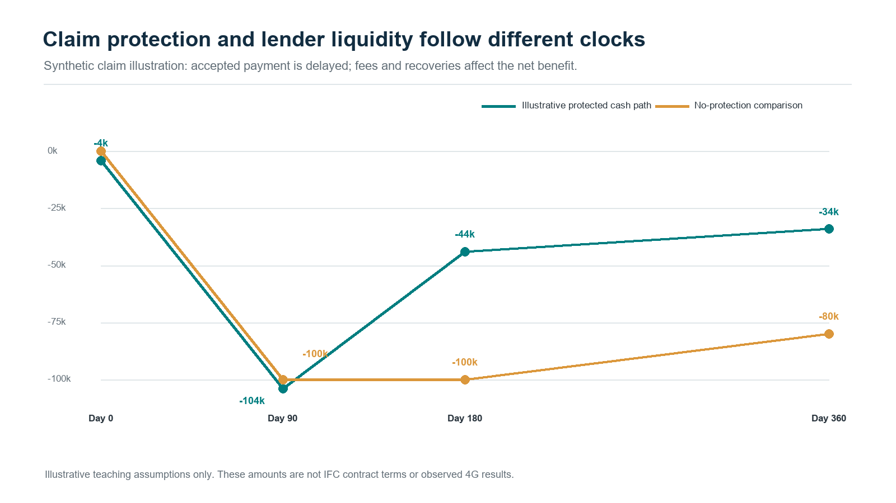
SYNTHETIC CLAIM CASH TEST
The claim arrives after the loss, so liquidity needs its own test
Research partnership concept · Nevil Maloba · 14 October 2026
10
Notes:
Synthetic cash illustration: USD 4k fee at day 0; USD 100k eligible-loss outflow at day 90; USD 60k claim proceeds at day 180; USD 20k recovery at day 360, with 50% retained in this teaching example. The protected path ends at -USD 34k and the comparison path at -USD 80k, a USD 46k nominal difference. The executed agreement supplies the claim, timing and recovery terms used in a transaction model.

Slide 11
PROPOSED ANALYTICAL WORK
Measure borrower, portfolio and guarantee cash on separate ledgers
Credit: cash-flow fit, arrears timing, cure, repeat borrowing and loss severity.
Guarantee: eligible balance, claim trigger, payment delay, fees, caps and post-claim recovery.
Liquidity: peak cumulative funding need before claim settlement.
Profitability: present value under matched protected and unprotected scenarios.
Mobilisation: contractually defined numerator and denominator with attribution evidence.
Borrower: trading cash retained, delivery, repayment fit, complaints and continuity.
Use reconciled event IDs and independent validation of borrower, portfolio and guarantee ledgers.
Research partnership concept · Nevil Maloba · 14 October 2026
11
Notes:
The study should distinguish empirical portfolio outcomes, synthetic scenario tests, public disclosure and contractually verified claim data. Independent validation and executed terms are necessary before making performance claims.

Slide 12
PROPOSED NEXT STEP
Agree a bounded evidence-design workshop
Participants
Outputs
4G product, credit, collections, distributor finance, field support, finance, risk, compliance, data and customer-protection owners; IFC workstream owners as appropriate.
Data dictionary and access plan; one product-cycle specification; intervention protocol; IFC claim-data map; outcome measures; decision gates.
Decision requested: identify one product cycle and nominate owners for a feasibility session.
Research partnership concept · Nevil Maloba · 14 October 2026
12
Notes:
This deck proposes a research partnership discussion. The next step is a scoped discussion with 4G and relevant IFC workstream owners.

Slide 13
REFERENCE SLIDE
Sources and use note
4G Capital public UPIA and KUZA product material (source URLs are recorded in the article source register).
IFC, Summary of Investment Information, Project SII/53511.
IFC, 4 August 2026 announcement on three Kenyan MSME financing transactions.
Central Bank of Kenya (Non-Deposit Taking Credit Providers) Regulations, 2026, Legal Notice No. 191.
Nevil Maloba, Underwrite for Collection integrated research whitepaper, Zenodo DOI: 10.5281/zenodo.23343888.
All cash and claim examples are synthetic unless expressly described as public disclosure.
Research partnership concept · Nevil Maloba · 14 October 2026
13
Notes:
Further source URLs and publication metadata are maintained in the 4G article's source and coverage files.

