Slide 1
RESEARCH PARTNERSHIP PROPOSAL
Moove × Mwendo Pamoja
Test how vehicle uptime changes driver cash, fee collection and the financing economics across a full contract.
Mobility finance · 156-week synthetic operating and financing case
Nevil Maloba · Research and quantitative finance · 14 October 2026
Notes:
Purpose: open a focused discussion about a research and operating partnership. All modeled examples are clearly identified as synthetic unless stated otherwise.

Slide 2
THE DECISION QUESTION
A repair outage can reduce earnings while scheduled fees continue
When a vehicle is unavailable, which operating response protects driver cash while keeping the full financing arrangement sustainable?
Observed mechanism
Research question
Fares and platform receipts depend on productive days. Repair delays can reduce available cash while contractual obligations continue.
Compare repair response and fee treatment using driver, operator, insurer and funder outcomes over the same contract horizon.
The 2023 CGAP case provides the motivation; this model turns the operating question into a reproducible test.
Research partnership concept · Nevil Maloba · 14 October 2026
02
Notes:
Anchor: CGAP, Putting Gig Data to Work (2023), pp. 4-5, as cited in the source package. This synthetic case sets out a specific mechanism for testing with partner operating records.

Slide 3
OPERATING MECHANISM
One repair event changes four cash ledgers
Vehicle availability
→
Settled fares
→
Driver cash
→
Contract fee
→
Arrears / cure
The weekly ledger reconciles the event into four views
Driver: fares, energy, household cash, fees and wallet balance
Operator: receipts, repair costs, debt service, equity calls and distributions
Funder: principal, interest, arrears and cure
Insurance: premium, claim timing, repair cost and service continuity
Research partnership concept · Nevil Maloba · 14 October 2026
03
Notes:
The full model has four separate weekly ledgers, joined through dated events. The plotted scenarios are synthetic and use author-selected assumptions.

Slide 4
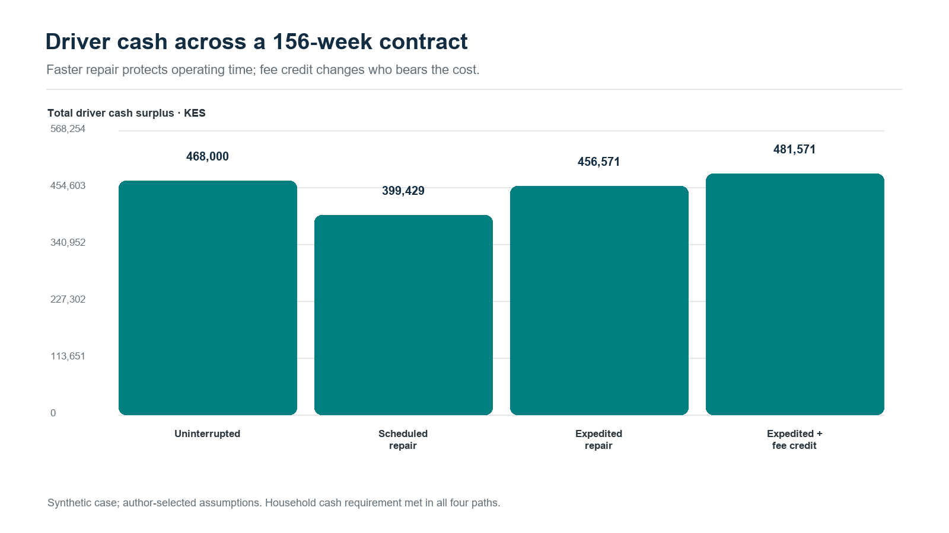
156-WEEK SYNTHETIC CASE
Scheduled repair leaves driver cash KES 68,571 below uninterrupted operation
The same contract fee total can sit beside different driver cash outcomes.
Research partnership concept · Nevil Maloba · 14 October 2026
04
Notes:
Synthetic 156-week model outputs. Driver cash surplus: uninterrupted KES 468,000; scheduled repair KES 399,429; expedited repair KES 456,571; expedited repair with KES 25,000 fee credit KES 481,571. Household cash requirement is met in all four modeled paths.

Slide 5
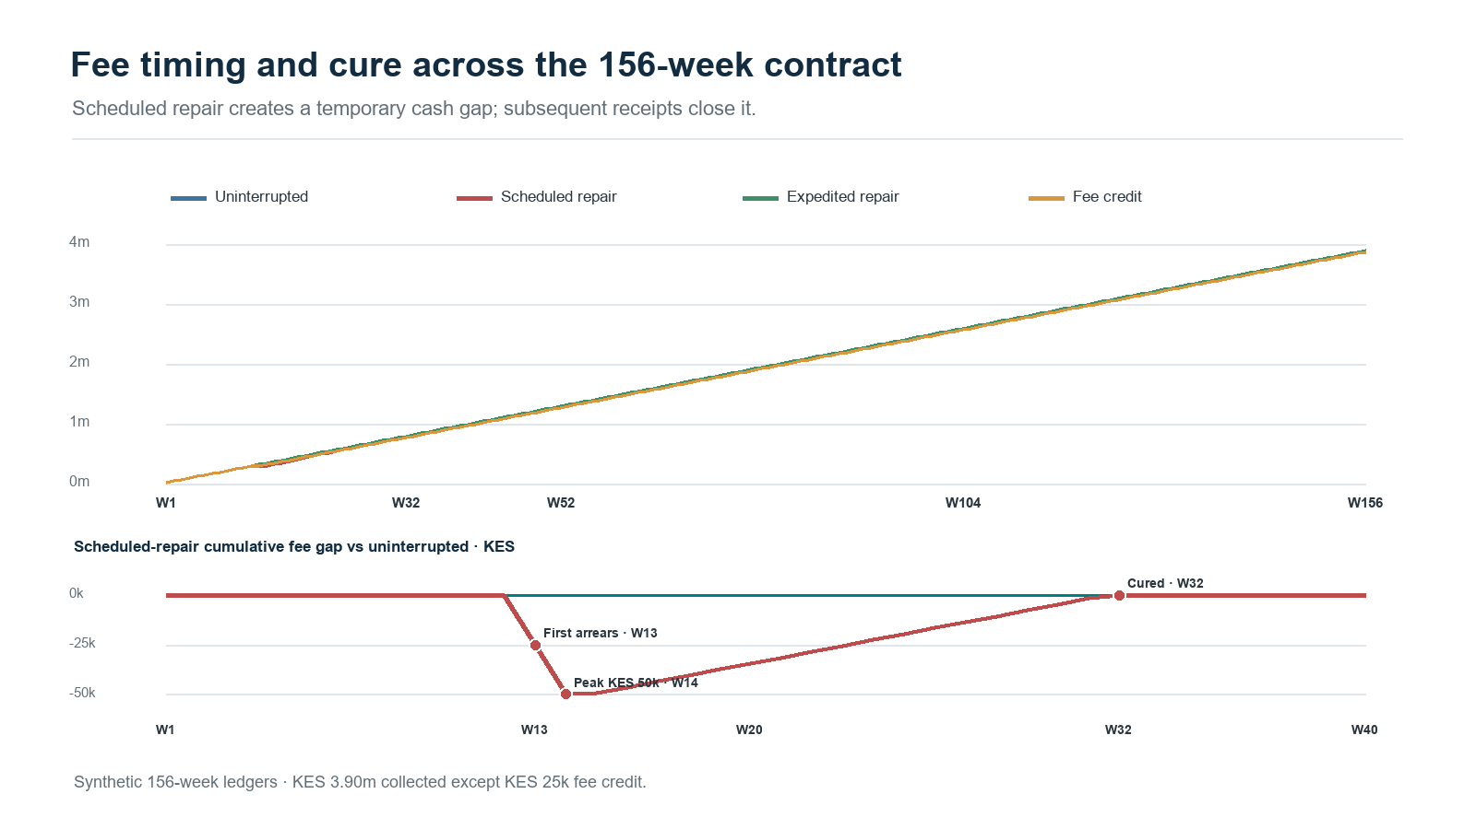
156-WEEK SYNTHETIC CASE
Scheduled repair creates KES 50,000 peak arrears
Scheduled repair reaches full collection after a KES 50,000 peak arrears balance and cure in week 32.
Research partnership concept · Nevil Maloba · 14 October 2026
05
Notes:
From the retained weekly ledgers: scheduled repair has 12 unavailable days, first arrears in week 13, peak arrears KES 50,000, cure in week 32, and KES 3.9 million collected over 156 weeks. Uninterrupted and expedited repair scenarios collect KES 3.9 million without modeled arrears.

Slide 6
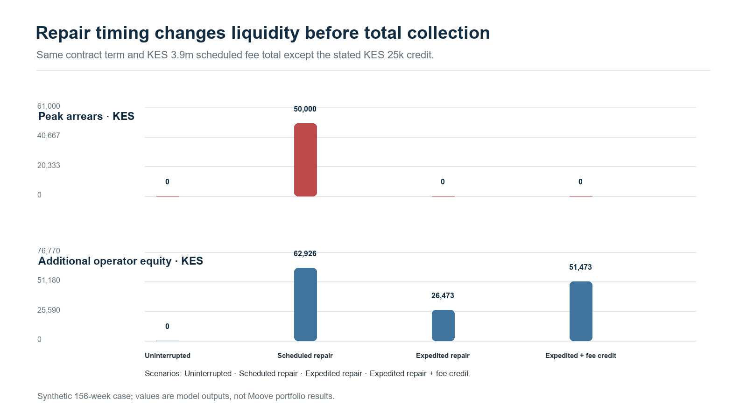
156-WEEK SYNTHETIC CASE
Expedited repair cuts the operator equity call by KES 36,453
Expedited repair reduces the modeled equity call relative to scheduled repair; fee treatment changes who carries the cost.
Research partnership concept · Nevil Maloba · 14 October 2026
06
Notes:
All values are synthetic outputs, not observed Moove outcomes. Scheduled repair requires KES 62,926 additional equity and has KES 50,000 peak arrears. Expedited repair requires KES 26,473 additional equity and has no modeled arrears. Fee credit requires KES 51,473 additional equity, with KES 25,000 waived fees.

Slide 7
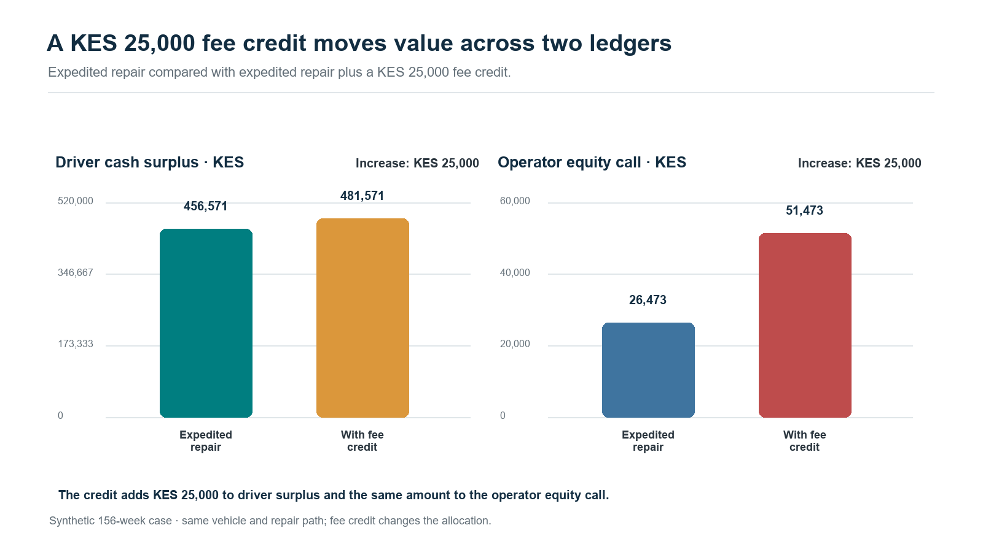
DESIGN TRADE-OFF
Fee relief increases driver cash and operator capital need
Pilot question: does the liquidity gain improve uptime and repayment enough to justify the operator cash call?
Research partnership concept · Nevil Maloba · 14 October 2026
07
Notes:
Synthetic fee-credit comparison. Driver cash surplus rises from KES 456,571 to KES 481,571, while the operator equity call rises from KES 26,473 to KES 51,473.

Slide 8
RESEARCH DESIGN
Pilot the service response that operations can deliver
Randomise eligible repair cases between the current process and one specified expedited-response offer, with safety and service rules fixed in advance.
Primary outcomes
Balancing outcomes
Unavailable days; time to repair; driver net cash; on-time payment; arrears and cure.
Operator cash and equity calls; fee waivers; claim frequency; customer complaints; service quality.
Pre-specify eligibility, assignment, follow-up, exclusions, missing-data treatment and stop conditions.
Research partnership concept · Nevil Maloba · 14 October 2026
08
Notes:
The proposed trial assigns eligible repair cases to the current process or a specified expedited-response offer. If randomisation does not fit operations, a registered comparison design would document its identification assumptions.

Slide 9
DATA AND GOVERNANCE
Keep participant rights and decision authority visible
Use a purpose-specific data map across platform, repair, repayment, insurance and household cash records.
Minimise identifiers; retain the linkage key under restricted access.
Record source, timestamp, event ID, model version and decision owner.
Route material changes and hardship cases to trained human review.
Separate proposed service alerts from credit-policy changes and collection authority.
The pilot needs an approved data-protection assessment, customer communication, access controls and a documented review path.
Research partnership concept · Nevil Maloba · 14 October 2026
09
Notes:
Apply Kenyan data-protection requirements and the participating institutions' governance. Operational events supply measurement evidence, while authorized teams retain credit decision authority.

Slide 10
PROPOSED NEXT STEP
A focused design phase can produce a decision-ready pilot
First working session
First deliverables
Bring fleet/repair operations, credit, collections, finance, insurance, data, compliance and customer-support owners.
Agreed event schema; verified scenario inputs; intervention definition; outcome dictionary; pilot protocol; review gates.
Decision requested: nominate data and operating owners for a scoped feasibility workshop.
Research partnership concept · Nevil Maloba · 14 October 2026
10
Notes:
The workshop will define feasibility, data ownership, operating measures and approval gates for a scoped pilot.

Slide 11
SOURCES AND MODEL NOTE
Evidence and scope
CGAP, Putting Gig Data to Work, 2023.
Mwendo Pamoja repository and 156-week mobility fleet case: https://github.com/TheAlchemistNerd/mwendo-pamoja-continuous-underwriting
Synthetic operating and financing assumptions; weekly ledgers and verification files are retained in the research_lab and output folders.
All chart amounts are KES. Results are illustrative and depend on stated model assumptions.
Proposed collaboration question: which service and financing design can improve fleet uptime while maintaining transparent economics for each participant?
Research partnership concept · Nevil Maloba · 14 October 2026
11
Notes:
Primary evidence anchor: CGAP 2023. Model evidence comes from the local reproducible case package at research_lab/mobility_fleet_case and output/mobility_fleet_case_2026-10-13. GitHub remote is the repository URL shown.

