Slide 1

By Dylan Reid and Dylan Swarts

Slide 2
Student Life Improvement
Quick access to more information on any Stellenbosch module
Student reviews to gain insight into taking a module
More informed decision on electives, reducing the need to change modules later
Connect students and tutors
Notes:
4) tutors are rated by other students, and it's also possible to see whether the tutor has passed or passed with distinct

Slide 3
Core Features
Login functionality
Viewing of all available modules
Viewing of all pre-requisites, co-requisites and pass pre-requisites of modules
Posting and viewing reviews from other students
Tutor advertisements
Reddit-style voting on module reviews
Notes:
3) Help to understand what modules you can and should take based on your current degree phase
4) Gain a better understanding of the available module options you have based on real student experiences
5) Students vote on others' reviews, making for accurate reviews getting the most attention

Slide 4
Live Demo

Slide 5
Tech Stack
Frontend: Typescript + React
Backend: Python + FastAPI
Database: PostgreSQL + Docker

Slide 6
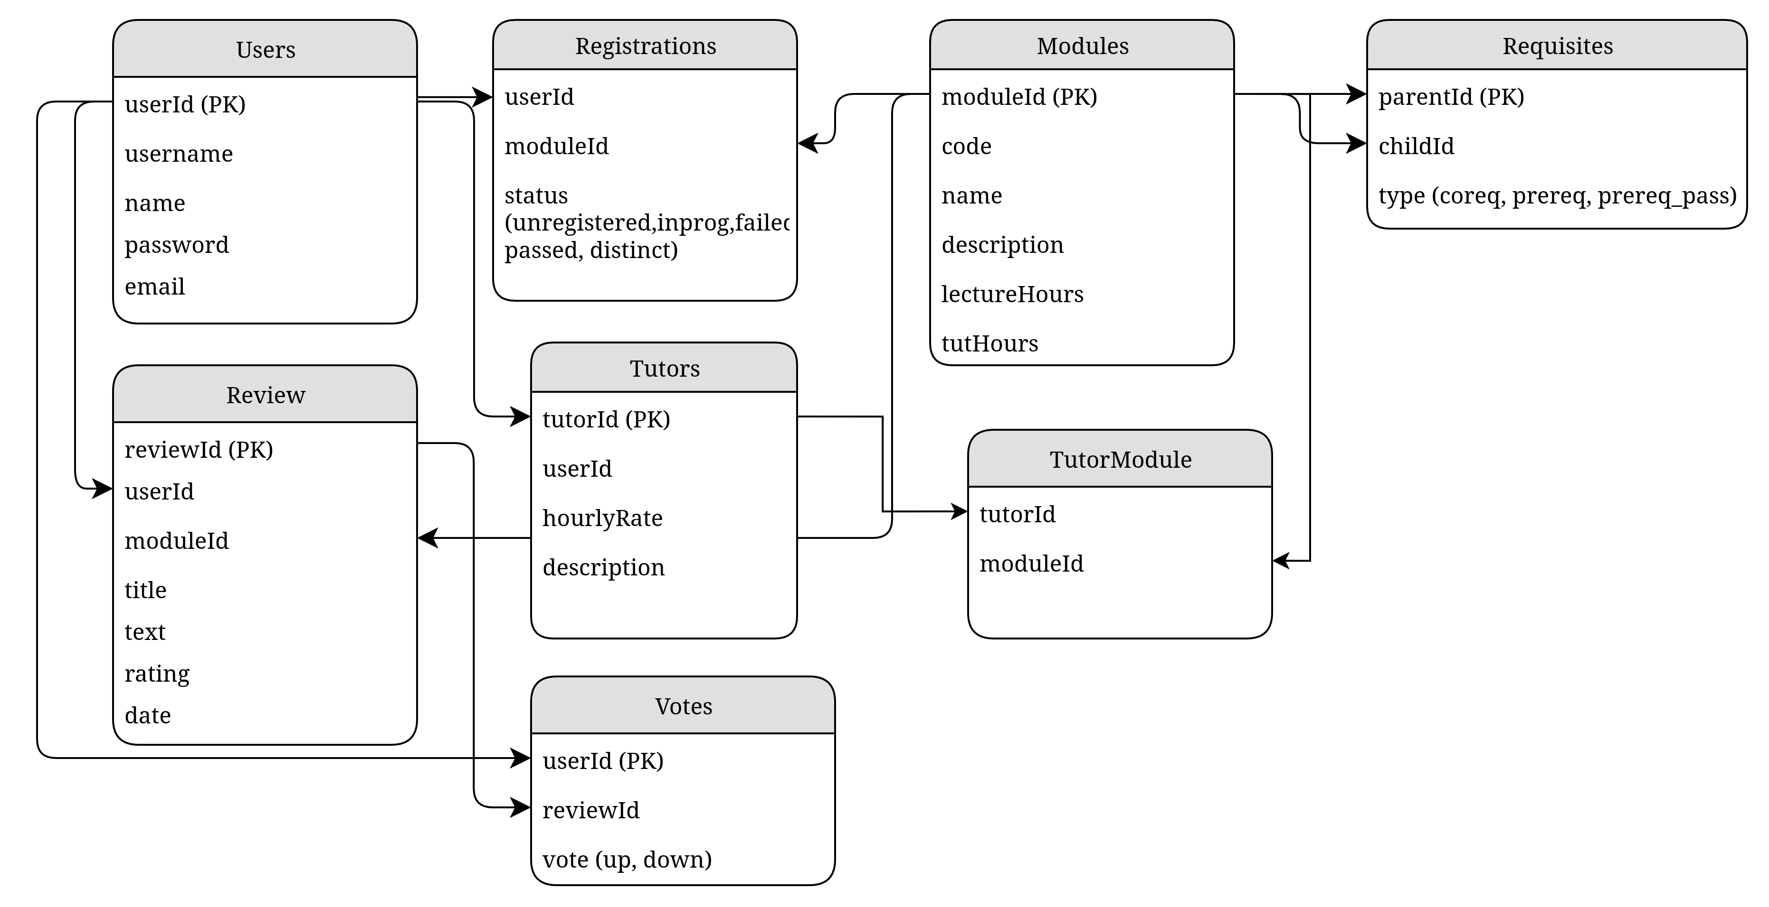
Database Design

Slide 7
Code Design & Maintainability
Modular design
Dedicated database service
Easily extendable to include other services
Reusable React components and styling
Maintainability
Well documented, single-purpose functions
Separate-concern API endpoints

Slide 8
Future Improvements
Integrate real authentication (through SU Microsoft login)
Source modules from an API
Allow students to share module notes on the app
Register as a tutor
Voting on tutors
Automatic timetable scheduler

Slide 9
Questions?
What do you want to know about Maroonut?

Slide 10
Thank you

