Slide 1

遊戲物理約束
Physics Constraints in Games
接觸約束
Contact Constraints
Part 2
Ming-Lun “Allen” Chou
周明倫

Slide 2




周明倫
Min-Lun “Allen” Chou
AllenChou.net
@TheAllenChou
TheAllenChou
MingLunChou

Slide 3
速度約束解析
Velocity Constraint Resolution
有效質量
Effective Mass
拉格朗日乘數
Lagrange Multiplier

Slide 4
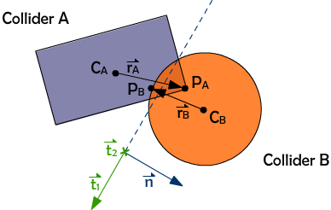
碰撞接觸點
Collision Contact Point

Slide 5
碰撞接觸點
Collision Contact Point

Slide 6
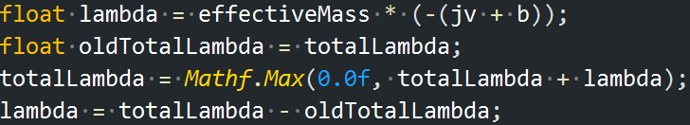
總衝量箝制
Clamped Total Impulse

Slide 7
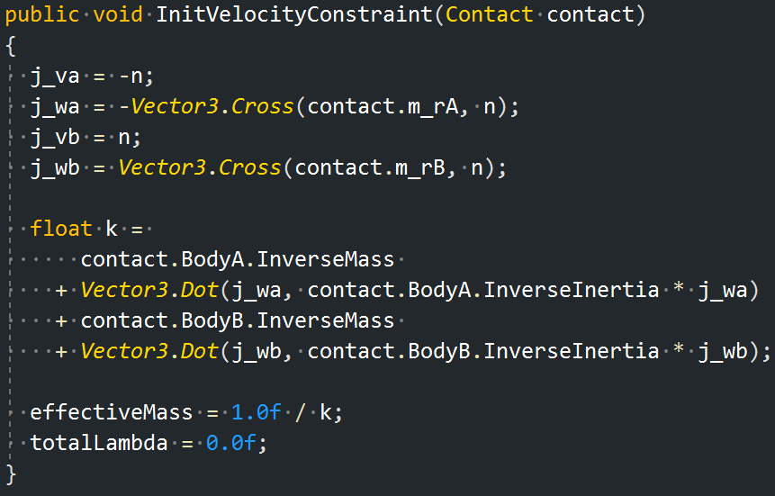
碰撞限制初始化
Contact Constraint Initialization

Slide 8
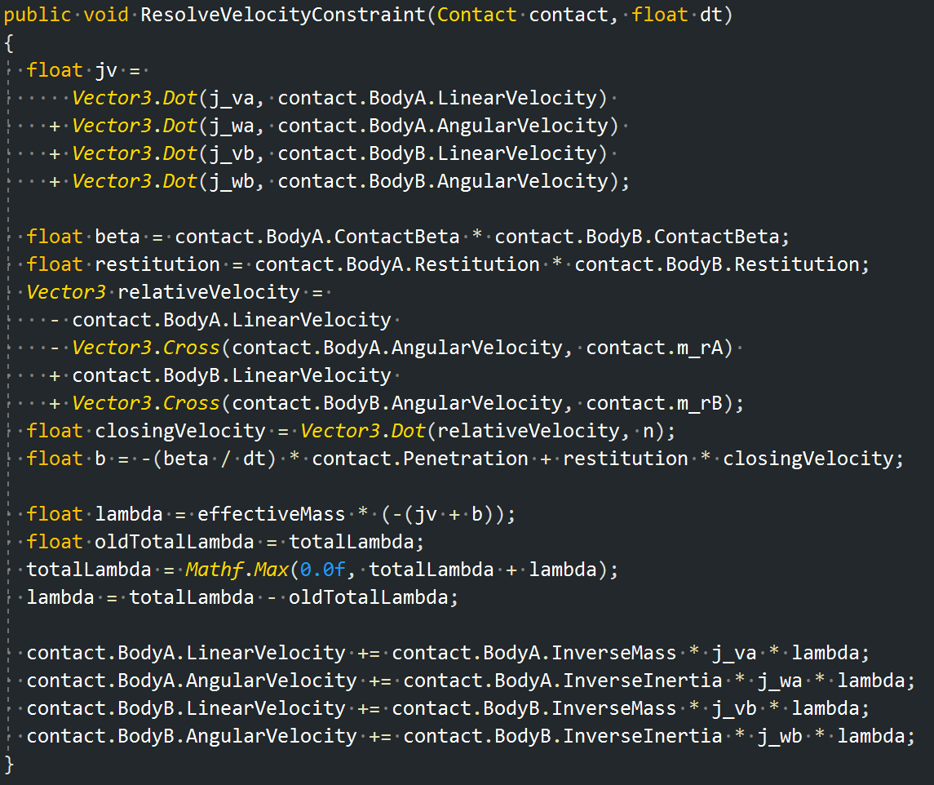
碰撞限制解析
Contact Constraint Resolution

Slide 9
位置誤差修正
Positional Error Correction

Slide 10
彈性
Restitution

Slide 11
碰撞限制解析
Contact Constraint Resolution

Slide 12
摩擦
Friction

Slide 13
Thank You!
http://github.com/TheAllenChou/unity-physics-constraints

