Slide 1

Physics Constraints in Games
Part 1 - Constraint Basics
Ming-Lun “Allen” Chou
周明倫

Slide 2




周明倫
Min-Lun “Allen” Chou
AllenChou.net
@TheAllenChou
TheAllenChou
MingLunChou

Slide 3
Constraints
e. g.

Slide 4
Inequality Constraints
?
If
then enforce

Slide 5
Position Constraints vs Velocity Constraints
e. g.
e. g.

Slide 6
Example: Ground Constraint
If
then enforce

Slide 7
Example: Ground Constraint
= Position Error
Use error
to fix
→
→

Slide 8
Example: Ground Constraint
= Position Error
Use error
to fix
→
→

Slide 9
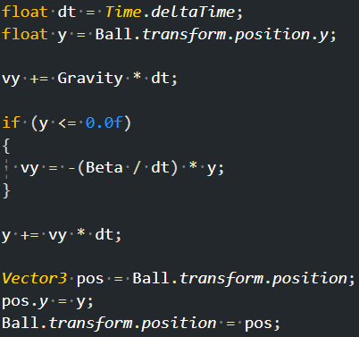
Example: Ground Constraint

Slide 10
Generalization
:
Jacobian Matrix
:
Velocity Matrix
Bias
:
:
:

Slide 11
Example: Ground Constraint

Slide 12
Velocity Constraint Resolution
:
Mass Matrix

Slide 13
Velocity Constraint Resolution
Effective Mass
Lagrange Multiplier

Slide 14
Velocity Constraint Resolution
Effective Mass
Lagrange Multiplier

Slide 15
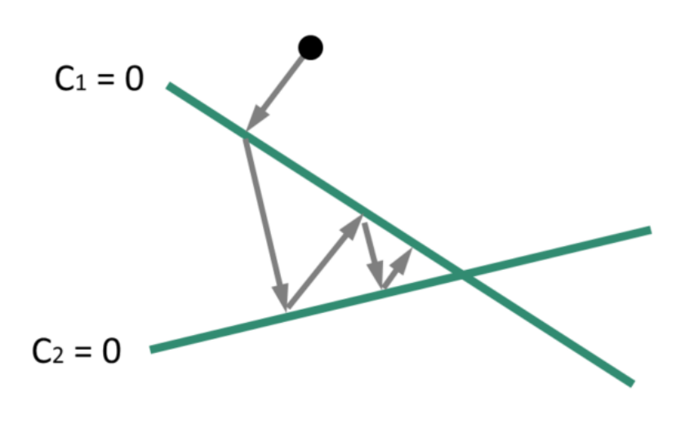
Why?
Plane!

Slide 16
Example: Ground Constraint

Slide 17
Multiple Constraints

Slide 18
Example: Point Constraint

Slide 19
Example: Point Constraint

Slide 20
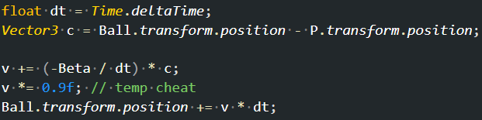
Example: Point Constraint

Slide 21
Rotation & Moment of Inertia

Slide 22
Example: Rotation Constraint

Slide 23
Example: Rotation Constraint

Slide 24
3D Constraints

Slide 25
Example: Point Constraint + Rotation
R
P
X

Slide 26
Example: Point Constraint + Rotation

Slide 27
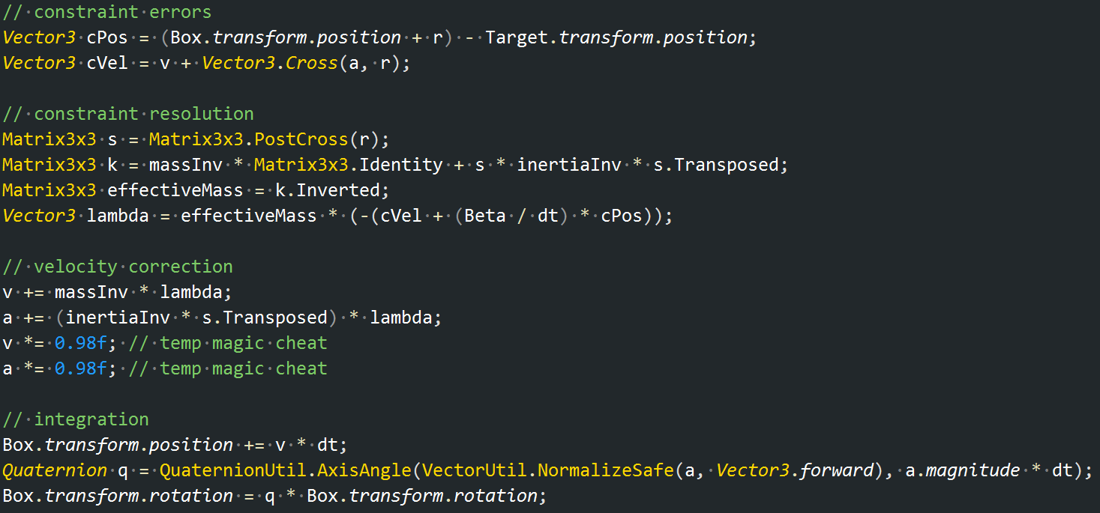
Example: Point Constraint + Rotation

Slide 28
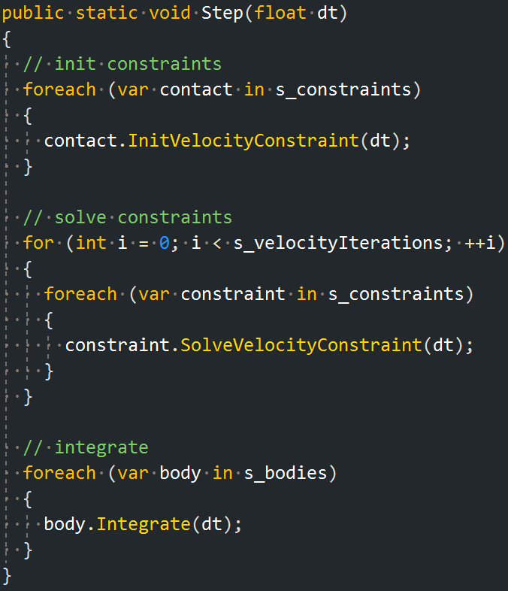
Simple Physics Constraint System

Slide 29
Thank You!
http://github.com/TheAllenChou/unity-physics-constraints

