Slide 1

遊戲物理約束
Physics Constraints in Games
軟性約束
Soft Constraints
Part 3
Ming-Lun “Allen” Chou
周明倫

Slide 2





周明倫
Ming-Lun “Allen” Chou
AllenChou.net
TheAllenChou
MingLunChou

Slide 3
位置誤差修正
Positional Error Correction

Slide 4
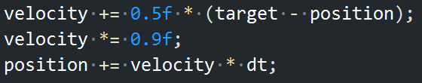
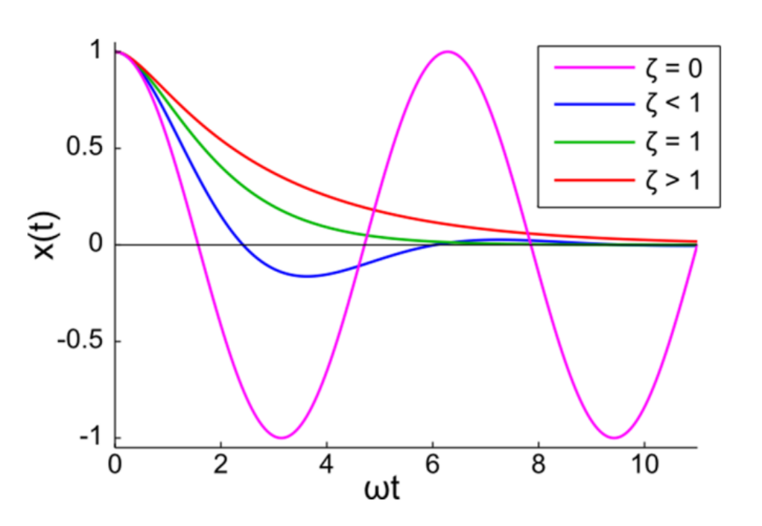
???
原點彈簧約束
Spring Constraint at Origin
阻尼係數
Damping Coefficient
彈力常數
Spring Constant
阻尼比
Damping Ratio
角頻率
Angular Frequency
“Soft Constraints – Reinventing the Spring”
Erin Catto, 2011

Slide 5
原點彈簧約束
Spring Constraint at Origin

Slide 6
目標
Goal
阻尼比
Damping Ratio
阻尼係數
Damping Coefficient
誤差回饋係數
Error Feedback Factor
角頻率
Angular Frequency
彈力常數
Spring Constant
力回饋係數(軟度)
Force Feedback Factor
(Softness)

Slide 7
原點彈簧約束
Spring Constraint at Origin

Slide 8
軟性約束參數
Soft Constraint Parameters
阻尼比
Damping Ratio
阻尼係數
Damping Coefficient
誤差回饋係數
Error Feedback Factor
角頻率
Angular Frequency
彈力常數
Spring Constant
力回饋係數(軟度)
Force Feedback Factor
(Softness)

Slide 9
軟性約束參數
Soft Constraint Parameters

Slide 10
進階參數化
Further Parameterization
硬性約束
Hard Constraint
震盪+半衰期
Oscillation + Half-Life
指數衰退+半衰期
Exponential Decay + Half-Life
: 震盪頻率(Hz)
: 半衰期
: 半衰期
指數衰退:

Slide 11
Thank You!
http://github.com/TheAllenChou/unity-physics-constraints
TheAllenChou
Reference
“Soft Constraints – Reinventing the Spring”, Erin Catto, 2011
Further Reading
“Precise Control over Numeric Springing”, Allen Chou, 2015
“More on Numeric Springing”, Allen Chou, 2015

