Slide 1

Physics Constraints in Games
Part 2 – Contact Constraints
Ming-Lun “Allen” Chou
周明倫

Slide 2





周明倫
Ming-Lun “Allen” Chou
AllenChou.net
TheAllenChou
MingLunChou

Slide 3
Velocity Constraint Resolution
Effective Mass
Lagrange Multiplier

Slide 4
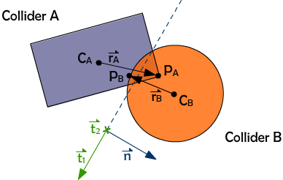
Collision Contact Point

Slide 5
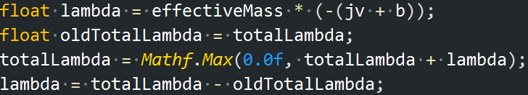
Clamped Total Impulse

Slide 6
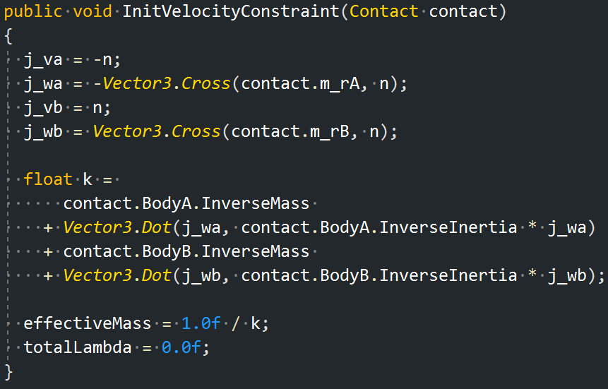
Contact Constraint Initialization

Slide 7
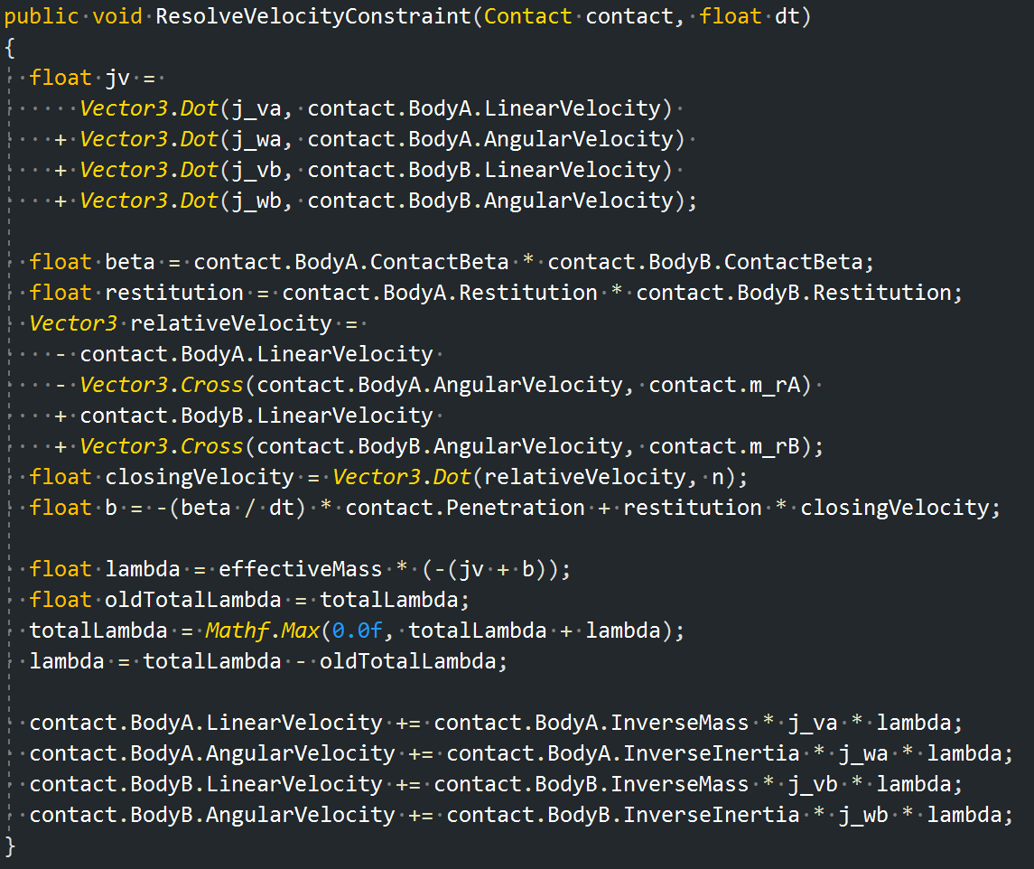
Contact Constraint Resolution

Slide 8
Positional Error Correction

Slide 9
Restitution

Slide 10
Contact Constraint Resolution

Slide 11
Friction

Slide 12
Thank You!
http://github.com/TheAllenChou/unity-physics-constraints
TheAllenChou

