Slide 1

Physics Constraints in Games
Part 3 – Soft Constraints
Ming-Lun “Allen” Chou
周明倫

Slide 2





周明倫
Ming-Lun “Allen” Chou
AllenChou.net
TheAllenChou
MingLunChou

Slide 3
Positional Error Correction

Slide 4
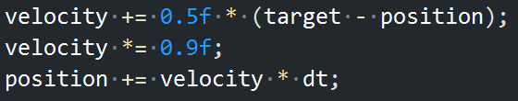
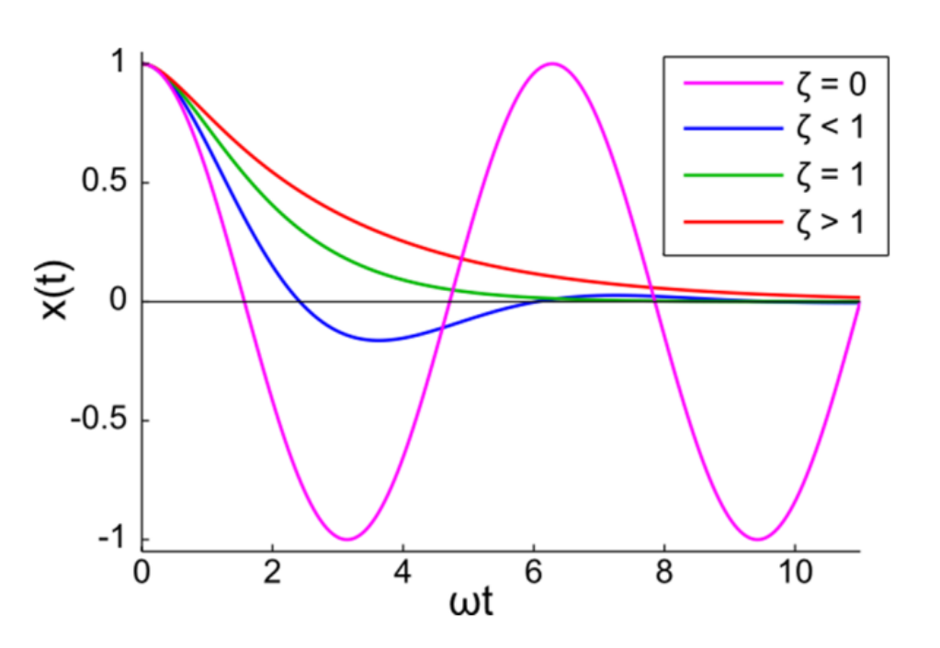
???
Spring Constraint at Origin
Damping Coefficient
Spring Constant
Damping Ratio
Angular Frequency
“Soft Constraints – Reinventing the Spring”
Erin Catto, 2011

Slide 5
Spring Constraint at Origin

Slide 6
Goal
Damping Ratio
Damping Coefficient
Error Feedback Factor
Angular Frequency
Spring Constant
Force Feedback Factor
(Softness)

Slide 7
Spring Constraint at Origin

Slide 8
Soft Constraint Parameters
Damping Ratio
Damping Coefficient
Error Feedback Factor
Angular Frequency
Spring Constant
Force Feedback Factor
(Softness)

Slide 9
Soft Constraint Parameters

Slide 10
Further Parameterization
Hard Constraint
Oscillation + Half-Life
Exponential Decay + Half-Life
: Frequency(Hz)
: Half-Life
: Half-Life
Exponential Decay:

Slide 11
Thank You!
http://github.com/TheAllenChou/unity-physics-constraints
TheAllenChou
Reference
“Soft Constraints – Reinventing the Spring”, Erin Catto, 2011
Further Reading
“Precise Control over Numeric Springing”, Allen Chou, 2015
“More on Numeric Springing”, Allen Chou, 2015

